Slide 1
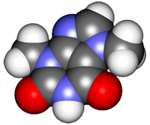
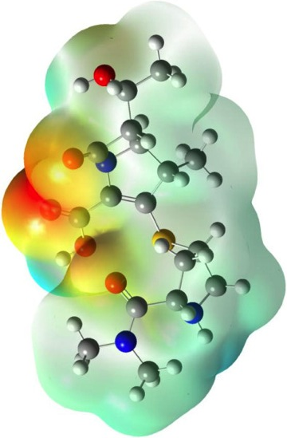
CHE2060 Lecture 7: Brief Overview of Reactions
7.1 Reaction energies & transition states
7.2 Review of acid-base reaction mechanisms
7.3 Writing reactions as transformations
7.4 Substitution reactions
7.5 Addition reactions
7.6 Elimination reactions
7.7 Competition between substitution, addition & elimination reactions
7.8 Diagnostic chart to identify reactions
Daley & Daley, Chapter 6
Reaction Mechanisms: an
Overview of Organic Chemistry

Slide 2
Substitution reactions
Notes:
In the early 1800s chemists found the chemistry of living things to be amazing and a bit intimidating:
“ Organic chemistry nowadays drives me mad. To me it appears like a primeval tropical forest full of the most remarkable things, a dreadful endless jungle into which one does not dare enter for there seems to be no way out.” – Friedrich Wohler, 1835

Slide 3
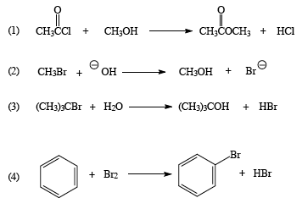
Substitution reactions
Substitution: a reaction in which an atom (or group) from a reactant takes the place of an atom (or group) on the substrate
A new group is substituted for an existing one
nucleophilic
substitution
Nu: is reagent
E+ is substrate
electrophilic
substitution
Substrate (Nu:) provides the : to make the new bond
D&D, p.276 - 7
Notes:
M

Slide 4
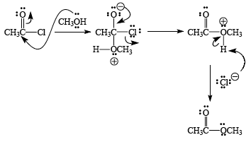
Nucleophilic substitution mechanism (SN1)
SN1 – two step reaction with intermediate
Secondary or tertiary E+
Weak Nu:
Nu:
E+
proton transfer
tetrahedral intermediate
final product
D&D, p.276 - 7
Notes:
M

Slide 5
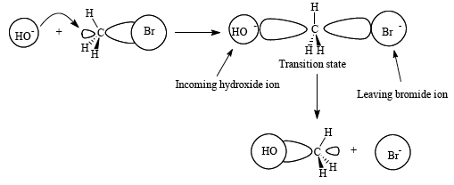
Nucleophilic substitution mechanism (SN2)
SN2 – aka concerted mechanism
No intermediates
Strong Nu:
Primary E+
Causes stereochemical inversion of the product
Nu: -
E+
final product
D&D, p.276 - 7
Notes:
M

Slide 6
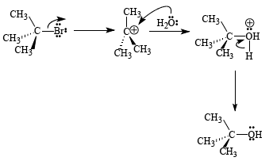
Nucleophilic substitution example
Which type of nucleophilic substitution is this?
Label each component & process.
SN1
Nu: reactant
LG:-
proton transfer
substrate
final product
D&D, p.276 - 7
Notes:
M

Slide 7
Electrophilic substitution
Electrophilic substitution: the substrate is the actor
Substrate is a Nu:
Substrate supplies : to create the bond with the reactant
Intermediate is a stable carbocation called a σ complex
Both of theses steps are 1,3 electron pair displacements
reactant
final product
v
HBr
substrate Nu:
proton transfer makes
HBr by-product
carbocation σ complex
D&D, p.276 - 7
Notes:
M

