Slide 1
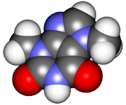
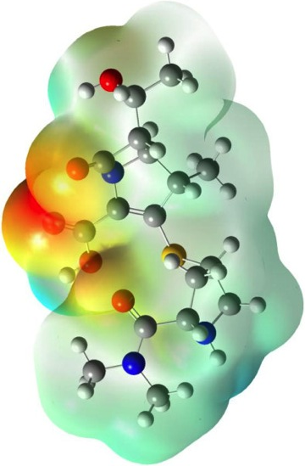
CHE2060 Lecture 7: Brief Overview of Reactions
7.1 Reaction energies & transition states
7.2 Review of acid-base reaction mechanisms
7.3 Writing reactions as transformations
7.4 Substitution reactions
7.5 Addition reactions
7.6 Elimination reactions
7.7 Competition between substitution, addition & elimination reactions
7.8 Diagnostic chart to identify reactions
Daley & Daley, Chapter 6
Reaction Mechanisms: an
Overview of Organic Chemistry

Slide 2
Key Concepts for Lecture 7 (1)
The relative free energies of the molecules involved in a reaction determine their positions in the chemical equilibrium. The equilibrium moves toward the most stable molecule.
Reactants often form products via unstable species called transition states. Among reactions, the smaller the differences in the energy levels between reactants and transition states the faster the reaction rate.
The slowest step of a multistep reaction mechanism governs the rate of that reaction. The transition state is involved in the step with the highest energy of activation.
A curved arrow symbolizes the electron movement in a reaction. This curved arrow shows the formal flow of electrons as the bonds form or break. A double barb arrow shows the movement of an electron pair. A single barb arrow shows the movement of a single electron.
A chemical reaction involves the substrate, other reagents, product, and by-products.
Organic chemists often do not write a balanced equation for a chemical reaction; instead they write a transformation. A transformation shows only what changes occur in the substrate as it reacts with the reagent to form the product.
D&D, p.286
Notes:
M

Slide 3
Key Concepts for Lecture 7 (2)
Most organic reagents fall into two categories: electrophiles and nucleophiles. An electrophile is a Lewis acid. A nucleophile is a Lewis base.
All organic reactions can be classified as substitution, addition, or elimination reactions. Each of these categories has a number of different reaction mechanisms.
In a substitution reaction, an incoming atom or group of atoms replaces a leaving atom or group of atoms.
In an addition reaction, pairs of atoms or groups of atoms add to a multiple bond.
In an elimination reaction, a pair of atoms or group of atoms leaves the substrate. The substrate then forms a multiple bond or forms a cyclic structure.
Addition, elimination, and substitution reactions may proceed through a nucleophilic or electrophilic mechanism.
D&D, p.286
Notes:
M

