Slide 1
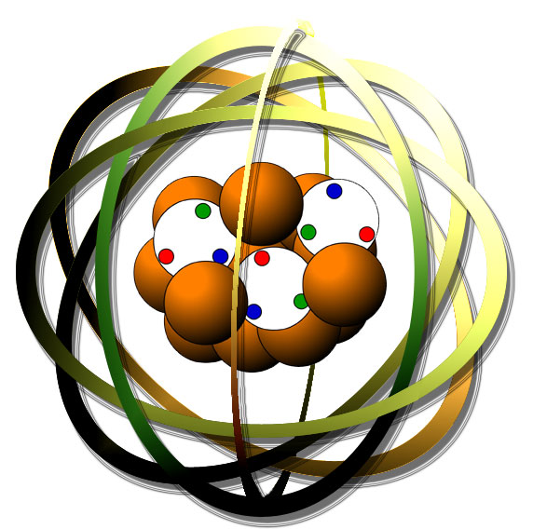
Chemistry Review for the FE Exam
Chemistry topics included on the FE exam:
Naming
Redox
Periodic Table
States of matter
Acids & bases
Equations & stoichiometry
Equilibrium
Metals & nonmetals
Which of these topics do you feel you need to work on most?

Slide 2
Physical states of matter
What are the three physical states of matter?
Solids, liquids & gases
How are they affected by changing temperature & pressure?
As temperature increases: solid → liquid → gas
As pressure increases: gas → liquid → solid
How do they differ in terms of:
density (abundance)
energy / movement
shape & compressibility
Solids > liquids > gases
Gas > liquid > solids
Only gases can be compressed.
Solids have definite shapes, but liquids & gases conform to containers
Examples of each physical state? Pure substances? Mixtures?
Pure substances: iron is a solid; mercury is a liquid; hydrogen is a gas
Mixtures:
alloys are solid solutions
coffee with milk & sugar is a liquid
air is a gaseous solution

Slide 3
Atoms & elements
What’s the difference between an atom & an element?
Atoms are the smallest indivisible form of matter that retain the physical & chemical properties of that matter.
An element is a type of atom with a defined number of p, n & e-.
What are the three subatomic particles? What do you know about each?
Protons = + charge, mass of 1 amu, in the nucleus
Neutron = no charge, mass of 1 amu, in the nucleus
Electrons = - charge, mass of 1/2000 amu, surrounding the nucleus
How are subatomic particles arranged to form an atom? Structure?
Nucleus = tiny, incredibly dense center of the atom created from all protons and neutrons
Electrons surround the nucleus…. many models for the electrons
diffuse cloud
orbiting like planets
orbitals

Slide 4
1 2 3 4 5 6 7 8
The periodic table
Let’s review what you need to know about his awesome tool:
alkalai
alkalai metals
…………..transition metals…………….
halogens
noble
+3
+1
+2
Number subatomics
Atomic mass
Column (group)
Row
metals
nonmetals
mettaloids
valence electrons
oxidation numbers

Slide 5
Shells, orbits & orbitals
The modern atomic model?
Prior to the modern atomic model (proved by Rutherford in the gold-
foil experiment no one knew how subatomic particles were arranged. Rutherford proved that protons & neutrons form a central nucleus, and that electrons surrounded the nucleus in a diffuse cloud.
The Bohr or planetary model of the atom?
Bohr believed that electrons circled the nucleus only at specific, or principle, energy levels. Like planets orbiting the nucleus, sitting sun-like at the center of the atom.
The quantum mechanical model?
The key here is orbitals rather than orbits.
Electrons still occupy discrete and specific energy levels….
…but they don’t orbit.
Instead they occupy specific 3D shapes corresponding to those energy levels.
Orbitals are likely 3D locations of electrons.

Slide 6
Isotopes & ions
What’s the difference between an atom and an isotope?
Atoms have a defined standard number of neutrons.
Number of neutrons = atomic mass – atomic number
Isotopes have a non-standard number of neutrons (heavy or light)
How do you calculate average atomic mass?
Average atomic mass is a weighted average of the masses of all isotopes.
Avg atomic mass = sum of all isotope (frequency)(mass)
What’s the difference between an atom and an ion?
Atoms are not charged because they have equal numbers of protons & e-.
Ions are atoms that have lost or gained electrons.
Cations = metals that lost e- &are now + charged
Anions = non-metals that gained e- & are now – charged
Why do atoms form ions? What’s their motivation? Predicting their charges?
Atoms want a full valence shell – an octet for all but H & He
Anions gain to get to 8 ve-
Cations lose to get the the intact valence shell “below” the lost ve-

Slide 7
FE isotopes & ions problems
Which element has the highest ionization energy?
Ar ←
Cl
H
Kr ←

Slide 8
FE isotope problems
For a particular isotope, the sum of the atomic number & the atomic mass is 148, and the difference between atomic number & atomic mass is 58. How many protons does this isotope have?
45
58
90
148
Atomic mass ~2 x protons
Mass – number = neutrons = 58
148 = (2 x protons) + neutrons
protons = (148 – 58)/2 = 90/2 = 45 = a
Uranium-235 and uranium-238 have the same number of:
Neutrons
Protons
Electrons
Protons and electrons ←

Slide 9
Half-life
Radioactive elements degrade over time. The rate at which they are degraded is described by half-life, the amount of time it takes for the amount (or concentration) to be reduced by 50%.
N = N0^{e-0.693t/t1/2}
What’s the half-life of a substance that decays to 25% of its original amount in 6 days?
0.08 d
3 d
8 d
12 d
Solve for t1/2…… t1/2 = -0.693 t = (-0.693)(6 d) = 3 d
ln(N/No) ln(0.25)
A given sample of radioactive material has 80% of activity left after 10 years.
How much will be left after 90 more years?
0.1%
1.7%
11%
13%
Solve for t1/2…… t1/2 = -0.693 t = (-0.693)(10 d) = 31.06 d
ln(N/No) ln(0.8)
N/No = e^{(-0.693)(100 yr)/31.06} ^{yr} = 0.107 (11%)

Slide 10
Molecules: ionic & molecular
Why do atoms join to form molecules? What’s a molecule?
Atoms crave stability and form molecules to get it.
Charged ions “bond” to form uncharged (more stable) compounds.
Non-metal atoms share electrons to form covalent bonds & share into mutual octets.
What types of atoms form salts? Move the electrons and make it happen?
Metals → cations |__ionic compounds
Nonmetals → anions |
..
..
..
..
.Mg. + :Cl. + :Cl. → :Cl:⁻¹ Mg⁺² :Cl:⁻¹
..
..
..
..
Lewis dot structures show how atoms share electrons in covalent bonds.
..
CH2Cl2
:Cl:
|
H – C – H
|
:Cl:
..

Slide 11
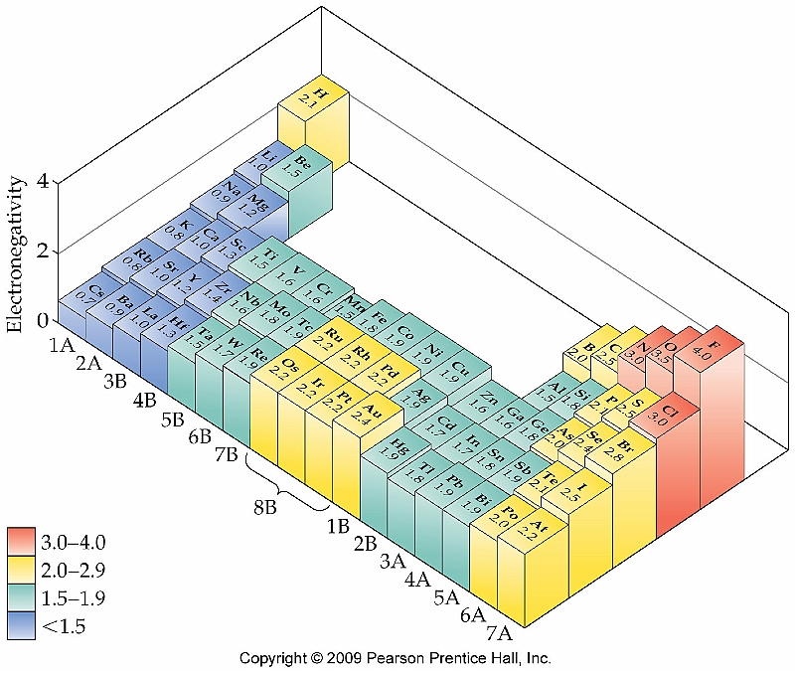
Electronegativity & bond polarity
Electronegativity is a measure of an atoms ability to:
Hold on to its own electrons
Attract electrons away from other atoms
Calculating Δ EN values of 2 bonded atoms lets us classify bonds or molecules as:
ΔEN
non-polar covalent <0.5
polar covalent 0.5 – 2.0
ionic >2.0
Note how en changes in the periodic table.

Slide 12
FE electronegativity & bond polarity problems
Which element is the most electronegative?
Br
Cl
F ←
I
Arrange these in order of increasing polarity of their bonds: SO2, H2S, SF2, OF2
SO2, H2S, SF2, OF2
H2S, SF2, SO2, OF2
H2S, OF2, SO2, SF2 ←
SF2, OF2, SO2, H2S
Note how en changes in the periodic table.

Slide 13
Naming ionics, moleculars & acids
Ionic formulas must be balanced for a net charge of zero.
mono- vs. polyatomic ions
transition metals?
Na2S sodium sulfide
Fe(SO3) iron (II) sulfite
Mn(SO4) manganese (II) sulfate
Acids also need to balance to a net charge of zero.
mono is hydro_______ acid
poly _____ite becomes ______ous acid, but ______ate to_______ic acid
H2S hydrosulfuric acid
H2(SO3) sulfurous acid
H2(SO4) sulfuric acid
Molecular compounds don’t have to be net zero, but turn #s into pre-fixes.
P4S7 tetraphosphorous heptasulfide
NO mononitrogen monoxide
SF9 sulfur nonasulfide

Slide 14
FE formula & naming questions
Which of these compounds is ionic?
CO
NO
I2
KCl ← metal + non-metal
Which formula is incorrect?
Ca(OH)2
Na2(CO3)
CaCl ← Should be CaCl2
K(OH)
What are the formulas of: aluminum nitrate, magnesium hydroxide, calcium oxide, copper (II) carbonate [cupric carbonate]?
Al(NO3)3, Mg(OH)2, CaO, Cu(CO3) ←
Al2(NO3), Mg(OH), CaO2, Cu(CO3)
Al(NO3), Mg(OH)2, CaO, Cu(CO3)2
Al(NO3), Mg(OH), Ca2O3, Cu(CO3)

Slide 15
Moles
Unit of “amount” for atoms, isotopes, ions or molecules.
1 mole = number of atoms in 12 g of ¹²C = 6.02 x 10²³ atoms/molecules
1 mole of gas occupies 22.4 L at STP (25°C, 1 atm)
Mole fraction of x = mole of x / total moles
A gas mixture is made by combining 2 kg of O2, 5 kg of N2 & 3 kg of Xe. What’s the mole fraction of O2 gas?
O2 = 2000 g 1 mol = 0.0625 mol O2 0.0625 O2/ 0.2639 mol total
32 g = 0.2368 mole fraction
N2 = 5000 g 1 mol = 0.1786 mol N2
28 g
Xe = 3000 g 1 mol = 0.0228 mol Xe
131.3 g
Molar mass (aka molecular weight) = the mass of one mole (g/mol)
Calculate the MW of H2(SO4).
MW = (2x1.01) + (32.02) + (4x15.99) = ~98 g/mol

Slide 16
FE mole questions
How many electrons are in 0.01 g of gold?
The atomic mass of gold is 196.97 g/mole, atomic number 79
0.01 g 1 mole 6.02 x 10²³ atoms 79 e- = 2.42 x 10²¹ e-
196.97 g 1 mole 1 atom
Which is not about a mole?
22.4 L N2 at STP
6.02 x 10²³ O2 molecules
16 g O2 ← 1 mol ~ 32 g O2
2 g of H2

Slide 17
Percent composition
Percent composition tells us how much of a molecule’s mass is made up of each of the molecule’s elements.
Think of the part vs. the whole.
An unknown compound is 49.3% C, 9.6% H 21.9% O and 19.2% N. Molecular formula?
C4H8NO
C4H6NO
C3H6N2O
C3H7NO
Convert percentage to grams to moles, ratios:
49.3 g 1 mol = 4.11 mol C/1.37 = 3
12.01 g
9.6 g 1 mol = 9.50 mol H/1.37 = 6.9 C3H7ON
1.01 g
21.9 g 1 mol = 1.37 mol O/1.37 = 1
15.99 g
19.2 g 1 mol = 1.37 mol N/1.37 = 1
14.01 g

Slide 18
FE percent composition problems
What is the % composition (gravimetric percentage) of oxygen in K2CrO4?
33%
42%
C57%
66%
Calculate MW, and then look at total O mass as % of that whole:
MW = 194.18
Ox4 = (15.99)(4) ~ 64
64/194.18 = 32.9%

Slide 19
Empirical formulas
Empirical formulas are simplified versions of molecular formulas that tell us the lowest possible ratio of atoms in the molecule. EF doesn’t give us enough information to “build” the molecule.
A student finds that a compound contains 2.7626 g of lead, 0.00672 g of H, and 0.8534 g of oxygen. What’s its empirical formula? a) Pb2O4H
b) Pb4O2H
c) Pb4OH2
d) Pb2O8H ←
First express each element as a % of total mass, 3.6227 g:
Pb = 76.2%, O = 23.6%, H = 0.185%
Then… make % into grams & go to moles
76.2 g 1 mol = 0.367 mol/0.183 = 2
207.19 g
23.6 g 1 mol = 1.47 mol/0.183 = 8 So, Pb2O8H
15.99 g
0.185 g 1 mol = 0.183 mol/0.183 = 1
1.01 g

Slide 20
Chemical equations
Chemical equations show change of molecular identity.
The atoms don’t change, but they are taken apart & rearranged.
C3H8 + 5O2 → 3CO2 + 4H2O
reactants → (change) → products
The carbon loses its hydrogen & hooks up with oxygen, creating CO2. Some of the oxygen combines with hydrogen to make water.
Equations must be balanced.
Same number & type of atoms on either side of the arrow.
Good idea to save O & H for last.
Stoichiometry uses the coefficients of balanced equations to predict yields.
1 mole of propane + 5 moles of oxygen -- react to form → 3 moles of carbon dioxide + 4 moles of water

Slide 21
Typical chemical reactions
Combination
Decomposition
Combustion
Exchange
Precipitation
Neutralization
Redox displacement
A + B → AB
AB → A + B
CH4 + 2O2 → CO2 + 2H2O
Fuel + oxygen carbon dioxide + water
2Na3N + 3CaCl2 → 6NaCl + Ca3N2
2Ag(NO3) + CaBr2 → 2AgBr + Ca(NO3)2
2H3(PO4) + 3Ca(OH)2 → 6H(OH) + Ca3(PO4)2
Mg + 2HCl → H2 + MgCl2
0 +1/-1 0 +2/-1
ox
red

Slide 22
FE balancing questions
Balance this equation:
Al + H2(SO4) → Al2(SO4)3 + H2
2Al + 3H2(SO4) → Al2(SO4)3 + 3H2
What is the smallest possible coefficient of Na2(CO3) when this reaction is balanced: Na2(CO3) + HCl → NaCl + H2O + CO2
Na2(CO3) + 2HCl → 2NaCl + H2O + CO2 one
Balance this equation: FeS2 + O2 → Fe2O3 + SO2
2(2FeS2 + 11/2O2 → Fe2O3 + 4SO2)
4FeS2 + 11O2 → 2Fe2O3 + 8SO2

Slide 23
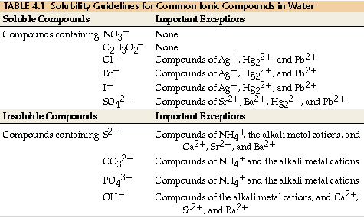
Precipitation reactions

Slide 24
Acids, bases & neutralization reactions
Acids can donate H ions (begin with H)
Bases can accept H ions (typically OH- or NH3)
pH is a logarithmic scale of acidity = -log [H⁺¹] so this scale is inverse
Calculate the pH values of 0.1 M and 0.01 M HCl solutions.
pH = - log 0.1 M = 1
pH = - log 0.01 M = 2
To go the other way? Calculate the H ion concentration of solutions whose pH values are 6.0 and 7.0.
[H⁺¹] = 10⁻⁶ and 10⁻⁷
Acids & bases react via exchange to produce salt & water:
3H2(SO4) + 2Al(OH)3 → Al2(SO4)3 + 6H(OH)
low pH high pH no pH neutral pH 7
14-
7 -
1 -

Slide 25
FE acid & base problems
A 1.0 M solution of HCl has a pH of 1.1. What is the percent of the acid that is ionized?
pH = 1.1 = -log [H⁺¹] -> log [H⁺¹] = - 1.1 -> [H⁺¹] = 10 ^{-1.1} = 0.079 M
So, 79% (?) is ionized.
If you need to neutralize 4 g of Na(OH) dissolved in 1 L of water, you will need 1 L of:
0.001 M HCl
0.01 M HCl
0.1 M HCl
1.0 M HCl
MW of Na(OH) = 40 g/mol
4 g 1 mole = 0.1 M
40 g 1 L
Since the acid and base react with a 1:1 stoichiometry, the answer is c.
Na(OH) + HCl → NaCl + H2O

Slide 26
Solution stoichiometry
Limiting reactants – the reactant that is completely consumed in a chemical reaction; rxn yield is dependent on the limiting reactant.
3H2(SO4) + 2Al(OH)3 → Al2(SO4)3 + 6H(OH)
3 moles 1 mole ? moles ? moles 0.5 3
100 g 100 g ? g ? g
100 g 1 mol 1 Al2(SO4)3 340 g = 115.6 g Al2(SO4)3 *** limiting/theor yield
98 g 3 H2(SO4) 1 mol
100 g 1 mol 1 Al2(SO4)3 340 g = 220.8 g Al2(SO4)3
77 g 2 Al(OH) 1 mol
Percent yield =
Grams
A
Moles
A
Moles
B
Grams
B
MW
A
Ratios
MW
B

Slide 27
FE stoichiometry problem
How many kg of NaOH are made from 2000 kg of Na2(CO3) by the following reaction. Assume there is excess Ca(OH)2.
Na2(CO3) + Ca(OH)2 → 2Na(OH) + Ca(CO3)
MW of NaOH = 40 g/mole
MW of Na2(CO3) = 106 g/mole
2000 kg 1000 g 1 mol 2 mol Na(OH) 40 g 1 kg = 1509
1 kg 106 g 1 mol Na2(CO3) 1 mol 1000 g

Slide 28
Redox reactions
What are oxidation & reduction? Oxidation numbers?
Metals usually take their charge
H = +1/1
O = -2
F = -1
C, N, S, others vary
Molecule’s ox # sum to zero
Ion ox # sum to ionic charge
What are reducing and oxiding agents?
The element that is oxidized is the reducing agent.
The element that is reduced is the oxidizing agent.
Sacrificial anodes, cathodic protection & galvanization

Slide 29
FE redox problems
In the following rxn, which elements are reducing & oxidizing agents: 2Mg + O2 → 2MgO
0 0 +2/-2 Mg is oxidized = reducing agent
O is reduced = oxidizing agent
Break this reaction into half-equations and balance for electrons:
2Na + Cl2 → 2NaCl
2Na → 2Na⁺¹ + 2e- oxidation (e- with products)
Cl2 + 2e- → 2C⁻¹ reduction (e- with reactants)

Slide 30
Redox FE questions
What are the oxidation numbers of atoms in ClO3⁻¹ &MnO4⁻¹ ions?
ClO3⁻¹ → Cl? +5 So calculate the ox # of Cl so sums to -1
-2 x 3 = -6
-1
MnO4⁻¹ → Mn? +7 So calculate the ox # of Mn so sums to -1
-2 x 4 = -8
-1
Look at this equation: 2H(NO3) + 3H2S → 2NO + 4H2O + 3S
What’s oxidized?
What’s reduced?
What’s the oxidizing agent?
What’s the reducing agent?
+1/+5/-2 +1/-2 +2/-2 +1/-2 0
S goes from -2 to zero
N goes from +5 to +2
N
S

Slide 31
Redox FE questions
Given this unbalanced equation, how many moles of Ag(NO3) are formed for each molecule of NO produced?
Ag + H(NO3) → Ag(NO3) + NO + H2O
Ag + H(NO3) → Ag(NO3) + NO + H(OH)
0 +1/+5/-2 +1/+5/-2 +2/-2 +1/-2
1e- lost
3e- gained
3Ag + H(NO3) → 3Ag(NO3) + NO + H(OH)
0 +1/+5/-2 +1/+5/-2 +2/-2 +1/-2
3e- lost
3e- gained

Slide 32
Chemical equilibrium
What is equilibrium? What factors affect equilibrium?
Equilibrium occurs when two opposite chemical reactions are happening simultaneously:
reactants products
Many chemical reactions are equilibrium reactions
Equilibrium constants, Keq and direction of reaction. A + B → C + D Keq = [C]^{c}[D]^{d}
[A]ª[B]^{b}
Keq = 1, neither favored
Keq > 1, products are favored
Keq < 1, reactants are favored
Le Châtelier’s Principle predicts the direction in shift of an equilibrium reaction when the reaction is stressed or when conditions change.

Slide 33
FE equilibrium problems
Here’s a reversible chemical reaction in which all reactants & products are gases.
N2 + 3H2 2NH3 + heat
What happens if the pressure in the reaction container is doubled?
Amount of NH3 doubles
No change in amount of NH3
More NH3 is made ←
Amount of NH3 falls by half

Slide 34
FE equilibrium problems
A liter of solution contains 52.7 g of H2(SO4), 240.8 g of KMnO4, 11.3 g of K2(SO4), 5.5 g of Mn2O7. This reaction happens
H2(SO4) + 2KMnO4 K2(SO4) + Mn2O7 + H2O
MW are shown here:
H2(SO4) 98 g/mol
KMnO4 158 g/mol
K2(SO4) 174 g/mol
Mn2O7 222 g/mol
H2O 18 g/mol
What’s the Keq?
0.0013 ←
0.0026
0.0052
0.0069
H2(SO4) = 52.7 g/L = 0.538 M
98 g/mol
KMnO4 = 240.9 g/L = 1.524 M
158 g/mol
K2(SO4) = 11.3 g/L = 0.065 M
174 g/mol
Mn2O7 = 5.5 g/L = 0.025 M
222 g/mol
Keq = (0.065)(0.025) = 0.0013
(0.538)(1.524)²
Keq = 1, neither favored
Keq > 1, products are favored
Keq < 1, reactants are favored

