Slide 1
MEC 3040 Module 10:
Technical factors that affect manure digestion
10.1: Microbial populations
10.2: Feedstock
10.3: Loading rate & retention times
10.4: Mixing
10.5: Environmental factors
This curriculum is adapted from: eXtension Course 3: AD, University of Wisconsin

Slide 2
10.1: Microbial populations

Slide 3
Bacteria & methanogens
Fermenting bacteria: bacteria that degrade organic compounds to organic acids like acetic acid
Hydrolytic bacteria: convert complex organics like polysaccharides and proteins to simpler molecules
Acidogenic bacteria: reduce simple organics to organic acids
Acetogenic
Homoacetogenic
Syntrophic
Methanogens: bacteria that convert acetic acid into methane
Manure should provide all of the bacteria needed for anaerobic digestion.
convert organic acids to acetate
CO₂-reducing methanogens
Aceticlastic methanogens
CO₂ + 4H₂ → CH₄ + 2H₂O
~20 – 30% methane production
CH₃COOH → CH₄ + CO₂
~ 70% methane production
Farhan & Farhan (2006)

Slide 4
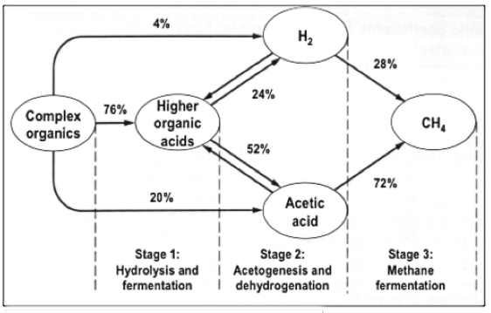
3 steps of AD
Most methane is made from acetate, but some is made by reducing CO₂with H₂.
28%
72%

Slide 5
3 steps of AD
Stage 1: Complex organic molecules are broken into simple organic
acids by bacterial enzymes secreted from (outside of) the bacterial cells. Slow process, although the bacteria reproduce quickly.
Stage 2: Organic acids are converted to volatile fatty acids (VFAs), mainly acetic acid. This process is rapid!
Stage 3: Two populations of methanogens convert acetate to methane. This is usually the rate-limiting step because methanogens are slow-growing and sensitive to environmental factors.
1st population converts acetic acid to methane.
2nd population converts hydrogen + carbon dioxide to methane.
WPCF (1987)

Slide 6
Fermentors & methanogens
Efficient AD occurs when bacterial populations are high and the activities of fermenting and methanogenic bacteria are balanced. Any change in AD conditions (like temperature & pH) affects that balance.
A ‘sour’ digester is an example of imbalance due to high VFA & low pH:
Methanogens work between pH 6.8 – 7.2.
Acetogenic bacteria tolerate low pH (<6) & keep making acetate.
Increased acetate concentrations lower the pH.
Methanogens die and acetate accumulates, keeping pH low.
Methane production stops.
The cure?
Simply feed a plug flow AD (each plug is independent of others).
Stop feeding a mixed AD and wait for biogas production to resume.
Test the slurry and treat as necessary (raise pH).
As a last resort, empty it and start over.

Slide 7
Factors that affect AD
Physical factors:
Temperature
Hydraulic retention time (HRT)
Solids retention time (SRT)
Organic loading rate (OLR)
Volatile solids loading rate
Mixing
Chemical factors:
pH
Alkalinity
Volatile fatty acids (VFAs)
Nutrients
Trace elements
Toxins
WPCF (1987)

Slide 8
10.2: Feedstock basics
(See Module 11 for a detailed discussion of feedstock.)

Slide 9
Examples of feedstock
Manure: has low energy since the feed has already been digested. But:
Manure has a neutral pH & high buffering capacity (alkalinity);
Has all the microbes needed for AD;
Has all the macro- & micronutrients needed for AD; and
Manure is abundant & pumpable.
Non-manure feedstock is often acidic with higher energy; increases biogas.
Waste feed
Food residuals
Fats, oils & grease (FOG)
Energy crops
Waste from ethanol or biodiesel production
Produce waste
Cafeteria waste
Farm animal mortalities

Slide 10
Vermont: who regulates what?
We’ll cover feedstock regulation in detail in Module 11, but Vermont has two agencies with regulatory power that affects feedstock.
Vermont Agency of Natural Resources
Wastewater Division grants indirect discharge permits to the generators of wastewater and liquid food processing materials.
Solid Waste Division permit those accepting solid waste.
A full solid waste certification is required for AD facilities that accept solid pre- and post-consumer food residuals, whether they are collected in a clean stream or with municipal solid waste.
Vermont Agency of Food, Farms and Markets
Requires on-farm digesters to report all feedstock accepted via LFO, MFO or coming SMO (small farm operations) regulations.
Blocks sale of separated solid bedding to other farms if AD facilities take any organic residuals including beef.

Slide 11
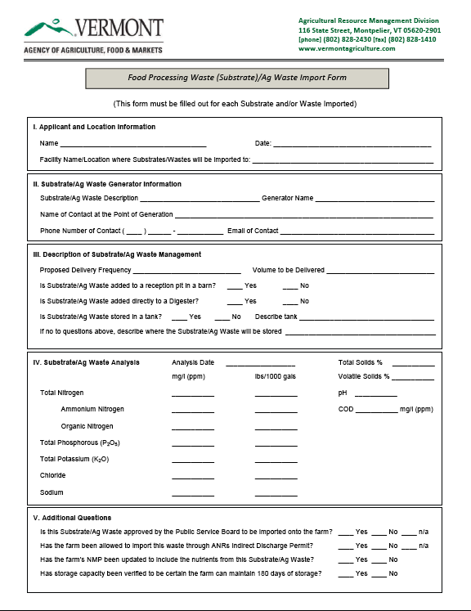
Vermont

Slide 12
Vermont: not yet regulated
In Vermont, there are some organic residuals that are not yet regulated by ANR. These include:
Glycerol (aka glycerin): by-product of biodiesel production from FOG
Grease trap waste: dilute FOG collected from wash water in restaurants
It’s critical that GTW from industrial facilities, or containing heavy metals, or other chemicals toxic to the AD process be avoided.
Note that some GTW is thickened by the addition of flocculants. Some flocculants are biodegradable and non-toxic, but others are toxic to aquatic ecosystems and should be avoided.

Slide 13
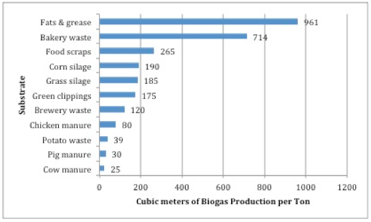
Volatile solids
Volatile solids are organic compounds that can be made into methane. The best feedstock materials have high levels of volatile solids.

Slide 14
10.3: Organic loading rate

Slide 15
Feedstock loading
AD operators monitor and control AD feeding rates, aka organic loading rates.
Critical factors include:
Concentration of feedstock (solids/volume);
Volatile solids content of feedstock;
Inorganic (or inert) content of feedstock;
Volatile solids / AD volume; and
Hydraulic retention time.

Slide 16
Loading rate from VS
Example: complete mixed AD (50’ dia x 20’ deep w/ 5’ cone depth)
Fed 5,000 gallons manure/day @ 100F
6.5% TS, 69% VS, density =1
Calculating manure volume
cylinder = (π)(r²)(h) = (π)(25²)(20) = 39,250 ft³
cone = (1/3)(r²)(h) = (1/3)(25²)(5) = 3,217 ft³
total = 42,521 ft³ = 1.20x10⁶ L
Calculating loading rate
pounds TS/day = (gallons/day)(8.34 lb/gallon)(%TS)
= (5000)(8.34)(0.065) = 2,710 lb TS/day = 1,232 kg TS / day
pounds VS/day = (lb TS/day)(%VS) = (2,710 lb TS/day)(0.69) = 1,869 lb VS/day = 850 kg VS/day
loading rate = (lb VS/day) / volume of manure = 1,869 lb/day / 45,521 ft³
= 0.04 lb / day / ft³ = 7.08x10⁻⁴ kg/L/day
Average loading rates are 0.02 – 0.37 lb VS / ft³ volume = 3.21x10⁻⁴ – 5.94x10⁻³ kg/L/day

Slide 17
Hydraulic retention time (HRT)
Hydraulic retention time (HRT) (aka hydraulic loading): average days that feedstock stays in AD.
Allows the bacteria enough time to convert all VS to methane
Related to AD capacity
Equals AD volume (gallons) / feed volume (gallons/day)
Minimum HRT depends on:
AD type and design
Temperature
Type and volume of feedstock
HRT = total tank volume = gallons = days
volume fed daily gallons/day

Slide 18
10.4: Mixing

Slide 19
Mixing methods
Biogas mixing: as biogas forms, bubbles rise to the surface = natural mixing
Requires a loading rate of 0.4 lb VS / ft³ / day = 6.43x10⁻³ kg/L/day
Heating causes convention currents that provide some vertical mixing (aka zonal mixing). Used by DVO plug-flow designs.
Mechanical mixing: using impellers and pumps
Impellers are blades attached to a shaft and motor; speed varies.
Pumps should be strong enough to move the entire AD volume.
Placing motors outside of AD tanks allows for easier servicing.
Mixing speed: mixing should be done as little as needed
Studies show that start-up is best with slow mixing while faster mixing later improves long-term stability.

Slide 20
10.5: Environmental factors
For more details on the mechanisms of toxicity, please the optional slide set.

Slide 21
Indicators of unstable AD
Instability? Watch for increases or decreases in operational parameters:
Decreased:
Biogas production
Methane production
Alkalinity
pH
Destruction of volatile solids (VS)
Methane is a better indicator than biogas volume.
Changes in feedstock (drop in volume of VS content) normally decrease biogas & methane production.
Drops in methane + alkalinity are significant indicators of methanogen toxicity.
Drop in methane (but not alkalinity) indicates that both fermentors & methanogens are inhibited.
Increased:
VFA concentration
% CO2 in biogas
Gerardi (2003)

Slide 22
7 concerns
Interruptions in steady state conditions cause upset & unstable AD. We can boil down the causes to seven operational conditions:
Hydraulic overload
Organic overload
pH change
Temperature fluctuation
Toxicity
Large purge of sludge
Sudden changes
Gerardi (2003)

Slide 23
Environmental factors for AD
A number of environmental factors affect AD:
Presence of oxygen
Temperature
AD robustness
pH range
buffers
VFA production
Toxic materials
Alkaline / alkaline earth toxicity
Heavy metals
Sulfide toxicity
Ammonia toxicity
These can all be considered critical operational parameters and should be monitored to establish a baseline for robust AD operation.

Slide 24
Presence of oxygen
Methanogenesis cannot occur in the presence of oxygen gas because even small amounts of oxygen gas kill or inactivate methanogens.
Note that the first steps of AD (fermentation) require oxygen.
Some digester designs separate fermentation & methanogenesis for this reason.
However, small amounts of oxygen are sometimes introduced into the gas space in order to oxidize, and therefore precipitate, sulfur.
This technique is discussed in more detail in Module 5.

Slide 25
Temperature
AD is possible at three temperature ranges:
Higher temperatures:
Speed up the AD process;
Increase destruction of pathogens (thermophilic vs. mesophilic); &
May allow digestion of some refractory feedstock: organic materials that resists degradation by AD.
Psychrophilic AD:
Uses less parasitic energy for heating tanks, but requires larger tanks; &
May reduce the level of human pathogens that require higher temperatures to thrive & grow.
AD | °C | °F | HRT
psychrophilic | 20 - 25 | 68 – 77 | up to 100 days
mesophilic | 20 - 40 | 95 - 100 | 5 – 50 days
thermophilic | 40 - 110 | 130 - 145 | 5 – 12 days

Slide 26
Digester robustness
Robust AD design and construction allows systems to handle changes of season and temperature.
AD systems can adapt to changes in temperature if they occur gradually.
Being able to heat organic material before feeding is helpful. If heating is not possible, cold feedstock should be limited to <5% of the daily load.
During our first year of operation Vermont Tech’s facility (VTCAD) did not heat feedstock. Feeding the full volume of 16,000 gallons / day sometimes lowered temperatures in the hydrolysis tank for part of the day. However, the temperature in the more sensitive AD tank were not affected.
When 70% full, VTCAD’s hydrolysis tank has a volume of 73,500 gallons.
The 16,000 gallons feed volume represents 21.7% of this volume…
But only 5% of the volume of the 316,000-gallon AD tank.

Slide 27
pH range
The groups of bacteria responsible for AD have different pH preferences:
Fermenting bacteria (hydrolysis & acetogenesis) perform best at pH 4.5 – 5.5 but will function above this range
Methanogens don’t function below pH 6 and perform optimally from 6.8 – 7.2 (though 6.4 to 8.0 can be tolerated).
Below pH 6, unionized VFAs are toxic to methanogens.
Above pH 8, unionized dissolved ammonia is toxic to methanogens.
pH measurements of slurry must be taken carefully and quickly because of high levels of dissolved CO₂. Biogas in the headspace is >30% CO₂, so the slurry gains quite a bit. The level of carbonates in the slurry helps determine pH. When samples are pulled some CO₂ evaporates quickly causing pH to appear higher than it is in the AD.
Saber (2009); Yadvika (2004); WPCF (1987)

Slide 28
Buffers
The pH of the slurry is determined by the balance of VFAs, CO₂ & alkalinity.
This is the buffering capacity: the ability of the slurry to resist changes of pH when chemical composition changes.
In AD systems, the carbonate acid-base buffering system exerts the most control over pH.
In a balanced AD, VFA concentrations are low and total alkalinity should be roughly equal to bicarbonate alkalinity.
Bicarbonate alkalinity should be 2500 – 5000 mg/L in stable AD.
Bicarbonate buffer is present in feedstock, particularly manure, and…
… are created by methanogens: carbonates, bicarbonates, ammonia.
When pH begins to drop, buffering capacity is nearly depleted.
The rate of fermentation > methanogenesis.
Bacteria may be growing slowly or have been washed out.
Toxins may be present.

Slide 29
VFA:TA ratio
The ratio of volatile fatty acids:total alkalinity (Ripley ratio) is useful.
pH a bit like starlight: pH values indicate biochemical balance from the past and is a good indicator of what has happened, not the now.
The VFA:TA gives operators a better view of what is going on in the digester now. For example: Ripley can reach 7.5:1 before pH begins to change.
Increasing the VFA concentration will increase biogas production & power output. But without buffering capacity (alkalinity) increasing VFA concentrations will lower pH & cause bacteria to stop functioning and/or die. This is often referred to as ‘souring’.
For manure, the VFA:TA should be no higher than 2:1
AD systems with low solids (< 3% TS) are more sensitive to changes in acidity, so use lower VFA:TA ratios.
Treatment for a sour digester? (high Ripley or low pH)
Feed a plug flow AD or ‘starve’ a complete mix AD
Add buffers like Na₂CO₃, CaO, CaCO₃ to increase pH.

Slide 30
Production of volatile acids
In a stable AD system, VFAs are used by methanogens as quickly as they are made & concentration of acetic acid should be 50–300 mg/L.
If the loading rate is increased, or feedstock rich in VS is suddenly added, production of VFAs will surge and pH. Preliminary data from the college’s digester shows that VFAs are liberated during the AD process, peaking in the hydrolyzer. VFA concentrations are much reduced in effluent (98.1%), as VFAs have been converted to methane.
VTCAD samples (Dec 2014) | Total VFA* (mg/L)
College manure | 2884
Abdie manure | 3687
Feedstock preparation pit | 5400
Hydrolysate | 11565
Digestate | 411
Effluent | 225
*VFA assayed by distillation & titration.

Slide 31
Inhibition
The AD process can be inhibited by a number of factors: operational error or lack of fine tuning; or toxins present in feedstock.
Operational examples:
Low temperature; over-stirring; …
Feedback inhibition caused by build up of VFAs or H₂S.
Toxins:
Note that some toxins are always present in the AD process. They can be stimulatory (good) at low concentrations, tolerated at higher concentrations, and downright toxic above a specific threshold.
Specific inorganic materials
Specific organic materials.
Fortunately, bacteria – methanogens included – are capable of adapting to some amount of toxins. However, this adaptability makes it difficult to determine precise concentrations at which toxicity occurs.
Gerardi (2003)

Slide 32
Toxicity can be acute or chronic
Acute toxicity: rapid exposure of unacclimated bacteria to a relatively high concentration of toxin(s)
The effect is sudden.
Chronic toxicity: gradual & long-term exposure of unacclimated bacteria to toxin(s)
The effect builds over time.
Generally, toxicity depends on a number of factors:
Ability of bacteria to adapt to a constant concentration of the toxin;
Presence or absence of other toxins; &
Changes in operational conditions.
Acclimatization occurs by two means:
1. Bacteria repair damaged enzyme systems that degrade toxin.
2. Expansion of populations of bacteria that degrade the toxin. Either way, toxin levels cannot be high, and time is required.
Gerardi (2003)

Slide 33
Symptoms of toxicity
Symptoms of toxicity may appear slowly or rapidly, depending on the type of toxin, its concentration and operational conditions.
Loss of hydrogen
Loss of methane
Loss of alkalinity and/or pH
Increase of VFA concentration
Gerardi (2003)

Slide 34
Inorganic & organic AD toxins
Alcohols (isopropanol)
Alkaline cations ( Ca⁺², Mg⁺², K⁺¹, Na⁺¹)
Alternate electron acceptors (NO₃⁻¹ & SO₄⁻²)
Ammonia*
Benzene ring compounds
Detergents (like dodecyl or lauryl sulfates)
Food preservatives
Chlorinated hydrocarbons
Cyanide
Disinfectants
Formaldehyde (> 100 mg/L)
Heavy metals*
Hydrogen sulfide*
Organic nitrogen compounds (like acrylonitrile)
Pharmaceuticals (like monensin)
Solvents
VFAs and long-chain fatty acids
* Most commonly described
feedback inhibition
Gerardi (2003)

Slide 35
Feedback inhibition
Fermentation produces ‘intermediate’ compounds that methanogens convert to methane:
H₂ gas
VFAs
At high concentrations, these intermediates cause feedback inhibition in order to slow down production until conversion can catch up.
Feedback inhibition slows the metabolic rate of fermenting bacteria…
… but also inhibits production of methane.
High partial pressure (concentration) of H₂ inhibits acetate-producing bacteria.
Accumulation of VFAs inhibits methanogens by direct toxicity:
Increased propionate concentration is a sign of excess VFAs.
Loss of alkalinity or decrease in pH is caused by VFA accumulation.
Two-phase AD (separation of hydrolysis & AD as in VTCAD’s design) usually prevents feedback inhibition, increases stability & resistance to toxins.
Gerardi (2003)

Slide 36
VFA toxicity
Build up of unionized 1-3 carbon VFAs decreases alkalinity and pH.
Toxicity occurs at neutral pH.
Both acid-forming and methane-forming bacteria are inhibited.
Propionate is the most toxic VFA.
Toxic effects occur at propionate concentrations of < 5 mg/L.
Treatment?
Overcome VFA inhibition by addition of alkaline compounds to buffer pH.
VFA | aka | number of carbons
acetic acid | acetate | 2
propionoic* acid | propionate | 3
butyric acid | butyrate | 4
valeric acid | valerate | 5
Gerardi (2003)

Slide 37
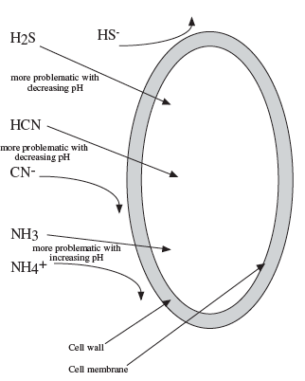
pH dependent toxins
The toxicity of ammonia (NH₃), sulfides (S⁻²) & cyanides (CN⁻¹) is pH dependent.
Ammonia becomes less toxic as pH decreases because low pH adds a H to create ammonium. Ammonium can’t cross the bacterial membrane as readily.
Sulfides and cyanides become more toxic as pH drops because their protonated & neutral forms (H₂S and HCN) are better able to cross bacterial membranes than non-protonated forms.
Gerardi (2003)

Slide 38
H₂S toxicity
Sulfides (S⁻²) are an essential bacterial nutrient, but seldom limiting.
Excess sulfide or hydrogen sulfide (H₂S) are toxic
H₂S is an acid and a gas!
Amino acids & proteins are the most common sources of sulfur.
Sulfate (SO₄⁻²) has little effect on methanogenesis, but this form of S is reduced to H₂S by sulfate-reducing bacteria (SRB).
H₂S toxicity is most severe for hydrogen-consuming methanogens & less severe fro acetoclastic methanogens. Fermenting bacteria that break feedstock into small organic acids are also susceptible to H₂S inhibition.
Toxicity occurs at dissolved H₂S levels of > 200 mg/L.
H₂S partitions between digester slurry and biogas (ie dissolved vs. gas).
H₂S production increases at low organic loading rates because of decreased biogas production. Increased concentrations of CO₂, H₂ and CH₄ inhibit formation of H₂S.
Gerardi (2003)

Slide 39
H₂S toxicity: treatment
Precipitation:
Sulfides are toxic only in their soluble form. Sulfide can be precipitated (made solid rather than soluble) by reaction with metals, most commonly iron.
Addition of iron ions (typically as ferric or ferrous chloride) precipitates sulfides, forming a black sludge.
Note that iron precipitation lowers the concentration of sulfides and H₂S but does not completely prevent H₂S formation. This treatment lowers [H₂S].
Diluting slurry to reduce the concentration of sulfides.
Feedstock: reduce the amount of sulfate & sulfide in feedstock, mainly by monitoring and capping levels of protein in the AD diet.
Scrubbing biogas to remove H₂S & recirculating the scrubbed biogas into the AD slurry so that the remaining methane, carbon dioxide and hydrogen can inhibit formation of H₂S.
Gerardi (2003)

Slide 40
Ammonia toxicity
Ammonical nitrogen (NH₄⁺¹-N or ammonium ions (NH₄⁺¹) are both reduced forms of ammonia and can be added in feedstock or produced during digestion of amino acids & proteins.
The form of ammonia depends on pH:
NH₄⁺¹ ←→ NH₃ + H⁺¹
Free ammonia (NH₃) is toxic to methanogens & toxicity is pH-dependent, decreasing with decreasing pH as ammonia is converted to ammonium (NH₄⁺¹).
Unacclimated bacteria can be inhibited by ammonia concentrations >50 mg/L, but acclimated bacteria are more tolerant:
Ammonium is the preferred source of N for reproducing bacteria & buffers.
equal concentrations @ 9.3
only 0.5% ammonia @ 7.0
NH4+1 / NH3 (mg/L) | effect
50 - 200 | stimulatory (good)
200 - 1000 | no adverse effect
1500 – 3000 | inhibitory at pH > 7 (can cause failure)
Gerardi (2003)

Slide 41
Ammonia toxicity: treatment
Treatment?
Lower digester pH
Dilute AD slurry with material less likely to form ammonia: low protein feedstock.
To some extent, ammonia toxicity is ‘self-correcting’:
Ammonia concentrations rise (perhaps due to increasing pH or high-protein feedstock);
Methanogens become inhibited;
Fermenting bacteria continue to produce VFAs;
Accumulating VFAs lower pH, converting ammonia to ammonium;
This may allow methanogenesis to resume.
Gerardi (2003)

Slide 42
Recalcitrant compound toxicity
Recalcitrant compounds or materials are those materials that cannot be efficiently degraded by AD.
May be toxic to methanogens.
Examples:
Aliphatic hydrocarbons (fossil fuels)
Chlorinated compounds like:
Lignin
Humic substances
Chlorinated biphenyls
Recalcitrance is increased when these compounds contain:
Alkyl groups
Halogens
Nitro groups
Sulfo groups
Gerardi (2003)

