Slide 1
MEC 3040: Bioenergy
Module 2B: Perennial grass biomass resources
2.10: Grass is an herbaceous perennial biomass feedstock
2.11: Grass biomass feedstock considerations & species
2.12: Environmental impact of grass biomass

Slide 2
2.11: Grass biomass feedstock considerations & species

Slide 3
Feedstock supply
Grass biomass feedstock supply includes:
production;
harvest;
transportation; and
storage prior to processing or conversion
Creation of a market for any feedstock requires that the material is readily available and of predictable and acceptable quality.
Feedstock availability depends on:
available & suitable land;
biomass yield on that land; and
distance to the conversion site – optimally less than 80 km (50 miles)
Yield depends on:
latitude & temperature;
species;
soil fertility; and
management.
Since yields vary, conservative planning should use 20% more acreage than needed.
Dahiya (2015)

Slide 4
Feedstock supply: chicken or egg
Emerging markets are bedeviled by chicken or egg problems.
Feedstock processors hesitate to invest large amounts of capital in conversion plants unless feedstock is abundant and reasonably price.
Farmers hesitate to convert acreage to feedstock crops until there is a reliable market for that crop.
And that concern is amplified if there aren’t alternative markets for the crop in question. Most perennial grasses best suited for bioenergy aren’t great animal feed crops.
Feedstock buyers can ensure reliable yields by offering contracts for feedstock purchase but that increases their capital costs.
And because biomass energy is not energy dense, feedstock processors need to be assured of a robust and fairly local market for their processed bioenergy product.
Exception: the European market for wood pellets is not local.
Dahiya (2015)

Slide 5
Herbaceous species for bioenergy
The ideal biomass crop should have a sustained capacity to convert solar energy into biomass with maximal efficiency and minimum inputs while having a minimal effect on the environment.
Consider:
Highly favorable energy balance (EROI);
Maximum utilization of sunlight;
Dry biomass at harvest to minimize use of energy for drying;
High water use efficiency;
Highly efficient use of nitrogen and other nutrients;
C4 photosynthesizer (the most efficient for biomass production);
Minimal need for cultivation and pesticides;
Non-invasive;
Ecological benefits like wildlife habitat, soil & water conservation, carbon sequestration; and
Qualities consistent with processing and end-use.
Dahiya (2015); Heaton et al. (2004)

Slide 6
C4 photosynthesis
C4 photosynthesis allows more efficient production of grass biomass, but there are a limited number of C4 species that grow in the cooler temperatures of the northern regions of North America.
Cool season (C3) | Warm season (C4)
CO₂ is converted to a 3-C acid | CO₂ is converted to a 4-C acid
Photorespiration | No photorespiration
Optimal temp: 18 - 24°C (72°F) | Optimal temp: 32 – 35°C (90°F)
Matures in June / July | Matures in July / August / September
More mesophyll cells | More vascular bundles
Relatively low fiber | Relatively higher fiber
Responds to high N inputs | More efficient N use
Moderate to high N content | Low to moderate N content
Lack of photorespiration allows: uptake of CO₂ at lower concentrations; less water loss from open stoma.
Ideal: species that produce for at least 10 years in marginal conditions.
Dahiya (2015); Heaton et al. (2004)

Slide 7
Switchgrass
Switchgrass (Panicum virgatum) is a native warm-season C4 found in prairies.
High yields & suited to marginal conditions
Deep roots (6-8’) allow it to thrive in many conditions including “droughty”
Low nutrient requirements
Grown for pasture and low-quality livestock hay
Conserves soil & water quality, creates wildlife habitat
Grows up to 6 feet tall and can yield 4-6 dry tons/acre
Requires care to establish a field, so unlikely to act invasively
In the Northeast, 300,000 acres of land are enrolled in the USDA Conservation Reserve Program, and much is planted in switchgrass.
Two ecotypes:
Upland: upland sites not prone to flooding
Lowland: prone to flooding; floodplains
→ Northern US & Canada
→ Lower Midwest & South
Can be grown from eastern NA to the Rockies
Map for switchgrass growing
Dahiya (2015); USDA

Slide 8
Switchgrass yields
The highest yields in the US are about 10 US tons per acre.
In the US, modeling studies show the highest yields will be in the middle latitudes.
Yields will be lower further north.
Vermont is the northern limit of the highest yielding switchgrass cultivars & yields max out at 5 US tons per acre for established stands (3 years old).
Northern cultivars: ‘Blackwell’, ‘Cave-in-rock’, ‘Timber’, ‘Kanlow’
Willow = 25 – 30 tons/acre every 3 years = 10 tons per acre
Dahiya (2015); USDA

Slide 9
Switchgrass polyculture
Switchgrass can be grown in polycultures: mixed with other warm season grasses.
Big bluestem (Andropogon gerardii)
Indiangrass (Sorghastrum nutans)
The American prairie included polycultures of these three grasses and grew with incredible resilience and productivity for thousands of years.
Advantages of polyculture:
Resilience to change & challenge
Changing soil conditions
Weather
Diseases & pests
Wood Crest Farm (PA) plants a switchgrass polyculture to provide biodiversity.
seed | application rate (lb/acre)
switchgrass | 7
big blue stem | 1
Indian grass | 1
native wildflowers | 1/4
Dahiya (2015)
On-farm production of biomass grass pellets, Penn State Extension, (2014)

Slide 10
Switchgrass knowledge & markets
There is more knowledge and information about switchgrass than for the other energy grasses.
Well known culture, production, varieties & harvest methods.
Science confirms its ability to sequester carbon, protect soils, and absorb nutrients.
More alternative (non-energy) uses:
Forage extender
Bedding
Mushroom compost
Particle board component
Stream buffer
Switchgrass buffers can reduce nitrate N surface runoff & sediment by 34 – 99%.
Grass Energy in Vermont and the Northeast, Wilson Engineering for VSJF (2014)

Slide 11
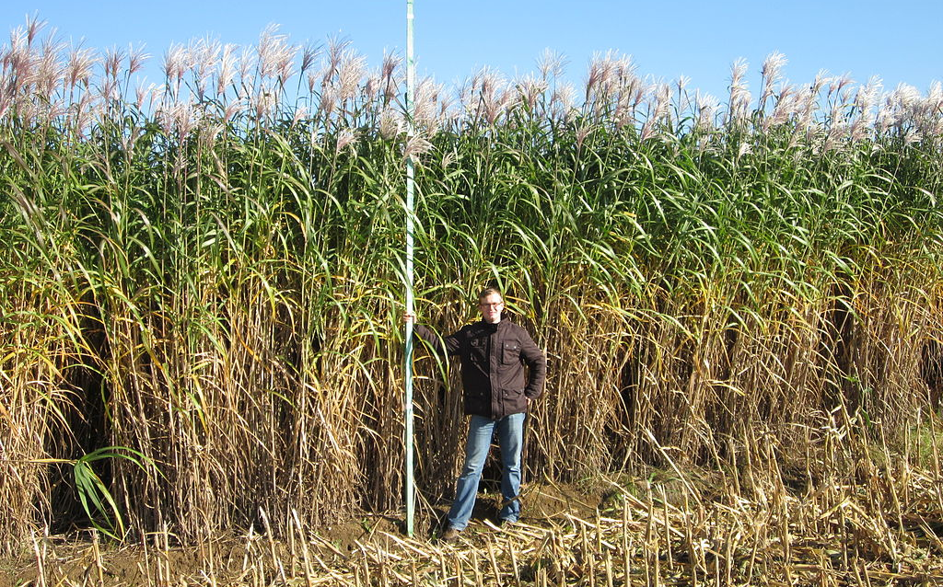
Giant miscanthus
Giant miscanthus (Miscanthus x giganteus) is a C4 warm season grass from Asia brought to Europe & the US in the 1930s as an ornamental grass.
wikipedia

Slide 12
Giant miscanthus
Giant miscanthus (Miscanthus x giganteus) is a C4 warm season grass from Asia brought to Europe & the US in the 1930s as an ornamental grass.
Used as bedding and biomass for heat & electricity in Europe since the 1970s.
Combusted
Low moisture, ash & mineral content
Investigated in the US since 2001.
Twice the biomass yield of switchgrass; 7 – 10 tons/year in Northeast
Stands can produce for 15 – 20 years
Requires robust mowing & baling equipment
Much larger growing range than sugarcane (which has similar productivity)
Likes wet, marginal soils
In the US, most focus is on cellulosic ethanol
Miscanthus could meet US biomass yields without affecting food yields.
Dahiya (2015)

Slide 13
Giant miscanthus production
Giant miscanthus (Miscanthus x giganteus) is sterile cross of Miscanthus sacchriflorus and Miscanthus sinensis.
Since the seed is sterile, miscanthus must be propagated by planting rhizome cuttings (root plantings). This process costs three times that of planting seeds.
But since stands can yield for 20 years this cost can be overcome by long yields.
$500 – 1,000/acre to establish miscanthus
Growing conditions are critical:
Miscanthus uses more water than switchgrass and suffers in droughts.
32 inches of water per growing season
It will grow in Vermont but suffers winter injury and yields are low.
Alternative markets for miscanthus?
Bedding
Fewer alternative uses developed than for switchgrass
Dahiya (2015)

Slide 14
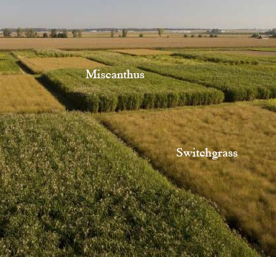
Switchgrass vs miscanthus
Economics of using biomass for residential heating, U Ill, Urbana-Champaign

Slide 15
Switchgrass vs miscantus
Characteristic | Switchgrass | G Miscantus
Growing cycle | 20 years of annual harvest | 20 years of annual harvest
Planting stock | seed | rhizomes
Plants/acre | 8 pounds | 6,000 rhizomes
Establishment $ | $500/acre | $1,500/acre
Yield/acre | 4-6 dry tons/year | 8 – 12 dry tons/year
fertilizer | For maintenance | Not needed
herbicide | At establishment | At establishment
Pests/diseases | Few known | unknown
Harvest method/timing | hay equipment, late winter | hay equipment, late winter
Invasiveness | Some cultivars are not invasive | Non-invasive
Feedstock | High Btu, low water, low ash | High Btu, low water, low ash
Establishment? | 2 years | 2 years
2nd year yield | 2 tons | 6 tons
Alternative uses | numerous | numerous
C sequestering | excellent | excellent
Nutrient filtration | excellent | excellent
Soil building | excellent | excellent
Grass Energy in Vermont and the Northeast, Wilson Engineering for VSJF (2014)

Slide 16
Reed canarygrass
Reed canarygrass (Phalaris arundinacae) is a cool season C3 perennial grass common in the Northeast & upper Midwest.
Reed canarygrass is grown for hay or pasture.
Growing conditions:
Best adapted to moist soils but will tolerate drought in upland soils
Tolerates a wide range of soil pH
Spreads by rhizomes and forms a sod
High biomass yield when compared to other cool season grasses
Harvested in August before new growth mixes dry and fresh material
Addition of N fertilizer is needed for maximal yields
75 lb/acre in Vermont
Reed canarygrass has higher ash, mineral & N content than warm season grasses.
Dahiya (2015)

Slide 17
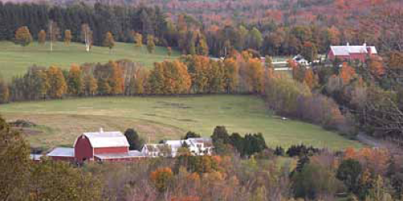
Land for growing energy grass?
There is widespread concern that energy crops will compete with human (and animal) food crops for good agricultural land.
Perennial grasses can be grown on ‘marginal’ agricultural land.
Studies show that Vermont has about 84,000 acres of idle cropland & significantly more marginal land.
As fewer dairy farms remain in Vermont more land is being brush hogged just to keep it open. Why not use the harvest for energy?
Technical assessment of grass pellets as boiler fuel in Vermont, BERC (2011)

Slide 18
Grass biomass remediation?
Programs and incentives are effective ways of creating viable markets and motivating producers and processors.
Nutrient runoff into Lake Champlain causes major water quality & environmental challenges in Vermont.
Incentivize planting perennial energy grass riparian buffer strips (bio-filters) along lakeside fields.
Harvest once a year for energy.
Regrowth requires & soaks up nutrients running towards the Lake.
Nutrients would be captured in ash & then used only where needed.
Burning the grass in larger boilers (> 3 m Btu) would ensure emission controls.
Grass Energy in Vermont and the Northeast, Wilson Engineering for VSJF (2014)

Slide 19
Grants / assistance?
REAP (Rural Energy for America Program) from USDA helps agricultural producers and small businesses purchase, install & construct renewable energy systems.
EQIP (Environmental Quality Incentives Program) from USDA’s Natural Resources Conservation Service (NRCS) provides financial & technical assistance to farmers and landowners to help them improve wildlife habitat, air quality or water quality.
On-farm production of biomass grass pellets, Penn State Extension, (2014)

