Slide 1
MEC 3040: Bioenergy
Module 2A: Woody biomass resources
2.1: Recap: What is woody biomass
2.2: Use and benefits of woody biomass
2.3: Sources of bioenergy biomass
2.4: Wood resources
2.5: Study of wood energy resources in Vermont
2.6: Role of woody biomass in the Northern Forest region
2.7: Harvesting, transporting & storage of woody biomass
2.8: Northern Forest recommendations for biomass use
2.9: Future of woody biomass

Slide 2
2.2 Use & benefits of
woody bioenergy

Slide 3
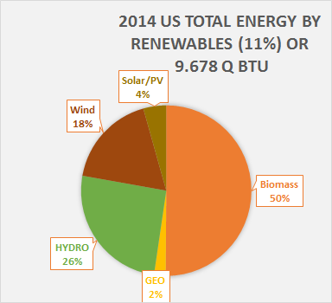
Breakdown of biomass use in US
In 2010, US biomass use looked like this:
46% was wood or wood-derived
43% was biofuel, mainly ethanol
11% was derived from municipal waste
Add graph?
BIOEN1
EIA @www.eia.doe.gov and www.repp.org/bioenergy/link6.htm;
www.extension.org/pages/Biomass_Feedstocks_and_Energy_Independence

Slide 4
Woody bioenergy: very old technology
The burning of wood for heat and power is a very old technology & pre-dates the written history of human civilizations.
The use of wood for heating is increasing in Europe, partly due to clean-air regulations.
Wood pellets are shipped from the US & Canada.
In 2015, 6.1 million tons were exported.
Four times as much as in 2010.
In the US, many wood producers and processors use waste wood for heat and or CHP.
In the US, wood bioenergy is 23% of total renewable energy production.
Dahiya (2015); US Energy Information Administration;
http://biomassmagazine.com/articles/13224/north-american-wood-pellet-exports-reached-record-high-in-2015

Slide 5
Benefits?
Woody bioenergy has a number of potential benefits.
Displacing fossil fuels and thus slowing increase of climate change
Energy security & independence
Economic benefits for rural communities & land owners
Enhancing forests (???)
Wood energy makes sense when the need is located close to abundant supplies, making it popular in rural areas with forest cover.
Dahiya (2015); US Energy Information Administration

Slide 6
Use of wood in Vermont
Two commercial wood-fired electric-generating stations
Several industrial scale heating plants that use wood-chips
Wood-chips heat over 40 schools;
Four college campuses;
Two state office complexes; and
Five other state facilities.
Wood pellets heat 10 schools;
14 multi-family housing complexes; and
Two state buildings.
Many residential households are heated with chunk wood or wood pellets.
Dahiya (2015); US Energy Information Administration; http://fpr.vermont.gov/forest/wood_biomass_energy

Slide 7
The most efficient use of biomass?
Using wood biomass to produce heat is the most efficient use of this resource at both the residential and commercial scale.
30% of Vermont’s annual wood harvest is already used for firewood.
At the larger, commercial, scale Vermont should support sustained and efficient “thermal-led” biomass energy projects:
Thermal energy; or
CHP with > 75% efficiency; rather than
Electric generation only.
← Only 20-25% efficient
Vermont’s forests and our energy future, National Wildlife Federation and VNRC

Slide 8
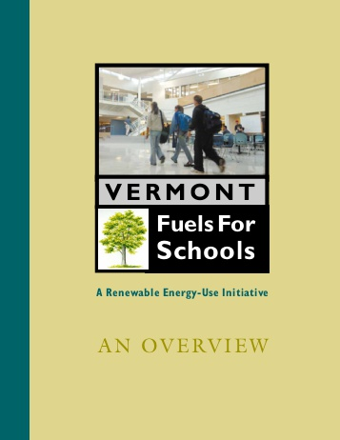
Fuels for schools in Vermont
In 2009 / 2010, 43 Vermont schools used woodchip heat.
Used 23,271 green tons of woodchips;
Offset 1.5 million gallons of oil;
Saved $1.7 million dollars; for
An average of 46% of each school’s heating cost.
This is an efficient use of biomass energy.
Vermont’s forests and our energy future, National Wildlife Federation and VNRC

Slide 9
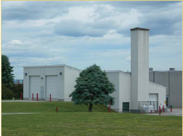
Efficient Vermont biomass case studies
Barre Town Elementary School
Converted from electric heat to woodchip heating in late 1990s
Annual cost savings of $100,000
2009 – 2010 heating season:
477 tons of wood from Lathrop Forest Products of Bristol, VT
For $42,786
Wood-chip heating systems: a guide for institutional and commercial biomass installations, BERC (2004)

Slide 10
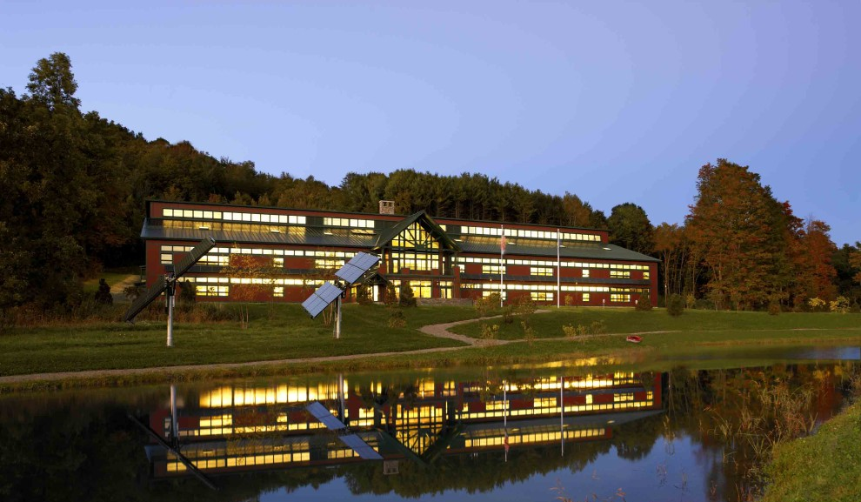
Efficient Vermont biomass case studies
NRG Systems’ pellet heating project
NRG Systems of Hinesburg, VT has two LEED-gold certified facilities:
46,000-square foot and 31,000-square foot
Four Tarm wood pellet boilers, each with 140,000 Btu capacity
In the 2010 – 2011 heating season they used pellets from New England Coop
25 tons and 10 tons
Wood-chip heating systems: a guide for institutional and commercial biomass installations, BERC (2004)

Slide 11
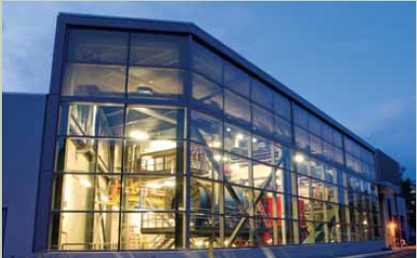
Efficient Vermont biomass case studies
Middlebury College district heating project
Central woodchip gasifier was installed in 2008
Tied into the existing oil-fired heating plant
Uses 20,000 tons of woodchips annually
Supplied from a 75-mile radius
Includes a willow plantation
Replaced 40% of oil use
In the first year, annual savings were about $2 million
Wood-chip heating systems: a guide for institutional and commercial biomass installations, BERC (2004)

