Slide 1
MEC 3040: Bioenergy
Module 2A: Woody biomass resources
2.1: Recap: What is woody biomass
2.2: Use and benefits of woody biomass
2.3: Sources of bioenergy biomass
2.4: Wood resources
2.5: Study of wood energy resources in Vermont
2.6: Role of woody biomass in the Northern Forest region
2.7: Harvesting, transporting & storage of woody biomass
2.8: Northern Forest recommendations for biomass use
2.9: Future of woody biomass

Slide 2
2.3: Sources of energy biomass

Slide 3
Forest sources of wood for energy?
Logging residues & thinnings provide several tons per acre of:
Whole trees;
Limbs;
Leaves;
Branches; and
Tops.
Many believe that this practice removes nutrients need for forest regrowth.
There are guidelines and recommendations aimed at preventing adverse effects from use of this ‘waste’ material.
Thinnings created when reducing risks of fires or cleaning up from natural disasters.
Fires;
Hurricanes & wind storms; and
Ice storms; and
Large insect infestations (often invasive)
Dahiya (2015); US Energy Information Administration

Slide 4
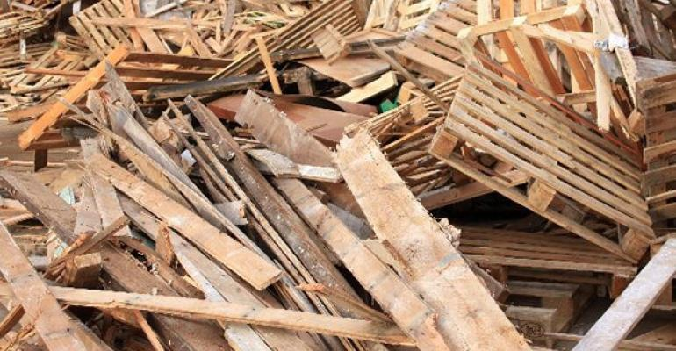
Waste sources of wood energy
Wood manufacturing waste
sawdust
chips
slabs
← Often used as on-site / process bioenergy
Urban waste
Construction / deconstruction debris
Landscape waste
← typically sent to landfills
Waste wood picture
Dahiya (2015)

Slide 5
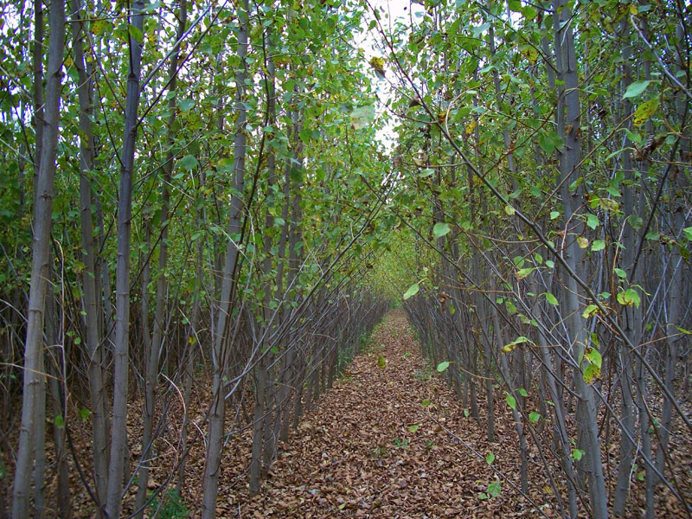
Short rotation woody crop systems
Short rotation woody crop systems (SRWCs) are forests managed for the production of energy biomass
Plantations
Fast-growing trees with desirable energy traits
Typical species:
hybrid poplar
eucalyptus
sweetgum
Special equipment chips trees as they are harvested.

Slide 6
Silviculture
Silviculture: the intentional growing of trees for human use
Aka forest management
Purposeful manipulation of the natural landscape to achieve a set of objections.
Production of a forest product like pulpwood or timber.
Improving habitat for wildlife
Enhancing recreational opportunities
Improving the land for future generations
Aesthetics and beauty
The intensity of silvicultural projects varies with location and objectives.
Most projects use foresters and other professionals.

Slide 7
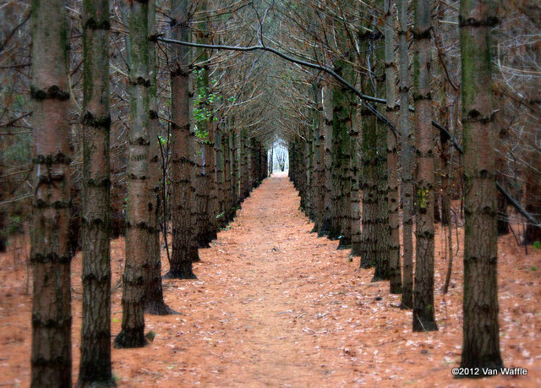
Southern pine plantations
The term ‘plantation’ reflects the intensely agricultural approach to this type of silviculture.
The most productive seedlings are selected for the location and purpose.
Seedlings are planted in the most productive locations.
Seedlings are planted in rows at a specified density per acre.
Ground is prepared for planting.
Fertilizer is applied.
Forests are monitored and managed to ensure the maximum production of wood per acre.
Thinning produces the first product; and
Allows remaining trees to grow larger and faster.
Split slide and add images?
While most SRWCs involve growing softwoods, advances are being made with hardwood SRWCs in some locations.

Slide 8
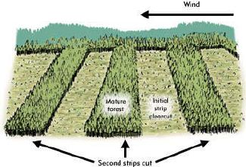
Southern pine plantations
Harvest can take several forms:
Clearcut
Seed tree
Shelter wood
Gap cuts
Group cuts
While most SRWCs involve growing softwoods, advances are being made with hardwood SRWCs in some locations.

