Slide 1
MEC 3040: Bioenergy
Module 2A: Woody biomass resources
2.1: Recap: What is woody biomass
2.2: Use and benefits of woody biomass
2.3: Sources of bioenergy biomass
2.4: Wood resources
2.5: Study of wood energy resources in Vermont
2.6: Role of woody biomass in the Northern Forest region
2.7: Harvesting, transporting & storage of woody biomass
2.8: Northern Forest recommendations for biomass use
2.9: Future of woody biomass

Slide 2
2.4: Wood resources

Slide 3
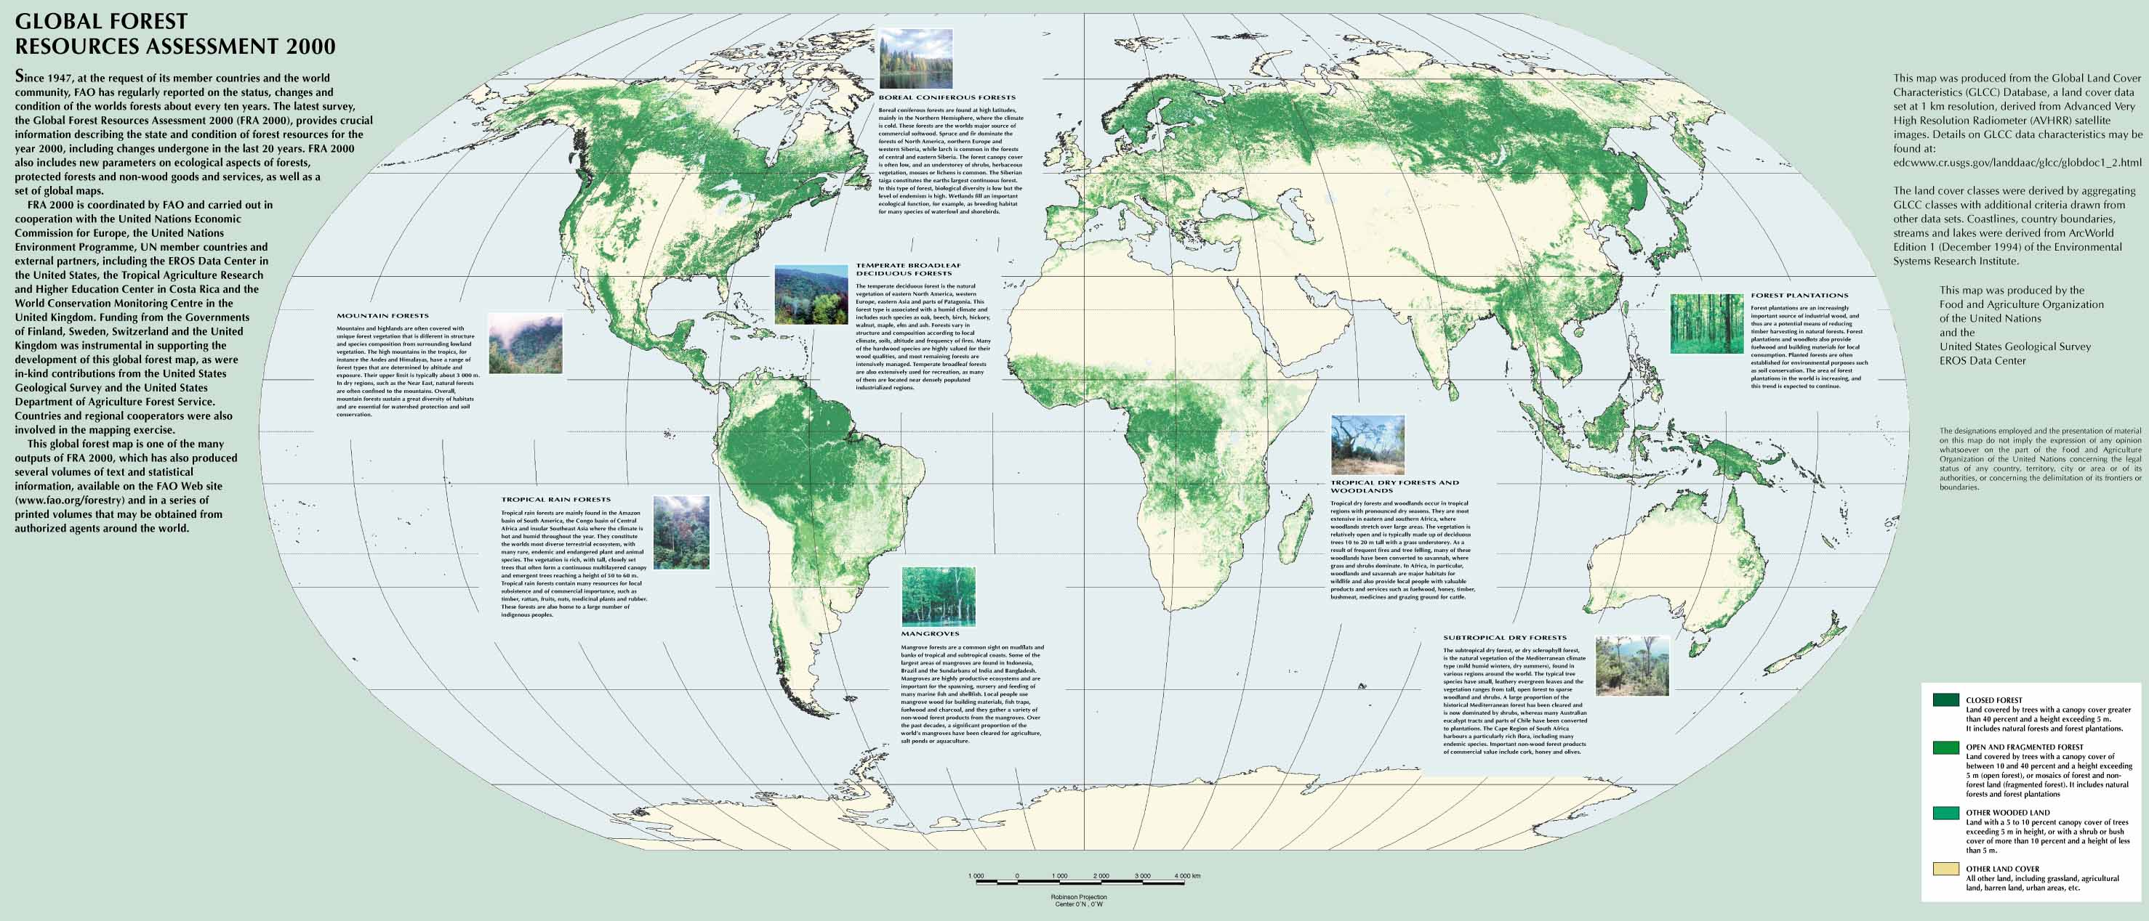
Forests
Forest: land with at least 10% tree cover
US: Forest covers about 1/3 of all land mass.
750 million acres (~3 million square km)
Table of forest resources by country from UN FAO
Dahiya (2015); UN FAO

Slide 4
Forest ownership
In the US forest ownership varies by region.
In the eastern US forests are largely privately owned.
Individuals
Corporations
Investment firms
NGOs
In the western US forests are largely publically held.
US Forest Service;
US Bureau of Land Management; &
US National Park Service.
Dahiya (2015); US Forest Service

Slide 5
Goals of forest ownership?
Forests are managed for a variety of goals & objectives ranging from simple profit to ongoing profit to preservation and conservation.
Plantation management: trees are planted for the express purpose of harvesting for uses ranging from paper pulp to lumber to bioenergy.
Common in the southeastern US (45 million acres)
Harvest can wait for need or maximal profit. The longer the tree grows the more valuable it is.
Advantages?
Preserves natural forests?
Disadvantages?
Monocultures are vulnerable to diseases & pests; and
Don’t benefit wildlife as much as natural ecosystems do.
Dahiya (2015)

Slide 6
Forest management
Most forest management schemes share the goal of creating sustainable forest or sustainable tree production.
Regeneration is accomplished by:
Artificial replanting; or
Natural regeneration
Best management practices seek to:
Maintain water quality; and
Create resilience to attack by diseases & insects.
Dahiya (2015)

Slide 7
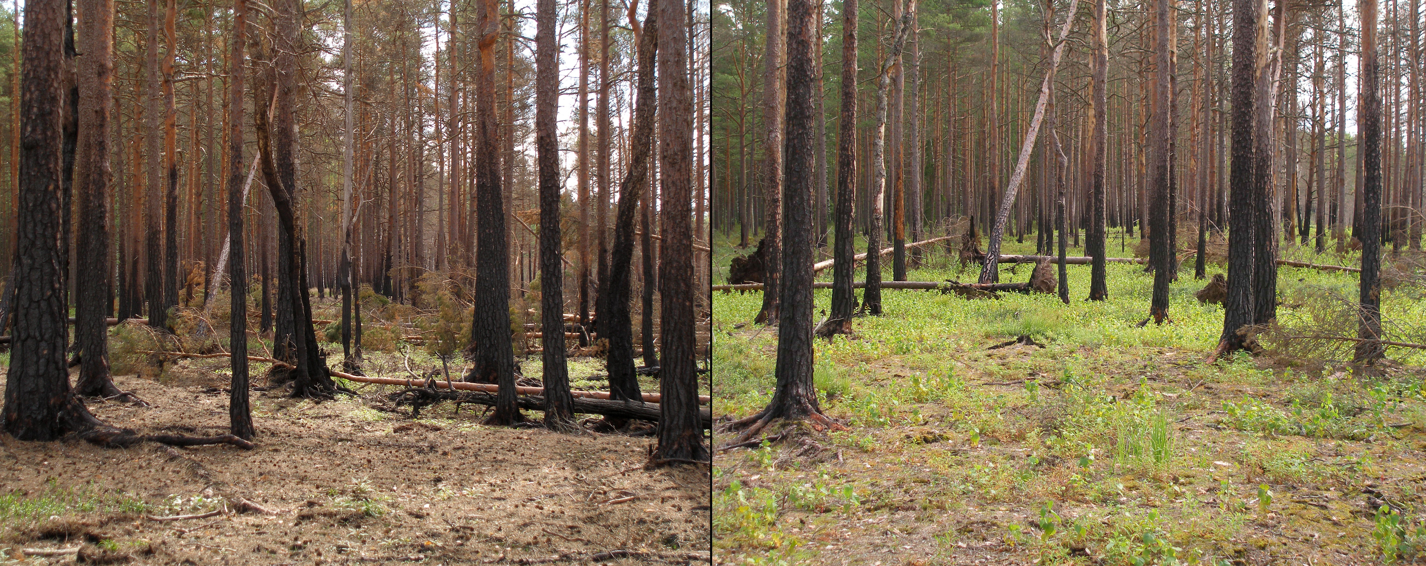
Issues: overstocking
Overstocking: forests that are too densely wooded for optimal timber growth.
Fire hazards;
Stagnant growth; and
Encourage diseases, insects & invasive species.
Management solutions?
Controlled burning;
Thinning; or
Limited commercial harvesting
Add images?
Dahiya (2015)
Yellowstone fire of 1988 burned 880,000 acres

Slide 8
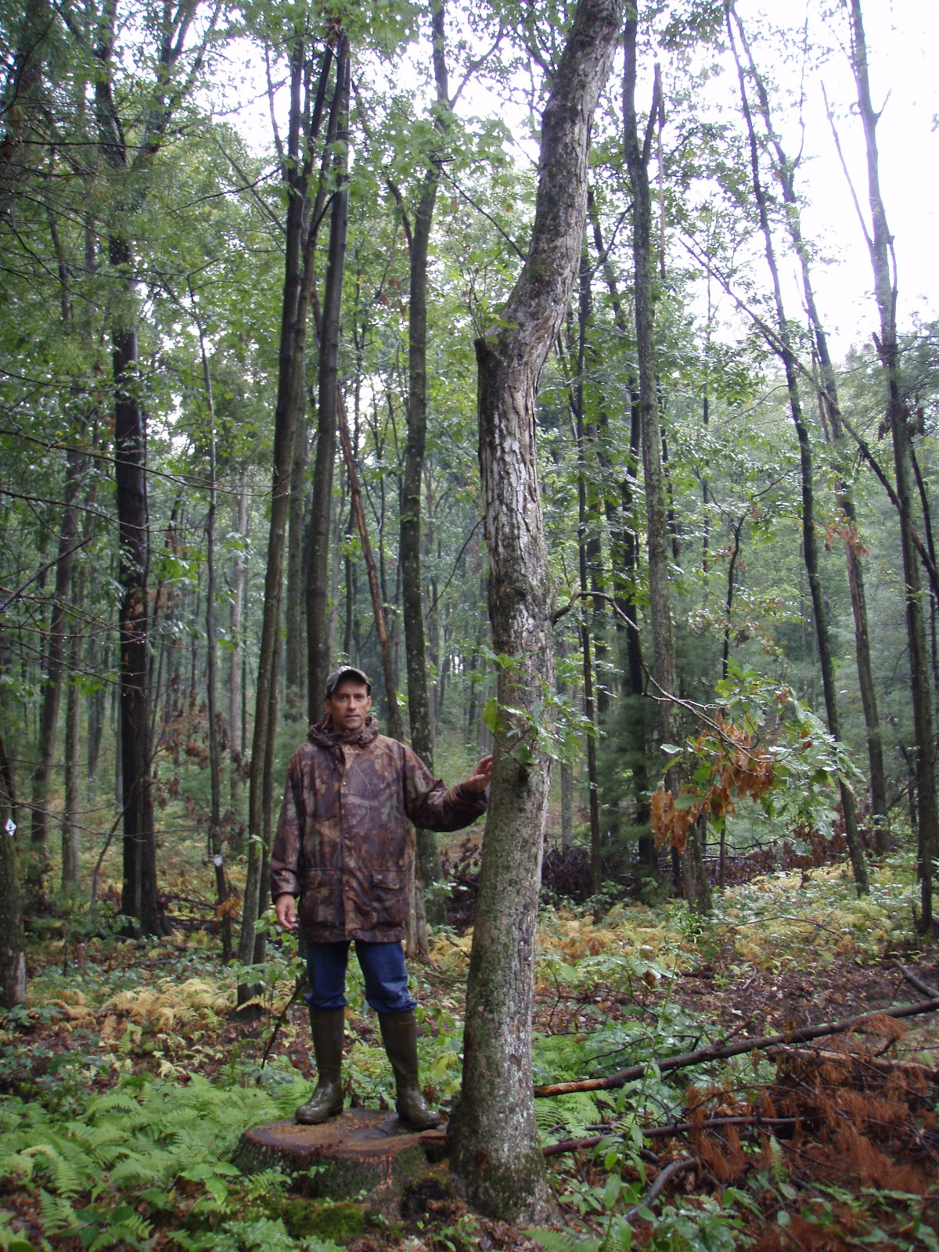
Issues: ‘hi-grading’
‘Hi-grading’: harvesting only the biggest or healthiest trees and leaving the small or unhealthy trees to regenerate the forest. Common in hardwood forests.
Limits long-term profits; and
Limits ecosystem regeneration and function.
Management solutions?
Clearing small & sick trees after the harvest of the most valuable lumber.
This material may be valuable as a bioenergy resource.
Dahiya (2015)

