Slide 1
MEC 3040: Bioenergy
Module 2A: Woody biomass resources
2.1: Recap: What is woody biomass
2.2: Use and benefits of woody biomass
2.3: Sources of bioenergy biomass
2.4: Wood resources
2.5: Study of wood energy resources in Vermont
2.6: Role of woody biomass in the Northern Forest region
2.7: Harvesting, transporting & storage of woody biomass
2.8: Northern Forest recommendations for biomass use
2.9: Future of woody biomass

Slide 2
2.5: Study of wood energy
resources in Vermont

Slide 3
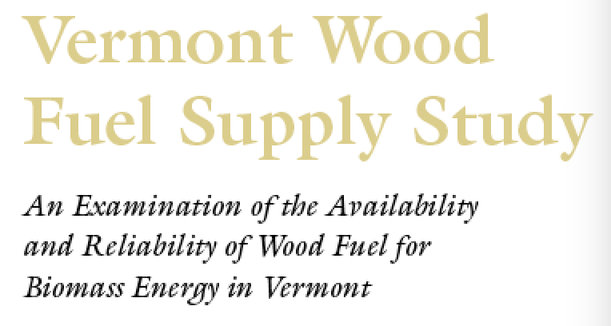
Study of Vermont’s wood supply
In 2007, Vermont’s Biomass Energy Research Center undertook a study called the Vermont Wood Fuel Supply Study (VTWFSS) to understand the capacity of Vermont’s forest to provide fuel in a sustainable fashion.
Note that most forest data focuses on high quality wood used for timber. Energy wood is of lower quality.
The study focused on Vermont & adjacent counties of NY, MA, NH and considered large users of wood fuel in those same areas.
Goals:
Determine the potential low-grade wood available for harvest;
Model the impacts of future demand for fuel wood; and
Examine economics of fuel wood supply.
Vermont Wood Fuel Supply Study, BERC (2007); VTWFSS Update (2010)

Slide 4
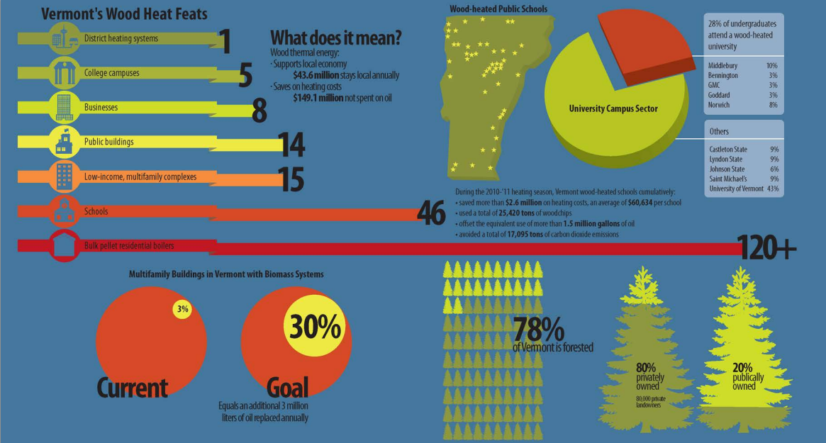
Graphic of wood energy in Vermont
http://www.revermont.org/technology/bioenergy/modernwoodheating/

Slide 5
Demand & supply?
Combined consumption of residue & low-grade wood for pulp, biomass & seasonal heating by chips or cordwood within the study are is estimated at 3.5 million green tons annually.
Today much of this need is met using wood harvested outside the study area.
In study area | Just outside study area | Green tons used annually
1 pulp mill | 3 pulpmills | 750,000
6 biomass power plants | 5 power plants | 1,400,000
Many institutional & commercial heating systems |  | 40,000
Widespread use of firewood for residential heating |  | 1,400,000
Vermont Wood Fuel Supply Study, BERC (2007)
Vermont Wood Fuel Supply Study, BERC (2007); VTWFSS Update (2010)

Slide 6
Calculation of potential supply
USDA Forest Service information about forests in study areas suggests this potential supply.
9.3 million acres of forested land designated ‘timberland’ with:
1.1 billion tons of above-ground biomass;
24.8 million tons of net growth new wood annually
4.8 million tons average annual harvest of all forest products
So, 20 million tons of under-utilized wood produced annually
What portion of that 20 million tons should be harvested and how much is accessible?
Net Available Low-Grade Growth (NALG) spreadsheet tool created:
Rate of forest growth?
Percentage of growth considered low-grade?
Physical & legal accessibility of this biomass?
Political, social & economic feasibility?
Vermont Wood Fuel Supply Study, BERC (2007)
Vermont Wood Fuel Supply Study, BERC (2007); VTWFSS Update (2010)

Slide 7
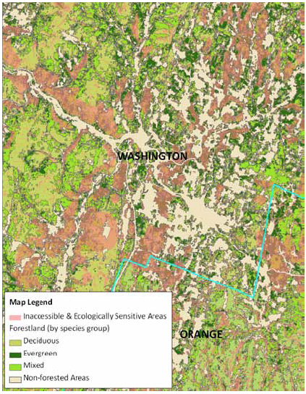
Data & methods
Data:
US Forest Service’s Forest Inventory & Analysis (FIA) program
Methods:
GIS analysis connected to
Spreadsheet analysis
Vermont Wood Fuel Supply Study, BERC (2007);
VTWFSS Update (2010)

Slide 8
Methods
1. Start with forestland acres (2006 NLCD)
2. GIS filtering for physical & ecological features
3. Apply key assumptions: % management by ownership category
4. Calculate forest inventory & composition per acre of timberland
5. Apply net annual growth rate
6. Apply key assumption: % low-grade bole vs. top & limb
7. Calculate net annual growth of low-grade wood on accessible, appropriate & managed forestland
8. Subtract averaged annual harvest of low-grade wood
9. Calculate NALG wood.
Vermont Wood Fuel Supply Study, BERC (2007);
VTWFSS Update (2010)

Slide 9
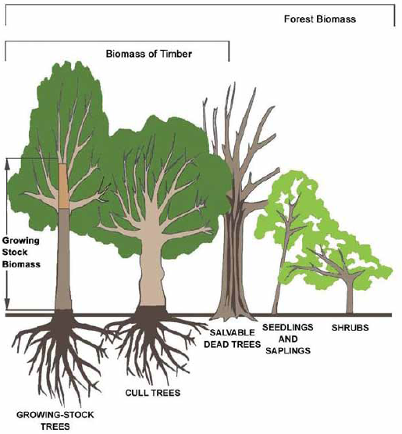
FIA data
FIA data was used for 5” diameter and larger for:
growing stock;
cull; &
non-commercial species.
Excluded:
Standing & downed deadwood;
Seedlings & sapwood;
Foliage;
Stumps; &
Below-ground biomass.
Vermont Wood Fuel Supply Study, BERC (2007);
VTWFSS Update (2010)

Slide 10
FIA net growth
Net growth = in-growth + accretion - mortality
(new trees)
(natural tree death)
(growth of existing trees)
Vermont Wood Fuel Supply Study, BERC (2007);
VTWFSS Update (2010)

Slide 11
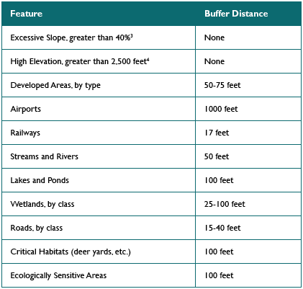
Data filters
The forest footprint was filtered for features that would indicate:
Inaccessibility; or
Inappropriateness.
………….sidebar…………..
Vermont Wood Fuel Supply Study, BERC (2007);
VTWFSS Update (2010)

Slide 12
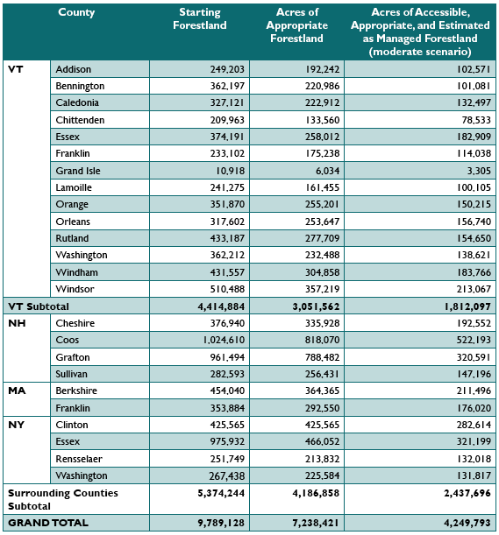
Forestland area
Vermont | %
Inaccessible, inappropriate | 31
Accessible & appropriate; not managed | 28
Accessible, appropriate & managed | 42
………….sidebar…………..
Vermont Wood Fuel Supply Study, BERC (2007);
VTWFSS Update (2010)

Slide 13
NAGL inventory (moderate scenario)
 | Growing stock |  |  | Cull trees |  |  | Total wood
 | boles | tops & limbs | all | boles | tops & limbs | all | boles | tops & limbs | all
Addison | 3,441,891 | 419,333 | 3,861,225 | 1,018,565 | 71,203 | 1,089,769 | 4,460,457 | 490,537 | 4,950,990
Bennington | 5,014,087 | 600,922 | 5,615,010 | 1,003,679 | 76,207 | 1,079,887 | 6,017,767 | 677,129 | 6,694,897
Caledonia | 3,332,124 | 398,610 | 3,730,735 | 1,476,066 | 89,348 | 1,565,414 | 4,808,191 | 487,958 | 5,296,149
Chittenden | 3,068,780 | 376,372 | 3,445,153 | 808,747 | 55,751 | 864,498 | 3,877,528 | 432,123 | 4,309,651
Essex | 4,511,428 | 603,023 | 5,114,451 | 831,097 | 71,912 | 903,010 | 5,342,525 | 674,936 | 6,017,462
Franklin | 3,916,993 | 489,761 | 4,406,754 | 1,108,336 | 72,871 | 1,181,208 | 5,025,329 | 562,633 | 5,587,963
Grand Isle | 251,336 | 31,741 | 283,078 | 22,250 | 2,033 | 24,284 | 273,587 | 33,774 | 307,362
Lamoille | 4,162,847 | 514,832 | 4,677,680 | 1,135,991 | 77,260 | 1,213,251 | 5,298,838 | 592,093 | 5,890,931
Orange | 5,597,063 | 637,203 | 6,234,266 | 1,115,052 | 75,248 | 1,190,301 | 6,712,116 | 712,451 | 7,424,568
Orleans | 3,901,181 | 494,102 | 4,395,284 | 1,525,058 | 107,307 | 1,623,366 | 5,246,240 | 601,410 | 6,027,651
Rutland | 6,814,036 | 812,706 | 7,626,743 | 1,392,758 | 100,529 | 1,493,287 | 8,206,794 | 913,236 | 9,120,030
Washington | 5,044,535 | 609,590 | 5,654,126 | 1,201,157 | 85,493 | 1,295,651 | 6,254,693 | 695,084 | 6,949,777
Windham | 9,205,693 | 1,073,539 | 10,279,232 | 1,380,600 | 91,575 | 1,472,175 | 10,586,293 | 1,165,114 | 11,751,408
Windsor | 9,573,023 | 1,135,837 | 10,708,860 | 1,344,309 | 94,619 | 1,438,929 | 10,917,332 | 1,230,457 | 12,147,789
Total | 67,835,024 | 8,197,579 | 76,032,603 | 15,372,673 | 1,071,363 | 16,444,036 | 83,207,697 | 9,268,942 | 92,476,639
………….sidebar…………..

Slide 14
Most low-grade wood is bole
Some conclusions:
Most NAGL wood is growing stock vs. cull;
And most is bole vs. top and limb;
Net annual growth rates of NAGL are highest in Vermont’s southern counties where they reach 200,000 green tons/year.
Harvest of saw logs has dropped with economic decline.
Harvest of pulpwood has declined due to closure of mills in NH.
………….sidebar…………..
Vermont Wood Fuel Supply Study, BERC (2007); VTWFSS Update (2010)

Slide 15
Harvest of NAGL in Vermont
 | Firewood | Pulp | Woodchips | Total
Addison | 35,026 | 3,600 | 1,141 | 39,766
Bennington | 37,565 | 6,302 | 8,888 | 53,755
Caledonia | 55,762 | 96,282 | 21,719 | 173,763
Chittenden | 56,196 | 3,706 | 19,397 | 79,300
Essex | 24,684 | 30,101 | 12,560 | 67,345
Franklin | 54,890 | 15,045 | 14,263 | 84,198
Grand Isle | 11,796 |  |  | 11,796
Lamoille | 53,434 | 5,934 | 7,650 | 67,018
Orange | 82,886 | 37,541 | 7,650 | 167,732
Orleans | 45,727 | 26,619 | 13,502 | 85,848
Rutland | 31,385 | 17,514 | 2,282 | 51,181
Washington | 80,640 | 16,027 | 12,058 | 108,725
Windham | 72,262 | 17,860 | 826 | 90,948
Windsor | 109,793 | 25,571 | 49,456 | 184,820
Total | 752,045 | 302,102 | 211,047 | 1,265,194
………….sidebar…………..
59% 24% 17%

Slide 16
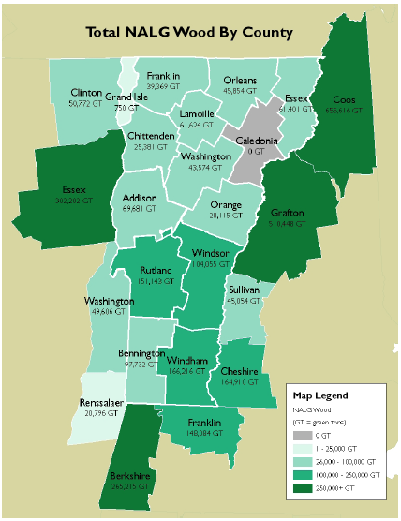
NALG analysis
Spatial distribution of NAGL modeling in the moderate scenario deemed most realistic.
Note that forest cover in some surrounding counties is high and harvest in NH has dropped as mills closed. NY has likely underestimated current harvests for paper mills in Ticonderoga and Glenns Falls
………….sidebar…………..
Vermont Wood Fuel Supply Study, BERC (2007);
VTWFSS Update (2010)

Slide 17
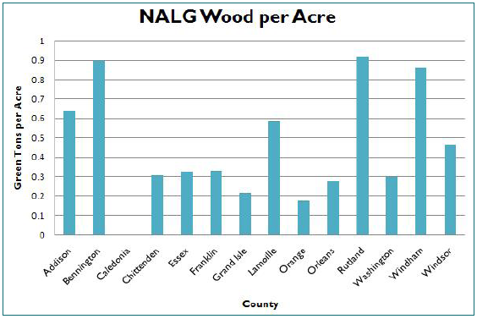
NALG density per county
NALG wood yields shown on a per-acre basis.
Reflects the high levels of low-grade harvest in Caledonia, Orange & Windsor counties.
………….sidebar…………..
Vermont Wood Fuel Supply Study, BERC (2007);
VTWFSS Update (2010)

Slide 18
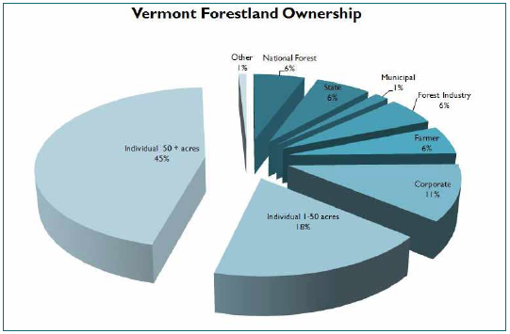
Ownership affects forest management
………….sidebar…………..
Vermont Wood Fuel Supply Study, BERC (2007);
VTWFSS Update (2010)

Slide 19
Ownership affects forest management
Note that parcel size also influences management: parcels of greater than 50 acres are more likely to be harvested than smaller parcels.
 | % actively managed & periodically harvested
ownership | conservative | moderate | intensive
National Forest | 10 | 15 | 20
State | 40 | 55 | 65
Municipal | 40 | 55 | 65
Forest industry | 80 | 90 | 100
Farmer | 65 | 75 | 90
Corporate | 65 | 75 | 90
Individual <50 acres | 15 | 30 | 45
Individual >50 acres | 65 | 75 | 85
Other | 50 | 55 | 60
………….sidebar…………..
Vermont Wood Fuel Supply Study, BERC (2007); VTWFSS Update (2010)

Slide 20
NAGL results
 | conservative | moderate | intensive
Addison | 24,475 | 69,681 | 131,549
Bennington | 40,596 | 97,732 | 188,040
Caledonia | - | - | 7,058
Chittenden | - | 25,381 | 69,249
Essex | 20,083 | 61,401 | 133,513
Franklin | 1,271 | 39,369 | 105,578
Grand Isle | - | 750 | 1,963
Lamoille | 14,467 | 61,624 | 134,513
Orange | - | 28,115 | 98,648
Orleans | 4,225 | 45,854 | 120,391
Rutland | 66,614 | 151,143 | 269,166
Washington | - | 43,574 | 131,660
Windham | 57,930 | 166,216 | 314,943
Windsor | 17,138 | 104,055 | 234,928
Vermont total | 246,799 | 894,893 | 1,940,695
Study total | 1,332,419 | 3,107,597 | 5,822,497
………….sidebar…………..
Vermont Wood Fuel Supply Study, BERC (2007); VTWFSS Update (2010)

Slide 21
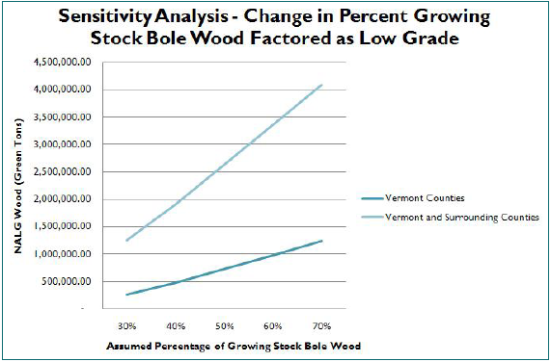
NAGL is sensitive to assumptions
The results of the VTWSSF study are dependent on a host of variables that include assumptions. Some of these assumptions can vary widely with interpretation.
For example, if a group of foresters walk through a plot each may estimate a different percent of growing stock bole wood.
These differences change the inventory of NAGL green tons.
………….sidebar…………..
Vermont Wood Fuel Supply Study, BERC (2007)
Vermont Wood Fuel Supply Study, BERC (2007); VTWFSS Update (2010)

Slide 22
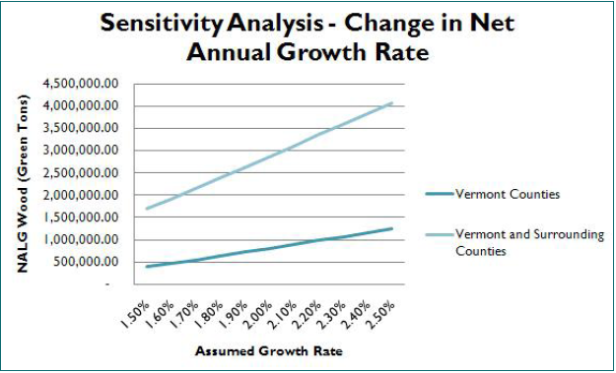
Effect of changing forest growth rate?
The NALG model uses a constant annual growth rate.
If that rate is changed over the 10-year study period, the inventory of NAGL wood is dramatically changed.
………….sidebar…………..
Vermont Wood Fuel Supply Study, BERC (2007); VTWFSS Update (2010)

Slide 23
Economic analysis: chip cost
There are two types of wood chips:
Residue chips, a co-product of activities; and
Chips produced from wood harvested for fuel
Whole-tree chips
Bole chips
Increased demand won’t increase the production of residue chips, but will increase the amount of chips produced for energy production.
The economics of wood chips were studied under three conditions:
Current product mix maintained under integrated harvesting;
Increased demand for low-grade wood under integrated harvesting; and
Complete independence from integrated harvesting (ie harvesting low-grade wood exclusively.
………….sidebar…………..
Product | $/green ton
Bole chips | $40 - $64
Whole-tree chips | $30 - $40
Higher costs occur when low-grade wood is harvested for energy rather than as part of integrated harvesting.
Vermont Wood Fuel Supply Study, BERC (2007)
Vermont Wood Fuel Supply Study, BERC (2007); VTWFSS Update (2010)

Slide 24
VTWFSS conclusions
Vermont’s biomass supply is produced as a co-product of forest harvesting.
Vermont’s forests have the capacity to sustain some additional biomass fuel harvest: 0.25 – 1.9 million green tons.
Some counties have greater capacity than others.
The future of the pulp and paper industry will effect the harvest & cost of biomass for heating.
Higher prices paid for wood fuel will increase harvest and reliability of biomass supply.
Bole- & whole-tree chips may become a commodity on their own rather than as a co-product.
Loggers & mills are barely surviving.
Average age of loggers is 45.
There are no new sawmills in Vermont.
Pulp mill activity is decreasing.
Vermont Wood Fuel Supply Study, BERC (2007)
Vermont Wood Fuel Supply Study, BERC (2007); VTWFSS Update (2010)

Slide 25
Capacity to expand wood energy in VT?
What are the implications of some additional “low-grade” wood fuel?
250,000 – 900,000 additional green tons per year in sustainable scenarios.
The conservative amount wouldn’t even fire one large electric generation facility.
The high estimate would supply several power stations, OR
could be used to hat all of the states schools
and heat more homes;
plus heating districts like Monteplier and Brattleboro.
Vermont must use this small additional supply wisely and sustainably.
Decentralized use would spread the economic benefits across the state.
Vermont’s forests and our energy future, National Wildlife Federation and VNRC

