Slide 1
MEC 3040: Bioenergy
Module 2A: Woody biomass resources
2.1: Recap: What is woody biomass
2.2: Use and benefits of woody biomass
2.3: Sources of bioenergy biomass
2.4: Wood resources
2.5: Study of wood energy resources in Vermont
2.6: Role of woody biomass in the Northern Forest region
2.7: Harvesting, transporting & storage of woody biomass
2.8: Northern Forest recommendations for biomass use
2.9: Future of woody biomass

Slide 2
2.6: Role of woody biomass in the Northern Forest region?

Slide 3
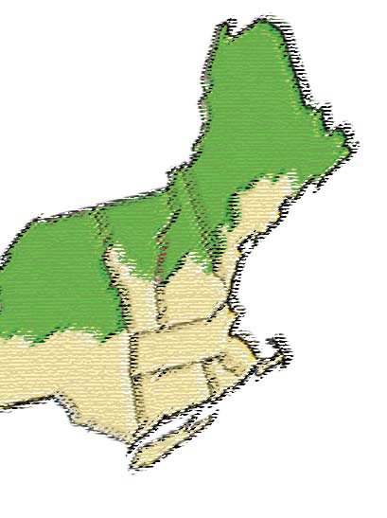
The Northern Forest region
The Northern Forest region encompasses northern Maine, New Hampshire, Vermont and New York
More than 26 million acres of forestland.
The largest contiguous forested region in eastern US.
Valuable resource for both man and wildlife.
Previously exploited for timber & then pulp & paper.
What’s the future here?
Will the region become a leader in sustainable biomass use?
Or will biomass use exploit the forests & lead to boom-and bust economic cycles?
Roadmap to a sustainable energy future for the Northern Forest Region, BERC (2009)
Northern forest biomass energy action plan, BERC (2007)

Slide 4
Vision of the future
In 2007, meetings of stakeholders in the Northern Forest region developed a vision and principles for a local biomass energy future of the region.
This vision has five guiding principles:
Sustainable forestry: to keep the forest healthy and allow harvest that supports overall ecological function and integrity of the forest ecosystem.
Maximized efficiency: to ensure that the energy value of harvested biomass will be utilized as fully and cleanly as possible.
Local energy: to use local wood resources for community & regional needs at the appropriate scale.
Energy security: to provide communities & businesses with a stable, consistent & affordable supply of clean energy using local resources.
Climate change mitigation: to reduce net carbon emissions and increase carbon sequestration to mitigate global warming.
Northern forest biomass energy action plan, BERC (2007)

Slide 5
Purpose of recommendations
A group of 17 recommendations serve to:
Encourage private-sector initiatives inspired by public-sector leadership & support.
Emphasize public- and private-sector partnerships that leverage action and investment in each sector while adding substantial value for private industry, government and local communities.
Address issues of interest to large forestland owners (pubic & private) as well as small private landowners aka ‘family forest landowners’.
………….sidebar…………..
Northern forest biomass energy action plan, BERC (2007)

Slide 6
Wood supply
To understand the capacity of the forest to supply woody biomass sustainably and to guard against overharvesting.
Assess the amount of low-quality woody biomass available on a long-term sustainable basis.
Track wood harvest and compare with forest growth annually for optimal management.
………….sidebar…………..
Northern forest biomass energy action plan, BERC (2007)

Slide 7
Harvest & procurement
To support sustainable forest management
3. Fund state & federal agencies to practice sustainable forest management on
public lands.
4. Strongly support sustainable forest management on public lands through
voluntary approaches.
5. Develop model wood fuel procurement standards to ensure sustainable
harvest.
………….sidebar…………..
6. Maintain, support & expand existing forest harvesting & wood-product
supply infrastructure through workforce development & training, policies,
incentives, etc.,.
7. Expand education & outreach to forestland owners, the public & others
about sustainable forest stewardship & the benefits of clean biomass
energy.
Northern forest biomass energy action plan, BERC (2007)

