Slide 1
MEC 3040: Bioenergy
Module 2A: Woody biomass resources
2.1: Recap: What is woody biomass
2.2: Use and benefits of woody biomass
2.3: Sources of bioenergy biomass
2.4: Wood resources
2.5: Study of wood energy resources in Vermont
2.6: Role of woody biomass in the Northern Forest region
2.7: Harvesting, transporting & storage of woody biomass
2.8: Northern Forest recommendations for biomass use
2.9: Future of woody biomass

Slide 2
2.7: Harvest, transportation & storage of woody biomass

Slide 3
Scale
The specialized equipment used to harvest and process woody biomass for energy requires considerable capital investment and limits the scale of operations that can be profitable.
In North America, most operations are large-scale and quite mechanized.
Equipment:
feller/bunchers
skidders
harvesters
chippers
How much acreage makes an operation profitable? This depends on a number of factors like:
volume & quality of wood;
access to roads & markets; and
ease of geography.
Ideally product & residues are collected in either one or two passes without moving the equipment.
Dahiya (2015)

Slide 4
Transportation
Ease of transportation depends on the condition, size and weight of the biomass.
Moisture & grit content matter.
Typically, wood is processed on-site into smaller pieces for transportation using:
chippers;
shredders; and
grinders.
Wood that has been broken down this way is said to be ‘comminuted’.
Smaller pieces of wood also dry more quickly; moisture reduction is a critical part of processing.
Most processed biomass is transported by truck.
Dahiya (2015)

Slide 5
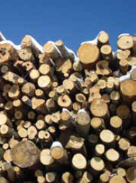
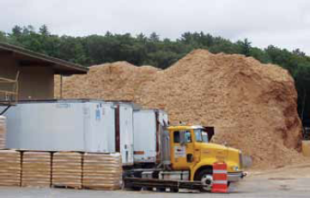
Storage
Ideally woody biomass is used as received without the need for long-term storage.
Long-term storage of damp or wet woody biomass can result in:
Growth of mold and fungi; and
Significant heating (as decomposition begins).
Heat of decomposition can cause piles of stored chips or sawdust to self-ignite.
Dahiya (2015)

