Slide 1
MEC 3040: Bioenergy
Module 2A: Woody biomass resources
2.1: Recap: What is woody biomass
2.2: Use and benefits of woody biomass
2.3: Sources of bioenergy biomass
2.4: Wood resources
2.5: Study of wood energy resources in Vermont
2.6: Role of woody biomass in the Northern Forest region
2.7: Harvesting, transporting & storage of woody biomass
2.8: Northern Forest recommendations for biomass use
2.9: Future of woody biomass

Slide 2
2.8: Northern Forest region recommendations on use of woody biomass

Slide 3
Where does biomass energy fit in?
Reducing fossil fuel consumption by 5% per year over the next 40 years would cut carbon emissions by 50% by 2030 and by 80-90% by 2050.
To enhance use of biomass energy:
Develop policy & financing that supports clean & efficient biomass to heat institutions, communities & businesses.
Inventory low-quality woody biomass for sustainable energy use.
Support local ownership of biomass with public benefits by creating energy service companies that allow local capital investment & equity while providing technical, financial, regulatory & permitting expertise.
Create a Northeast Biomass Energy Incubator.
Roadmap to a sustainable energy future for the Northern Forest Region, BERC (2009)

Slide 4
Efficient technology
To encourage clean & efficient use of biomass fuel & improve technologies that are matched to community-scale use.
8. Create & fund a ‘Northeast Biomass Incubator Center’ to commercialize
and support development & implementation of clean, efficient biomass
energy.
9. Create / expand grants, incentives, etc., to develop & implement clean,
efficient biomass energy technologies.
10. Ensure that state & federal policies & programs aimed at RE – RPS,
REC, SBC – include clean, efficient biomass technologies.
………….sidebar…………..
Northern forest biomass energy action plan, BERC (2007)

Slide 5
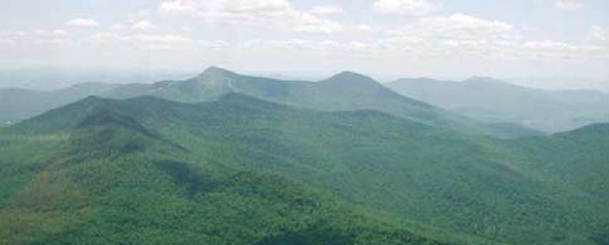
Emissions
To ensure that biomass energy is used in ways that meet or exceed air emission regulations.
11. Establish consistent state & federal air emission standards for biomass
facilities; multi-pollutant including carbon.
………….sidebar…………..
Northern forest biomass energy action plan, BERC (2007)

Slide 6
Climate change mitigation
To increase carbon sequestration & decrease atmospheric carbon dioxide levels by supporting utilization of woody biomass to replace or offsett fossil fuels.
12. Evaluate & document the carbon cycles of biomass energy to increase
understanding and work to carbon neutrality and sequestration.
13. Use state, regional or national carbon registries to measure, aggregate or
verify carbon offsets. Dovetail with national & international carbon
markets.
14. Support & expand national, regional, state & municipal carbon
sequestration & reduction policies & incentives like RGGI and carbon
taxes. Identify the role of biomass energy.
………….sidebar…………..
Northern forest biomass energy action plan, BERC (2007)

Slide 7
Investment & financing
To stimulate the purchase & use of a variety of clean, efficient biomass energy technologies & develop biomass energy projects that enhance local economies.
15. Create or expand federal & state financing mechanisms to capitalize
and support use of clean, efficient biomass energy in publically owned
facilities.
16. Develop public policy mechanisms & financial incentives to support
the use of clean, efficient biomass in thermal applications for
institutions, communities & businesses.
………….sidebar…………..
17. Support local ownership of biomass energy projects that deliver public
benefits by encouraging the creation of energy service companies that
allow local capital investment & provide assistance & expertise.
Northern forest biomass energy action plan, BERC (2007)

