Slide 1
MEC 3040: Bioenergy
Module 2A: Woody biomass resources
2.1: Recap: What is woody biomass
2.2: Use and benefits of woody biomass
2.3: Sources of bioenergy biomass
2.4: Wood resources
2.5: Study of wood energy resources in Vermont
2.6: Role of woody biomass in the Northern Forest region
2.7: Harvesting, transporting & storage of woody biomass
2.8: Northern Forest recommendations for biomass use
2.9: Future of woody biomass

Slide 2
2.9: Future of wood biomass

Slide 3
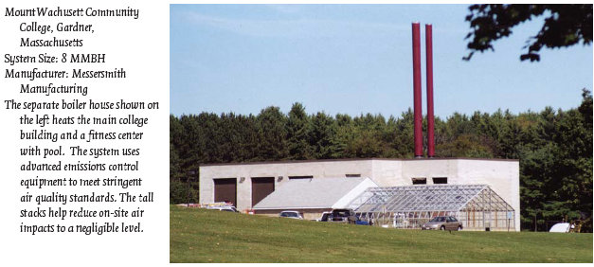
Trend in biomass burning
1980s: Installation of integrated fuel handling & combustion systems that worked smoothly in schools, hospitals, commercial buildings
Early 1990s: Improvements in efficiency and cleaner emissions
Late 1990s, early 2000s: Improved reliability and ease of operations
Wood-chip heating systems: a guide for institutional and commercial biomass installations, BERC (2004)

Slide 4
New uses: district heating
District heating plants: use of a central plant with buried piping to heat a district or group of buildings.
Common on college campuses
St. Paul, MN (hot water)
Government complexes in Waterbury & Montpelier VT (steam)
Scandinavia
Charlottetown PEI
50-apartment low-income housing in Barre, VT ($26/month heat/hot water)
Wood-chip heating systems: a guide for institutional and commercial biomass installations, BERC (2004)

Slide 5
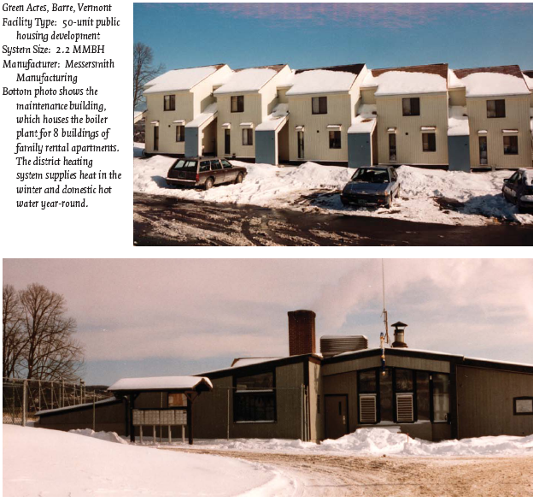
New uses: district heating
Wood-chip heating systems: a guide for institutional and commercial biomass installations, BERC (2004)

Slide 6
New uses: gasification
Gasification: wood fuel is heated without oxygen to release combustible gases that are cooled and cleaned to produce a bio-gas that can be stored & transported.
Gasification would make production of electricity by wood more efficient, particularly with a CHP system.
Bio-gas can also be used in micro-turbines & fuel cells.
Wood-chip heating systems: a guide for institutional and commercial biomass installations, BERC (2004)

