Slide 2
MEC 3040: Bioenergy
Module 3A: Cordwood and woodchip heating
3.1: EROEI – energy return on energy investment
3.2: Residential heating: a case for cord wood
3.3: Efficient cord wood heating systems
3.4: Buyer’s guide to wood chip energy
3.5: Wood chip heating systems
3.6: Economic analysis of wood chip systems
3.7: Operating and maintaining a wood chip system

Slide 3
3.1: Energy return on energy investment (EROEI)

Slide 4
EROI values
Energy return on investment values show how much energy is produced by a fuel as a ratio of the amount of energy used to produce the fuel.
The higher the EROI the better.
Fuel | EROI
domestic oil (1930) | 100:1
coal (2005) | 80:1
hydroelectric | 40:1
Imported oil (1970) | 38:1
domestic oil (1970) | 37:1
firewood | 30:1
Imported oil (2005) | 30:1
wind | 28:1
natural gas | 16:1
nuclear energy | 16:1
domestic oil (2000) | 9:1
solar photovoltaic | 6:1
tar sands | 6:1
biodiesel and ethanol | 2:1
Energy return on investment (EROI) of different wood products, Pandur et al.

Slide 5
Wood fuel comparisons (2012, 2019)
How do values for wood stack up?
Less processing allows greater EROEI values.
Fuel | Price | Thermal efficiency | $/Mbtu* | EROEI
cord wood | $200-300/cord | 50 - 60% | $15.15 | 50:1
wood chips | $80/ton | 30% |  | 18:1
wood pellets | $260/ton | 80 - 85% | $15.15 | 15:1
co-op wood pellets | $120/ton | 80 - 85% | $9.09 | 15:1
fuel oil | $2.81/gallon | 70% | $41.20 | 9:1
natural gas | $17.07/TCF | 80% | $54.74 | 16:1
* $/million Btu
EROEI = energy return on energy investment: EROEI depends on distance transported & system efficiency
Other studies find higher whole-tree wood chip EROI values of ~27:1
Vermont sustainable heating initiative (2012)
Residential wood heat: a non-commercial service in support of responsible home heating with wood (2016)

Slide 6
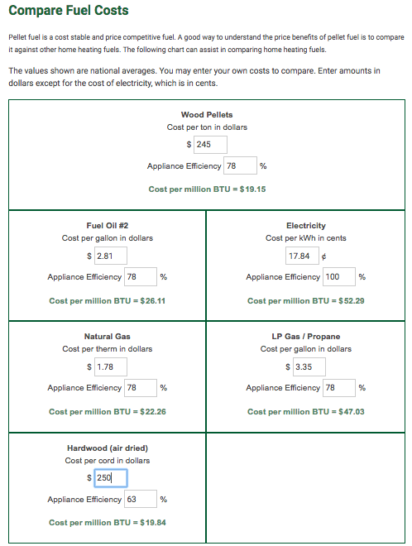
Fuel comparisons (2019)
A number of websites provide comparison tools.
This screenshot uses approximate Vermont costs in September of 2019.
https://www.pelletheat.org/compare-fuel-costs

