Slide 1
MEC 3040: Bioenergy
Module 3B: Wood pellet heating
3.8: Wood pellets & current use
3.9: Two wood pellet heat case studies
3.10: Bulk delivery
3.11: Pellet stoves
3.12: Pellet boilers
3.13: Air emissions, permitting & ash
3.14: Economics of wood pellet heating
3.15: Recent wood pellet projects

Slide 2
3.10: Bulk delivery

Slide 3
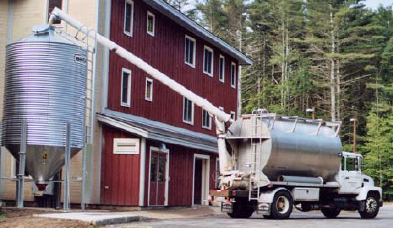
Bulk delivery considerations
Bulk delivery is very convenient for the user as most storage systems automatically feed pellets to the stove or boiler and require little work by the users.
However, bulk delivery and storage require a reliable supplier. When finding a supplier consider the following issues:
Delivery distance: less than 50 miles optimally;
Commitment to the bulk market;
Guarantee of a reliable supply;
Quality of pellets: avoid pellets produced from construction & demolition waste and be sure that pellet quality is compatible with the heating equipment you choose.
Wood pellet heating: a reference on wood pellet fuels & technology for small commercial & institutional systems

Slide 4
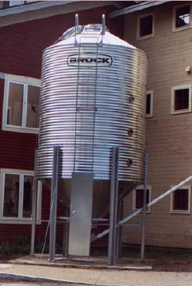
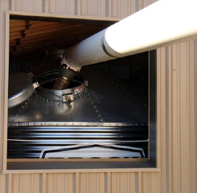
Sizing a pellet storage silo
Consider installing a silo capable of storing more than the pellet delivery truck used by your supplier, maybe 1.5x larger.
This will allow you to accept delivery before the current supply of pellets is depleted.
Silos are available in increments of 10, 15, 25 or 35 tons.
Use a minimum silo size of 15 tons for small commercial or institutional boilers.
While most silos are located outside of the building they supply, they can be housed in structures.
Wood pellet heating: a reference on wood pellet fuels & technology for small commercial & institutional systems

