Slide 1
MEC 3040: Bioenergy
Module 3B: Wood pellet heating
3.8: Wood pellets & current use
3.9: Two wood pellet heat case studies
3.10: Bulk delivery
3.11: Pellet stoves
3.12: Pellet boilers
3.13: Air emissions, permitting & ash
3.14: Economics of wood pellet heating
3.15: Recent wood pellet projects

Slide 2
3.12: Pellet boilers

Slide 3
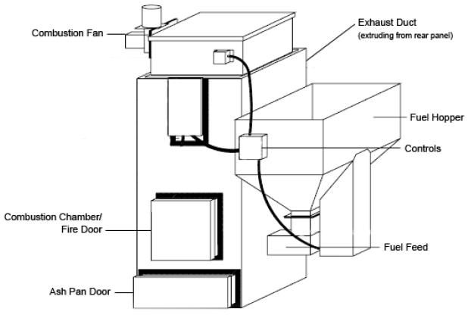
Wood pellet boilers
or auger from storage
Wood pellet heating: a reference on wood pellet fuels & technology for small commercial & institutional systems

Slide 4
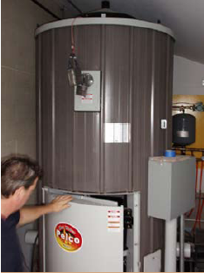
Boiler components (1)
Combustion chamber (fire door) Where pellets are burned to produce heat.
Accessible via fire door.
Combustion fan
Provides air to the combustion chamber.
Primary controls
Controls flow of pellets & air into the combustion chamber & reads boiler & exhaust temperatures.
Fuel hopper & feed system
Automatic conveyer from storage bin; or
Feed system from a manual fuel hopper.
Exhaust duct
Combustion exhaust gases are removed via a duct in the rear of the system & then through a chimney.
Wood pellet heating: a reference on wood pellet fuels & technology for small commercial & institutional systems

Slide 5
Boiler components (2)
OPTIONAL
Ash removal system
Automatic soot-cleaning system
Connections:
The exhaust system connects to a new or existing high-temperature chimney.
The boiler connects to the buildings hot water heat distribution system.
Wood pellet heating: a reference on wood pellet fuels & technology for small commercial & institutional systems

Slide 6
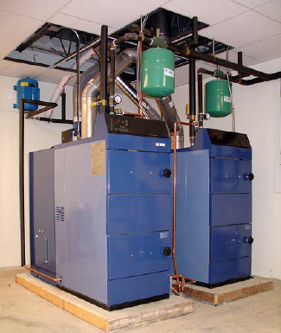
Sizing a boiler system
Any boiler system should be sized to produce enough heat to meet the peak demands of the building.
Peak demand depends on:
Building size;
Building efficiency; and
Climate.
For new buildings, consult a mechanical or building engineer or a heating system consultant or contractor.
For existing buildings, gather several seasons of heating fuel bills & data on climate like number of heating degree days.
If possible, weatherize the building before installing a new heating system.
Wood pellet heating: a reference on wood pellet fuels & technology for small commercial & institutional systems

Slide 7
More than one building?
Wood pellet boilers can be used to heat small district systems: several buildings located close to one another.
The boiler is located in the most central building.
Buried hot water distribution pipes connect to the other buildings.
Creation of small districts tend to maximize cost savings as a single boiler system needs to be purchased, installed and maintained.
Wood pellet heating: a reference on wood pellet fuels & technology for small commercial & institutional systems

Slide 8
Operating & maintenance?
Wood pellet boilers are relatively simple systems, but they will require more maintenance than traditional fossil fuel or electric heating systems.
Usually estimated as 15 – 30 minutes of operator time per day
For a bit more of a capital investment boiler systems can include components that automate some cleaning and save time.
Weekly tasks:
Empty ash containers;
Monitor temperatures, fuel use;
Check settings & alarms.
Annual tasks:
Grease augers, gear boxes, other moving parts;
Check for wear on conveyors, augers, motors, & gear boxes.
Wood pellet heating: a reference on wood pellet fuels & technology for small commercial & institutional systems

