Slide 1
MEC 3040: Bioenergy
Module 3B: Wood pellet heating
3.8: Wood pellets & current use
3.9: Two wood pellet heat case studies
3.10: Bulk delivery
3.11: Pellet stoves
3.12: Pellet boilers
3.13: Air emissions, permitting & ash
3.14: Economics of wood pellet heating
3.15: Recent wood pellet projects

Slide 2
3.13: Air emissions, permitting & ash

Slide 3
Air emissions?
Like all fuels, wood produces a number of air emissions:
Particulate matter (PM);
Carbon monoxide (CO);
Nitrogen oxides (NOx); &
Sulfur oxides (SOx)
← Increased with wood vs. fossil fuel
← Decreased with wood vs. fossil fuel
Partial emissions data for wood pellets from a Danish study.
lb / million Btu | PM10 | CO | NOx | SOx
Wood pellet boiler | NA | 0.51 | 0.272 | NA
Wood chip boiler | 0.1 | 0.73 | 0.165 | 0.0082
Oil boiler | 0.014 | 0.035 | 0.143 | 0.5
Propane boiler | 0.004 | 0.021 | 0.154 | 0.016
Natural gas boiler | 0.007 | 0.08 | 0.09 | 0.0005
Wood pellet heating: a reference on wood pellet fuels & technology for small commercial & institutional systems

Slide 4
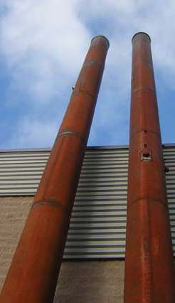
Permitting pellet boilers in MA
MA has air emission regulations that all combustion equipment must meet.
Boilers larger than 3 million Btu / hour need an operating permit.
Smaller boilers do not need this permit.
However, MA Department of Environmental Protection (DEP) may require plan approval for boilers.
Contact the DEP during the planning phase and before you purchase a boiler.
Plan approval may require installation of emissions control technology.
Wood pellet heating: a reference on wood pellet fuels & technology for small commercial & institutional systems

Slide 5
Ash
MA considers wood ash from commercial or institutional sources to be a solid waste and it may therefore be subject to hazardous waste rules.
However, only ash from pellets made from construction and demolition debris is subject to such regulation.
In MA, the DEP Bureau of Waste Prevention-Business Compliance Division must issue a “beneficial use determination” in order to approve any use of ash from pellet boilers.
Potential beneficial uses of ash?
Fertilizer for lawns or athletic fields;
Soil amendment; &
Composting.
Inappropriate use may lead to accumulation of excess nutrients and nutrient runoff.
Wood pellet heating: a reference on wood pellet fuels & technology for small commercial & institutional systems

