Slide 1
MEC 3040: Bioenergy
Module 3B: Wood pellet heating
3.8: Wood pellets & current use
3.9: Two wood pellet heat case studies
3.10: Bulk delivery
3.11: Pellet stoves
3.12: Pellet boilers
3.13: Air emissions, permitting & ash
3.14: Economics of wood pellet heating
3.15: Recent wood pellet projects

Slide 2
3.14: Economics of wood pellets

Slide 3
Heating fuel equivalencies
One ton of wood pellets equals:
120 gallons of heating oil;
170 gallons of propane;
16,000 cubic feet of natural gas; or
4,775 kWh of electricity.
A price of $200/ton for pellets is the equivalent of these fuel prices:
$1.67 per gallon for heating oil;
$1.18 per gallon for propane;
$12.50 per 1000 cubic feet for natural gas; or
$0.04 per kWh for electricity.
Over the last 20 years, only natural gas has been competitive with wood pellets.
Wood pellet heating: a reference on wood pellet fuels & technology for small commercial & institutional systems

Slide 4
Calculating potential fuel cost savings
Step 1: Calculate total fuel use and costs.
(total fuel units used annually)(current fuel price) = current annual fuel bill
(5,000 gallons of heating oil)($2.03/gallon) = $10,150
Step 2: Calculate how many tons of pellets will be required to replace current fuel.
total fuel units used annually = tons * $price = $ annual pellet cost
fuel units per ton year ton
5,000 gallons of heating oil = (41.67 tons)($260/ton) = $10,833.33
120 gallons/ton
Step 3: Calculate potential fuel savings
Potential cost savings = $ annual pellet cost - $ current annual fuel bill
$10,150 - $10,833 = - $683
Wood pellet heating: a reference on wood pellet fuels & technology for small commercial & institutional systems

Slide 5
Economic analysis of wood pellet heat
When are pellet boilers cost effective? Life cycle cost (LCC) or analysis incudes fuel costs, inflation rates, projected costs and calculates the net present value (NPV) of savings over the life of the pellet boiler system.
Spreadsheet-based LCC analysis tools are available from:
BERC
National Resources Canada (RETScreen)
Universities of Wisconsin and Alaska
Select architects & engineers
Wood pellet heating: a reference on wood pellet fuels & technology for small commercial & institutional systems

Slide 6
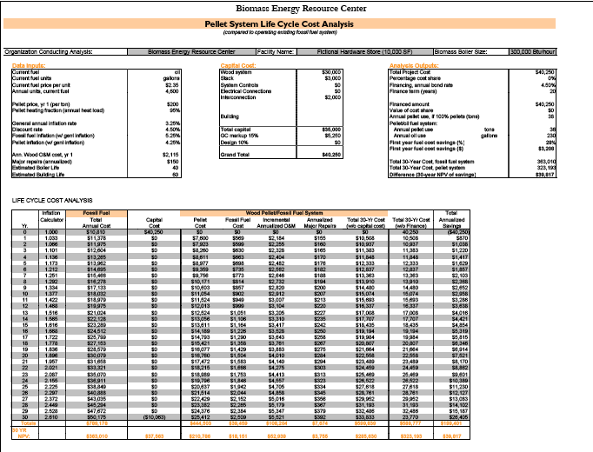
BERC LCC
Wood pellet heating: a reference on wood pellet fuels & technology for small commercial & institutional systems

Slide 7
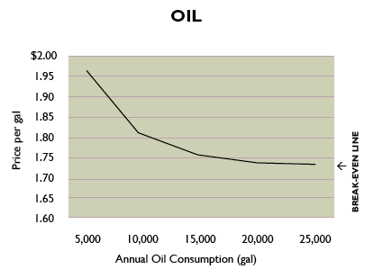
Plot LCC of wood vs. alternate fuel
The line on the graph represents the break-even point: where the wood pellet system costs as much as it saves over the 30-year life of the system.
wood pellets are cost effective
wood pellets are not cost effective
Wood pellet heating: a reference on wood pellet fuels & technology for small commercial & institutional systems

Slide 8
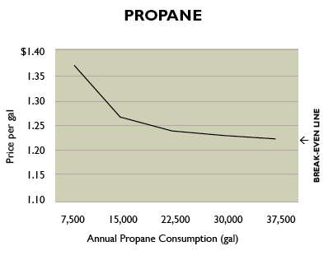
Plot LCC of wood vs. alternate fuel
The line on the graph represents the break-even point: where the wood pellet system costs as much as it saves over the 30-year life of the system.
wood pellets are cost effective
wood pellets are not cost effective
Wood pellet heating: a reference on wood pellet fuels & technology for small commercial & institutional systems

Slide 9
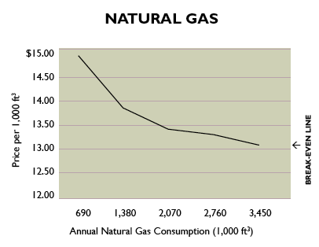
Plot LCC of wood vs. alternate fuel
The line on the graph represents the break-even point: where the wood pellet system costs as much as it saves over the 30-year life of the system.
wood pellets are cost effective
wood pellets are not cost effective
Wood pellet heating: a reference on wood pellet fuels & technology for small commercial & institutional systems

Slide 10
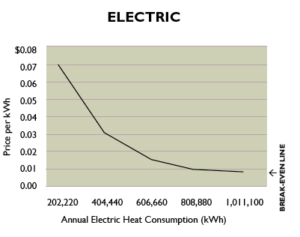
Plot LCC of wood vs. alternate fuel
The line on the graph represents the break-even point: where the wood pellet system costs as much as it saves over the 30-year life of the system.
wood pellets are cost effective
wood pellets are not cost effective
Wood pellet heating: a reference on wood pellet fuels & technology for small commercial & institutional systems

Slide 11
Detailed LCC analysis?
Complete wood pellet systems typically cost $75,000 – 100,000 per million Btu.
Includes:
System equipment & installation;
Fuel storage & handling system & installation;
Construction;
Site costs;
Chimney equipment & installation;
Emissions permit or control equipment;
Professional fees (like engineering); and
Connection of controls & piping to existing heat distribution system.
LCC analysis should include O&M costs:
30’ per day for the staff who operates the system; &
Routine parts and or service.
Wood pellet heating: a reference on wood pellet fuels & technology for small commercial & institutional systems

Slide 12
Fictional LCC: hardware store
A hardware store is located within 50 miles of a wood pellet distribution center. The store is roughly 10,000 SF and uses 4,600 gallons of heating oil per year at an average cost of $2.35 per gallon. This is an annual heating cost of $10,810. The cost of pellets is $200 per ton, delivery charges included.
LCC calculates the total project cost, including fuel, at $39,817 and shows that the store would save $3,208 (28%) during the first year of operation.
This translates to $45,000 over 30 years.
This LCC analysis suggests going forward with installation.
Wood pellet heating: a reference on wood pellet fuels & technology for small commercial & institutional systems

Slide 13
Fictional LCC: Town Hall
The Town Hall is a municipal building located within 50 miles of a wood pellet distribution center. The building houses a variety of town offices within its 30,000 SF. The space is heated by one central boiler. The price of oil is $2.35 per gallon. Pellets would cost $200 per ton.
LCC shows that the Town Hall would require 110 tons of pellets per year and that a pellet system would cost $124,200.
First-year fuel savings would be 28 percent.
This translates to $211,722 over 30 years.
This LCC analysis suggests going forward with installation.
Wood pellet heating: a reference on wood pellet fuels & technology for small commercial & institutional systems

