Slide 1
MEC 3040: Bioenergy
Module 3C: Grass biomass heating
3.16: Grass biomass densification and combustion
3.17: Vermont study of energy grass densification &
combustion
3.18: Conversion of grass to liquid biofuels
3.19: Economic considerations for grass biomass

Slide 2
3.17: Vermont study of energy grass densification & combustion

Slide 3
Collaborative study of grass biofuel
The Vermont Grass Energy Partnership conducted a study to learn more about:
Growing & harvesting perennial grasses;
Pre-processing & densifying the grasses;
Combustion of densified grass, and grass-wood blends; &
Air emissions from the combustion.
Three perennial hay grasses were studied:
Switchgrass (Panicum vigratum) A promising biomass grass not typically grown in Vermont
Reed Canarygrass (Phalaris arundinacea) Common in Vermont & adapted to many conditions including wet, marginal soil
Mulch hay Hay that is too poor in quality to serve as livestock feed
Technical assessment of grass pellets as boiler fuel in Vermont, BERC (2011)

Slide 4
Harvesting
Some harvest energy grass in the fall and some in the spring.
In the spring, the crop is dry, and the new growth can be fertilized as it begins to come up through the fresh stubble.
Leaving the grass in the field over the winter probably allows nutrients to be reabsorbed by the roots and may lower ash content.
If mowed in the fall, the grass can be left on the ground over the winter to allow the minerals to leach back into the soil.
After baling, moisture content is about 6-8%. But optimal pelletizing requires 12 – 15% moisture. Leaving bales outdoors allows moisture to seep back in.
Store bales on pallets and cover with a tarp to prevent too much moisture.
On-farm production of biomass grass pellets, Penn State Extension, (2014)

Slide 5
Processing & densification
The pelletizing process:
40-lb bales were chopped by study personnel.
The chopped hay was reground, blended, dried & pelletized by the Vermont Wood Pellet Company in North Clarendon, VT
Chemical and mineral testing was performed by Twin Ports Testing, Inc.
pellets | 100% | 25%* | 12%* | 6%*
switchgrass | ✔ | ✔ | ✔ | ✔
Reed canarygrass | ✔ | ✔ | ✔ | ✔
mulch hay | ✔ | ✔ | ✔ | ✔
* % grass in wood blend
The 100% grass pellets had less structural integrity than wood pellets or wood/grass blends. This is probably due to the lower lignin content of grass.
Technical assessment of grass pellets as boiler fuel in Vermont, BERC (2011)

Slide 6
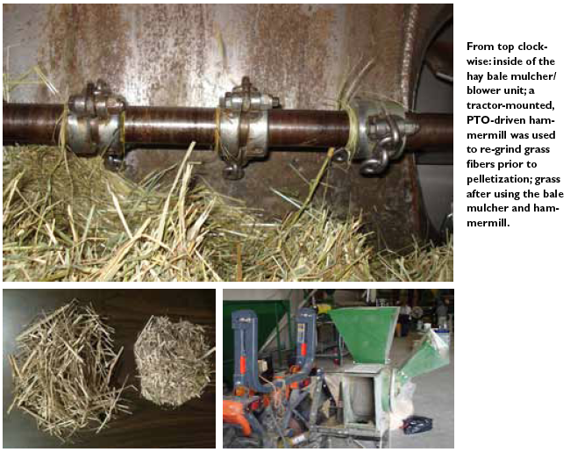
Processing & densification
Technical assessment of grass pellets as boiler fuel in Vermont, BERC (2011)

Slide 7
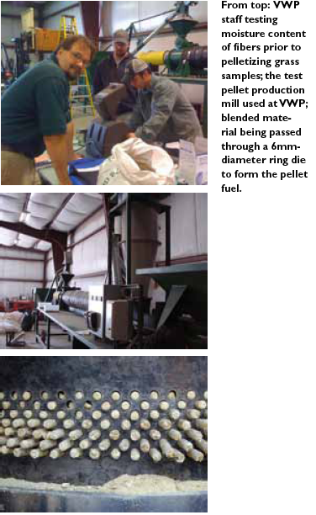
Processing & densification
Technical assessment of grass pellets as boiler fuel in Vermont, BERC (2011)

Slide 8
Processing & densification
bale at 12-14% moisture
While wood has 22 – 24% lignin, switchgrass has less, 12 – 15%.
But grass still forms pellets without added binders.
bale buster = coarse chopping
coarse chopped
¼” screen hammer mill
1/4” chopped
10” warm-up
pellet mill
> 80°C, lignin melts & gets tacky
pellet production starts
Ending the pellet run with low-lignin feedstock like soymeal will purge the die & prevent build up of hard lignins.
cooling
bagging
On-farm production of biomass grass pellets, Penn State Extension, (2014)

Slide 9
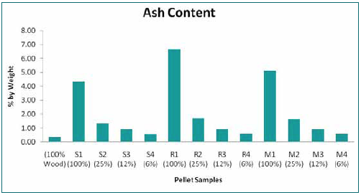
Ash content
The grass pellets had dramatically higher ash content (4.3 – 6.7%) than premium grade wood pellets.
100% grass pellets would be classified as utility- or industrial-grade wood pellets.
100% reed canarygrass pellets had ash contents to high for classification.
Switchgrass had the lowest ash content (4.3%) of all the grasses.
The grass-wood blend pellets had lower ash content than 100% grass pellets.
Technical assessment of grass pellets as boiler fuel in Vermont, BERC (2011)

Slide 10
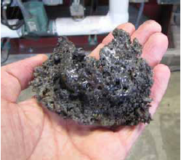
Energy content, clinkers & emissions
The energy content of grass pellets was quite comparable to that of wood pellets.
Energy content
wood | 100%
switchgrass | 102%
Reed canarygrass | 90%
mulch hay | 92%
However, fused minerals (aka clinkers) formed during test combustion of the grass pellets.
Grasses had higher concentrations of N, S and Cl than wood, creating more potential emissions:
NOx
SOx
Corrosive chlorine-containing gases.
Stack emission tests confirmed higher Nox & ash (particulate) emissions.
Technical assessment of grass pellets as boiler fuel in Vermont, BERC (2011)

Slide 11
‘Real world’ combustion tests
The longer ‘real world’ combustion tests lasted three hours and boiler performance was monitored.
All grass pellets could be combusted.
Mulch hay combustion was a challenge.
Even switchgrass pellets produced clinkers that blocked new fuel feed and air flow in the combustion chamber.
The best combustion was achieved for grass/wood blends with the most wood.
Technical assessment of grass pellets as boiler fuel in Vermont, BERC (2011)

Slide 12
Conclusions?
Hay and energy grasses can be grown productively in Vermont.
Hay and energy grasses can be densified into pellets, pucks or briquettes.
Blending with wood increases the integrity of the densified forms.
Grass pellets should not be used in residential pellet stoves designed for wood.
The VGEP believes that larger boilers designed for alternative fuels will be able to handle grass biofuels… and the search is on!
Next steps:
Blend wood and grass to allow use in current stoves & boilers.
2. Find appliances capable of burning 100% grass and build a market for this
biofuel.
Technical assessment of grass pellets as boiler fuel in Vermont, BERC (2011)

Slide 13
Cost & markets
A 2014 study of growing, harvesting and pelletizing switchgrass at Wood Crest Farm in PA found that the barebones cost of producing and pelletizing switchgrass was $89 per ton without including the cost of labor, equipment purchase or land rental.
While the intended market for switchgrass is energy a grower should be aware of alternate markets. In PA, a switchgrass grower has found these markets:
Ground switchgrass is used as a landscaping mulch and sold to landscapers or hardware and gardening stores;
Animal bedding for cows and chickens; &
Absorbent and erosion control.
On-farm production of biomass grass pellets, Penn State Extension, (2014)

Slide 14
Grass pellet burning appliances
Grass pellets burn best in appliances with:
Adjustable fuel feed rate & air-to-fuel ratios;
Automatic &/or mechanical method of ash removal; &
Ample ash storage bins, easily emptied.
Cornell has identified the best stoves for grass pellets:
Quadrafire S
Europa 75
Harman P43 S
Skanden (Reka), B
LEI BB100, B
Cornell has identified the best boilers for grass pellets:
LEI multifuel boilers
New Horizon’s modified Futura MultiBio Boiler
Grass Energy in Vermont and the Northeast, Wilson Engineering for VSJF (2014)

Slide 15
Case study: VT Farmers Food Center
Vermont Farmers Food Center occupies a renovated mill building in Rutland, VT. This vibrant new 4,200 SF agricultural hub uses a heating system that can be fueled by agriculture as well.
With the help of Chris Callahan, an agricultural engineer at UVM Extension, the center installed a multi-fuel boiler that can be fueled with:
Wood pellets;
Grass pellets or pucks; and
Other densified biomass.
video
While this multi-purpose boiler was more expensive than similar boilers with more limited fuel capacity, payback is expected to be 2-8 years, depending on the price of alternative fuels like propane.
Vermontbioenergy.com/tag/grass-biofuel

Slide 16
Case study: Meach Cove Farms
Meach Cove Farms is a 1,000-acre organic farm in Shelburne, VT that grows soybeans, rye, wheat, corn hay and wine-grapes and has a sizeable wood lot.
Have used wood pellet boilers.
Hosts grass energy trials funded by a Conservation Innovation Grant from the USDA’s Natural Resource Conservation Service (2011).
Installed the EvoWorld 350c dual wood chip & pellet boiler manufactured in Troy, NY.
The company is eager to help adapt the system to grass pellets & pucks.
video
Evoworldusa.com/helping-an-organic-farm-test-biomass-heating/

