Slide 1
MEC 3040: Bioenergy
Module 3C: Grass biomass heating
3.16: Grass biomass densification and combustion
3.17: Vermont study of energy grass densification &
combustion
3.18: Conversion of grass to liquid biofuels
3.19: Economic considerations for grass biomass

Slide 2
3.19: Economic considerations for grass biomass

Slide 3
Modeling economics of grass biomass
The return on energy grasses isn’t high so keeping the costs of production down is essential.
Fortunately grasses require very few inputs once stands are established.
Switchgrass cost of production for five yield scenarios
Establishment cost ($/acre): $350 - 400
Annual maintenance & harvest cost ($/acre): $170 - 270
Scenario | 1 |  | 2 | 3 | 4 | 5
Biomass yield (tons/acre)
Establishment year | 0 |  | 0 | 1.5 | 1.5 | 1.5
Year 2 | 2.0 |  | 2.0 | 2.5 | 2.5 | 2.6
Years 3 - 10 | 4.0 |  | 5.0 | 4.0 | 5.0 | 6.0
Total yield (10 years) | 34 |  | 42 | 36 | 44 | 52
Average yield/year | 3.4 |  | 4.2 | 3.6 | 4.4 | 5.2
Annual average cost
$/acre | 261 | 261 |  | 261 | 261 | 286
$/ton | 77 | 62 |  | 73 | 59 | 55
Costs of establishing stands?
From seed: $400 – 500/acre
From rhizomes: $1500 – 2000/acre
N added & economics improved
Dahiya (2015)

Slide 4
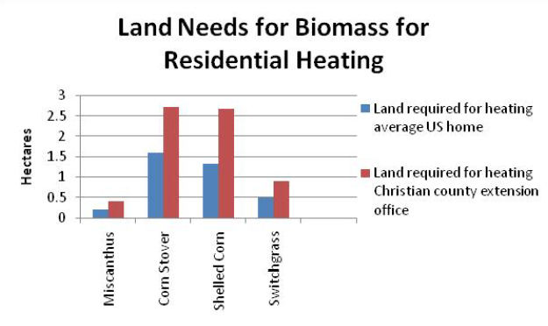
Land use for residential heating?
How much land would be needed to grow enough biomass to heat a residence?
Economics of using biomass for residential heating, U Ill, Urbana-Champaign

Slide 5
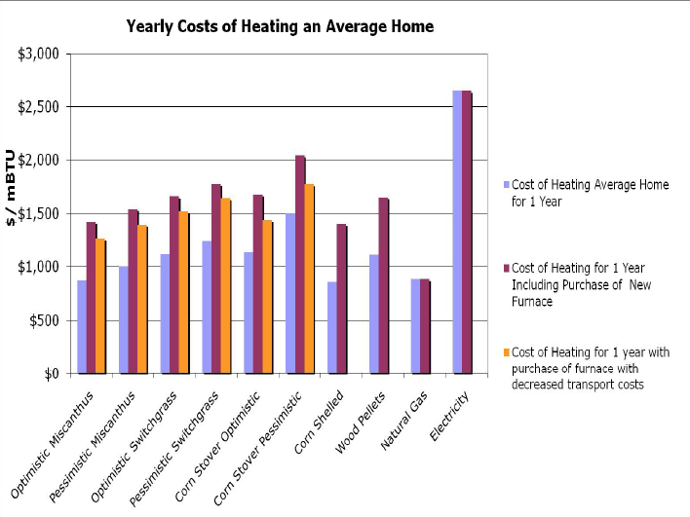
Annual cost for residential heating?
How much would it cost to heat a home with biomass vs. fossil fuels?
Economics of using biomass for residential heating, U Ill, Urbana-Champaign

