Slide 1
MEC 3040: Bioenergy
Module 3A: Cordwood and woodchip heating
3.1: EROEI – energy return on energy investment
3.2: Residential heating: a case for cord wood
3.3: Efficient cord wood heating systems
3.4: Buyer’s guide to wood chip energy
3.5: Wood chip heating systems
3.6: Economic analysis of wood chip systems
3.7: Operating and maintaining a wood chip system

Slide 2
3.3: Efficient cord wood heating systems

Slide 3
When is cordwood a good option?
Cordwood systems are generally less expensive than woodchip or pellet systems and are good options when:
Heat, but not electricity, is sought;
The cordwood is produced locally; &
The space to be heated is relatively small, making chip or pellet systems to expensive.
Target heating load for cordwood systems?
100,000 – 900,000 Btu/hour
Replacing systems that require 2,500 – 30,000 gallons of oil per year
Cordwood energy systems for community heating in Alaska: an overview, USDA (2009)

Slide 4
More efficient cordwood systems?
Cordwood heating systems, particularly small residential systems, are often inefficient and produce high levels of air emissions:
Fireplaces (really inefficient!);
Home heating stoves; &
Outdoor wood furnaces.
However, more efficient cordwood systems are available with these features:
Efficient combustion (> 70%);
Heating loads of 350,000 – 950,000 Btu/hour;
Refractory-lined combustion chambers;
Better use of fans; all leading to lower levels of particulate emissions.
Fed manually;
Also: larger water heat storage units with 1,500 – 4,400 gallon capacities.
Such systems generally need to be stoked (loaded with cordwood) several times a day.
Cost of a good cordwood system? <$100,000 for system that displaces 2,500 – 30,000 gallons of oil per year.
Cordwood energy systems for community heating in Alaska: an overview, USDA (2009)

Slide 5
Example: home cord wood gasifier
Tarm offers the Austrian Fröling FHG wood boiler that uses wood gasification combustion technology for residential heating.
91% overall efficiency when combined with a 500 – 1000-gallon water storage tank
Down-draft gasification is used for hot & fast combustion.
Water stores the heat provided by intermittent but hot combustion at maximum efficiency.
Thermal storage allows most homes to heat with one firing per day.
Clean double-burn with very little smoke and creosote
Primary combustion produces wood gases; &
Secondary burn adds oxygen & combusts the gases at 1800 - 2000°F.
Operating features:
Smokeless addition of wood;
Periodic ash removal
www.revisionheat.com/home-cord-wood-boilers/

Slide 6
Cord wood gasification case study
NY stone home built in 1948.
3 levels
3,000 square feet
Original oil-fired hot air furnace was inefficient ($1,400/month for 55°F)
Renovations weatherized the building & added radiant floor heating.
Fröling FHG-L wood gasification boiler was chosen for primary heating.
2 combustion chambers w/ final combustion temps of 1800 - 2000°F
Microprocessor control via oxygen & temperature sensors
Three pressurized 220-gallon thermal storage tanks set at 100°F
A domestic hot water tank stores at 140°F
Six zone radiant floor system
Backup heating system is an efficient propane-fired boiler.
Performance?
‘We only have to put in wood maybe twice a day on very cold days…then you put two pieces of paper in, and light it. It’s the easiest thing. We clean it out maybe once every two weeks.’
Old stone home uses modern heating technology, Radiant Living (2012)

Slide 7
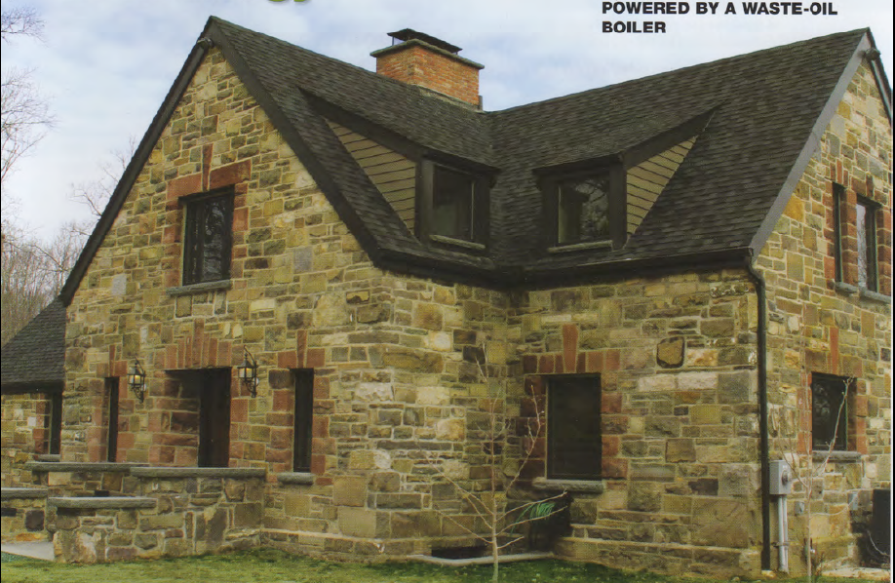
Cord wood gasification case study
Old stone home uses modern heating technology, Radiant Living (2012)

Slide 8
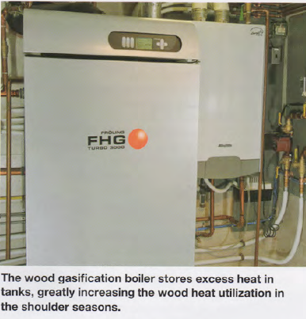
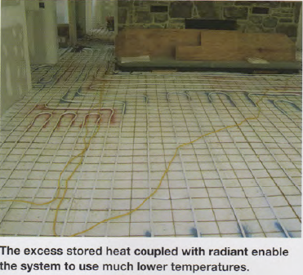
Cord wood gasification study
Old stone home uses modern heating technology, Radiant Living (2012)

Slide 9
Examples from Alaska
Examples of high-efficiency cordwood heating systems:
Tarm USA: boiler of 100,000 – 198,000 Btu/hour @ 80% efficient.
Tarm gasification boiler for home heating in Palmer, AK
GARN boiler heats seven homes & a laundromat in Dot Lake, AK
900,000 Btu/hour
Uses 4,400 gallons of water.
Replaces 7,000 gallons of fuel oil per year.
Very low emissions when compared to other wood systems by EPA.
Cordwood energy systems for community heating in Alaska: an overview, USDA (2009)

