Slide 1
MEC 3040: Bioenergy
Module 3A: Cordwood and woodchip heating
3.1: EROEI – energy return on energy investment
3.2: Residential heating: a case for cord wood
3.3: Efficient cord wood heating systems
3.4: Buyer’s guide to wood chip energy
3.5: Wood chip heating systems
3.6: Economic analysis of wood chip systems
3.7: Operating and maintaining a wood chip system

Slide 2
3.4: Buyer’s guide to sourcing wood chip energy

Slide 3
Is wood biomass the right choice?
Wood energy is becoming a popular choice for those who want to stabilize their fuel prices and reduce their use of fossil fuels.
When is wood the right choice?
Begin by answering these three questions:
1. How much will the fuel cost?
2. Will the supply be reliable?
3. Where specifically will the fuel come from?
A buyer’s guide to sourcing wood heating fuel in the northeastern US, BERC (2014)

Slide 4
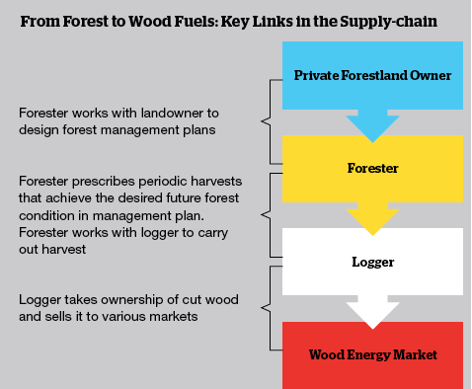
Where do woodchips come from?
Traditionally, woodchips are produced as a co-product by sawmills and wood processors. But sawmills have declined in the Northeast.
Today, most chips are produced by harvesters and chipping contractors.
Low-quality wood used for chips is usually harvested only as the better timber is cut.
Cutting only low-quality wood is not as economically feasible.
A buyer’s guide to sourcing wood heating fuel in the northeastern US, BERC (2014)

Slide 5
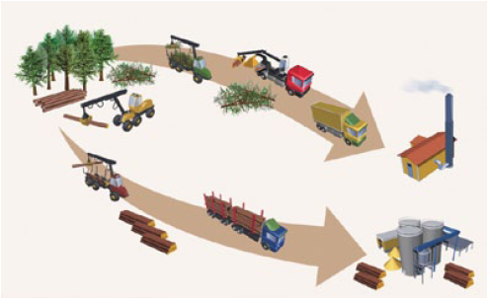
What type of wood is chipped?
Chips can be made from many tree species and tree components.
Tops and limbs are often chipped in the woods.
Whole trees can be chipped in the woods.
Bole chips made by chipping stems of low-quality trees now produces most wood chips used for heating. Often chipped in yards
A buyer’s guide to sourcing wood heating fuel in the northeastern US, BERC (2014)

Slide 6
How expensive & reliable?
Chips cost less than fossil fuels, typically less than half of the cost.
In 2014, chips for heating cost $45 - $65 per green ton.
Chip prices are less volatile than fossil fuel prices.
In Vermont, prices have increased 2% since 2000.
Factors that impact cost:
Wood source & production costs.
Strength of the saw log market.
Regional balance of supply & demand for low-quality wood. Other uses:
Pulp mills (paper mills);
Power plants; and
Pellet mills.
Trucking distances
Demand and demand seasonality
Woodchip quality
← Lower demand frees up low-quality wood for energy
A buyer’s guide to sourcing wood heating fuel in the northeastern US, BERC (2014)

Slide 7
Can I track the origin of my chips?
If you buy chips directly from the forest harvest location documenting the source of the chips is fairly simple.
However, in practice tracking chip origin is rarely simple.
Wood is often aggregated from several logging jobs prior to chipping;
And chips aren’t usually segregated by origin.
Buying chips from specific management processes is possible but costs more.
Verification is required.
1st-party verification: the logger self-verifies
2nd-party verification: the consumer verifies by assessing the supplier’s records
3rd-party verification: sourcing is verified by someone with a vested interest who is not the producer or consumer. Considered the most rigorous.
A buyer’s guide to sourcing wood heating fuel in the northeastern US, BERC (2014)

Slide 8
National Life case study
National Life (Montpelier) heats their HQ with wood chips.
Bids for long-term supply asked about price, quality, reputation and source.
Limlaw Pulpwood & Chipping (Topsham VT) has the contract.
Wood comes from a 50-mile radius.
Sourced from 50 small suppliers.
Most is cut by under the guidance of a forester;
But only a small fraction is 3rd-party certified by FSC, SFI or TreeFarm
National Life would like to buy more certified material but it just isn’t available.
A buyer’s guide to sourcing wood heating fuel in the northeastern US, BERC (2014)

Slide 9
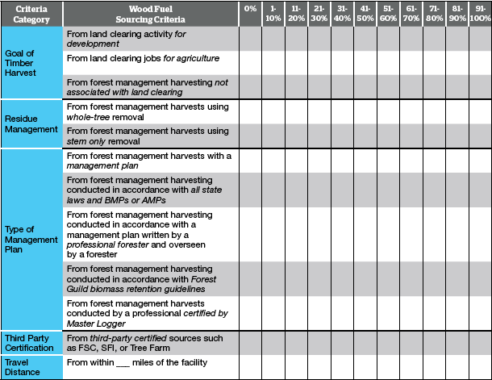
Wood sourcing template (BERC)

