Slide 1
MEC 3040: Bioenergy
Module 3A: Cordwood and woodchip heating
3.1: EROEI – energy return on energy investment
3.2: Residential heating: a case for cord wood
3.3: Efficient cord wood heating systems
3.4: Buyer’s guide to wood chip energy
3.5: Wood chip heating systems
3.6: Economic analysis of wood chip systems
3.7: Operating and maintaining a wood chip system

Slide 2
3.5: Woodchip heating systems

Slide 3
When to use chips?
Woodchip systems are cost-effective where:
Conventional (fossil) fuels are expensive;
In larger facilities;
Financed for 10 years or more; and / or
There are state funds to subsidize installation.
Wood-chip heating systems: a guide for institutional and commercial biomass installations, BERC (2004)

Slide 4
Wood combustion FAQs
Q: Doesn’t this require a lot of labor?
A: Depends on the degree of automation. Systems loaded with a tractor require an extra 30’ a day from the operator.
Q: Isn’t wood fuel a fire hazard?
A: Green chips are 50% water and won’t ignite outside of the furnace.
Q: Won’t the system increase truck traffic?
A: Depends: may be several times a week or once every few months.
Q: Won’t the wood smoke be a health hazard?
A: Large institutional systems are designed to meet air quality standards.
Q: Won’t the wood smoke cause acid rain?
A: No, wood fuel doesn’t produce SOx.
Q: Isn’t wood ash toxic?
A: No, wood ash is used as an agricultural fertilizer.
Q: Is there enough wood in the region to increase use of wood fuel?
A: Yes, the Northeast has underutilized stocks of low-grade wood.
Q: Is wood heat cheaper than gas or oil heat?
A: It has been over the last twenty years, but may not be right now.
Wood-chip heating systems: a guide for institutional and commercial biomass installations, BERC (2004)

Slide 5
What about the chips?
Moisture content of green chips varies between 30 – 55% moisture.
Varies by species, season & handling
Hardwood or softwood?
Hardwood is more common in the Northeast.
Hardwood is denser and has up to 10% less moisture.
Thus, hardwood has a higher energy density.
Wood-chip heating systems: a guide for institutional and commercial biomass installations, BERC (2004)

Slide 6
A woodchip system
Woodchip systems include these components:
Large volume fuel storage – above or below ground
Method of moving fuel from storage to burner
Burner
Boiler – larger than fossil fuel boiler
Chimney for exhaust – taller to deal with particulates
Fuel is delivered more frequently than at fossil fuel plants.
5 – 6 truckloads of chips are equivalent to 1 oil tanker
Wood-chip heating systems: a guide for institutional and commercial biomass installations, BERC (2004)

Slide 7
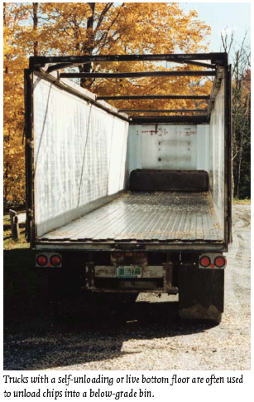
Woodchip transport & unloading
Fuel is delivered more frequently than at fossil fuel plants.
5 – 6 truckloads of chips are equivalent to 1 oil tanker
A 40-foot tractor trailer caries 2,400 cubic feet or about 25 tons.
Wood-chip heating systems: a guide for institutional and commercial biomass installations, BERC (2004)

Slide 8
Fuel storage systems
Woodchips are usually stored below ground. Below-ground systems have these advantages over above-ground systems.
Chips are less likely to freeze.
Gravity can be used to unload trucks.
Less visually obtrusive
Doors must be operable in all weather conditions and can be:
Horizontal (level with ground)
Sloped; or
Vertical.
Volume must allow enough storage to compensate for a missed delivery.
And deliveries must be made before the previous delivery is gone!
For a school-sized system, one load might last a week to a few months.
Wood-chip heating systems: a guide for institutional and commercial biomass installations, BERC (2004)

Slide 9
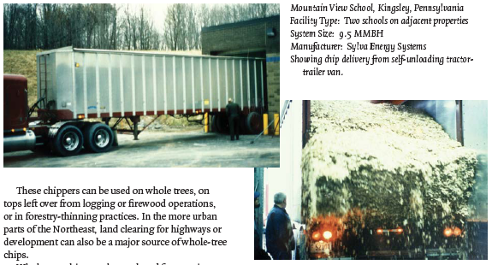
Fuel storage systems
Vertical doors:
The trailer has a hydraulic floor that self-unloads into the bay.
Wood-chip heating systems: a guide for institutional and commercial biomass installations, BERC (2004)

Slide 10
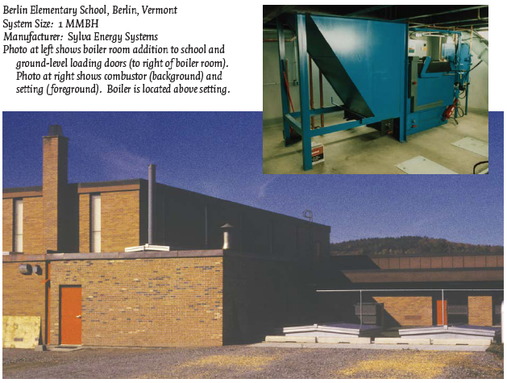
Fuel storage systems
Horizontal doors: are seen on the lower right.
Wood-chip heating systems: a guide for institutional and commercial biomass installations, BERC (2004)

Slide 11
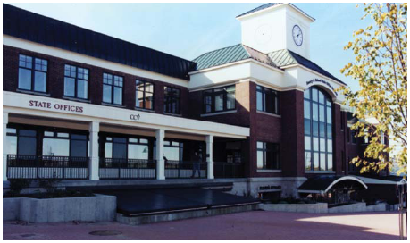
Fuel storage systems
Sloped doors: are seen on the lower center.
Wood-chip heating systems: a guide for institutional and commercial biomass installations, BERC (2004)

Slide 12
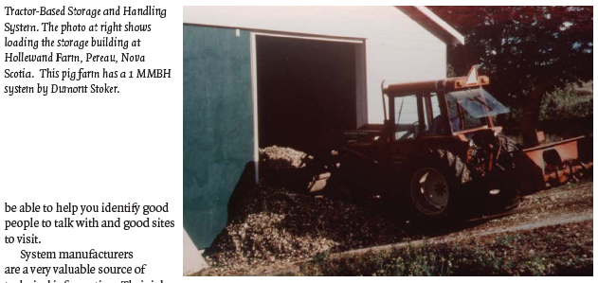
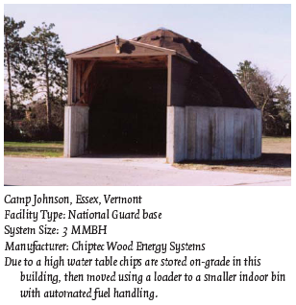
Fuel storage systems
Above-grade chip storage is sometimes used when below-grade systems are impossible, or when tractors are available for manual fuel loading.
Wood-chip heating systems: a guide for institutional and commercial biomass installations, BERC (2004)

Slide 13
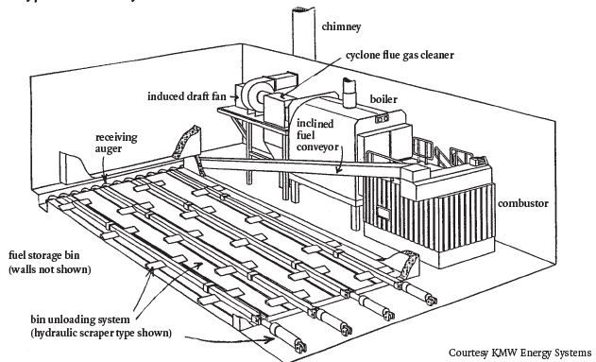
Fuel storage bins & conveyers
Chip bins often have hydraulic scraper systems used to move chips toward the conveyer that feeds chips into the combustion unit.
Traveling augers are also reliable.
Wood-chip heating systems: a guide for institutional and commercial biomass installations, BERC (2004)

Slide 14
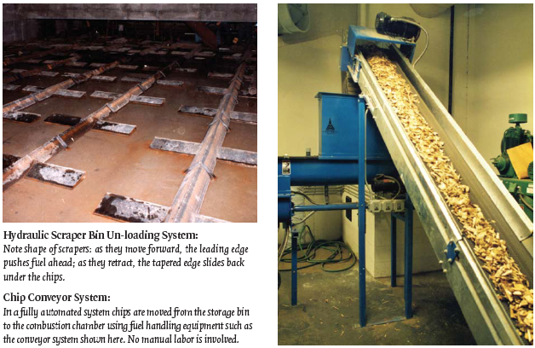
Fuel storage bins & conveyers
Wood-chip heating systems: a guide for institutional and commercial biomass installations, BERC (2004)

Slide 15
Combustion systems: the furnace
The part of the system where combustion happens is called the furnace.
1. Fuel is injected into the furnace with the final auger or belt, called the stoker and onto a grate that is flat or sloping.
2. Combustion air is added, often both above and below the grate. - Under-fire air helps to volatilize the wood, creating wood gas. - Over-fire air creates turbulence and allows complete gas combustion
3. The fuel is burned on the grate to create heat. - Moving grates create uniform combustion & move ash. - Water cooling may be used to keep surfaces from warping in high heat. - Combustion chamber is lined with ‘refractory’ to insulate & reflect heat back.
4. Hot exhaust gases flow from the furnace to the heat exchanger, transferring heat to water or air.
5. Cooled exhaust gases are discharged through a chimney.
Wood-chip heating systems: a guide for institutional and commercial biomass installations, BERC (2004)

Slide 16
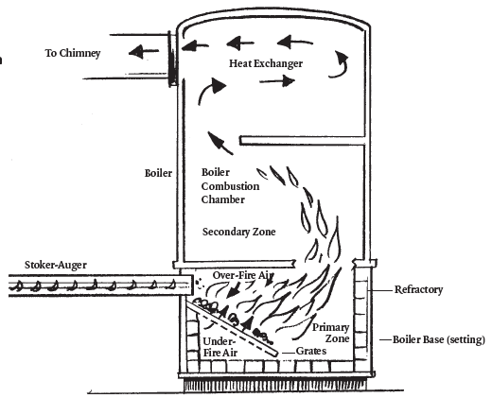
Combustion systems: the furnace
A direct burn furnace.
Wood-chip heating systems: a guide for institutional and commercial biomass installations, BERC (2004)

Slide 17
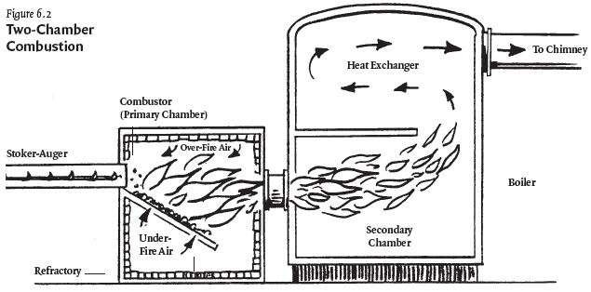
Combustion systems: the furnace
A two-chamber furnace.
Wood-chip heating systems: a guide for institutional and commercial biomass installations, BERC (2004)

Slide 18
Critical conditions for combustion
Complete and efficient combustion requires control of critical factors.
1. Accurate control of the fuel feed rate; - Often controlled by temperature or pressure of the boiler. - Simpler systems use a timing system that can be adjusted. - Some systems work well only over specific heating loads, others control the feed rate to respond to low vs. high heating loads.
2. Accurate control of combustion air feed to different areas within the furnace;
3. Turbulence of hot gases: air, wood gas, water vapor;
4. Ability of the furnace to hold high temperatures;
5. Proper furnace geometry to allow wood gases time to burn completely;
6. Ability to prevent ash build up.
Wood-chip heating systems: a guide for institutional and commercial biomass installations, BERC (2004)

Slide 19
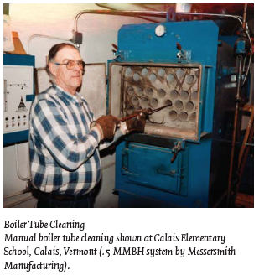
Heat exchange: the boiler
Heat exchangers use radiation and convection to transfer the heat of combustion to the medium of heat transfer, usually water or air.
Sizing of the heat exchanger must be large enough to capture the maximum amount of heat, increasing efficiency.
Most medium sized wood-fired systems use water to carry heat.
But older or larger systems sometimes use steam.
Heat exchange reduces flue gas temperatures from 1,200 – 2,200°F to 300 - 450°F.
Boiler water will increase to 150 – 300°F.
Wood-chip heating systems: a guide for institutional and commercial biomass installations, BERC (2004)

Slide 20
Backup systems
Many commercial & institutional biomass plants have oil or gas backup using additional boilers for those fossil fuels.
Backup systems might be used when:
The heating load is too small for the biomass system’s scale;
When the biomass system is being serviced;
If the woodchip bin is empty;
If the woodchip system malfunctions;
When the heating load exceeds the biomass system’s capacity both systems can be used.
Activation of backup systems can be manual or automatic.
Wood-chip heating systems: a guide for institutional and commercial biomass installations, BERC (2004)

Slide 21
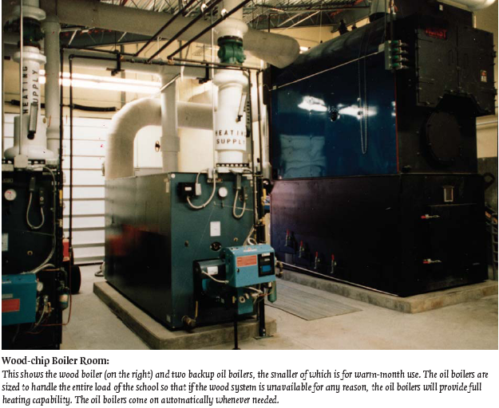
Backup systems
Wood-chip heating systems: a guide for institutional and commercial biomass installations, BERC (2004)

Slide 22
Domestic hot water?
Most systems also use the biomass system to supply domestic hot water using a DHW heat exchanger.
However, if the biomass system isn’t run during the summer the facility must have an additional independent hot water heater.
Wood-chip heating systems: a guide for institutional and commercial biomass installations, BERC (2004)

Slide 23
Emissions control
Institutional & commercial biomass systems usually have very low stack emissions and meet state air quality standards.
Air quality regulations are usually triggered by the size of the boiler and heat exchanger.
Small systems may not trigger regulations.
Particles can be removed from stack exhaust using cyclone separators or multi-cyclones.
Mounted between the heat exchanger and chimney.
Larger institutional systems may used newer ‘core separators’ that are particularly effective at removing fine particles.
Very large plants may have additional equipment to clean gases:
Char re-injectors;
Wet scrubbers; and
Bag houses.
Wood-chip heating systems: a guide for institutional and commercial biomass installations, BERC (2004)

Slide 24
Ash removal systems
About 25 pounds of ash are produced for each ton of green biomass burned. Ash must be removed regularly.
Automated removal systems are available but increase capital costs.
Manual removed is done with a rake and shovel and takes 10-20 minutes per day.
Many systems continue to run during ash removal.
Fly ash is very fine ash that accumulates in the heat exchanger and builds on surfaces, reducing heating efficiency.
Manual cleaning is required on a schedule ranging from weekly to annually.
In most states ash is not considered a hazardous waste and is given away or sold for use as a valuable soil amendment.
Wood-chip heating systems: a guide for institutional and commercial biomass installations, BERC (2004)

Slide 25
Safety devices
All biomass combustion systems must be equipped with safeguards:
Burn-back protection prevents fire from traveling into the fuel supply;
Water-quenching system will stop combustion at extreme temperatures;
Sprinkler protection in the facility;
Air locks that prevent unintentional oxygen for accidental fires;
Fuel cut-off that stops chip conveyers when the fire fails; and
Alarm systems to alert operators of problems or danger.
Wood-chip heating systems: a guide for institutional and commercial biomass installations, BERC (2004)

Slide 26
Chimney
The chimney removes and disperses flue gases to the atmosphere.
Induced draft fans ensure consistent draft and venting
Chimney height is determined by taking building height, geography and wind conditions into account.
The chimney does not magically detoxify stack gases;
But disperses them over a wider area to reduce risk.
Wood-chip heating systems: a guide for institutional and commercial biomass installations, BERC (2004)

Slide 27
Combustion efficiency
The efficiency of combustion is impacted by a number of factors:
Chemical composition of fuel – very consistent for wood biomass
Moisture content
Energy content of fuel
Steady state – consistent temperatures and gas composition
Complete combustion – monitored by low CO levels
Amount of excess air – excess air will actually cause energy loss
Stack temperatures – low temperatures indicate efficient heat transfer
Moisture loss
Typical performance: 55 – 75% steady state efficiency is typical
Careful monitoring of the factors listed here, combined with tweaking the system, can have significant effects on system efficiency and effectiveness.
Wood-chip heating systems: a guide for institutional and commercial biomass installations, BERC (2004)

Slide 28
System selection?
When selecting a biomass system, consider these factors:
System sizing;
Combustion controls;
Instrumentation;
Fuel moisture;
Boiler & pipe insulation; and
Multiple wood boilers.
Wood-chip heating systems: a guide for institutional and commercial biomass installations, BERC (2004)

