Slide 1
MEC 3040: Bioenergy
Module 3A: Cordwood and woodchip heating
3.1: EROEI – energy return on energy investment
3.2: Residential heating: a case for cord wood
3.3: Efficient cord wood heating systems
3.4: Buyer’s guide to wood chip energy
3.5: Wood chip heating systems
3.6: Economic analysis of wood chip systems
3.7: Operating and maintaining a wood chip system

Slide 2
3.6: Economic analysis of wood-chip systems

Slide 3
Preliminary feasibility
A quick analysis might look at the cost savings of installing biomass by comparing the fuel dollar savings to a rough estimate of system cost.
For example:
Biomass system cost estimate is $300,000.
Current oil fuel costs $15,000 per year.
Wood fuel cost savings are estimated at $6,000 – 7,000 per year, a 40 – 50% reduction in fuel costs.
Payback? $300,000 = 50 years!
$6,000
Wood-chip heating systems: a guide for institutional and commercial biomass installations, BERC (2004)

Slide 4
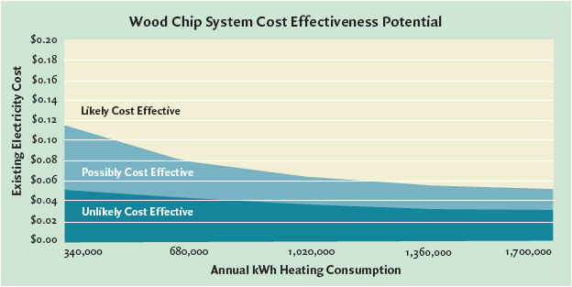
Cost-effectiveness modeling
Theses analyses assume that a school district is looking to replace existing heating systems with wood energy systems and that the school district bears the full capital costs of the system.
Wood systems have higher capital costs, but often lower fuel costs.
Wood-chip heating systems: a guide for institutional and commercial biomass installations, BERC (2004)

Slide 5
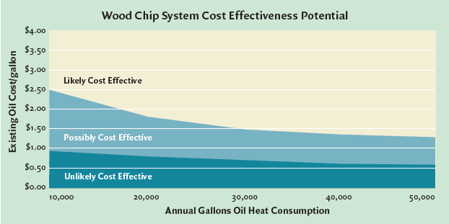
Cost-effectiveness modeling
Theses analyses assume that a school district is looking to replace existing heating systems with wood energy systems and that the school district bears the full capital costs of the system.
Wood-chip heating systems: a guide for institutional and commercial biomass installations, BERC (2004)

Slide 6
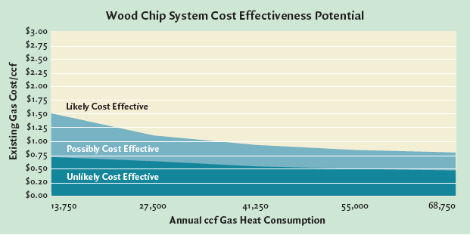
Cost-effectiveness modeling
Theses analyses assume that a school district is looking to replace existing heating systems with wood energy systems and that the school district bears the full capital costs of the system.
Wood-chip heating systems: a guide for institutional and commercial biomass installations, BERC (2004)

Slide 7
Aug – Oct 2016
Current comparative fuel prices in New Hampshire, 2016
Fuel type | price/unit | heat content per unit (BTU) | $ per million BTU
fuel oil (#2) | $2.03/gallon | 138,690 | $14.61
propane | $2.58/gallon | 91,333 | $28.27
kerosene | $2.79/gallon | 135,000 | $20.64
NG (< 20 therms) | $0.87/therm | 100,000 | $8.71
NG (>20 therms) | $0.81/therm | 100,000 | $8.11
electricity | $0.1629/kWh | 3,412 | $47.76
wood pellets (bulk) | $260.12/ton | 16,500,000 | $15.75
cord wood | $315/cord | 20,000,000 | $15.75
A therm is equal to 100 cubic feet of NG (1 CCF)
So 10 therms are 1,000 cubic feet of NG.
www.nh.gov/oep/energy/energy-nh/fuel-prices

Slide 8
When are woodchip systems effective?
As a general rule, woodchip systems are most cost-effective when:
Space-heating electricity and oil prices are high;
Energy consumption is high;
The competing fuel is electricity rather than oil or gas;
A new system is being installed rather than an old system being replaced;
A hydronic (hot water or steam) heat distribution system is already in place.
Wood-chip heating systems: a guide for institutional and commercial biomass installations, BERC (2004)

Slide 9
To perform a cost-effectiveness analysis
Three common methods of evaluating the cost-effectiveness of installing a woodchip system are:
Simple payback
First-year cash flow
Life-cycle costing
Wood-chip heating systems: a guide for institutional and commercial biomass installations, BERC (2004)

Slide 10
1. Simple payback
Simple payback: how many years it takes to pay back (or recover) the initial investment. Payback considers that investment and the first-year net savings. Payback = $300,000 investment = 10 years
$30,000 savings
This analysis is simple because it ignores factors like:
The cost of capital;
Future cost savings;
Cost of future equipment replacement.
Remember that the strength of biomass systems is their long-term savings.
Wood-chip heating systems: a guide for institutional and commercial biomass installations, BERC (2004)

Slide 11
2. First-year cash flow
2. First-year cash flow: Is the first-year cash outflow (loan payment) greater than the first-year cost savings?
For example:
You have a 10%, 10-year loan for $250,000, thus
Annual loan payments of $40,000
Annual energy savings are $50,000
So first-year cash flow is $10,000
This short-term analysis may also miss long-term savings.
Wood-chip heating systems: a guide for institutional and commercial biomass installations, BERC (2004)

Slide 12
3. Life-cycle costing
3. Life-cycle costing: This analysis accounts for future costs of biomass & competing fuels as well as financing, maintenance, repair, replacements and the future value of the dollar.
Principles of life-cycle analysis:
All project costs & benefits are considered for each year of the project’s life.
Short-term costs and benefits are given larger weight because future dollars may be less valuable and because we value money that we have now.
Software is becoming available for life-cycle costing.
Wood-chip heating systems: a guide for institutional and commercial biomass installations, BERC (2004)

Slide 13
Grants & for biomass projects
In the Northeast some grants are available for installing wood energy plants at schools.
State aid for construction projects
Green schools program
Other grants from private & public sources
Other methods of financing include:
Loan guarantees
Third-party financing
Leasing
Wood-chip heating systems: a guide for institutional and commercial biomass installations, BERC (2004)

Slide 14
Sizing a biomass system
There are two conflicting thoughts on sizing biomass systems. But both require an accurate peak heating load.
In any case, gross oversizing should be avoided because systems don’t run well when they are not run at full or design capacity.
Size to minimize use of backup fuel.
Design the system to supply all the heat needed at peak output when the system is running at full capacity.
Backup heat will be used on the rare occasions when the heating load exceeds these estimates.
Size to minimize capital costs.
Undersize the system so that it runs at full capacity most of the time.
Backup heat will be used more frequently.
Experience suggests that this approach uses more expensive fuel and may not deliver anticipated savings.
Two boilers: smaller boiler is used in the shoulder seasons & the larger boiler comes on as well during the colder months.
Works well for large applications.
Wood-chip heating systems: a guide for institutional and commercial biomass installations, BERC (2004)

