Slide 1
MEC 3040: Bioenergy
Module 3B: Wood pellet heating
3.8: Wood pellets & current use
3.9: Two wood pellet heat case studies
3.10: Bulk delivery
3.11: Pellet stoves
3.12: Pellet boilers
3.13: Air emissions, permitting & ash
3.14: Economics of wood pellet heating
3.15: Recent wood pellet projects

Slide 2
3.8: Wood pellet heating systems

Slide 3
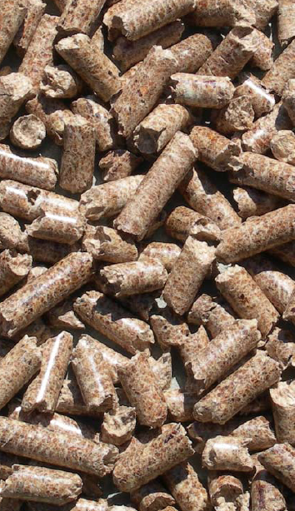
What are wood pellets?
Pellets are compressed by-products from the forest products industry.
Uniformly sized: ¼ - 5/16” in diameter and 1 – 1 ½ inches long;
Easy to store; &
Easy to use.
Available in:
40-lb bags; or
Bulk delivery
Because the moisture content of wood must be lowered before pellets can be made, the energy content of pellets is higher than other forms of wood biomass.
6% moisture
7,750 Btu per pound
Three grades classified by amount of ash produced:
Premium: <1% ash
Standard: 1-2% ash
Industrial: > 3% ash
Wood pellet heating: a reference on wood pellet fuels & technology for small commercial & institutional systems

Slide 4
Current use of wood pellet heating
As of 2007, 800,000 US homes used wood pellet stoves or furnaces for heating.
And use of pellet heat for larger buildings is increasing in Europe, and more slowly in the US:
Municipal or federal buildings;
Schools & colleges;
Housing complexes;
Office buildings, etc.,; &
Greenhouses.
In these larger settings pellets are delivered and stored in bulk for use by large boiler systems.
Wood pellet heating: a reference on wood pellet fuels & technology for small commercial & institutional systems

Slide 5
Ideal candidate for wood pellet heating
Buildings:
between 10,000 – 50,000 square feet;
use electricity or fossil fuel for space heating and hot water;
or are new construction;
with heating loads of 0.25 – 1.5 million Btu per hour.
Buildings should have:
Centralized hot water heat distribution;
Space for bulk wood pellets near the boiler; &
Access for delivery to the silo.
Ideally, pellet users should be no more than 50 miles from the supplier to control delivery charges.
Wood pellet heating: a reference on wood pellet fuels & technology for small commercial & institutional systems

