Slide 1
MEC 3040: Bioenergy
Module 3B: Wood pellet heating
3.8: Wood pellets & current use
3.9: Two wood pellet heat case studies
3.10: Bulk delivery
3.11: Pellet stoves
3.12: Pellet boilers
3.13: Air emissions, permitting & ash
3.14: Economics of wood pellet heating
3.15: Recent wood pellet projects

Slide 2
3.9: Two pellet heating case studies

Slide 3
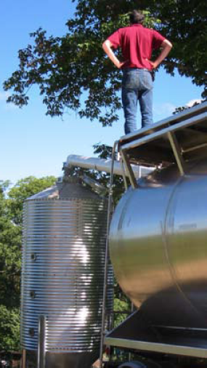
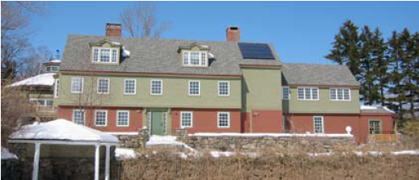
Case study: Harris Center (NH)
The Harris Center for Conservation Education provides educational programs and serves as a local land trust.
10,000 SF heated space
Nine-ton silo
Annual use of 10 – 15 tons
75 minutes per week
45% fuel cost savings (2007)
Wood pellet heating: a reference on wood pellet fuels & technology for small commercial & institutional systems

Slide 4
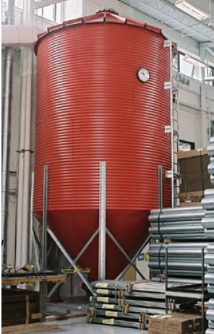
Case study: NRG Systems (VT)
NRG Systems makes wind-measurement equipment for the wind power industry.
Note that the building is so efficient that its heating load is smaller than expected for a building of this size.
46,000 SF heated space
30-ton silo (just 30-tons per year)
Fuels two residential scale 140,000 Btu/hour boilers
15 minutes per day
Offset 4,735 gallons of propane annually
Wood pellet heating: a reference on wood pellet fuels & technology for small commercial & institutional systems

