Slide 1
MEC 3040: Bioenergy
Module 3A: Cordwood and woodchip heating
3.1: EROEI – energy return on energy investment
3.2: Residential heating: a case for cord wood
3.3: Efficient cord wood heating systems
3.4: Buyer’s guide to wood chip energy
3.5: Wood chip heating systems
3.6: Economic analysis of wood chip systems
3.7: Operating and maintaining a wood chip system

Slide 2
3.1: Energy return on energy investment (EROEI)

Slide 3
EROI values
Energy return on investment values show how much energy is produced by a fuel as a ratio of the amount of energy used to produce the fuel.
The higher the EROI the better.
Fuel | EROI
domestic oil (1930) | 100:1
coal (2005) | 80:1
hydroelectric | 40:1
Imported oil (1970) | 38:1
domestic oil (1970) | 37:1
firewood | 30:1
Imported oil (2005) | 30:1
wind | 28:1
natural gas | 16:1
nuclear energy | 16:1
domestic oil (2000) | 9:1
solar photovoltaic | 6:1
tar sands | 6:1
biodiesel and ethanol | 2:1
Energy return on investment (EROI) of different wood products, Pandur et al.

Slide 4
Wood fuel comparisons (2012, 2019)
How do values for wood stack up?
Less processing allows greater EROEI values.
Fuel | Price | Thermal efficiency | $/Mbtu* | EROEI
cord wood | $200-300/cord | 50 - 60% | $15.15 | 50:1
wood chips | $80/ton | 30% |  | 18:1
wood pellets | $260/ton | 80 - 85% | $15.15 | 15:1
co-op wood pellets | $120/ton | 80 - 85% | $9.09 | 15:1
fuel oil | $2.81/gallon | 70% | $41.20 | 9:1
natural gas | $17.07/TCF | 80% | $54.74 | 16:1
* $/million Btu
EROEI = energy return on energy investment: EROEI depends on distance transported & system efficiency
Other studies find higher whole-tree wood chip EROI values of ~27:1
Vermont sustainable heating initiative (2012)
Residential wood heat: a non-commercial service in support of responsible home heating with wood (2016)

Slide 5
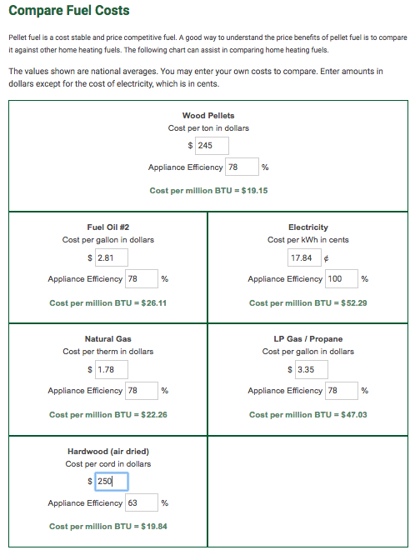
Fuel comparisons (2019)
A number of websites provide comparison tools.
This screenshot uses approximate Vermont costs in September of 2019.
https://www.pelletheat.org/compare-fuel-costs

Slide 6
3.2: Residential heating: a case for cord wood

Slide 7
Vermont residential heating (2012)
Statistics from the US Energy Information Agency (EIA) don’t include wood as a residential heating fuel.
However, 16% of Vermont households have wood stoves
This is the highest per capital use of wood stoves in the US.
In Canada, 20% of households use some wood heat.
VT residential heating fuel | 2012 (%) | 2019 (%)
fuel oil | 59 | 60
propane | 14
natural gas | 12 | 20
electricity | 5
other | 10
wood |  | 14
Total | 100 | 94
have wood stove? | 16
In 2008, the average Vermont household used 4.3 cords of wood.
Vermont sustainable heating initiative (2012)
https://www.eia.gov/state/print.php?sid=VT

Slide 8
Residential heating trends in Canada
Canadian households have a long history of using wood for heating.
14% of all households; or
21% of single-family dwellings use wood for primary or supplemental heat.
6.5% of single-family dwellings use wood as the primary source of heat.
In 1982, those who used wood as their primary source of heat used central wood furnaces.
By 1991, only half of that group used central wood furnaces and the other half had shifted to wood stoves, fireplace inserts or space heaters.
And 95% of supplemental wood users used these non-central appliances.
Why?
Houses are more energy efficient and require less heat;
Air quality regulations required replacement of older systems; and
“Glass air wash” systems in stoves allowed users to view the fire.
Residential wood heat: a non-commercial service in support of responsible home heating with wood (2016)

Slide 9
Residential heating attitudes in Canada
A 1983 study showed that most Canadian wood-heat users were very or somewhat satisfied with using wood even though this method of heating uses more personal time and effort.
97% of primary wood users
91% of supplemental wood users
A 1987 study in Ontario found that people who heated with wood connected to wood use on a personal & family level:
Family-centered activity;
Reflects personal and family values;
Reflects the desire for self-reliance.
Residential wood heat: a non-commercial service in support of responsible home heating with wood (2016)

Slide 10
Comparing use & safety of wood fuels
Each form of wood energy has advantages and disadvantages:
Wood fuel | Scale of use
Cord wood | Residential & up
Wood chips | District & commercial
Wood pellets | Residential & up
System cost
> $4,000
> $1.2 million
> $1,400
Wood fuel
Cord wood
Wood chips
Wood pellets
Safety?
Chimney fires, combustible ash, creosote
Commercial code
Vermont sustainable heating initiative (2012)

Slide 11
Can we increase use of wood heat?
BERC study of wood resources in Vermont concluded that the maximal additional amount of wood we could harvest sustainably would be 900,000 green tons per year.
Vermont’s population is about 620,000.
So additional wood per capita would provide:
0.725 green tons of hardwood + 0.725 green tons of softwood.
Assuming that the wood’s moisture content is 50%, each Vermonter would get:
0.36 cords of hardwood + 0.73 cords of softwood.
About a 1 cord increase on the average 4.3 cords/year use in Vermont.
Or 144,000 new users at the average of 4.3 cords/year rate.
Vermont sustainable heating initiative (2012)

Slide 12
Cordwood conclusions?
If all Vermont homes were converted to cordwood heat, we would deforest Vermont again!
So, what should we do with our additional wood resources?
Convert fast growing softwoods into wood pellets.
Evaluate heating systems for efficiency and EROEI.
Install new systems with the greatest local benefit.
Export of wood energy from Vermont should be the lowest priority.
Transportation should be considered when deciding which projects to implement.
Large-scale biomass systems should be required to get a certificate of public good to ensure they are sustainable and worthy of the resource use.
Any use of > 30,000 green tons per year.
Biomass stewardship is essential to long-term sustainability.
Vermont sustainable heating initiative (2012)

Slide 13
Economic impacts?
Biomass electricity generation will not lower Vermont electric rates.
And it is an inefficient use of biomass.
Biomass heating could save Vermonters $200 million per year.
And that money would be transferred to local economies.
Pellet production can produce efficient biomass from marginal softwood.
Vermont sustainable heating initiative (2012)

Slide 14
3.3: Efficient cord wood heating systems

Slide 15
When is cordwood a good option?
Cordwood systems are generally less expensive than woodchip or pellet systems and are good options when:
Heat, but not electricity, is sought;
The cordwood is produced locally; &
The space to be heated is relatively small, making chip or pellet systems to expensive.
Target heating load for cordwood systems?
100,000 – 900,000 Btu/hour
Replacing systems that require 2,500 – 30,000 gallons of oil per year
Cordwood energy systems for community heating in Alaska: an overview, USDA (2009)

Slide 16
More efficient cordwood systems?
Cordwood heating systems, particularly small residential systems, are often inefficient and produce high levels of air emissions:
Fireplaces (really inefficient!);
Home heating stoves; &
Outdoor wood furnaces.
However, more efficient cordwood systems are available with these features:
Efficient combustion (> 70%);
Heating loads of 350,000 – 950,000 Btu/hour;
Refractory-lined combustion chambers;
Better use of fans; all leading to lower levels of particulate emissions.
Fed manually;
Also: larger water heat storage units with 1,500 – 4,400 gallon capacities.
Such systems generally need to be stoked (loaded with cordwood) several times a day.
Cost of a good cordwood system? <$100,000 for system that displaces 2,500 – 30,000 gallons of oil per year.
Cordwood energy systems for community heating in Alaska: an overview, USDA (2009)

Slide 17
Example: home cord wood gasifier
Tarm offers the Austrian Fröling FHG wood boiler that uses wood gasification combustion technology for residential heating.
91% overall efficiency when combined with a 500 – 1000-gallon water storage tank
Down-draft gasification is used for hot & fast combustion.
Water stores the heat provided by intermittent but hot combustion at maximum efficiency.
Thermal storage allows most homes to heat with one firing per day.
Clean double-burn with very little smoke and creosote
Primary combustion produces wood gases; &
Secondary burn adds oxygen & combusts the gases at 1800 - 2000°F.
Operating features:
Smokeless addition of wood;
Periodic ash removal
www.revisionheat.com/home-cord-wood-boilers/

Slide 18
Cord wood gasification case study
NY stone home built in 1948.
3 levels
3,000 square feet
Original oil-fired hot air furnace was inefficient ($1,400/month for 55°F)
Renovations weatherized the building & added radiant floor heating.
Fröling FHG-L wood gasification boiler was chosen for primary heating.
2 combustion chambers w/ final combustion temps of 1800 - 2000°F
Microprocessor control via oxygen & temperature sensors
Three pressurized 220-gallon thermal storage tanks set at 100°F
A domestic hot water tank stores at 140°F
Six zone radiant floor system
Backup heating system is an efficient propane-fired boiler.
Performance?
‘We only have to put in wood maybe twice a day on very cold days…then you put two pieces of paper in, and light it. It’s the easiest thing. We clean it out maybe once every two weeks.’
Old stone home uses modern heating technology, Radiant Living (2012)

Slide 19
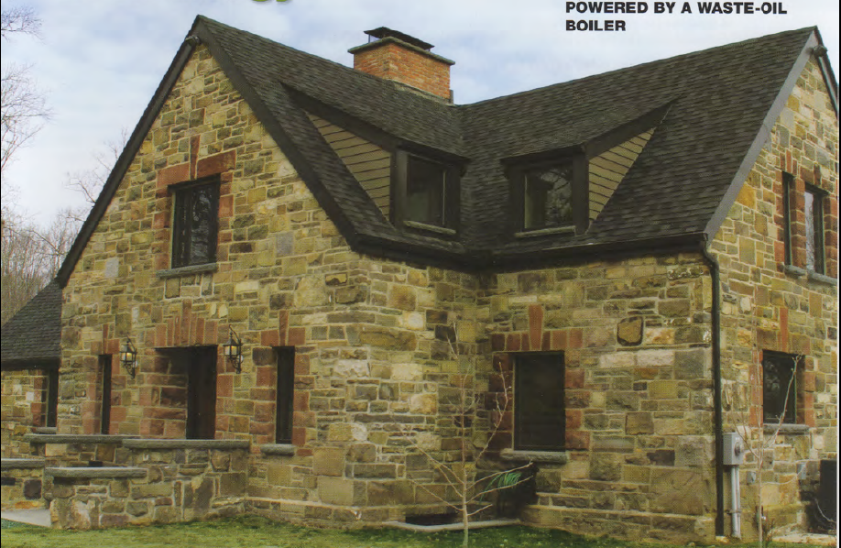
Cord wood gasification case study
Old stone home uses modern heating technology, Radiant Living (2012)

Slide 20
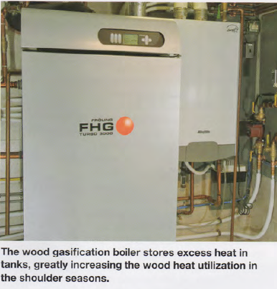
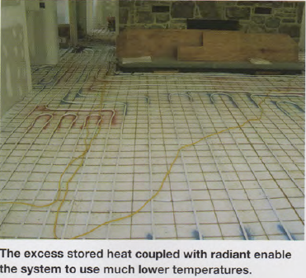
Cord wood gasification study
Old stone home uses modern heating technology, Radiant Living (2012)

Slide 21
Examples from Alaska
Examples of high-efficiency cordwood heating systems:
Tarm USA: boiler of 100,000 – 198,000 Btu/hour @ 80% efficient.
Tarm gasification boiler for home heating in Palmer, AK
GARN boiler heats seven homes & a laundromat in Dot Lake, AK
900,000 Btu/hour
Uses 4,400 gallons of water.
Replaces 7,000 gallons of fuel oil per year.
Very low emissions when compared to other wood systems by EPA.
Cordwood energy systems for community heating in Alaska: an overview, USDA (2009)

Slide 22
3.4: Buyer’s guide to sourcing wood chip energy

Slide 23
Is wood biomass the right choice?
Wood energy is becoming a popular choice for those who want to stabilize their fuel prices and reduce their use of fossil fuels.
When is wood the right choice?
Begin by answering these three questions:
1. How much will the fuel cost?
2. Will the supply be reliable?
3. Where specifically will the fuel come from?
A buyer’s guide to sourcing wood heating fuel in the northeastern US, BERC (2014)

Slide 24
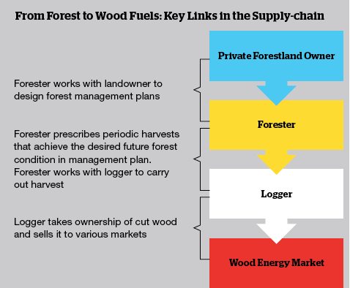
Where do woodchips come from?
Traditionally, woodchips are produced as a co-product by sawmills and wood processors. But sawmills have declined in the Northeast.
Today, most chips are produced by harvesters and chipping contractors.
Low-quality wood used for chips is usually harvested only as the better timber is cut.
Cutting only low-quality wood is not as economically feasible.
A buyer’s guide to sourcing wood heating fuel in the northeastern US, BERC (2014)

Slide 25
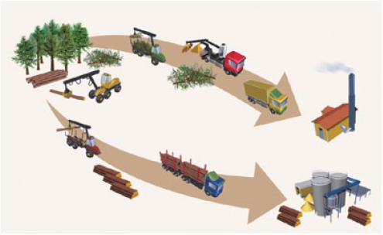
What type of wood is chipped?
Chips can be made from many tree species and tree components.
Tops and limbs are often chipped in the woods.
Whole trees can be chipped in the woods.
Bole chips made by chipping stems of low-quality trees now produces most wood chips used for heating. Often chipped in yards
A buyer’s guide to sourcing wood heating fuel in the northeastern US, BERC (2014)

Slide 26
How expensive & reliable?
Chips cost less than fossil fuels, typically less than half of the cost.
In 2014, chips for heating cost $45 - $65 per green ton.
Chip prices are less volatile than fossil fuel prices.
In Vermont, prices have increased 2% since 2000.
Factors that impact cost:
Wood source & production costs.
Strength of the saw log market.
Regional balance of supply & demand for low-quality wood. Other uses:
Pulp mills (paper mills);
Power plants; and
Pellet mills.
Trucking distances
Demand and demand seasonality
Woodchip quality
← Lower demand frees up low-quality wood for energy
A buyer’s guide to sourcing wood heating fuel in the northeastern US, BERC (2014)

Slide 27
Can I track the origin of my chips?
If you buy chips directly from the forest harvest location documenting the source of the chips is fairly simple.
However, in practice tracking chip origin is rarely simple.
Wood is often aggregated from several logging jobs prior to chipping;
And chips aren’t usually segregated by origin.
Buying chips from specific management processes is possible but costs more.
Verification is required.
1st-party verification: the logger self-verifies
2nd-party verification: the consumer verifies by assessing the supplier’s records
3rd-party verification: sourcing is verified by someone with a vested interest who is not the producer or consumer. Considered the most rigorous.
A buyer’s guide to sourcing wood heating fuel in the northeastern US, BERC (2014)

Slide 28
National Life case study
National Life (Montpelier) heats their HQ with wood chips.
Bids for long-term supply asked about price, quality, reputation and source.
Limlaw Pulpwood & Chipping (Topsham VT) has the contract.
Wood comes from a 50-mile radius.
Sourced from 50 small suppliers.
Most is cut by under the guidance of a forester;
But only a small fraction is 3rd-party certified by FSC, SFI or TreeFarm
National Life would like to buy more certified material but it just isn’t available.
A buyer’s guide to sourcing wood heating fuel in the northeastern US, BERC (2014)

Slide 29
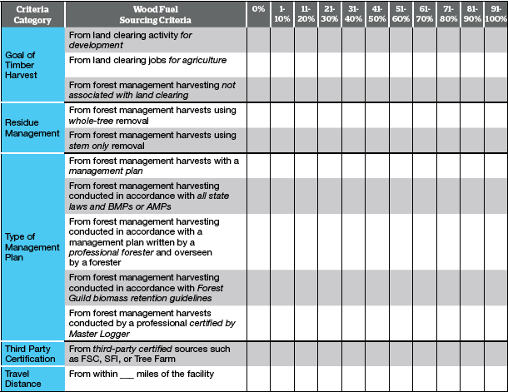
Wood sourcing template (BERC)

Slide 30
3.5: Woodchip heating systems

Slide 31
When to use chips?
Woodchip systems are cost-effective where:
Conventional (fossil) fuels are expensive;
In larger facilities;
Financed for 10 years or more; and / or
There are state funds to subsidize installation.
Wood-chip heating systems: a guide for institutional and commercial biomass installations, BERC (2004)

Slide 32
Wood combustion FAQs
Q: Doesn’t this require a lot of labor?
A: Depends on the degree of automation. Systems loaded with a tractor require an extra 30’ a day from the operator.
Q: Isn’t wood fuel a fire hazard?
A: Green chips are 50% water and won’t ignite outside of the furnace.
Q: Won’t the system increase truck traffic?
A: Depends: may be several times a week or once every few months.
Q: Won’t the wood smoke be a health hazard?
A: Large institutional systems are designed to meet air quality standards.
Q: Won’t the wood smoke cause acid rain?
A: No, wood fuel doesn’t produce SOx.
Q: Isn’t wood ash toxic?
A: No, wood ash is used as an agricultural fertilizer.
Q: Is there enough wood in the region to increase use of wood fuel?
A: Yes, the Northeast has underutilized stocks of low-grade wood.
Q: Is wood heat cheaper than gas or oil heat?
A: It has been over the last twenty years, but may not be right now.
Wood-chip heating systems: a guide for institutional and commercial biomass installations, BERC (2004)

Slide 33
What about the chips?
Moisture content of green chips varies between 30 – 55% moisture.
Varies by species, season & handling
Hardwood or softwood?
Hardwood is more common in the Northeast.
Hardwood is denser and has up to 10% less moisture.
Thus, hardwood has a higher energy density.
Wood-chip heating systems: a guide for institutional and commercial biomass installations, BERC (2004)

Slide 34
A woodchip system
Woodchip systems include these components:
Large volume fuel storage – above or below ground
Method of moving fuel from storage to burner
Burner
Boiler – larger than fossil fuel boiler
Chimney for exhaust – taller to deal with particulates
Fuel is delivered more frequently than at fossil fuel plants.
5 – 6 truckloads of chips are equivalent to 1 oil tanker
Wood-chip heating systems: a guide for institutional and commercial biomass installations, BERC (2004)

Slide 35
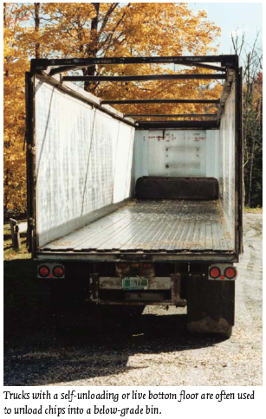
Woodchip transport & unloading
Fuel is delivered more frequently than at fossil fuel plants.
5 – 6 truckloads of chips are equivalent to 1 oil tanker
A 40-foot tractor trailer caries 2,400 cubic feet or about 25 tons.
Wood-chip heating systems: a guide for institutional and commercial biomass installations, BERC (2004)

Slide 36
Fuel storage systems
Woodchips are usually stored below ground. Below-ground systems have these advantages over above-ground systems.
Chips are less likely to freeze.
Gravity can be used to unload trucks.
Less visually obtrusive
Doors must be operable in all weather conditions and can be:
Horizontal (level with ground)
Sloped; or
Vertical.
Volume must allow enough storage to compensate for a missed delivery.
And deliveries must be made before the previous delivery is gone!
For a school-sized system, one load might last a week to a few months.
Wood-chip heating systems: a guide for institutional and commercial biomass installations, BERC (2004)

Slide 37
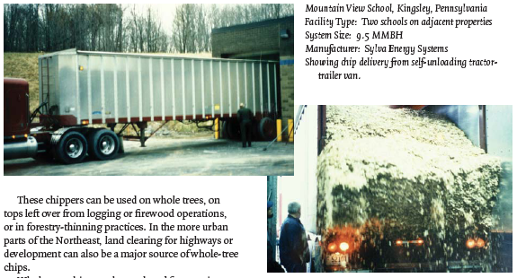
Fuel storage systems
Vertical doors:
The trailer has a hydraulic floor that self-unloads into the bay.
Wood-chip heating systems: a guide for institutional and commercial biomass installations, BERC (2004)

Slide 38
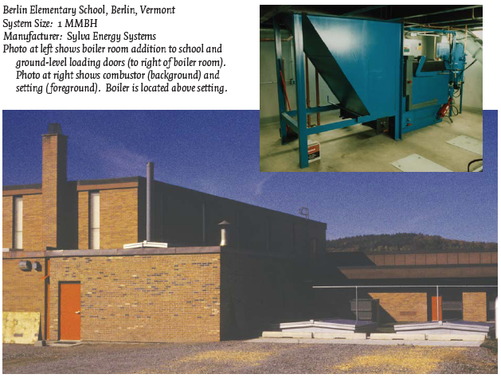
Fuel storage systems
Horizontal doors: are seen on the lower right.
Wood-chip heating systems: a guide for institutional and commercial biomass installations, BERC (2004)

Slide 39
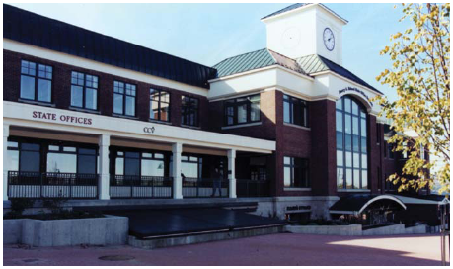
Fuel storage systems
Sloped doors: are seen on the lower center.
Wood-chip heating systems: a guide for institutional and commercial biomass installations, BERC (2004)

Slide 40
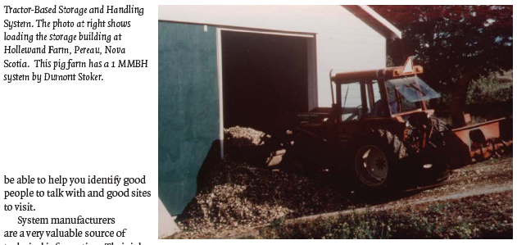
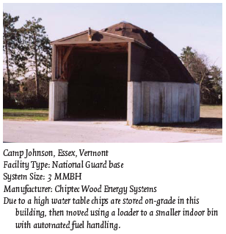
Fuel storage systems
Above-grade chip storage is sometimes used when below-grade systems are impossible, or when tractors are available for manual fuel loading.
Wood-chip heating systems: a guide for institutional and commercial biomass installations, BERC (2004)

Slide 41
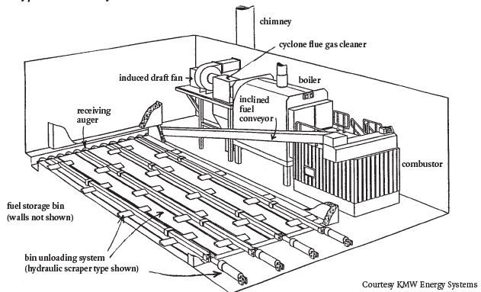
Fuel storage bins & conveyers
Chip bins often have hydraulic scraper systems used to move chips toward the conveyer that feeds chips into the combustion unit.
Traveling augers are also reliable.
Wood-chip heating systems: a guide for institutional and commercial biomass installations, BERC (2004)

Slide 42
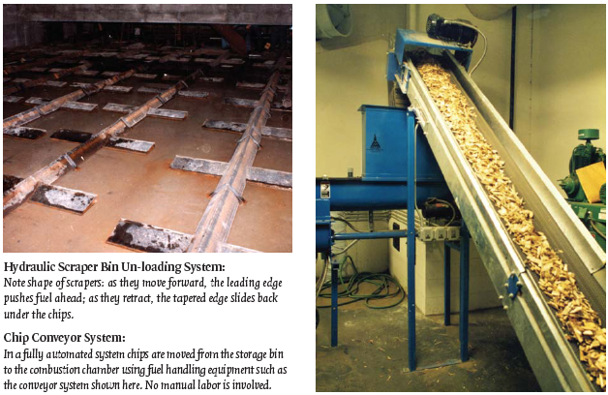
Fuel storage bins & conveyers
Wood-chip heating systems: a guide for institutional and commercial biomass installations, BERC (2004)

Slide 43
Combustion systems: the furnace
The part of the system where combustion happens is called the furnace.
1. Fuel is injected into the furnace with the final auger or belt, called the stoker and onto a grate that is flat or sloping.
2. Combustion air is added, often both above and below the grate. - Under-fire air helps to volatilize the wood, creating wood gas. - Over-fire air creates turbulence and allows complete gas combustion
3. The fuel is burned on the grate to create heat. - Moving grates create uniform combustion & move ash. - Water cooling may be used to keep surfaces from warping in high heat. - Combustion chamber is lined with ‘refractory’ to insulate & reflect heat back.
4. Hot exhaust gases flow from the furnace to the heat exchanger, transferring heat to water or air.
5. Cooled exhaust gases are discharged through a chimney.
Wood-chip heating systems: a guide for institutional and commercial biomass installations, BERC (2004)

Slide 44
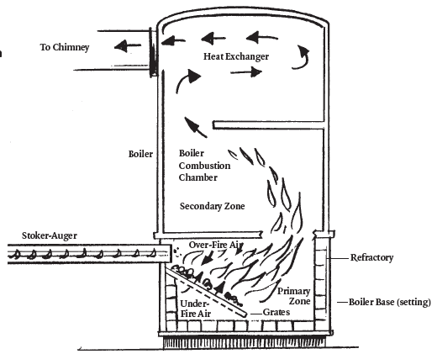
Combustion systems: the furnace
A direct burn furnace.
Wood-chip heating systems: a guide for institutional and commercial biomass installations, BERC (2004)

Slide 45
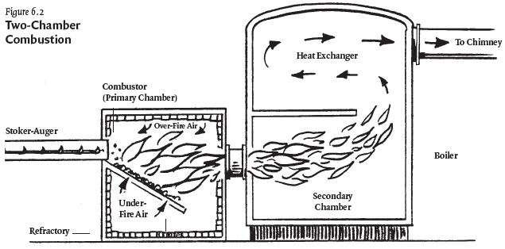
Combustion systems: the furnace
A two-chamber furnace.
Wood-chip heating systems: a guide for institutional and commercial biomass installations, BERC (2004)

Slide 46
Critical conditions for combustion
Complete and efficient combustion requires control of critical factors.
1. Accurate control of the fuel feed rate; - Often controlled by temperature or pressure of the boiler. - Simpler systems use a timing system that can be adjusted. - Some systems work well only over specific heating loads, others control the feed rate to respond to low vs. high heating loads.
2. Accurate control of combustion air feed to different areas within the furnace;
3. Turbulence of hot gases: air, wood gas, water vapor;
4. Ability of the furnace to hold high temperatures;
5. Proper furnace geometry to allow wood gases time to burn completely;
6. Ability to prevent ash build up.
Wood-chip heating systems: a guide for institutional and commercial biomass installations, BERC (2004)

Slide 47
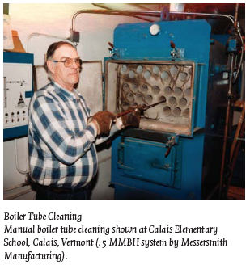
Heat exchange: the boiler
Heat exchangers use radiation and convection to transfer the heat of combustion to the medium of heat transfer, usually water or air.
Sizing of the heat exchanger must be large enough to capture the maximum amount of heat, increasing efficiency.
Most medium sized wood-fired systems use water to carry heat.
But older or larger systems sometimes use steam.
Heat exchange reduces flue gas temperatures from 1,200 – 2,200°F to 300 - 450°F.
Boiler water will increase to 150 – 300°F.
Wood-chip heating systems: a guide for institutional and commercial biomass installations, BERC (2004)

Slide 48
Backup systems
Many commercial & institutional biomass plants have oil or gas backup using additional boilers for those fossil fuels.
Backup systems might be used when:
The heating load is too small for the biomass system’s scale;
When the biomass system is being serviced;
If the woodchip bin is empty;
If the woodchip system malfunctions;
When the heating load exceeds the biomass system’s capacity both systems can be used.
Activation of backup systems can be manual or automatic.
Wood-chip heating systems: a guide for institutional and commercial biomass installations, BERC (2004)

Slide 49
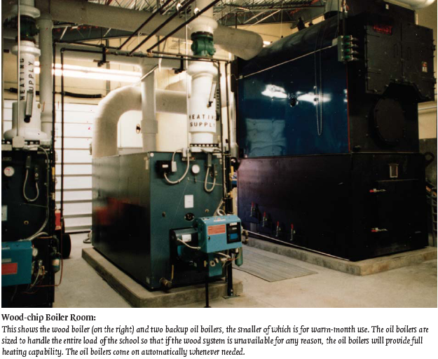
Backup systems
Wood-chip heating systems: a guide for institutional and commercial biomass installations, BERC (2004)

Slide 50
Domestic hot water?
Most systems also use the biomass system to supply domestic hot water using a DHW heat exchanger.
However, if the biomass system isn’t run during the summer the facility must have an additional independent hot water heater.
Wood-chip heating systems: a guide for institutional and commercial biomass installations, BERC (2004)

Slide 51
Emissions control
Institutional & commercial biomass systems usually have very low stack emissions and meet state air quality standards.
Air quality regulations are usually triggered by the size of the boiler and heat exchanger.
Small systems may not trigger regulations.
Particles can be removed from stack exhaust using cyclone separators or multi-cyclones.
Mounted between the heat exchanger and chimney.
Larger institutional systems may used newer ‘core separators’ that are particularly effective at removing fine particles.
Very large plants may have additional equipment to clean gases:
Char re-injectors;
Wet scrubbers; and
Bag houses.
Wood-chip heating systems: a guide for institutional and commercial biomass installations, BERC (2004)

Slide 52
Ash removal systems
About 25 pounds of ash are produced for each ton of green biomass burned. Ash must be removed regularly.
Automated removal systems are available but increase capital costs.
Manual removed is done with a rake and shovel and takes 10-20 minutes per day.
Many systems continue to run during ash removal.
Fly ash is very fine ash that accumulates in the heat exchanger and builds on surfaces, reducing heating efficiency.
Manual cleaning is required on a schedule ranging from weekly to annually.
In most states ash is not considered a hazardous waste and is given away or sold for use as a valuable soil amendment.
Wood-chip heating systems: a guide for institutional and commercial biomass installations, BERC (2004)

Slide 53
Safety devices
All biomass combustion systems must be equipped with safeguards:
Burn-back protection prevents fire from traveling into the fuel supply;
Water-quenching system will stop combustion at extreme temperatures;
Sprinkler protection in the facility;
Air locks that prevent unintentional oxygen for accidental fires;
Fuel cut-off that stops chip conveyers when the fire fails; and
Alarm systems to alert operators of problems or danger.
Wood-chip heating systems: a guide for institutional and commercial biomass installations, BERC (2004)

Slide 54
Chimney
The chimney removes and disperses flue gases to the atmosphere.
Induced draft fans ensure consistent draft and venting
Chimney height is determined by taking building height, geography and wind conditions into account.
The chimney does not magically detoxify stack gases;
But disperses them over a wider area to reduce risk.
Wood-chip heating systems: a guide for institutional and commercial biomass installations, BERC (2004)

Slide 55
Combustion efficiency
The efficiency of combustion is impacted by a number of factors:
Chemical composition of fuel – very consistent for wood biomass
Moisture content
Energy content of fuel
Steady state – consistent temperatures and gas composition
Complete combustion – monitored by low CO levels
Amount of excess air – excess air will actually cause energy loss
Stack temperatures – low temperatures indicate efficient heat transfer
Moisture loss
Typical performance: 55 – 75% steady state efficiency is typical
Careful monitoring of the factors listed here, combined with tweaking the system, can have significant effects on system efficiency and effectiveness.
Wood-chip heating systems: a guide for institutional and commercial biomass installations, BERC (2004)

Slide 56
System selection?
When selecting a biomass system, consider these factors:
System sizing;
Combustion controls;
Instrumentation;
Fuel moisture;
Boiler & pipe insulation; and
Multiple wood boilers.
Wood-chip heating systems: a guide for institutional and commercial biomass installations, BERC (2004)

Slide 57
3.6: Economic analysis of wood-chip systems

Slide 58
Preliminary feasibility
A quick analysis might look at the cost savings of installing biomass by comparing the fuel dollar savings to a rough estimate of system cost.
For example:
Biomass system cost estimate is $300,000.
Current oil fuel costs $15,000 per year.
Wood fuel cost savings are estimated at $6,000 – 7,000 per year, a 40 – 50% reduction in fuel costs.
Payback? $300,000 = 50 years!
$6,000
Wood-chip heating systems: a guide for institutional and commercial biomass installations, BERC (2004)

Slide 59
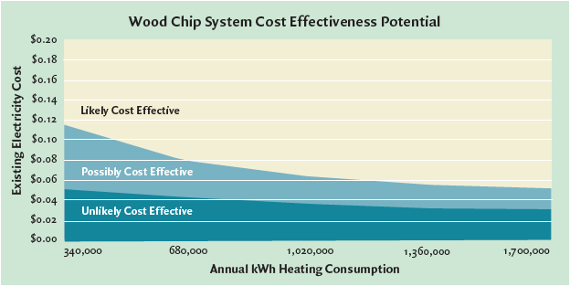
Cost-effectiveness modeling
Theses analyses assume that a school district is looking to replace existing heating systems with wood energy systems and that the school district bears the full capital costs of the system.
Wood systems have higher capital costs, but often lower fuel costs.
Wood-chip heating systems: a guide for institutional and commercial biomass installations, BERC (2004)

Slide 60
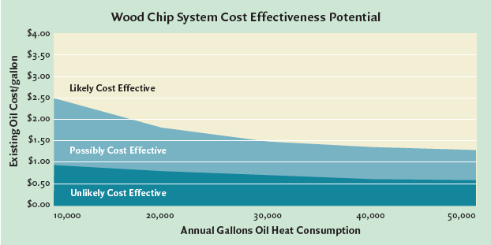
Cost-effectiveness modeling
Theses analyses assume that a school district is looking to replace existing heating systems with wood energy systems and that the school district bears the full capital costs of the system.
Wood-chip heating systems: a guide for institutional and commercial biomass installations, BERC (2004)

Slide 61
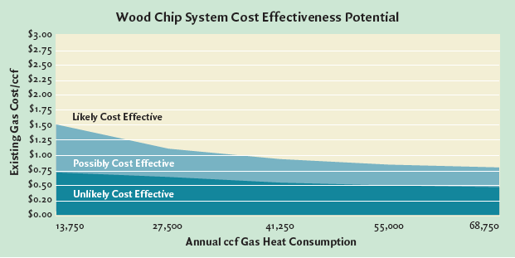
Cost-effectiveness modeling
Theses analyses assume that a school district is looking to replace existing heating systems with wood energy systems and that the school district bears the full capital costs of the system.
Wood-chip heating systems: a guide for institutional and commercial biomass installations, BERC (2004)

Slide 62
Aug – Oct 2016
Current comparative fuel prices in New Hampshire, 2016
Fuel type | price/unit | heat content per unit (BTU) | $ per million BTU
fuel oil (#2) | $2.03/gallon | 138,690 | $14.61
propane | $2.58/gallon | 91,333 | $28.27
kerosene | $2.79/gallon | 135,000 | $20.64
NG (< 20 therms) | $0.87/therm | 100,000 | $8.71
NG (>20 therms) | $0.81/therm | 100,000 | $8.11
electricity | $0.1629/kWh | 3,412 | $47.76
wood pellets (bulk) | $260.12/ton | 16,500,000 | $15.75
cord wood | $315/cord | 20,000,000 | $15.75
A therm is equal to 100 cubic feet of NG (1 CCF)
So 10 therms are 1,000 cubic feet of NG.
www.nh.gov/oep/energy/energy-nh/fuel-prices

Slide 63
When are woodchip systems effective?
As a general rule, woodchip systems are most cost-effective when:
Space-heating electricity and oil prices are high;
Energy consumption is high;
The competing fuel is electricity rather than oil or gas;
A new system is being installed rather than an old system being replaced;
A hydronic (hot water or steam) heat distribution system is already in place.
Wood-chip heating systems: a guide for institutional and commercial biomass installations, BERC (2004)

Slide 64
To perform a cost-effectiveness analysis
Three common methods of evaluating the cost-effectiveness of installing a woodchip system are:
Simple payback
First-year cash flow
Life-cycle costing
Wood-chip heating systems: a guide for institutional and commercial biomass installations, BERC (2004)

Slide 65
1. Simple payback
Simple payback: how many years it takes to pay back (or recover) the initial investment. Payback considers that investment and the first-year net savings. Payback = $300,000 investment = 10 years
$30,000 savings
This analysis is simple because it ignores factors like:
The cost of capital;
Future cost savings;
Cost of future equipment replacement.
Remember that the strength of biomass systems is their long-term savings.
Wood-chip heating systems: a guide for institutional and commercial biomass installations, BERC (2004)

Slide 66
2. First-year cash flow
2. First-year cash flow: Is the first-year cash outflow (loan payment) greater than the first-year cost savings?
For example:
You have a 10%, 10-year loan for $250,000, thus
Annual loan payments of $40,000
Annual energy savings are $50,000
So first-year cash flow is $10,000
This short-term analysis may also miss long-term savings.
Wood-chip heating systems: a guide for institutional and commercial biomass installations, BERC (2004)

Slide 67
3. Life-cycle costing
3. Life-cycle costing: This analysis accounts for future costs of biomass & competing fuels as well as financing, maintenance, repair, replacements and the future value of the dollar.
Principles of life-cycle analysis:
All project costs & benefits are considered for each year of the project’s life.
Short-term costs and benefits are given larger weight because future dollars may be less valuable and because we value money that we have now.
Software is becoming available for life-cycle costing.
Wood-chip heating systems: a guide for institutional and commercial biomass installations, BERC (2004)

Slide 68
Grants & for biomass projects
In the Northeast some grants are available for installing wood energy plants at schools.
State aid for construction projects
Green schools program
Other grants from private & public sources
Other methods of financing include:
Loan guarantees
Third-party financing
Leasing
Wood-chip heating systems: a guide for institutional and commercial biomass installations, BERC (2004)

Slide 69
Sizing a biomass system
There are two conflicting thoughts on sizing biomass systems. But both require an accurate peak heating load.
In any case, gross oversizing should be avoided because systems don’t run well when they are not run at full or design capacity.
Size to minimize use of backup fuel.
Design the system to supply all the heat needed at peak output when the system is running at full capacity.
Backup heat will be used on the rare occasions when the heating load exceeds these estimates.
Size to minimize capital costs.
Undersize the system so that it runs at full capacity most of the time.
Backup heat will be used more frequently.
Experience suggests that this approach uses more expensive fuel and may not deliver anticipated savings.
Two boilers: smaller boiler is used in the shoulder seasons & the larger boiler comes on as well during the colder months.
Works well for large applications.
Wood-chip heating systems: a guide for institutional and commercial biomass installations, BERC (2004)

Slide 70
3.7: Operating & maintaining a woodchip system

Slide 71
Installation & commissioning
System manufacturers or installers are responsible for bing sure that it runs properly.
The process of testing the system for performance is called ‘commissioning’.
The performance standards may have been stated in the bid or sales information.
The fuel used in commissioning should be the fuel to be used after commissioning.
Operator training is also critical and should include:
Operating the system;
Maintaining the system; and
Trouble shooting.
The installer should provide an operating manual.
Wood-chip heating systems: a guide for institutional and commercial biomass installations, BERC (2004)

Slide 72
What about the operator?
The biomass system operator is crucial to the success of any biomass energy project.
The operator must be interested and enthusiastic.
The project should involve the operator from the beginning.
Wood-chip heating systems: a guide for institutional and commercial biomass installations, BERC (2004)

Slide 73
Maintenance
The manufacturer’s recommendations should be followed & likely include:
Ash removal from grates;
Ash removal from under grates;
Boiler tube cleaning;
Removal of fly ash;
Cleaning of the fire box & heat exchange surfaces;
Lubrication;
Inspection of drive chains, belts & gearboxes;
Inspection of refractory;
Checking of safety devices; and
Checking and adjusting of fuel feed rates & combustion air.
Wood-chip heating systems: a guide for institutional and commercial biomass installations, BERC (2004)

Slide 74
Maintenance contracts & records
It may be possible to have maintenance done by the manufacturer, installer or an experienced operator on a contractual basis.
Contract offer the added benefit of periodic oversight by experienced professionals.
The contract may or may not include the cost of maintenance supplies and materials like lubricants and replacement parts.
Performance and maintenance records should be kept to determine, at minimum, how often:
The system fail or needs adjustment; and
Is repaired or routinely maintained.
And total operational hours.
Fuel consumption records allow calculation of fuel costs and needs for the next season.
Wood-chip heating systems: a guide for institutional and commercial biomass installations, BERC (2004)

