Slide 1
MEC 3040: Bioenergy
Module 3C: Grass biomass heating
3.16: Grass biomass densification and combustion
3.17: Vermont study of energy grass densification &
combustion
3.18: Conversion of grass to liquid biofuels
3.19: Economic considerations for grass biomass

Slide 2
3.16: Grass biomass densification & combustion

Slide 3
Types of grass biomass conversion
Direct combustion with or without co-fire
Simplest with lowest cost
Does not require huge supply or high-capital processing
Synthetic fuel production via thermal or biochemical conversion
Requires very large supplies of biomass feedstock
And capital intensive processing plants
Most feasible in the Mid-West and South
Dahiya (2015)

Slide 4
Solid fuel for combustion
Direct combustion is the most energy efficient use of grass as a fuel.
Grass is generally harvested at 10 – 12% moisture content as long hay or chopped grass.
Harvested dry grass can be burned with or without additional densification:
Whole bales;
Briquettes or cubes; or
Pellets
Increasing processing / production costs
Densification:
Increase production costs; but
Decreases storage costs of the finished fuel product.
Dahiya (2015)

Slide 5
Models for grass energy combustion
There are four models for combusting grasses for energy:
Closed loop, no processing (aka whole bale burning)
Works for high thermal load;
Campuses with district heating, hospitals, office complexes, large facilities.
← Easiest to implement with haying equipment
2. Small scale on-farm processing uses a small stationary or mobile pelletizer
or densifier.
Used on-farm or sold to local users.
← most challenging
3. Regional processing at a central processing plant using biomass grown in the surrounding area.
Densified fuel would be delivered to local & regional commercial users.
Users would have to be directed to appropriate furnaces / boilers.
4. Consumer pellet market served by a central pelletizing plant fed by local and regional biomass producers.
Goal: producing standardized pellets.
Users would have to be directed to appropriate furnaces / boilers.
← Hard to compete with wood unless demand increases.
Grass Energy in Vermont and the Northeast, Wilson Engineering for VSJF (2014)

Slide 6
Whole bale burners
Whole bale burners are fairly common in Europe, particularly Scandinavia.
Plants are large (district or region);
150 – 1,000 kW = 0.5 – 3.5 MM Btu / hour
Storage costs for bales are higher;
Boilers have moving grates to cope with clinkers; a
Automated ash handling systems;
Large thermal storage, usually water, to allow a constant burn rate.
Dahiya (2015)
Grass Energy in Vermont and the Northeast, Wilson Engineering for VSJF (2014)

Slide 7
Grass densification
Densification of grass involves a number of processing steps:
Hay bales are fed into a tub grinder that creates small lengths.
This material is fed to a grinder or hammer mill. Briquettes can be formed at this step.
Hammer milling must create particles of 3.5 mm or less.
Particles are passed through a cyclone to remove air.
Particles are pushed through a heated die where pressure and heat soften and crush the particles together into pellets.
Pellets are cooled and screened to remove fines.
densification | production cost ($/ton)
briquette | $130
cubes | $128
pellet | $173
Dahiya (2015)
Grass Energy in Vermont and the Northeast, Wilson Engineering for VSJF (2014)

Slide 8
3.17: Vermont study of energy grass densification & combustion

Slide 9
Collaborative study of grass biofuel
The Vermont Grass Energy Partnership conducted a study to learn more about:
Growing & harvesting perennial grasses;
Pre-processing & densifying the grasses;
Combustion of densified grass, and grass-wood blends; &
Air emissions from the combustion.
Three perennial hay grasses were studied:
Switchgrass (Panicum vigratum) A promising biomass grass not typically grown in Vermont
Reed Canarygrass (Phalaris arundinacea) Common in Vermont & adapted to many conditions including wet, marginal soil
Mulch hay Hay that is too poor in quality to serve as livestock feed
Technical assessment of grass pellets as boiler fuel in Vermont, BERC (2011)

Slide 10
Harvesting
Some harvest energy grass in the fall and some in the spring.
In the spring, the crop is dry, and the new growth can be fertilized as it begins to come up through the fresh stubble.
Leaving the grass in the field over the winter probably allows nutrients to be reabsorbed by the roots and may lower ash content.
If mowed in the fall, the grass can be left on the ground over the winter to allow the minerals to leach back into the soil.
After baling, moisture content is about 6-8%. But optimal pelletizing requires 12 – 15% moisture. Leaving bales outdoors allows moisture to seep back in.
Store bales on pallets and cover with a tarp to prevent too much moisture.
On-farm production of biomass grass pellets, Penn State Extension, (2014)

Slide 11
Processing & densification
The pelletizing process:
40-lb bales were chopped by study personnel.
The chopped hay was reground, blended, dried & pelletized by the Vermont Wood Pellet Company in North Clarendon, VT
Chemical and mineral testing was performed by Twin Ports Testing, Inc.
pellets | 100% | 25%* | 12%* | 6%*
switchgrass | ✔ | ✔ | ✔ | ✔
Reed canarygrass | ✔ | ✔ | ✔ | ✔
mulch hay | ✔ | ✔ | ✔ | ✔
* % grass in wood blend
The 100% grass pellets had less structural integrity than wood pellets or wood/grass blends. This is probably due to the lower lignin content of grass.
Technical assessment of grass pellets as boiler fuel in Vermont, BERC (2011)

Slide 12
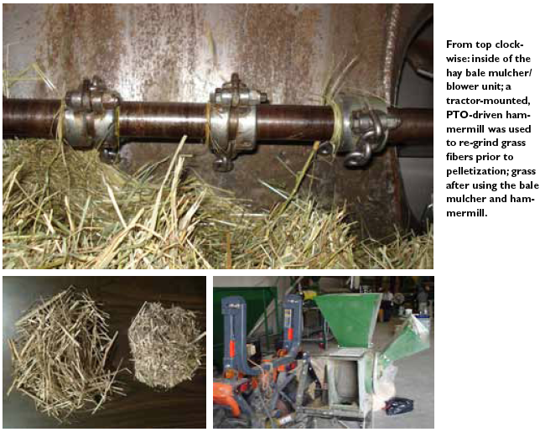
Processing & densification
Technical assessment of grass pellets as boiler fuel in Vermont, BERC (2011)

Slide 13
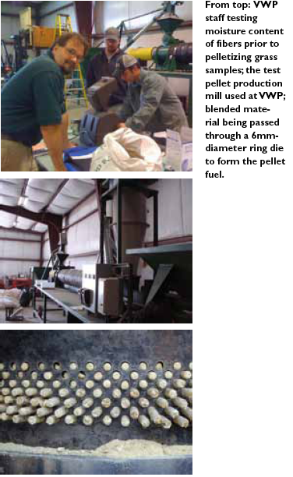
Processing & densification
Technical assessment of grass pellets as boiler fuel in Vermont, BERC (2011)

Slide 14
Processing & densification
bale at 12-14% moisture
While wood has 22 – 24% lignin, switchgrass has less, 12 – 15%.
But grass still forms pellets without added binders.
bale buster = coarse chopping
coarse chopped
¼” screen hammer mill
1/4” chopped
10” warm-up
pellet mill
> 80°C, lignin melts & gets tacky
pellet production starts
Ending the pellet run with low-lignin feedstock like soymeal will purge the die & prevent build up of hard lignins.
cooling
bagging
On-farm production of biomass grass pellets, Penn State Extension, (2014)

Slide 15
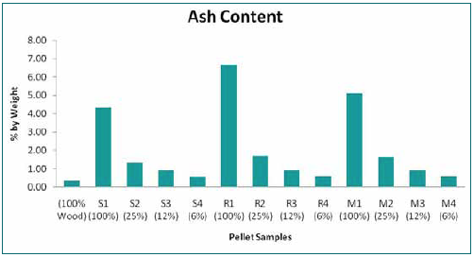
Ash content
The grass pellets had dramatically higher ash content (4.3 – 6.7%) than premium grade wood pellets.
100% grass pellets would be classified as utility- or industrial-grade wood pellets.
100% reed canarygrass pellets had ash contents to high for classification.
Switchgrass had the lowest ash content (4.3%) of all the grasses.
The grass-wood blend pellets had lower ash content than 100% grass pellets.
Technical assessment of grass pellets as boiler fuel in Vermont, BERC (2011)

Slide 16
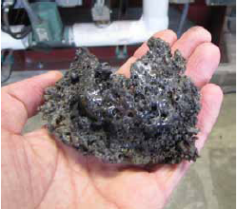
Energy content, clinkers & emissions
The energy content of grass pellets was quite comparable to that of wood pellets.
Energy content
wood | 100%
switchgrass | 102%
Reed canarygrass | 90%
mulch hay | 92%
However, fused minerals (aka clinkers) formed during test combustion of the grass pellets.
Grasses had higher concentrations of N, S and Cl than wood, creating more potential emissions:
NOx
SOx
Corrosive chlorine-containing gases.
Stack emission tests confirmed higher Nox & ash (particulate) emissions.
Technical assessment of grass pellets as boiler fuel in Vermont, BERC (2011)

Slide 17
‘Real world’ combustion tests
The longer ‘real world’ combustion tests lasted three hours and boiler performance was monitored.
All grass pellets could be combusted.
Mulch hay combustion was a challenge.
Even switchgrass pellets produced clinkers that blocked new fuel feed and air flow in the combustion chamber.
The best combustion was achieved for grass/wood blends with the most wood.
Technical assessment of grass pellets as boiler fuel in Vermont, BERC (2011)

Slide 18
Conclusions?
Hay and energy grasses can be grown productively in Vermont.
Hay and energy grasses can be densified into pellets, pucks or briquettes.
Blending with wood increases the integrity of the densified forms.
Grass pellets should not be used in residential pellet stoves designed for wood.
The VGEP believes that larger boilers designed for alternative fuels will be able to handle grass biofuels… and the search is on!
Next steps:
Blend wood and grass to allow use in current stoves & boilers.
2. Find appliances capable of burning 100% grass and build a market for this
biofuel.
Technical assessment of grass pellets as boiler fuel in Vermont, BERC (2011)

Slide 19
Cost & markets
A 2014 study of growing, harvesting and pelletizing switchgrass at Wood Crest Farm in PA found that the barebones cost of producing and pelletizing switchgrass was $89 per ton without including the cost of labor, equipment purchase or land rental.
While the intended market for switchgrass is energy a grower should be aware of alternate markets. In PA, a switchgrass grower has found these markets:
Ground switchgrass is used as a landscaping mulch and sold to landscapers or hardware and gardening stores;
Animal bedding for cows and chickens; &
Absorbent and erosion control.
On-farm production of biomass grass pellets, Penn State Extension, (2014)

Slide 20
Grass pellet burning appliances
Grass pellets burn best in appliances with:
Adjustable fuel feed rate & air-to-fuel ratios;
Automatic &/or mechanical method of ash removal; &
Ample ash storage bins, easily emptied.
Cornell has identified the best stoves for grass pellets:
Quadrafire S
Europa 75
Harman P43 S
Skanden (Reka), B
LEI BB100, B
Cornell has identified the best boilers for grass pellets:
LEI multifuel boilers
New Horizon’s modified Futura MultiBio Boiler
Grass Energy in Vermont and the Northeast, Wilson Engineering for VSJF (2014)

Slide 21
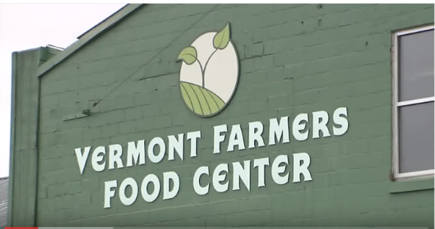
Case study: VT Farmers Food Center
Vermont Farmers Food Center occupies a renovated mill building in Rutland, VT. This vibrant new 4,200 SF agricultural hub uses a heating system that can be fueled by agriculture as well.
With the help of Chris Callahan, an agricultural engineer at UVM Extension, the center installed a multi-fuel boiler that can be fueled with:
Wood pellets;
Grass pellets or pucks; and
Other densified biomass.
video
While this multi-purpose boiler was more expensive than similar boilers with more limited fuel capacity, payback is expected to be 2-8 years, depending on the price of alternative fuels like propane.
Vermontbioenergy.com/tag/grass-biofuel

Slide 22
Case study: Meach Cove Farms
Meach Cove Farms is a 1,000-acre organic farm in Shelburne, VT that grows soybeans, rye, wheat, corn hay and wine-grapes and has a sizeable wood lot.
Have used wood pellet boilers.
Hosts grass energy trials funded by a Conservation Innovation Grant from the USDA’s Natural Resource Conservation Service (2011).
Installed the EvoWorld 350c dual wood chip & pellet boiler manufactured in Troy, NY.
The company is eager to help adapt the system to grass pellets & pucks.
video
Evoworldusa.com/helping-an-organic-farm-test-biomass-heating/

Slide 23
3.18: Conversion of grass to liquid biofuels

Slide 24
Liquid fuels
Grass can be converted into liquid fuels like ethanol, methanol and alkanes.
However, conversion is much more difficult for grasses than for high sugar or starch feedstock materials like sugarcane or grains because of the sugars in grass are bound and cross-linked into complex polymers that are difficult to break down: cellulose, hemicellulose and lignins.
Enzymes from yeast, fungi or bacteria are used to digest the highly fibrous material and break out the sugars for fermentation.
Dahiya (2015)

Slide 25
Liquid conversion steps
Feedstock is pre-treated with heat and acid or base to break down fibrous cell walls.
Enzymes or catalysts are used to hydrolyze (or break down) cellulose and hemicellulose into simple sugars like glucose and xylose.
Microbes are added in anaerobic conditions to convert the sugars to alcohols (like ethanol). - Alternatively, chemical catalysts rather than microbes can be used to create other products.
Products are recovered by separation from water, solvents, residual & feedstock materials.
Distribution of product that may, or may not, be blended with other liquid fuels.
The lignin that remains after conversion is burned to create heat & power for the conversion process.
Dahiya (2015); DOE (2010)

Slide 26
Scale of conversion plants?
The scale of conversion plants varies with the complexity of the process.
There are mobile densifiers that can produce grass briquettes or pellets.
Tractor PTO driven;
Or driven by on-trailer engines
However, cellulosic ethanol plants are complex plants that are built on a large scale to take advantage of economies of scale.
All biomass plants have to cope with the variation inherent in grass biomass feedstock.
Smaller and simpler processors are more likely to adapt…
… than large and complex plants that will have strict standards for feedstock material.
Dahiya (2015); DOE (2010)

Slide 27
3.19: Economic considerations for grass biomass

Slide 28
Modeling economics of grass biomass
The return on energy grasses isn’t high so keeping the costs of production down is essential.
Fortunately grasses require very few inputs once stands are established.
Switchgrass cost of production for five yield scenarios
Establishment cost ($/acre): $350 - 400
Annual maintenance & harvest cost ($/acre): $170 - 270
Scenario | 1 |  | 2 | 3 | 4 | 5
Biomass yield (tons/acre)
Establishment year | 0 |  | 0 | 1.5 | 1.5 | 1.5
Year 2 | 2.0 |  | 2.0 | 2.5 | 2.5 | 2.6
Years 3 - 10 | 4.0 |  | 5.0 | 4.0 | 5.0 | 6.0
Total yield (10 years) | 34 |  | 42 | 36 | 44 | 52
Average yield/year | 3.4 |  | 4.2 | 3.6 | 4.4 | 5.2
Annual average cost
$/acre | 261 | 261 |  | 261 | 261 | 286
$/ton | 77 | 62 |  | 73 | 59 | 55
Costs of establishing stands?
From seed: $400 – 500/acre
From rhizomes: $1500 – 2000/acre
N added & economics improved
Dahiya (2015)

Slide 29
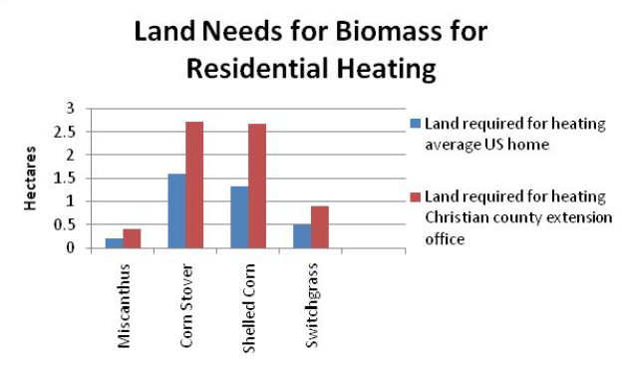
Land use for residential heating?
How much land would be needed to grow enough biomass to heat a residence?
Economics of using biomass for residential heating, U Ill, Urbana-Champaign

Slide 30
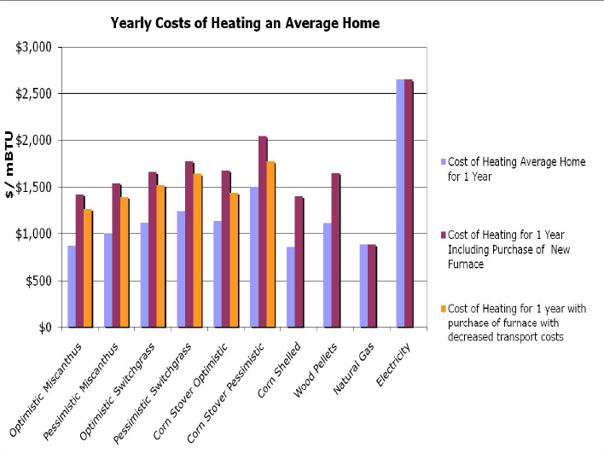
Annual cost for residential heating?
How much would it cost to heat a home with biomass vs. fossil fuels?
Economics of using biomass for residential heating, U Ill, Urbana-Champaign

