Slide 1
MEC 3040: Bioenergy
4. Bioenergy with carbon capture & storage
4.1: What is BECCS?
4.2: Why do we need BECCS?
4.3 : Methods: How do we do BECCS?
4.4: Deploying BECCS
4.5: Cost of BECCS

Slide 2
4. BECCS
4.1: What is BECCS?

Slide 3
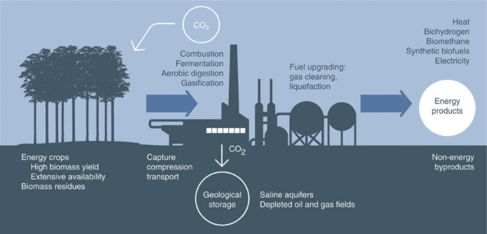
BECCS
Biomass energy carbon capture and storage
Hoped to be net carbon negative
https://www.sciencedirect.com/science/article/pii/S1750583615002650

Slide 4
Theory vs. practice?
In theory, biomass energy is carbon neutral.
“Research also shows that well-managed forests often can store as much carbon as unmanaged forests, making innovative forest management methods a key solution to fighting climate change while supporting local communities and making a profit.”
“In fact, there is increasing evidence that one of the best ways to protect forests is to use them—about half of the planet’s remaining natural forests are managed for production purposes. A viable forest-based economy means more forests. More well-managed forests mean more carbon sequestered from the atmosphere—and that means a better chance at mitigating climate change. This means that the potential for alliances between the conservation and the forest product sectors is significant.”
https://www.nature.org/en-us/what-we-do/our-insights/perspectives/forests-as-a-climate-solution/

Slide 5
Calculating carbon emissions from wood
In 2014, the UK’s Department of Energy and Climate Change (DECC) has created a biomass carbon calculator. Not all agree that all of its assumptions are valid, but let’s look at its conclusions.
Coal
1,018 kg CO2e/MWh
NG
437 kg CO2e/MWh
Waste biomass
Twigs, small branches, sawdust
100 kg CO2e/MWh
Plantation (or transitioning to plantation)
100 kg CO2e/MWh
Naturally regenerating forest
5,174 kg CO2e/MWh
The UK has created a standard of < 200 kg CO2e/MWh for 2020.
https://www.carbonbrief.org/is-burning-wood-for-energy-worse-for-the-climate-than-coal

Slide 6
‘No regrets’ forestry
Optimal management of forests to counter climate change will require a more robust ability to model and predict forest sinks.
Meanwhile, we need to practice ‘no regrets’ forestry.
1. Better science: remote sensing, common assumptions, shared goals.
2. Most carbon-efficient use of wood.
Long-term use stores carbon.
Use wood for energy rather than letting it decay.
3. Manage forests to increase both production of harvest and
storage of carbon.
https://www.nature.com/news/carbon-sequestration-managing-forests-in-uncertain-times-1.14687

Slide 7
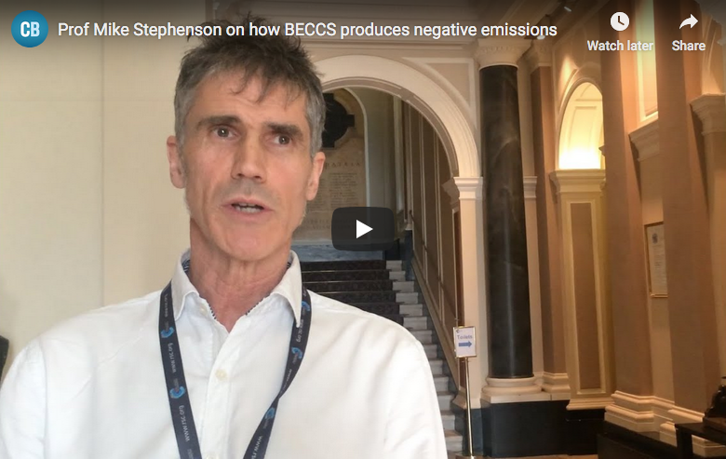
BECCS?
BECCS: biomass energy (or bioenergy) with carbon capture and storage
“Put simply, BECCS achieves net negative emissions through sequestering underground the emissions resulting from the burning of biomass for power. Negative emissions are achieved because of a “double gain” with the biomass, as it grows, having already drawn CO2 out of the atmosphere before the CCS process begins at the power plant.”
https://www.carbonbrief.org/explainer-10-ways-negative-emissions-could-slow-climate-change

Slide 8
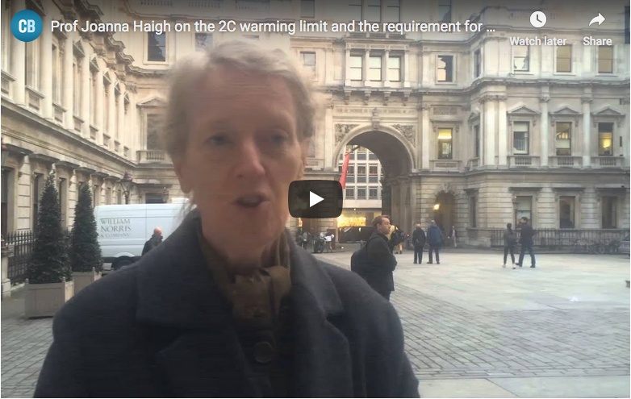
Negative carbon emissions?
Negative carbon emissions technologies: technologies that capture (or sequester) more carbon than they emit.
“To get to net-zero emissions, we need to have some of what are called “negative emissions” technologies, or things which will suck the CO2 out of the air to compensate for the ongoing release.”
- Professor Joanna Haigh
https://www.carbonbrief.org/explainer-10-ways-negative-emissions-could-slow-climate-change

Slide 9
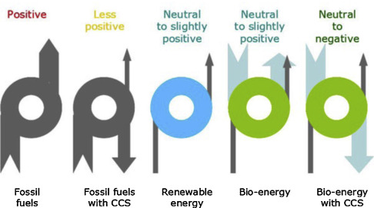
BECCS carbon emissions comparisons
https://www.sciencedirect.com/science/article/pii/S1750583615002650

Slide 10
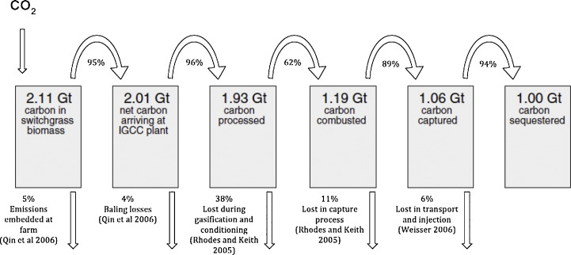
Capture isn’t perfect
https://www.sciencedirect.com/science/article/pii/S1750583615002650

Slide 11
Biomass carbon cycle
The biomass to energy cycle has three phases:
Biomass growth;
Harvest, processing, transportation; and
Combustion.
C sequestered
C emitted
growth
harvest, processing
combustion
Carbon emitted during combustion might be captured, but the emissions created by harvesting, processing and transportation are much harder to capture.
This makes negative emissions more challenging.
https://theconversation.com/carbon-capture-on-power-stations-burning-woodchips-is-not-the-green- gamechanger-many-think-it-is-110475

Slide 12
4. BECCS
4.2: Why do we need BECCS

Slide 13
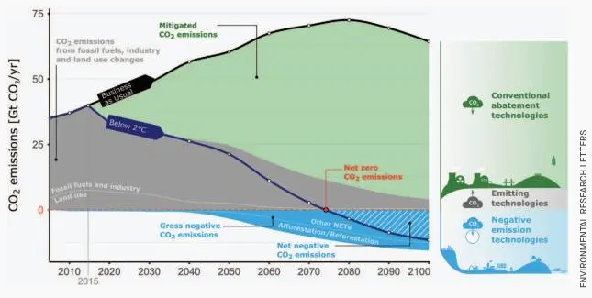
We need to ‘suck’: CCS
A 2018 IPCC report concludes that humans will have to actively remove carbon from the atmosphere to avoid catastrophic climate change.
https://qz.com/1416481/the-ultimate-guide-to-negative-emission-technologies/

Slide 14
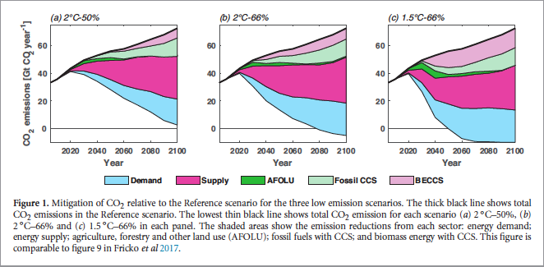
Need for BECCS (1)
Some believe that the mitigation of GCC isn’t possible without BECCS.
“Emissions reductions necessary to achieve the aspirations
of the Paris Agreement (UNFCCC 2015) may be
unachievable without large-scale use of BECCS (Larkin
et al 2017, Fuss et al 2014).”
https://iopscience.iop.org/article/10.1088/1748-9326/aaaa02/meta

Slide 15
Need for BECCS (2)
A 2014, Intergovernmental Panel on Climate Change (IPCC) report created 116 scenarios that would allow the planet to stay below 2C warming.
101 of these scenarios included BECCS
67% of these scenarios used BECCS to create at least 20% of primary electricity by 2100.
How much carbon do we need to capture (or sequester)?
Studies estimate 730 billion tonnes of C this century.
~ all carbon ever emitted by by UK, US, Germany & China
A recent study in Nature Climate Change suggested that BECCS could sequester 12 billion tonnes of CO₂ equivalents per year.
https://www.carbonbrief.org/explainer-10-ways-negative-emissions-could-slow-climate-change
https://www.theguardian.com/commentisfree/2019/aug/01/negative-emissions-tech-climate-emergency-carbon-dioxide-emissions

Slide 16
The danger of BECCS?
It’s been suggested that governments see BECCS as a ‘get-out-of-jail-for-free’ card.
The promise of BECCS – really untested potential at this point – may allow governments to believe that they can keep doing business as usual because BECCS will save the day.
But there is no denying that decarbonization is also essential.
https://www.theguardian.com/commentisfree/2019/aug/01/negative-emissions-tech-climate-emergency-carbon-dioxide-emissions

Slide 17
4. BECCS
4.3: How do we do BECCS? Methods

Slide 18
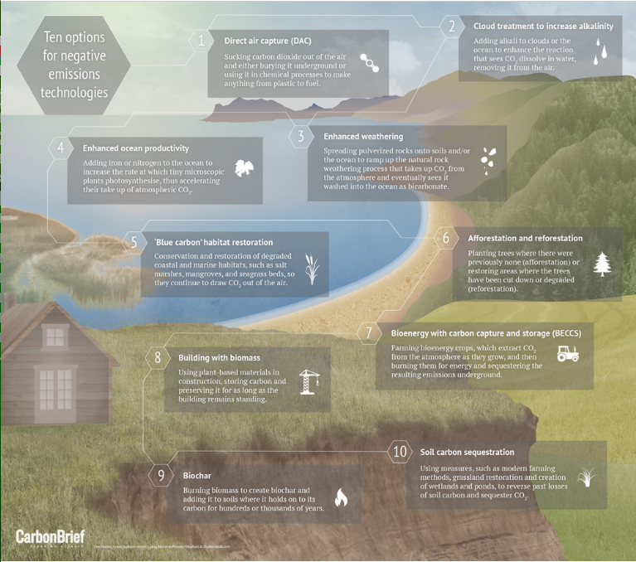
https://www.carbonbrief.org/explainer-10-ways-negative-emissions-could-slow-climate-change

Slide 19
CCS strategies
How can we move carbon from the atmosphere and sequester it?
1. Afforestation and reforestation
2. BECCS
3. Building with biomass
4. Biochar
5. Soil carbon
6. ‘Blue carbon’ habitat restoration
7. Enhanced weathering
8. Direct air capture
9. Geoengineering oceans and clouds
https://qz.com/1416481/the-ultimate-guide-to-negative-emission-technologies/
https://www.carbonbrief.org/explainer-10-ways-negative-emissions-could-slow-climate-change

Slide 20
1. Afforestation / reforestation
0.5 – 30 billion tonnes / year
$5 - $50 / tonne
Advantages:
Mature technology
Simple, though more complex than planting
Acreage
Soil
Right climate
Downsides:
Loss of albedo affect as arid land is converted to forest
Carbon sequestration only lasts decades to centuries
https://qz.com/1416481/the-ultimate-guide-to-negative-emission-technologies/

Slide 21
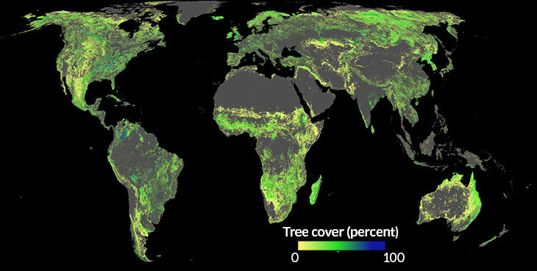
How much more forest could Earth have?
A July 2019 study suggests that Earth has room for 0.9 billion hectacres of forest (= 2.2 billion acres)
This could trap 2/3 of all carbon released by humans since the start of the Industrial Revolution.
Would not displace:
Cities
Grasslands
Farmlands
https://www.sciencenews.org/article/planting-trees-could-buy-more-time-fight-climate-change-thought

Slide 22
2. BECCS
0.5 – 5 billion tonnes / year
$100 - $200 / tonne
Advantages:
Biomass sequesters carbon as it’s growing, causing it to have a lower carbon footprint prior to combustion.
Downsides:
It’s not certain that biomass is always carbon neutral.
Significant lag time for regrowth.
Carbon released from soil as trees are harvested is often ignored.
Land is needed to grow more forest and may compete with food production.
Carbon will have to be moved to geologically appropriate storage.
https://qz.com/1416481/the-ultimate-guide-to-negative-emission-technologies/

Slide 23
3. Building with biomass
Advantages:
Simple for small and residential stuctures.
Downsides:
Will require changes in code.
At the largest scales, building technologies that use biomass rather than concrete and steel will have to be developed.
https://www.carbonbrief.org/explainer-10-ways-negative-emissions-could-slow-climate-change

Slide 24
4. Biochar
0.5 – 2.0 billion tonnes / year
$90 - 120 / tonne
What is biochar?
Wood that is combusted in the absence of sufficient oxygen; the process is called pyrolysis.
Advantages:
Biochar is easy to make and thus abundant.
Stores and builds soil carbon.
Helps soils store water and nutrients.
Downsides:
Creating biochar will use lots of wood which must be harvested sustainably.
Scaled-up trials should be done.
https://qz.com/1416481/the-ultimate-guide-to-negative-emission-technologies/

Slide 25
5. Soil carbon
up to 5 billion tonnes / year
$0 - $100 / tonne
Advantages:
Simple: add more carbon than is lost by:
Adding manure;
Growing legumes;
Avoiding soil disturbance; and / or
Optimizing grazing.
We know how to do this and can start now.
Better soils are better at feeding growing populations.
Downsides:
Soil carbon can be reach a maximum.
And carbon can be lost when soils are disturbed.
https://qz.com/1416481/the-ultimate-guide-to-negative-emission-technologies/

Slide 26
6. ’Blue carbon’ habitat restoration
‘Blue carbon’ habitats are coastal habitats: the edge of marine and terrestrial environments. Blue habitats are very complex and sequester large amounts of carbon when healthy.
Advantages:
Simple: conserving and restoring coastal habitats.
Side benefit of protection from storms.
Downsides:
Carbon will only be sequestered as long as the habitat is healthy.
https://www.carbonbrief.org/explainer-10-ways-negative-emissions-could-slow-climate-change

Slide 27
7. Enhanced weathering
2 – 4 billion tonnes / year
$50 - 200 / tonne
What is enhanced weathering?
When some rock is worn by weather, eroded or broken up it has the ability to bind carbon dioxide and chemically change, capturing the carbon.
Advantages:
Simple and low tech concept: mine and crush rock. Spread it out and let it absorb carbon.
Downsides:
Like biochar, better and larger trials are needed.
https://qz.com/1416481/the-ultimate-guide-to-negative-emission-technologies/

Slide 28
8. Direct air capture
0.5 – 5 billion tonnes / year
$200 - $600 / tonne
3 startups with demonstration projects only
Climeworks in Switzerland estimates $600 – 800 / tonne
Carbon Engineering in Canada estimates $250 / tonne
Advantages:
Could be located where storage conditions are optimal.
Downsides:
Far more expensive than CCS being used for concentrated source of carbon.
https://qz.com/1416481/the-ultimate-guide-to-negative-emission-technologies/

Slide 29
9. Geoengineering oceans and clouds
As the oceans absorb carbon dioxide a chemical reaction between the carbon dioxide gas and seawater creates carbonic acid and acidifies the ocean. Acidic oceans are not healthy ecosystems and cannot absorb more carbon dioxide.
Advantages:
Adding alkalai (lime) to the ocean or to clouds could increase the ocean’s ability to absorb carbon dioxide.
Fertilizing the oceans could grow more algae, capturing carbon.
Costs could be low: $79 - 129 / tonne of carbon captured.
Downsides:
How do you get the mix the lime and ensure it’s dissolved?
You’d have to spread an area the size of Greenland.
You’d need over a quarter of global lime production.
Playing with global systems is likely to produce unexpected effects.
https://www.carbonbrief.org/explainer-10-ways-negative-emissions-could-slow-climate-change

Slide 30
4. BECCS
4.4: Deploying BECCS

Slide 31
IMAGE model imagines BECCS scenarios
IMAGE biomass sources:
Forestry;
Waste biomass; and
Energy crops grown without impact on forestry and food.
“However, ensuring that this is the case in reality depends upon the robustness of regulatory frameworks at a regional level….”
Half of all global carbon storage required by 2100 occurs in:
US;
Western Europe;
China; and
India.
https://iopscience.iop.org/article/10.1088/1748-9326/aaaa02/meta

Slide 32
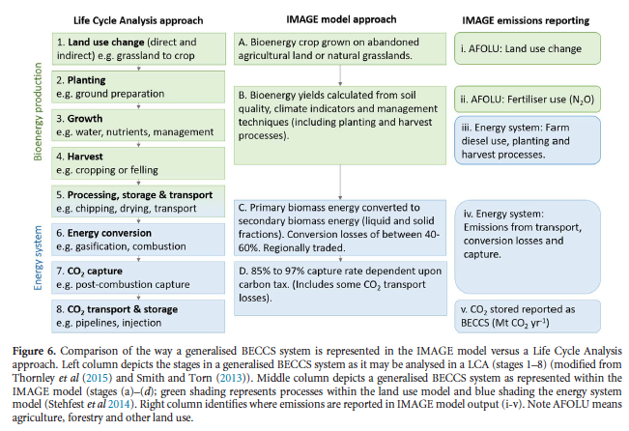
IMAGE vs. lifecycle analysis
https://iopscience.iop.org/article/10.1088/1748-9326/aaaa02/meta

Slide 33
Policy and enforcement are critical
“Deployment rates for CCS in the scenarios are challenging and may exceed those seen previously in fossil, renewable or nuclear technologies and will require
ambitious policy interventions.
It is important to note that without climate policy action (i.e. in the Reference scenario) there is no CCS.”
https://iopscience.iop.org/article/10.1088/1748-9326/aaaa02/meta

Slide 34
Drax
Drax (Yorkshire UK) is now the biggest biomass plant in the world
Fuel has transitioned from coal to now 2/3 biomass (wood pellets)
Drax burns more wood than the UK produces in one year.
4 GW generation
https://www.power-technology.com/features/draxs-carbon-capture/

Slide 35
China: co-firing BECCS
China is considering, modeling and testing many energy systems, and they are acutely aware of GCC.
A study of co-fired coal and waste biomass combined cycle gasification to produce electricity examined:
The ratio of biomass to coal; and
The cost of electricity.
35% waste biomass
$0.092 / kWh
net zero C emissions
C price of $52/tonne would make this BECCS competitive with pulverized coal power plants
https://www.pnas.org/content/116/17/8206

Slide 36
CCS experiment at Drax
Drax is conducting a CCS pilot project:
Cost: 400,000 UK pounds
Removes 1 tonne of carbon dioxide per day via an organic solvent
This novel solvent is said to be less environmentally damaging.
If successful, they will scale up to 10,000 tonnes/day at each of Drax’s four biomass units, or 40,000 tonnes of carbon dioxide/day.
Sadly, during the pilot carbon dioxide is being captured, quantitated and then released back into the flue gases.
https://www.power-technology.com/features/draxs-carbon-capture/

Slide 37
CCS pilot at ADM bioethanol plant
Archer Daniels Midland (ADM) has created a carbon capture and storage project at one of its bioethanol plants in Decatur, IL.
$208 m
U.S. DOE pays 68%
Federal agencies split the remaining costs
Ethanol plants create a relatively pure form of CO2.
CO2 is compressed into a liquid and concentrated
Pumps carbon dioxide down into the Mt Simon Sandstone formation about a mile down
Goal: 1 m tons of CO2 sequestered per year for five years
2,200 – 3,300 tons per day produced and potentially stored
Economics? Not feasible unless carbon is taxed!
https://herald-review.com/news/local/million-project-stores-adm-s-carbon-deep-beneath-decatur/article_b0c2fea2-4929-5190-b833-46dddd909e02.html

Slide 38
Snapshot of carbon capture 2019
As of 2019, 43 carbon-capture plants are operational worldwide:
US 10
Canada
Norway
Most are at oil fields or gas processing plants.
Two are at power plants.
Most CCS uses amine—based solvents that are corrosive and environmentally damaging.
And what’s the C-footprint of the CCS process?
https://theconversation.com/carbon-capture-on-power-stations-burning-woodchips-is-not-the-green- gamechanger-many-think-it-is-110475

Slide 39
4. BECCS
4.5: Cost of carbon capture?

Slide 40
Estimated cost of carbon capture?
Researchers studied the technical and economic feasibility of capturing carbon with amine technology at a Brazilian sugarcane mill during two phases:
phase | Euros / tonne CO2
Fermentation to bioethanol | 59 - 62
Combustion of bagasse to produce electricity | >>>
Carbon capture during electric generation had a negative impact on power production, so capture during fermentation was preferred.
Economics?
The current price of carbon, 10 – 20 Euros/tonne, could not support carbon capture. But market pressures, or GCC, could bump carbon costs to a point close to the cost of carbon capture.
Energies 2019, 12, 1129; doi:10.3390/en12061129 www.mdpi

Slide 41
4. BECCS
4.5: Nature-based climate solutions

Slide 42
Nature-based GCC solutions
Nature based solutions can provide up to 37% of emission reductions required for a 66% chance of maintaining 2C warming by 2030.
23.8 Pg CO2e
Half of this (11.3 PgCO2e) is cost effective if the cost of carbon is $100/MgCO2e by 2030.
One-third of this (7.9 PgCO2e) is cost effective if the cost of carbon is $10/MgCO2e by 2030.
And the co-benefits are massive:
Habitat protection
Climate resilience
Water filtration and flood buffering
Improved soil health
https://www.pnas.org/content/114/44/11645

Slide 43
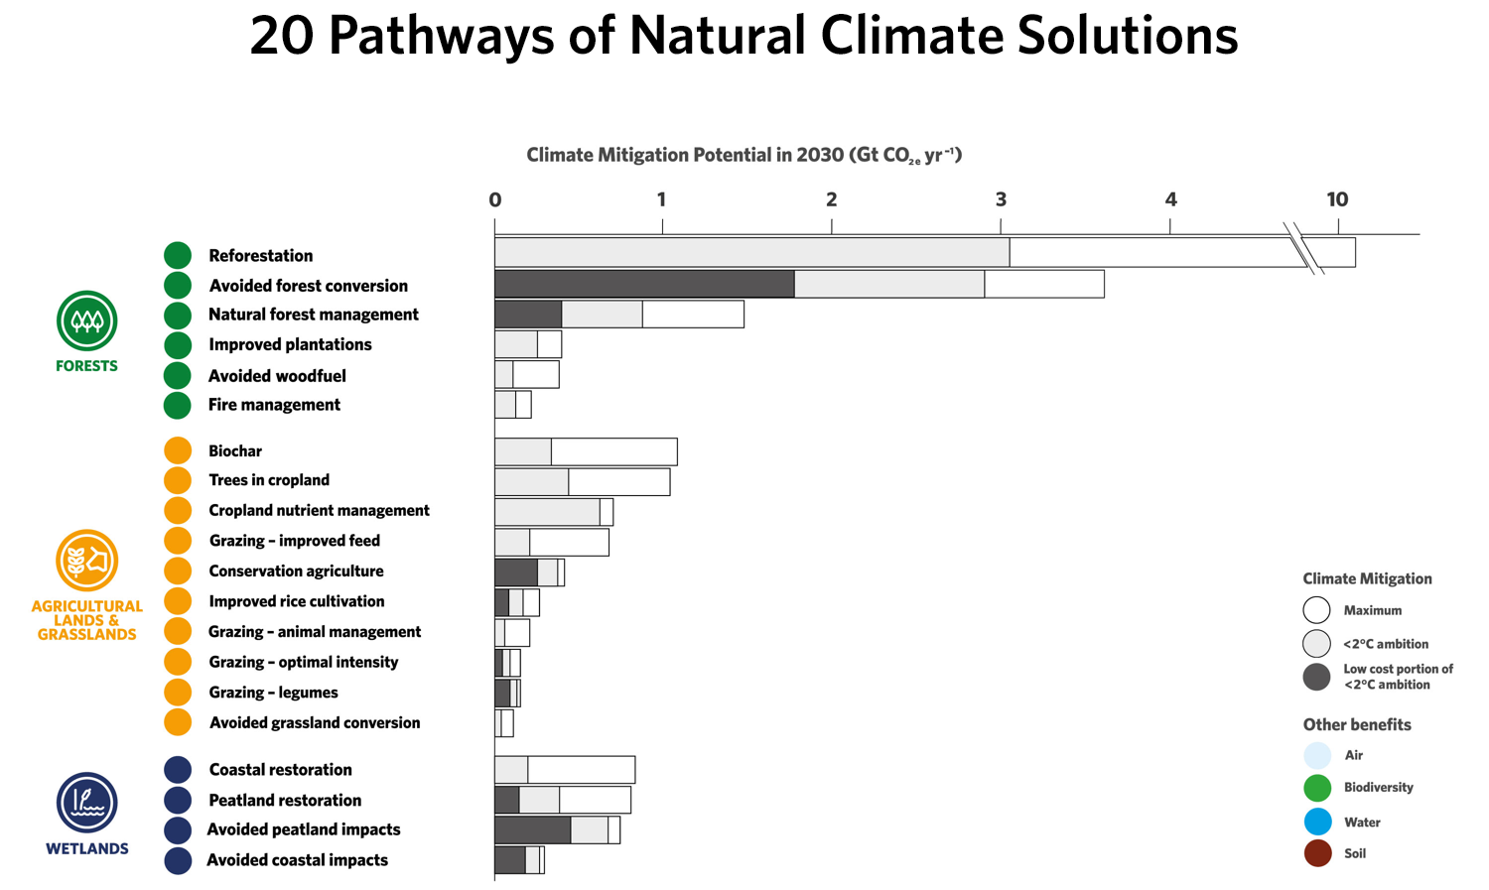
Nature-based GCC solutions
videos @ URL
https://www.nature.org/en-us/what-we-do/our-insights/perspectives/natures-make-or-break-potential-for-climate-change/
https://www.pnas.org/content/114/44/11645

Slide 44
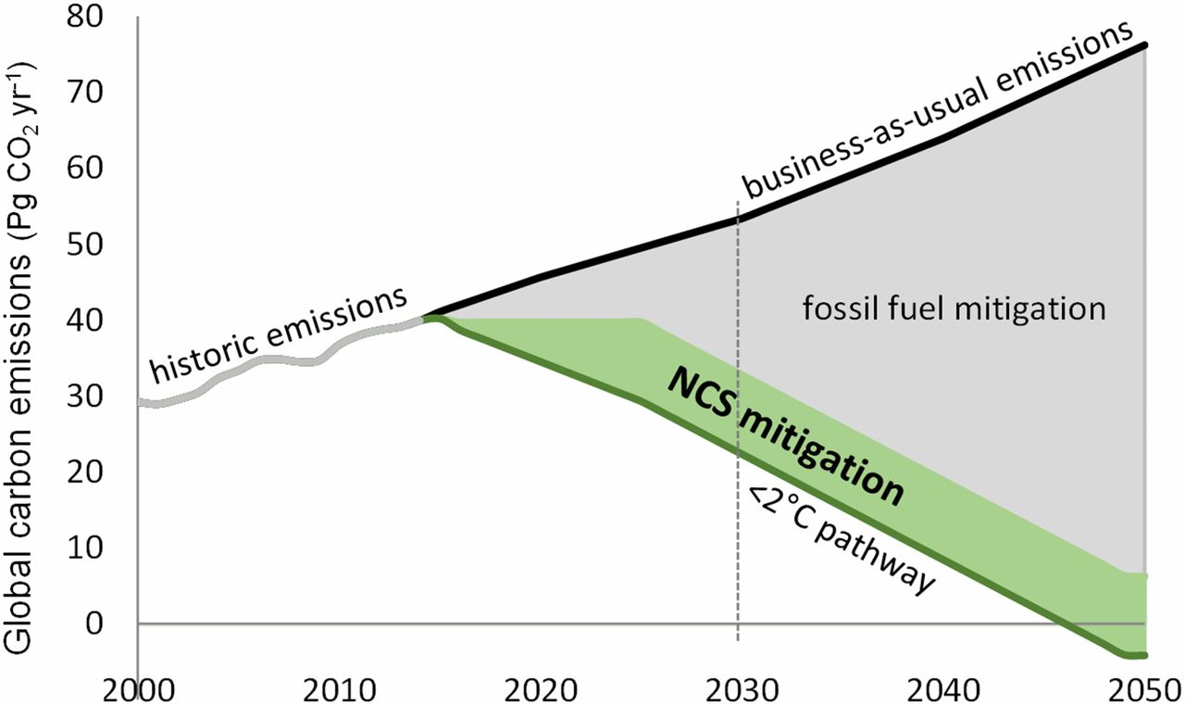
Nature-based GCC solutions
Given the magnitude of fossil fuel emissions reductions required under any <2 °C scenario, and the risk of relying heavily on negative emissions technologies (NETs) that remain decades from maturity (3), immediate action on NCS should not delay action on fossil fuel emissions reductions or investments in NETs.
Together with decreased use of coal, total NCS implementation would meet Paris Accord targets.
https://www.pnas.org/content/114/44/11645

Slide 45
Forest specific NCS methods
Together, forest pathways are two-thirds of the cost-effective NCS.
1. Reforestation – includes all grazing land in forested ecoregions, implying dietary change
35% potential in the Northeast
31% in the central South
2. Avoided forest conversion
3. Improved forest management – short-term losses in harvest, but longer-term harvest gains
Wildfires release huge amounts of carbon and slow regeneration. Recommends small prescribed burns and thinning to decrease extent of fires and increase growth rates.
4. Grassland and agriculture – nutrient management, trees in croplands
5. Wetlands – highest carbon per acre
https://www.pnas.org/content/114/44/11645

Slide 46
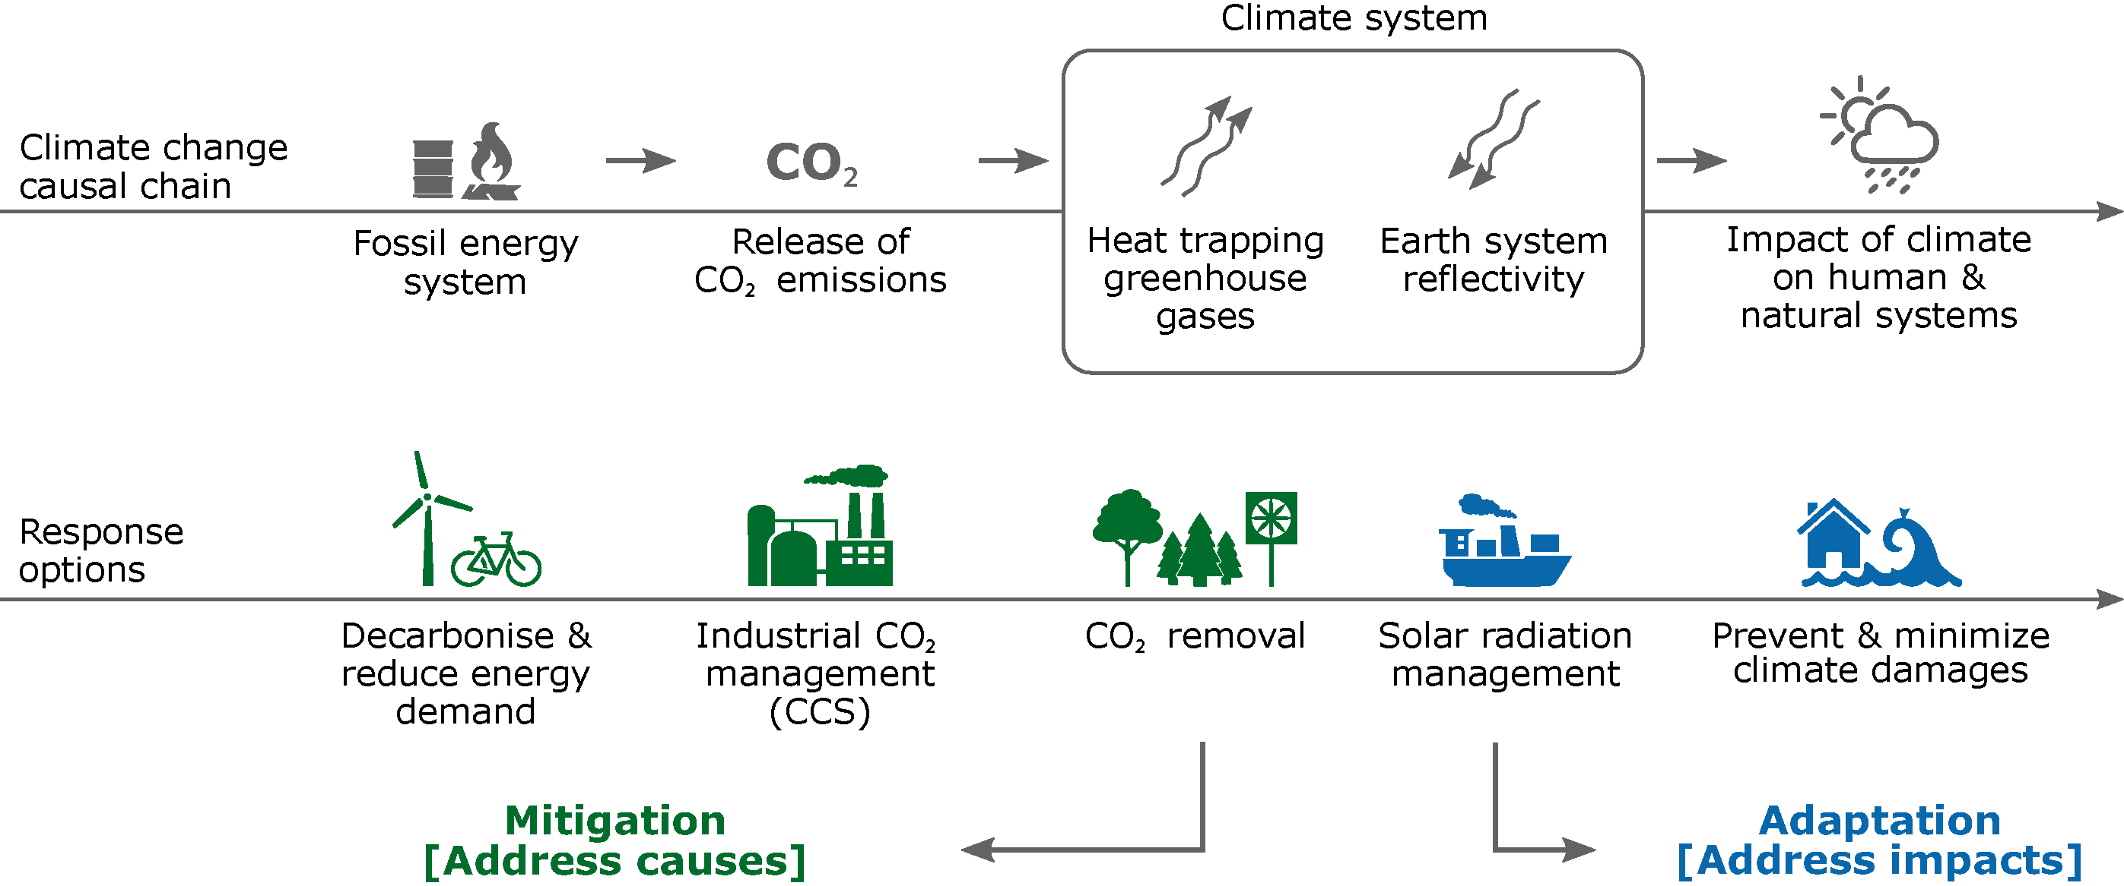
Seven thoughts about CDR (1)
CDR = CO2 removal, aka negative emissions technologies (NET)
1. CDR isn’t geoengineering
https://www.carbonbrief.org/guest-post-seven-key-things-to-know-about-negative-emissions

Slide 47
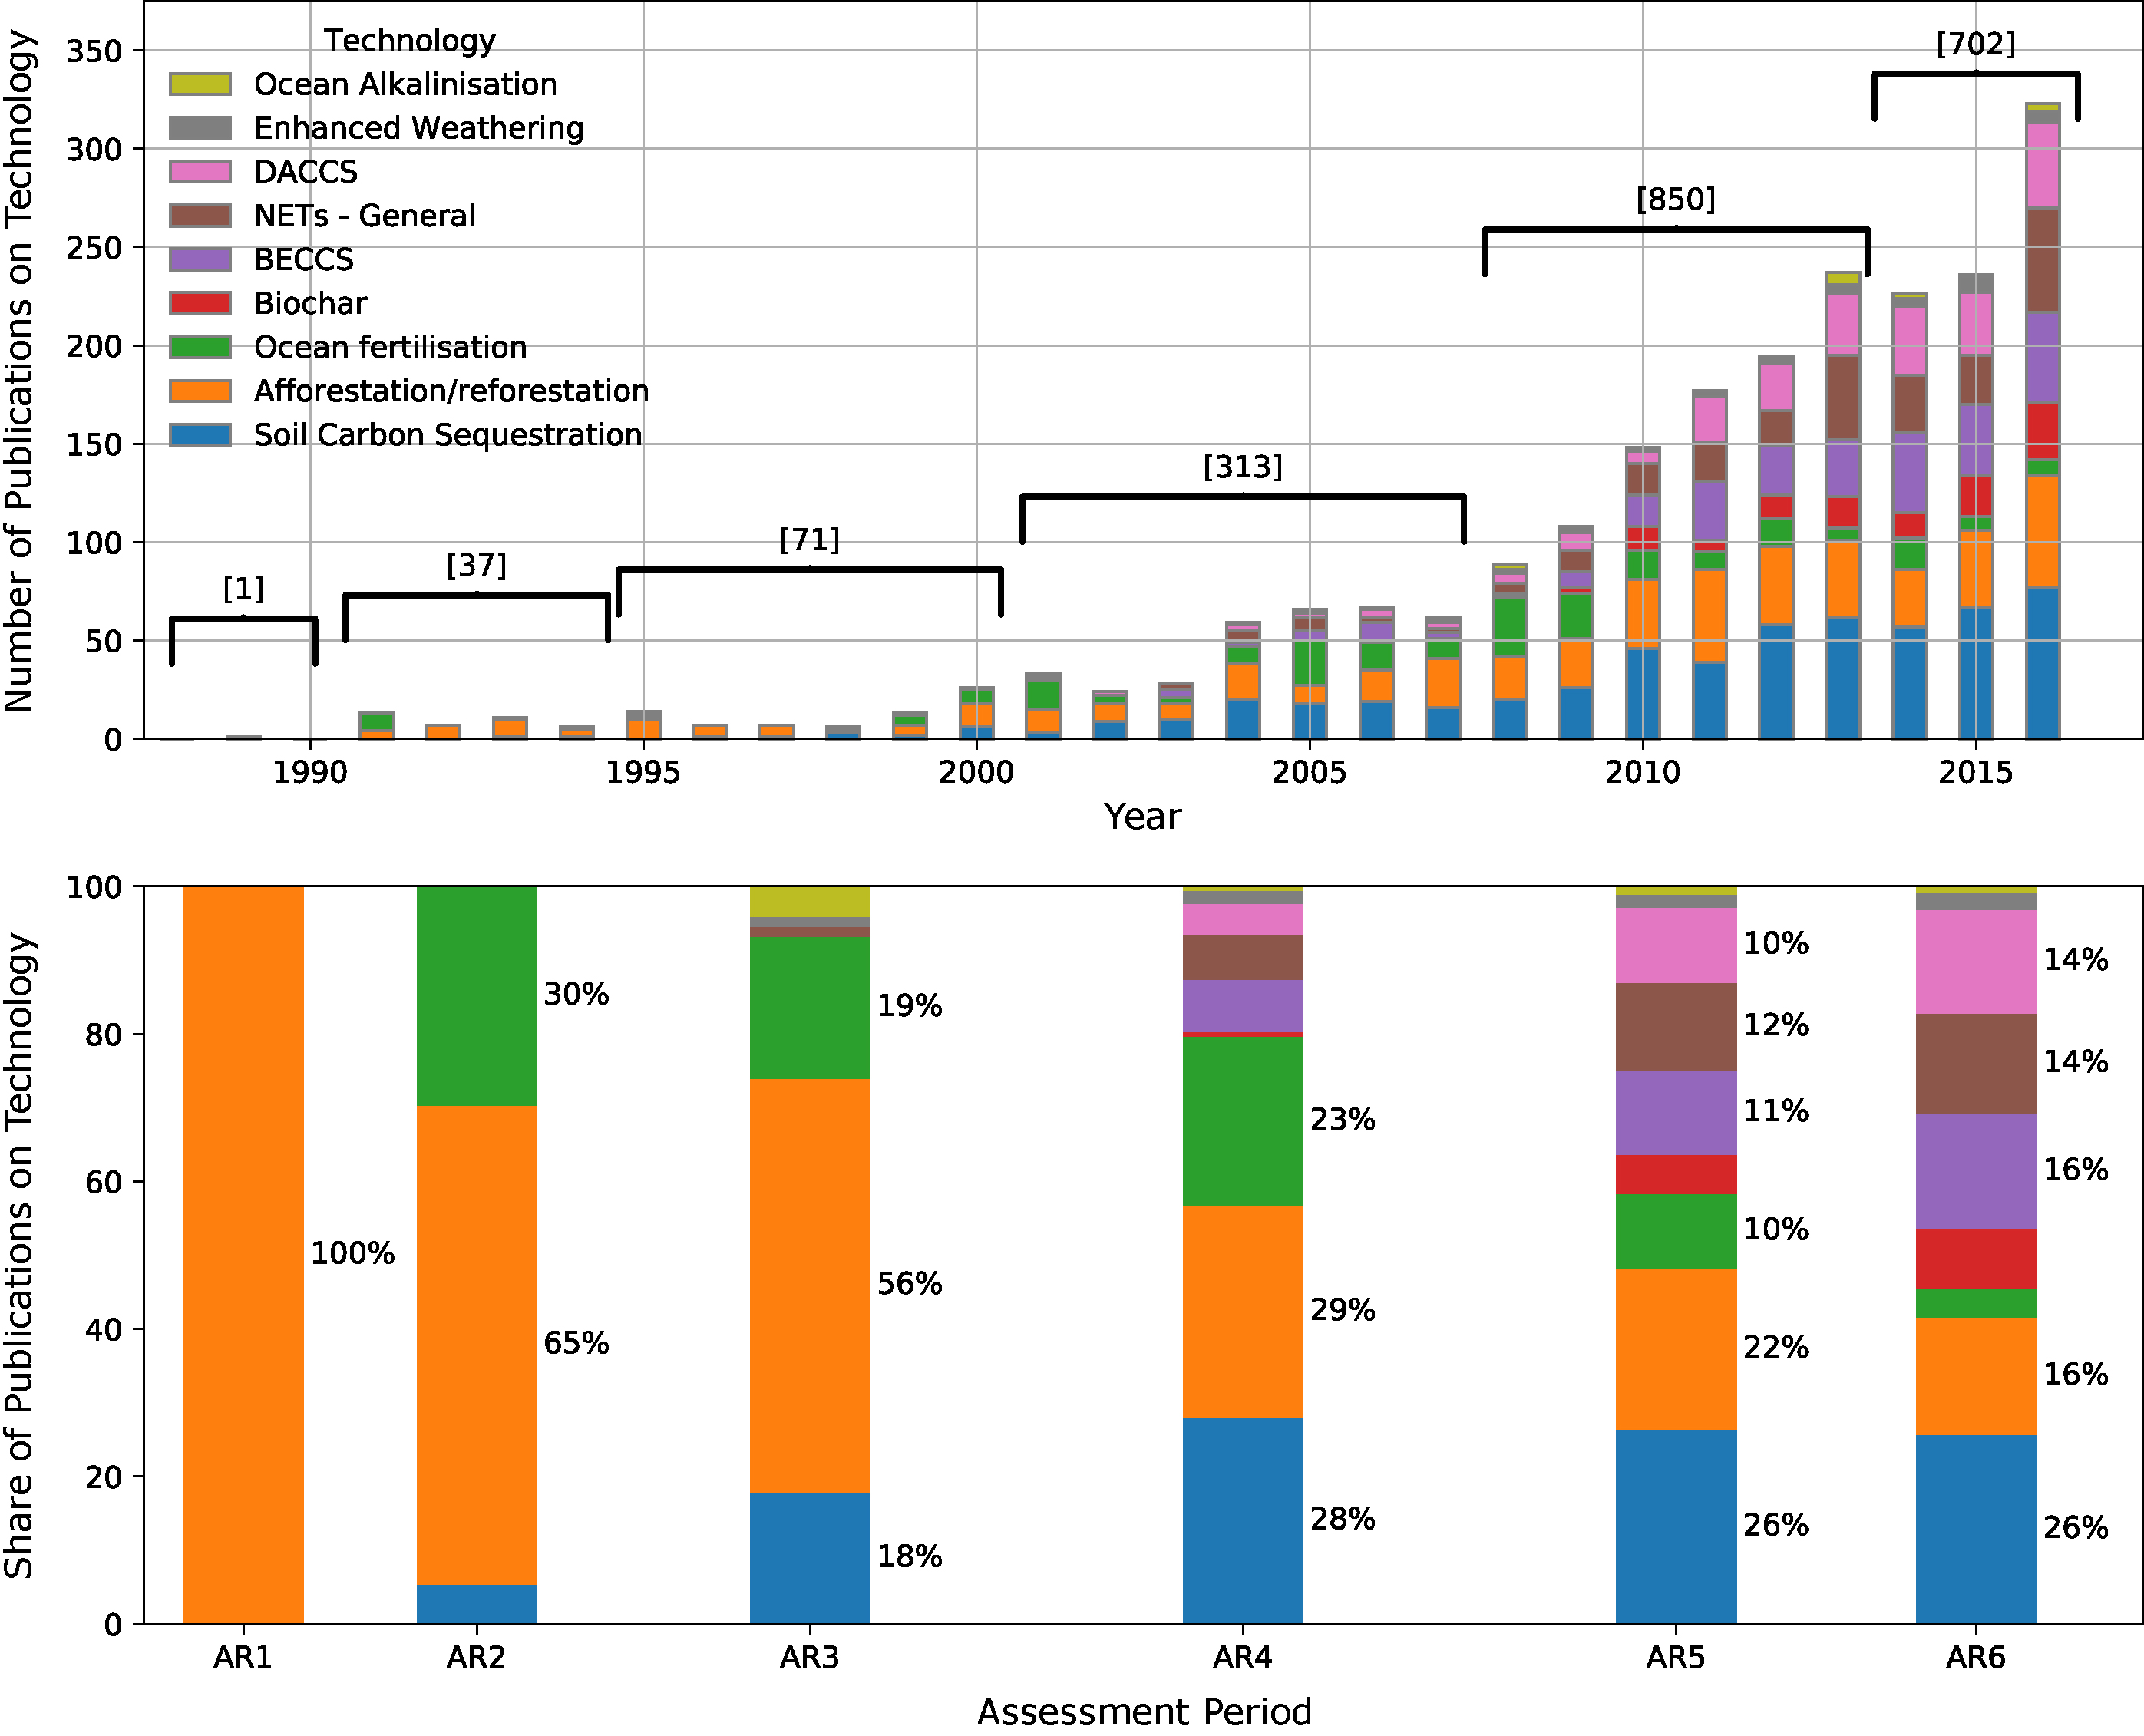
Seven thoughts about CDR (2)
2. Research on CDRs is increasing rapidly
https://www.carbonbrief.org/guest-post-seven-key-things-to-know-about-negative-emissions

Slide 48
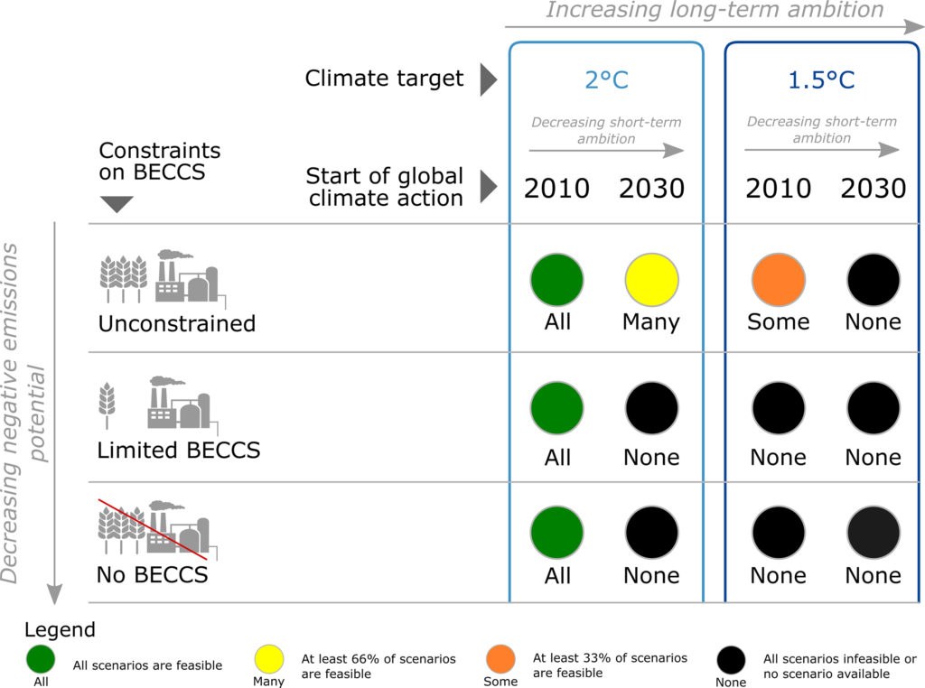
Seven thoughts about CDR (3)
3. CDRs are needed for the 1.5C goal, but not for the 2.0C goal
https://www.carbonbrief.org/guest-post-seven-key-things-to-know-about-negative-emissions

Slide 49
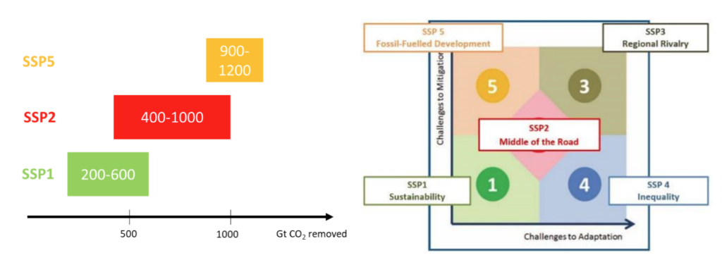
Seven thoughts about CDR (4)
4. What we do today determines how much we need CDRs
SSPs show here are shared socioeconomic pathways
Note that we’d have to agree to share first.
https://www.carbonbrief.org/guest-post-seven-key-things-to-know-about-negative-emissions

Slide 50
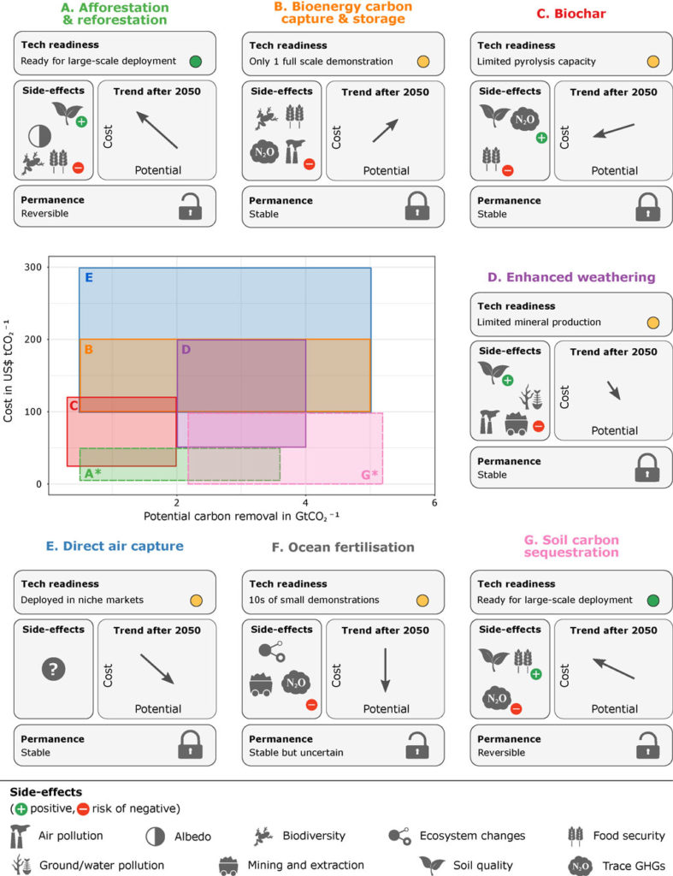
Seven thoughts about CDR (5)
5. Most CDRs have the potential for widespread deployment, but all have limits and side effects.
x-axis = benefits
y-axis = costs
https://www.carbonbrief.org/guest-post-seven-key-things-to-know-about-negative-emissions

Slide 51
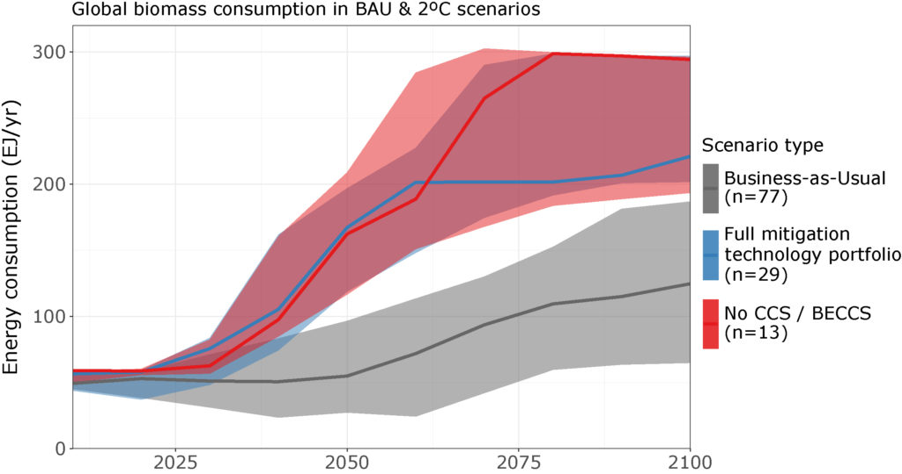
Seven thoughts about CDR (6)
6. BECCS adverse effects relate to bioenergy.
Modeling suggests that we’ll have to use bioenergy with or without BECCS, so we might as well use BECCS.
https://www.carbonbrief.org/guest-post-seven-key-things-to-know-about-negative-emissions

Slide 52
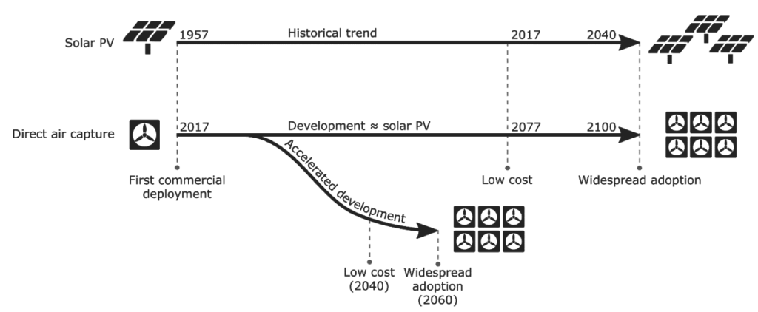
Seven thoughts about CDR (7)
7. CDRs are still in R&D and aren’t ready for widespread deployment.
Use PV as an example of timelines from R&D to deployment.
https://www.carbonbrief.org/guest-post-seven-key-things-to-know-about-negative-emissions

Slide 53
XXX
XXX
https://www.pnas.org/content/114/44/11645

Slide 54
XXX
XXX
https://www.pnas.org/content/114/44/11645

Slide 55
XXX
XXX
https://www.pnas.org/content/114/44/11645

Slide 56
XXX
XXX
https://www.pnas.org/content/114/44/11645

Slide 57
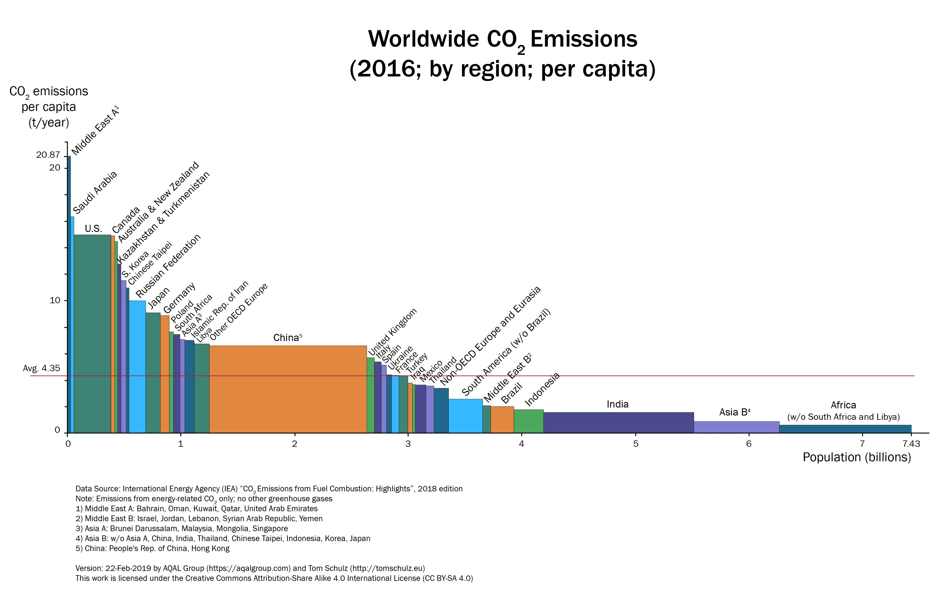
Per capital carbon emissions
https://en.wikipedia.org/wiki/List_of_countries_by_carbon_dioxide_emissions_per_capita

