Slide 1
MEC 3040: Bioenergy
Module 6: Biodiesel basics to sustainability
6.1: Brief overview of biodiesel
6.2: What’s oil anyway?
6.3: The viscosity problem
6.4: Biodiesel statistics
6.5: Transesterification basics
6.6: ‘Renewable diesel’ and ‘bio-jet’
6.7: Biodiesel sustainability?

Slide 2
6.2: What is ‘oil’ anyway?

Slide 3
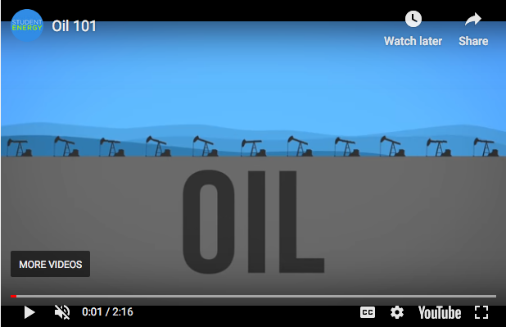
Oil: long, complex hydrocarbons
When we talk about energy and oil, we’re usually taking about petroleum:
A fossil fuel found in underground deposits;
Brown to black;
Viscous or thick;
Flammable;
A liquid hydrocarbon (C,H and less S,N,O);
Long carbon chains;
Heterogeneous size and structure.
https://www.studentenergy.org/topics/oil

Slide 4
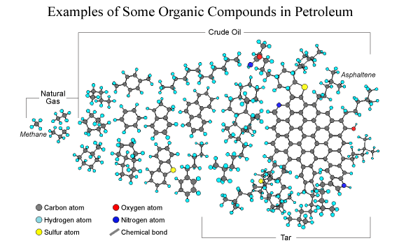
Crude petroleum: heterogeneous
https://steemit.com/steemstem/@ejehpeter/petroleum

Slide 5
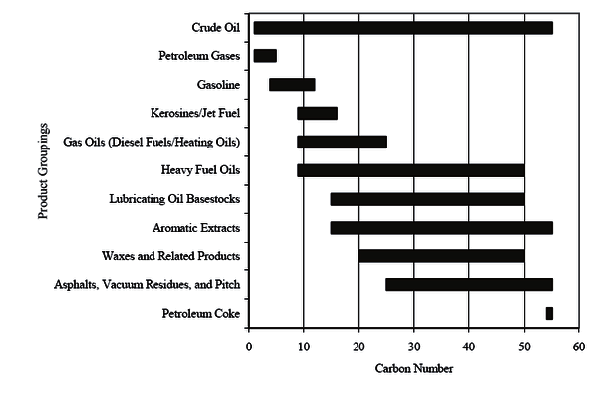
Crude petroleum: heterogeneous
octane (C₈H₁₈)
https://www.researchgate.net/figure/1Typical-Carbon-Chain-Lengths2_fig1_284022208

Slide 6
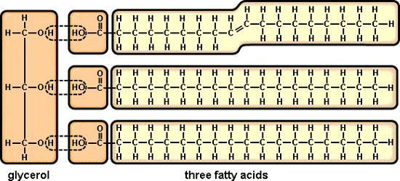
Petro-oil vs. vegetable oil
Vegetable oils are found in the seeds and nuts of plants where they are used to store energy needed for plant growth following germination but before photosynthesis.
Triacylglycerides (TAG): three fatty acids connected to a glycerol ‘backbone’ by ester (aka acyl) linkages
acyl linkages
hydrophilic: ‘water-loving’ or water soluble
hydrophobic: ‘water-hating’ or oily; soluble in oil but not water
https://www.biology.iupui.edu/biocourses/N100/2k4ch3carbolipidnotes.html

