Slide 1
MEC 3040: Bioenergy
Module 6: Biodiesel basics to sustainability
6.1: Brief overview of biodiesel
6.2: What’s oil anyway?
6.3: The viscosity problem
6.4: Biodiesel statistics
6.5: Transesterification basics
6.6: ‘Renewable diesel’ and ‘bio-jet’
6.7: Biodiesel sustainability?

Slide 2
6.3: The viscosity problem

Slide 3
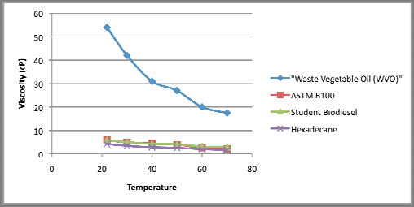
Viscosity and fuel oil
To fuel a diesel engine, oil should be:
Flammable;
Mainly C and H;
Low viscosity; and yet
Lubricating.
Viscosity: resistance to flow
TAG
16 C oil
https://www.researchgate.net/figure/Viscosity-of-Waste-Vegetable-Oil-WVO-compared-with-biodiesel- Viscosity-applications_fig4_312085587

Slide 4
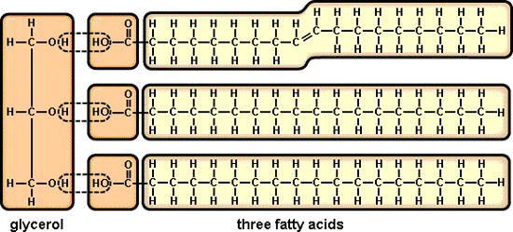
Why are TAGs more viscous?
When the long hydrocarbon chains of both petro-oil and vegetable oils (TAGs) line up and overlap, attractive force pulls them together.
The longer the hydrocarbon chains, the more viscous (the thicker) the oil.
bunker oil > fuel oil > diesel > kerosene > gas
longer chain TAG > short chain TAG
A second factor increases the viscosity of TAGs: their glycerol backbones interact via polar or hydrogen bonds.
https://www.biology.iupui.edu/biocourses/N100/2k4ch3carbolipidnotes.html

Slide 5
Straight vegetable oil as fuel?
Published studies suggest that long-term use of straight vegetable oil (SVO) in diesel engines will lead to reduced engine life caused by build up of carbon deposits inside the engine and of SVO in the engine lubricant.
Build up isn’t immediate, but takes time.
Root cause is the higher viscosity of vegetable oils when compared to no. 2 diesel fuel.
This buildup isn’t really prevented by:
Heating SVO prior to injection; or
Blending SVO with conventional fuel.
Dahiya (2015)

Slide 6
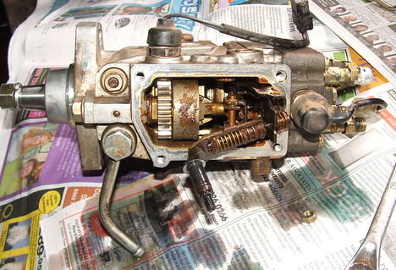
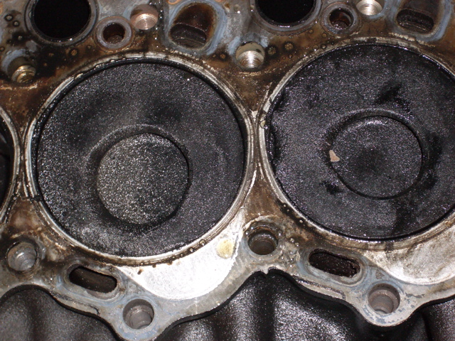
Coking and ‘gunk’
BELOW: note the damage to the edge of the piston and around the combustion chamber (the hole in the middle for the DI Toyota) and also the piston on the left sits slightly lower than the one on the right (due to hydraulic lockup).
ABOVE: gunge build up on an injector pump
https://www.biofuelsforum.com/threads/4379-Direct-Injection-Landcruiser-(Factory-Turbo-Diesel)-engine-insp-after-running-on-WVO

Slide 7
Why does SVO create ‘gunk’?
Modern diesel engines use fuel injection systems … Common vegetable oils are 10-20 times more viscous (thick) and cannot properly atomize in stock systems. Thicker more viscous fuels have larger droplets … These larger droplets do not burn completely. Indirect injection (IDI) engines have a little pre-combustion chamber where the fuel gets sprayed first before the fireball expands into the cylinder. Big droplets of fuel just splatter against the very hot walls of the pre-combustion chamber, vaporize and eventually burn completely. Direct Injection (DI) engines run the risk of accumulating partially-burnt fuel on the cylinder walls. If the fuel droplets are too big to finish burning before hitting the cylinder walls, the oil can stick to the cylinder wall because the cylinder walls are not hot enough to vaporize it like is done in the pre-combustion chamber. The rings scrape off this partially-burnt goo, which bakes itself into the ring grooves, gluing the rings in place. It is a process called "piston ring coking." The result of piston ring coking is a loss of compression and cylinder wall scoring if left uncorrected. The only way to repair the damages is to tear down and re-ring the engine.
Ring coking can allow fuel to blow by the seized rings diluting the crankcase oil with fuel. Once in the crankcase, vegetable oil polymerizes making the lubricating oil thicker and ineffective. The result is a catastrophic engine failure. Loss of lubrication has been known to cause loud knocking noises followed by the appearance of large holes in the engine block.
http://www.make-biodiesel.org/SVO-Tutorial/the-case-for-conversion.html

Slide 8
Fixing the oil?
As post-oil crisis experiments running diesel engines on SVO showed that long-term use would foul the engines, researchers in Austria, South Africa and Idaho realized that something had to change if vegetable oils were going to be a viable fuel.
Which should be changed, the engine or the fuel?
Modifying the oil already looked possible and certainly seemed more commercially viable as diesel engines were already in wide-spread use.
A quick ‘coking’ test was developed to screen for the best fuel modifications:
Run an engine on the fuels and monitor power in a torque test.
Pull the fuel injector and look at coking: carbon deposits on the injectors.
Biodiesel passed the coking test.
Pahl (2005)

