Slide 1
MEC 3040: Bioenergy
Module 6: Biodiesel basics to sustainability
6.1: Brief overview of biodiesel
6.2: What’s oil anyway?
6.3: The viscosity problem
6.4: Biodiesel statistics
6.5: Transesterification basics
6.6: ‘Renewable diesel’ and ‘bio-jet’
6.7: Biodiesel sustainability?

Slide 2
6.4: Biodiesel statistics

Slide 3
What is biodiesel?
Biodiesel is a nontoxic, biodegradable, combustible liquid fuel.
Domestic
Renewable
Made from vegetable & animal fats
The most diverse liquid fuel
EPA classifies biodiesel as an advanced biofuel
In Europe, canola oil is the predominant feedstock
Made from bio-oil feedstock:
Soybean oil
Canola oil
Sunflower oil
Mustard oil
Rapeseed oil
Cooking grease
Fish oil
Dahiya (2015)

Slide 4
Early US driving tests
1994: ‘Truck in the Park Project’
A Dodge pickup truck with diesel winterization package was fueled with 100% rapeseed ethyl ester;
130,000 miles prior to stripping and inspecting the engine;
Little wear and no carbon build up;
Bear study found that bears were not attracted to the French fry smell of the biodiesel.
1999: a Kenworth tractor-trailer was run on a 50:50 blend of bio:petro diesel
Biodiesel made from waste fryer oil;
200,000 mile road test;
Caterpillar evaluated the engine before and after;
Successful!
Pahl (2005)

Slide 5
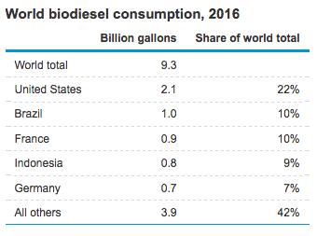
Biodiesel use today
As of 2005, total global production of biodiesel approached 2 million metric tons, or 570 million gallons annually.
2/3 in Western Europe
1/3 in Eastern Europe, the US and the rest of the globe
How does that compare with current use of liquid petroleum fuels in the US?
58 billion gallons per year
35 billion gallons (60%) for highway vehicles
Remainder (40%) for all other uses
So, biodiesel is about 6% of US petro-diesel.
Pahl (2005)

Slide 6
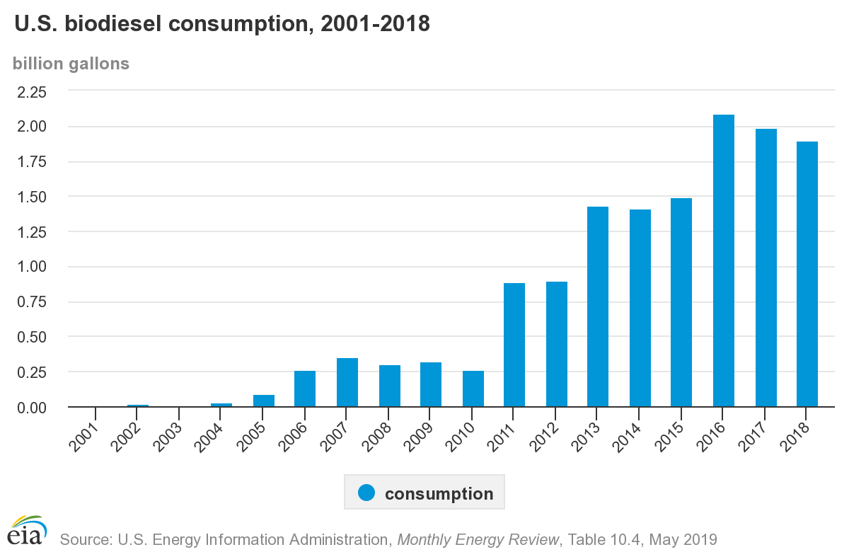
US increasing biodiesel use

Slide 7
Biodiesel potential?
Biodiesel could replace about 14% of petro-diesel use if made from:
½ of used cooking oil (2.5%)
½ of animal fats (1.25%)
All fallow cropland in the US converted to good canola (10%)
Algae might produce another 14% of biodiesel.
So, with investment and work biodiesel could make a dent in, but not replace petrofuels.
Notice that using virgin vegetable oils aren’t discussed for future biodiesel potential.
Pahl (2005)

Slide 8
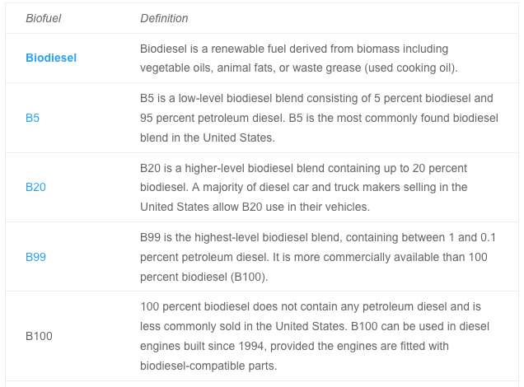
B5, B20 and biodiesel blends
2015: Biodiesel made up just 3% of all diesel fuel.
https://www.targray.com/biofuels/blends

