Slide 1
MEC 3040: Bioenergy
Module 6: Biodiesel basics to sustainability
6.1: Brief overview of biodiesel
6.2: What’s oil anyway?
6.3: The viscosity problem
6.4: Biodiesel statistics
6.5: Transesterification basics
6.6: ‘Renewable diesel’ and ‘bio-jet’
6.7: Biodiesel sustainability?

Slide 2
6.5: Transesterification basics

Slide 3
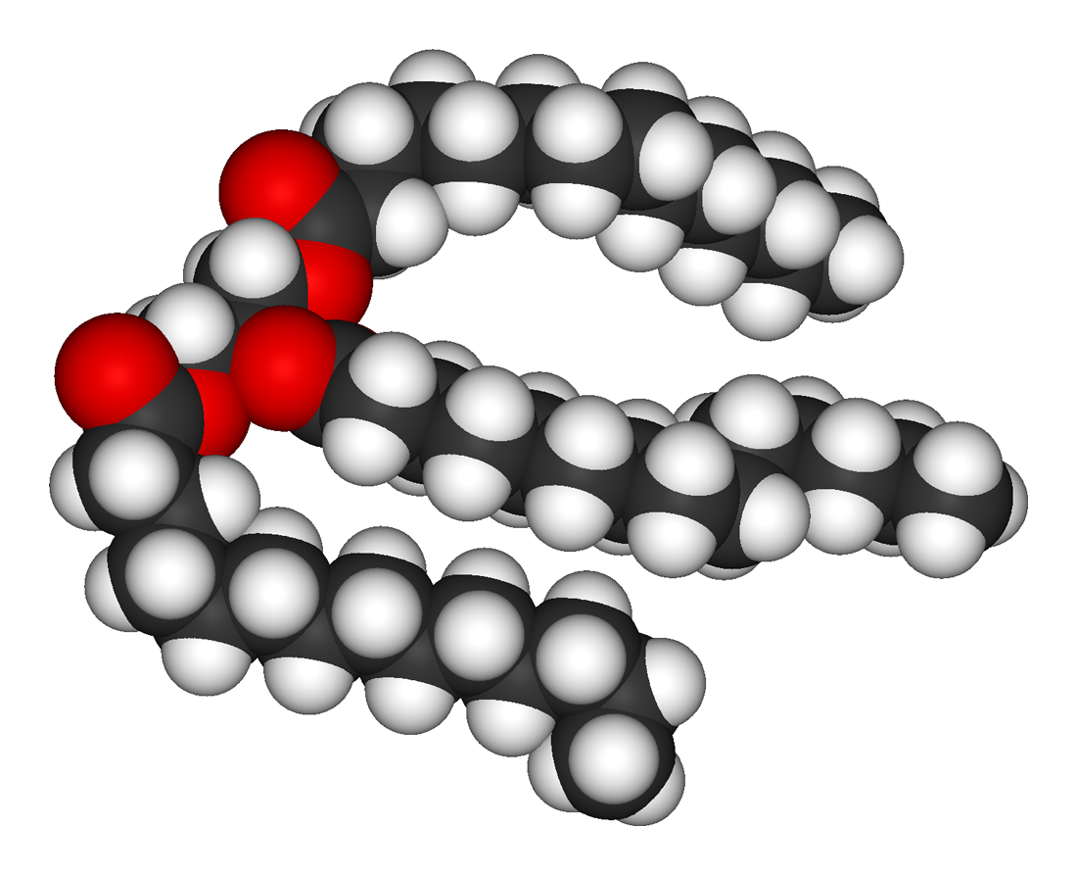
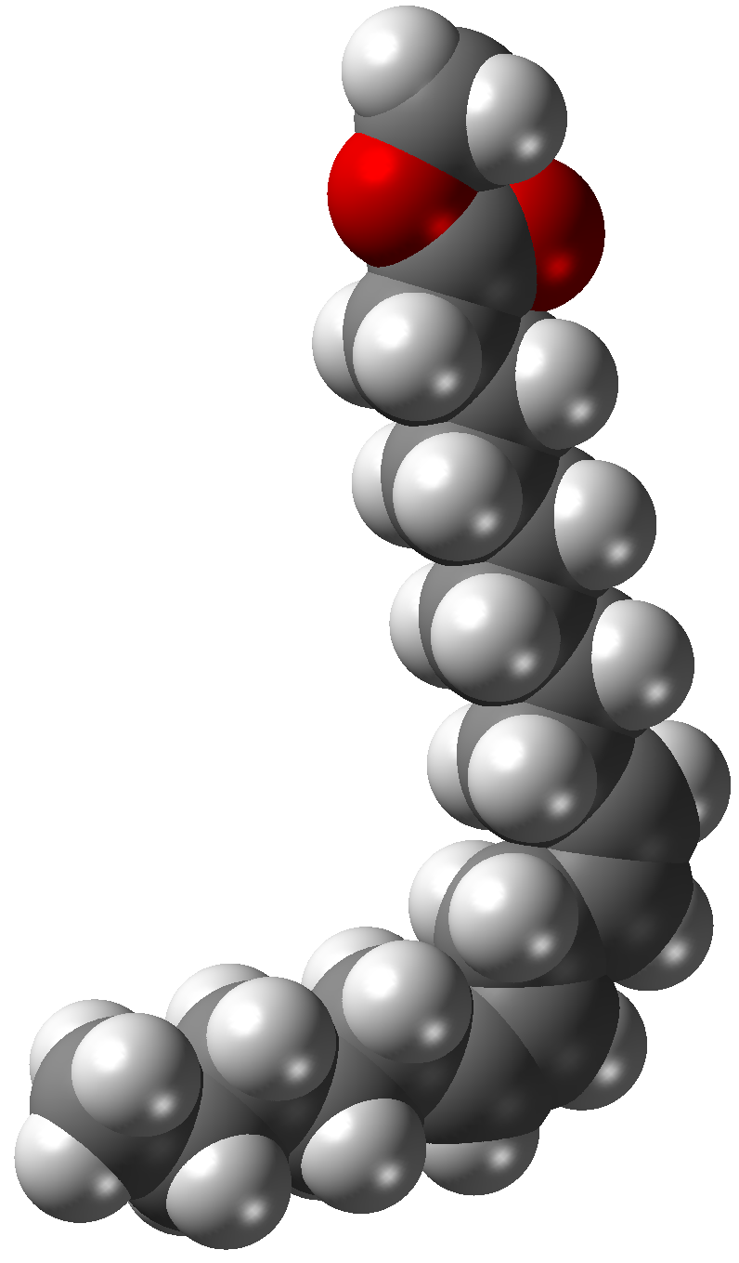
TAG to fatty acid methyl ester
Vegetable oils are triacylglycerols: three fatty acids attached to a 3-carbon glycerol backbone by acyl bonds.
TAG
transesterification
FAME x3
FAME (fatty acid methyl ester): fatty acids ‘cut’ from TAGs and capped with a methyl ester group
Pahl (2005)
Wikipedia images

Slide 4
Overview: biodiesel process
triacylglycerol
‘cracking’ via a
hydroxide catalyst
glycerol + 3 fatty acids
transesterification
reaction of fatty acids with alcohols
Phase separation:
oil & water separate
fatty acid alkyl esters
biodiesel layer on top (2/3 volume) over
glycerol-rich bottom phase (1/3 volume)
Acids are sometimes added to prevent the formation of soap.
Pahl (2005)

Slide 5
Translation?
Cracking: A base (a hydroxide) is used to cut the fatty acid chains from the glycerol backbone of triacylglycerols.
Sodium hydroxide (lye or caustic soda) is less expensive than potassium hydroxide.
In petroleum refining, cracking refers to cutting huge oil molecules into smaller and shorter, and thus less viscous, pieces.
Alkyl esters: Molecules created by capping free fatty acid chains with an ester group coming from an alcohol.
Ester (or acyl) linkages connect the FA and the ester.
Methyl ester have a one-carbon ester group.
Ethyl esters have a two-carbon ester group.
O
||
-- O – C --
Free fatty acids:
Fatty acid chains broken from the triacylglycerol by repeated & prolonged heating. FFA are carboxylic acids and lower the pH of oil used or stored oils.
Pahl (2005)

