Slide 1
MEC 3040: Bioenergy
Module 6: Biodiesel basics to sustainability
6.1: Brief overview of biodiesel
6.2: What’s oil anyway?
6.3: The viscosity problem
6.4: Biodiesel statistics
6.5: Transesterification basics
6.6: ‘Renewable diesel’ and ‘bio-jet’
6.7: Biodiesel sustainability?

Slide 2
6.6: ‘Renewable diesel’ and ‘bio-jet’

Slide 3
'Renewable diesel’?
Like biodiesel, renewable diesel is made by chemical modification of bio-oils.
But the oxygen atoms are replaced with hydrogen.
And it’s then structurally identical to petro-diesel.
A related process can be used to make ‘renewable’ jet fuel or ‘bio-jet’.
ASTM allows commercial jet fuel to be 50% bio-jet.
Because these fuels are chemically identical to petro-fuels they are sometimes referred to as ‘drop-in fuels’ or HEFA (hydroprocessed esters and fatty acids).
They can be used without any modification of vehicles.
Thus, more easily marketed.
Switching fuels isn’t a hardship.
In 2014, global production of HEFAs topped 1 billion gallons.
https://www.ucsusa.org/resources/biodiesel-basics (2015)
https://www.eia.gov/todayinenergy/detail.php?id=23692

Slide 4
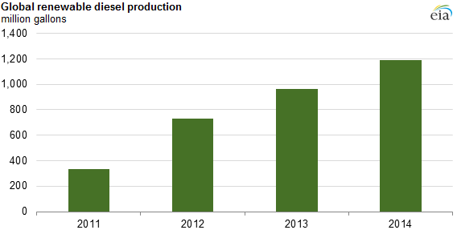
Global growth of HEFA production
2015: globally, 10 plants that produced HEFA
Major producers: ENI (Italy), Total (France), Neste (Finland), Diamond Green Diesel (US), Preem (Sweden)
https://www.eia.gov/todayinenergy/detail.php?id=23692

Slide 5
Making HEFAs?
Hydrotreated vegetable oil (HVO) is produced by reacting vegetable oil with hydrogen in the presence of a catalyst.
This process removes oxygen and product is identical to petro-oil.
Hydrogen can be derived from natural gas, biomass or biogas.
Neste Renewable Diesel Handbook
https://www.mdpi.com/2073-4344/9/4/337

Slide 6
HEFA and other products
Process options produce slightly different products.
Neste Renewable Diesel Handbook
https://www.mdpi.com/2073-4344/9/4/337

