Slide 1
MEC 3040: Bioenergy
Module 7: Biodiesel feedstock materials,
processing and production
7.1: Biodiesel feedstock sources and crops
7.2: Cultivation and harvesting in New England
7.3: Oil extraction
7.4: Algal biodiesel?
7.5: Transesterification
7.6: Small-scale (on-farm) production
7.7: Larger scale production

Slide 2
7.1: Biodiesel feedstock
sources and crops

Slide 3
Oils for biodiesel?
A wide variety of oils can be used as biodiesel feedstock.
Reuse increases the EROI.
Go local.
Be flexible; feedstock is 70% of the cost of production of biodiesel.
Oil palm
Coconut
Jatropha
Rapeseed / canola
Peanut
Sunflower
Safflower
Mustard
Soybean
Corn
Used cooking oil
Animal fat
Algae?
Biodiesel feedstock oils
Pahl (2005); Austrian Biofuels Institute

Slide 4
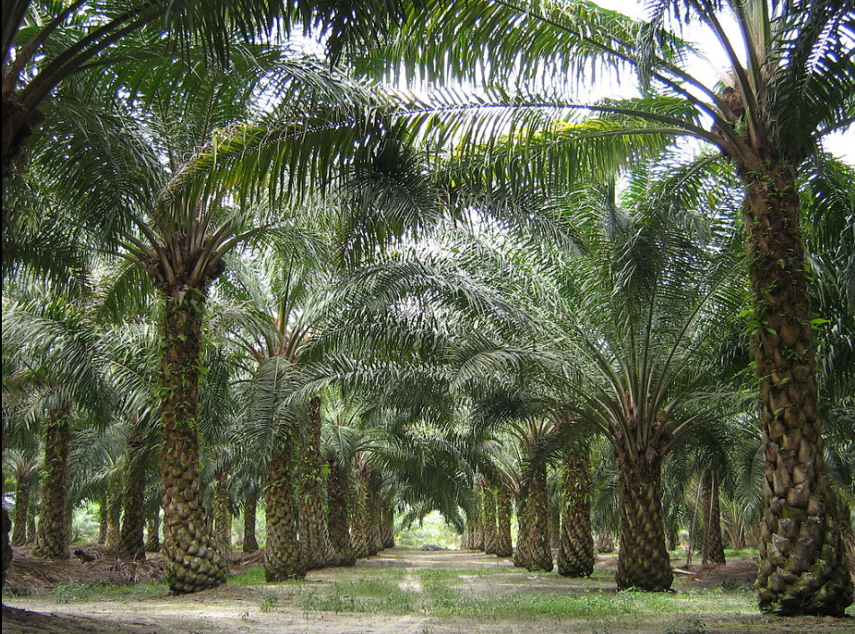
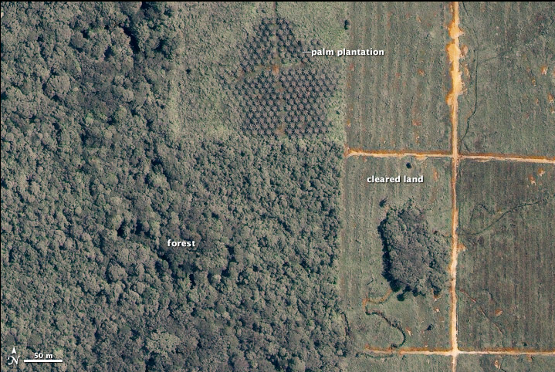
Oil palm
Oil palm:
Fruits are 45 – 55% oil.
High yields of 365 gallons per acre;
Cake is used as animal feed;
High cloud point.
Oil palm plantations are expanding rapidly.
Major threat to rainforest & tropical habitats that are cleared to plant palm plantations.
Drastically reduces biodiversity….
… and wildlife habitats.
Oil palm plantations are feeding
Europe’s biodiesel appetites,
fueled by renewable energy targets
and policies.
Image
Pahl (2005)

Slide 5
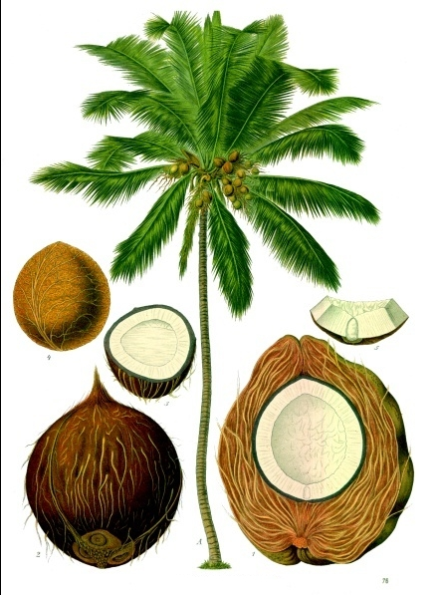
Coconut
Coconuts produce about half the oil as palm nuts:
High yields of 287 gallons per acre
Third most common oil globally
The meat of the coconut is shredded
& pressed to separate oil and meal.
The meal is used as an animal feed.
Image
Pahl (2005)

Slide 6
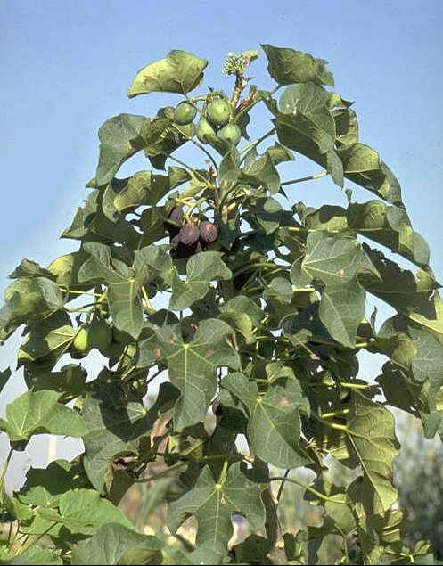
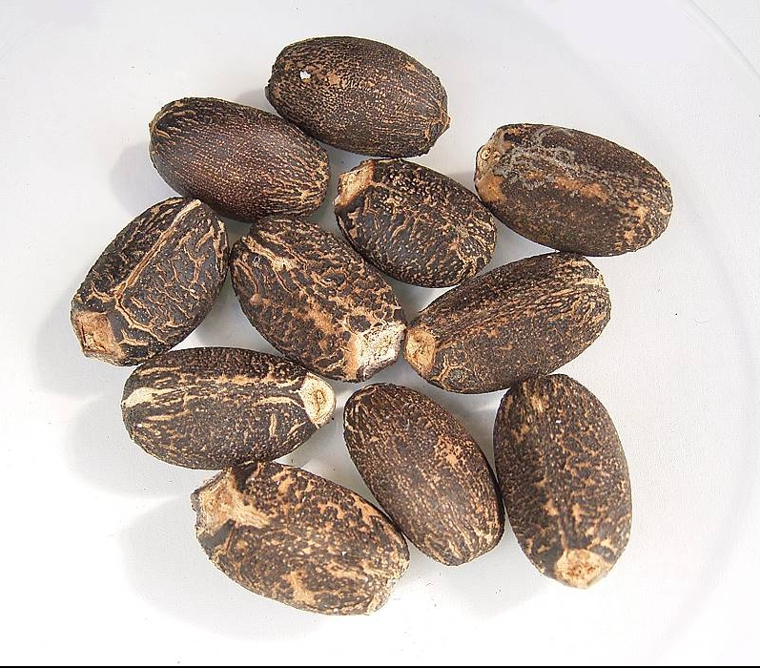
Jatropha
Jatropha is a bush or small tree:
Can be grown in marginal & semi-arid conditions.
Can be used as a hedge to fence in animals or prevent erosion.
Traditionally used as a lamp fuel, source
of soap and medicines.
Yield of 202 gallons per acre.
Jatropha has the potential to be a sustainable crop.
Image
Pahl (2005)

Slide 7
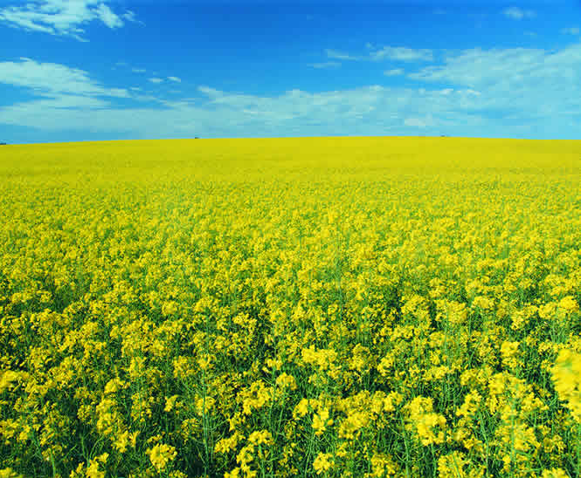
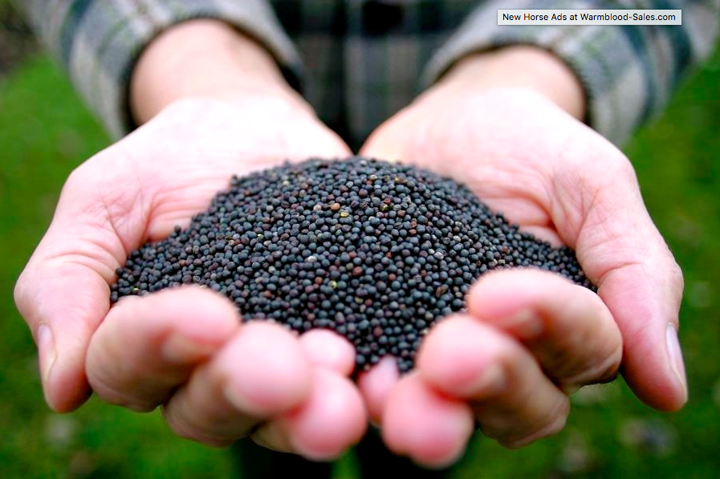
Canola / rapeseed
Canola is also known as rapeseed:
Already a major commercial crop in Europe and NA for oil and livestock feed.
Temperate zone crop.
Yields 127 gallons per acre: highest for conventional oilseed crops.
Currently the largest global
source for biodiesel feedstock.
Image
Pahl (2005)

Slide 8
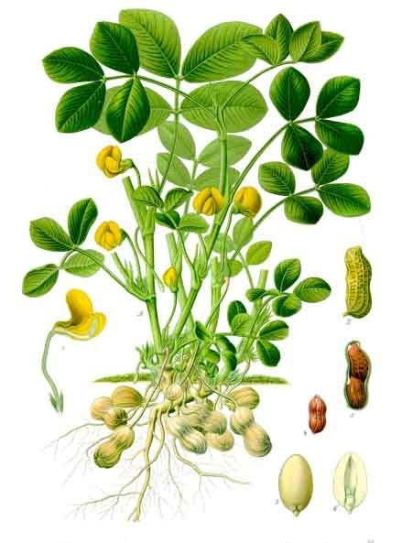
Peanut
Peanut:
Peanut oil is now produced as a
cooking oil and ingredient in a
variety of foods, drugs, soaps
and lubricants.
Grown in warm climates with
sandy soils.
Yields 113 gallons per acre.
Image
Pahl (2005)

Slide 9
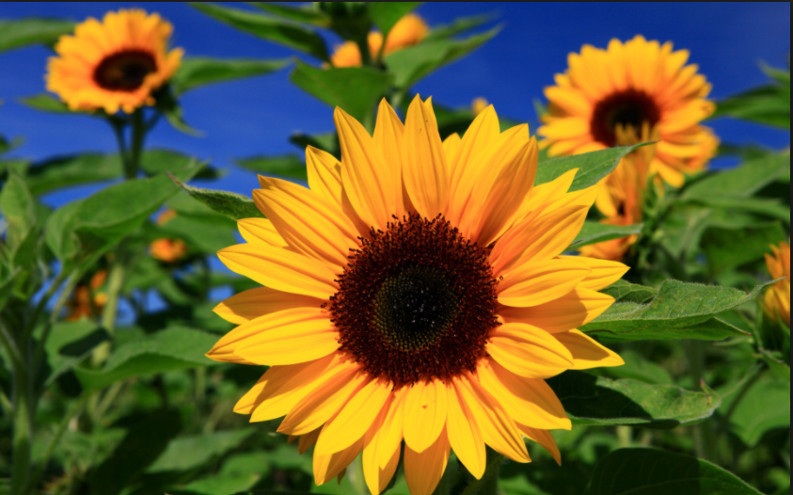
Sunflower
Sunflower:
World’s second most common edible oil.
Grows in temperate and tropical regions.
Yields 102 gallons per acre.
Used for cooking,
lamp oil,
lubricants, soaps,
paints & varnishes.
Cake is a high-
protein animal
feed.
Image
Pahl (2005)

Slide 10
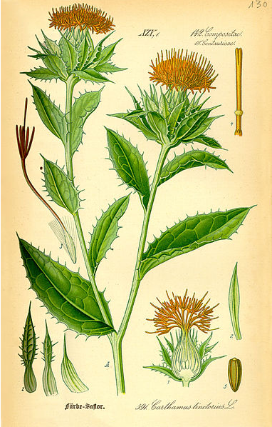
Safflower
Safflower:
Safflower is a thistle-like plant.
Grows where wheat and barley grow.
Yields 83 gallons per acre.
High in unsaturated fatty acids.
Used in cooking, candles, paints,
varnishes and linoleum.
Image
Pahl (2005)

Slide 11
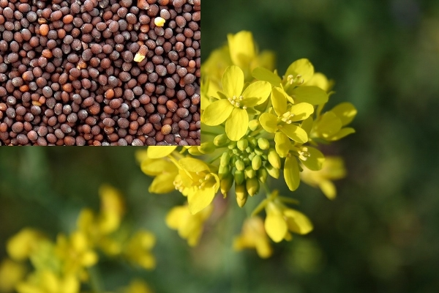
Mustard
Mustard:
Grown for their greens and their seed.
Yields 61 gallons per acre.
Meal is fed to animals, used in fertilizers and organic pesticides.
Pahl (2005)

Slide 12
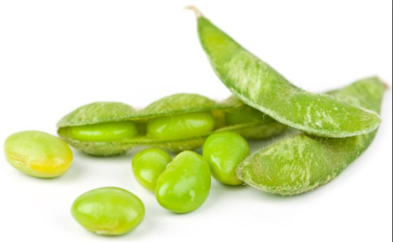
Soybean
Soy:
One of the world’s most critical sources of oil & proteins.
Soy is the most common crop in the US & grown around the world.
Yields 48 gallons per acre.
Oil is used in foods, paints, linoleum, inks, soaps, insecticides, etc.,.
Meal is a valuable feed for
animals and people.
Though most US biodiesel is
made from soy oil, it’s not
the most economic way to
make biodiesel.
Image
Pahl (2005)

Slide 13
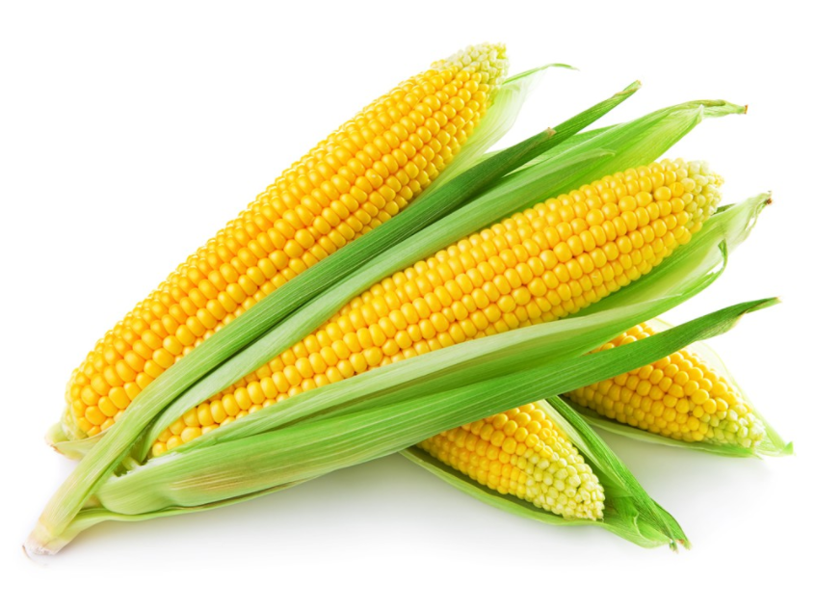
Corn
Corn (maize):
Now a staple crop around the world.
Yields 18 gallons per acre.
Useful in the sense that it is very abundant.
Image
Pahl (2005)

Slide 14
TAG composition
Triacylglycerols have three fatty acid chains and the identity (or chemical composition) of those FAs varies with the source of the oil.
 | Palmitic (%) (16:0) | Stearic (%) (18:0) | Oleic (%) (18:1) | Linoleic (%) (18:2)
corn | 10 | 3 | 50 | 34
olive | 7 | 2 | 84 | 5
peanut | 8 | 3 | 56 | 26
sesame | 9 | 4 | 45 | 40
soybean | 10 | 2 | 29 | 51
sunflower | 6 | 2 | 25 | 66
(16:O) indicates a 16-carbon chain with no double bonds (unsaturation)
Effects?
Chain length? Longer chains increase heat content, combustion, & viscosity and decrease NOx emissions.
Unsaturation (double bonds) decreases stability, melting point, viscosity but increases NOx emissions.
Pahl (2005); Dahiya (2015)

Slide 15
Used cooking oil
The US produces 3 billion gallons of fryer oil each year!
Used for animal feed, makeup, fertilizer.
But also sent to landfills or sewage treatment plants.
Big advantages:
Abundant, particularly in cities;
Inexpensive; and
High EROI.
One-fifth of NY City’s waste oil
could power the city’s public
bus system!
Disadvantages?
High free fatty acid content from high & repeated heating.
Contamination with water, crumbs, etc.,.
Requires extra processing steps to produce commercial biodiesel.
Pahl (2005)

Slide 16
Animal fat
The US produces 11 billion gallons of animal fat each year.
Enough to make 1.5 billion gallons of biodiesel.
Big advantages:
Abundant - & may become more so with concerns about BSE;
Inexpensive;
High EROI; and
Lower NOX levels than biodiesel from plant oils.
Disadvantages?
High cloud point & poor cold-weather properties, but this isn’t a problem in warmer climates.
Pahl (2005)

Slide 17
7.2: Cultivation and harvesting
in New England

Slide 18
Oil seed crops in New England
Common oil seed crops grown in the US include sunflower, canola and soybeans.
Oil content of the grain must be >20%.
None are common crops in New England.
Also trials of camelina, winter canola, crambe, pennycress, flax
Grinding and pressing the seeds produces two products:
  Oil; &
  Meal;
(…and sometimes fiber.)
← Used for fuel or food
← Used as animal feed, fertilizer, or solid fuel
Small-scale processing on farms can process local crops and create products for use on the farm or for local sale.
Is this economically feasible?
Biodiesel on-farm production
  Costs $0.60 – 2.52/gallon
  EROI is 2.6:1 – 5.9:1
  Estimated 1420 lb/acre net reduction in carbon emissions
Dahiya (2015)

Slide 19
Oil seed crop cultivation
Soybeans (Glycine max)
< 25% oil
    Long growing season (100 – 140 days) & warm temperatures
Sunflower (Helianthus annuus)
> 40% oil
    Somewhat shorter & cooler growing season
Canola (Brassica napus, B. rapa, B. juncea)
> 40% oil
    Short & cool growing season
Dahiya (2015)
Dahiya (2015)

Slide 20
Oil seed crop cultivation
Choosing the right oil seed crop?
Depends on the grower’s situation.
Livestock? Soybean meal is a great livestock feed.
Soil that needs nutrients? Soybean fix nitrogen & thus fertilize the soil.
Short growing season? Canola might be the right choice.
Happy neighbors? Everyone loves sunflowers!
Choosing the right variety?
Find a variety that balances great yield with oil content, season length and resistance to disease.
Look for early or medium season and excellent dry down
Dahiya (2015)

Slide 21
Seed & oil yields?
crop | Seed yield (lb/acre) | Oil yield (%)
soybeans | 2000 - 4000 | 25%
sunflowers | 1000 - 3000 | 40%
canola | 1500 - 4500 | 40%
crop | Soil type? | Nutrient need? | pH
soybeans | Loose, well-drained loam | Modest, mainly P&K, Mn | 6.0 – 7.2
sunflowers | Sands to clays | Modest & they go deep! | 6.0 – 7.2
canola | Loose loam, good drainage | Needs N, some P&K, S | 6.0 – 7.0
What’s the oil?
A combination of mono-, di-, and triacylglycerides;
aka vegetable oil (SVO)
Dahiya (2015)

Slide 22
Seed harvesting, screening & storage
Harvesting oilseeds requires a combine that reaps and threshes (cuts and separates seed from stem/straw)
Combines aren’t too common in New England.
Older smaller combines work well for trials & small fields.
The seed path has to be sealed to prevent loss of seed and this process needs to be customized for each type of seed. Screens are critical.
  Canola is tiny and easily lost.
  Sunflower heads fall over when their long stems are cut.
Dahiya (2015)

Slide 23
Seed screening & storage
Secondary screening will be needed if seeds from the combine have more than 3% trash.
Fanning mill; or
Rotary drum cleaner
Drying the seeds is usually done with ambient air in a drying bin to a moisture content of 8-10%.
Storage in grain bins is stable once the dried seed has reached temperatures below freezing.
Dahiya (2015)

Slide 24
7.3: Oil extraction

Slide 25
Oil extraction
On-farm oil extraction is done by cold-pressing and often with a screw press.
Cold-pressing is pressing without heating seeds first.
A screw press uses an auger to press seed into an increasingly narrow space, often surrounded by a screen. As the seed is compressed it is cracked and crushed and the increasing pressure forces oil to flow out of the seed.
Chris Callahan of UVM extension tested a variety of types of oil presses in on-farm operation. He found that:
Maximum oil extraction occurs below the press’s maximal capacity, so the best oil requires operating a slower than maximal speeds.
Slower speed also decreased levels of phosphorous in oils.
P indicates the presence of compounds that can easily oxidize and become rancid.
Dahiya (2015)

Slide 26
Oil seed cake or meal
The solids produced by pressing oil seed are called oil-seed meal or oil-seed cake.
Cellulosic
Caloric & high in fat
Nutritional
Meal can be used in livestock feeds.
Limited by the high amount of oil.
Soymeal is especially valuable.
Other uses?
Fertilizer (N-rich meal may have some capacity to suppress weeds.)
Pelletized for use as a combustion fuel.
Dahiya (2015)

Slide 27
7.4: Algal biodiesel?

Slide 28
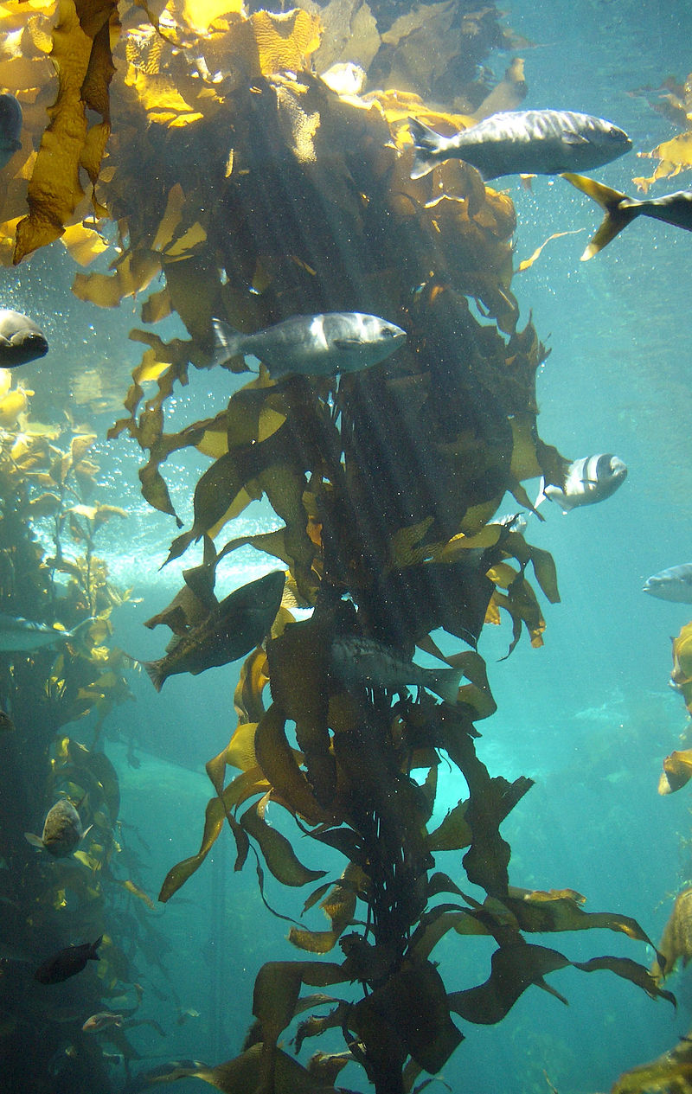
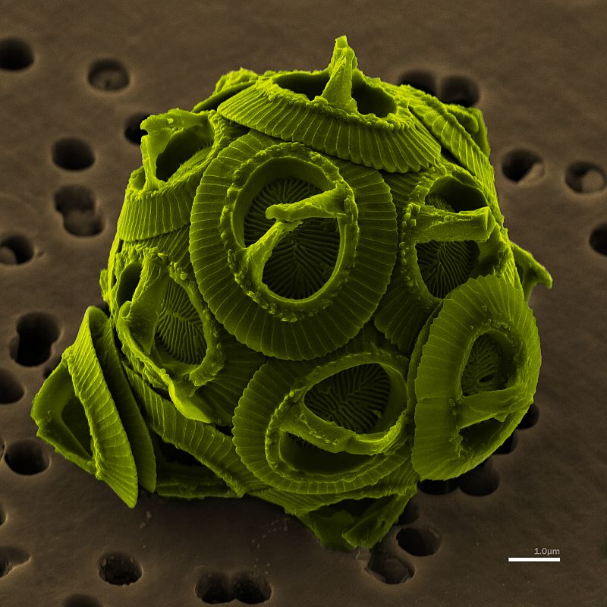
What are algae?
Algae (/ˈældʒi, ˈælɡi/; singular alga /ˈælɡə/) is an informal term for a large, diverse group of photosynthetic eukaryotic organisms that are not necessarily closely related, and is thus polyphyletic. Included organisms range from unicellular microalgae, such as Chlorella and the diatoms, to multicellular forms, such as the giant kelp, a large brown alga which may grow up to 50 m in length. Most are aquatic and autotrophic ….
Over 30,000 species
Basis of the aquatic food chain
Wikipedia
https://www.e-education.psu.edu/egee439/node/692

Slide 29
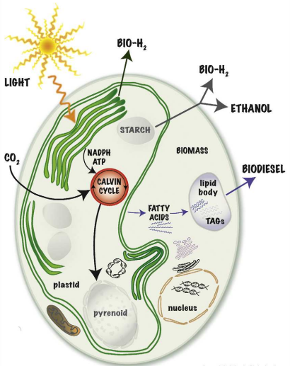
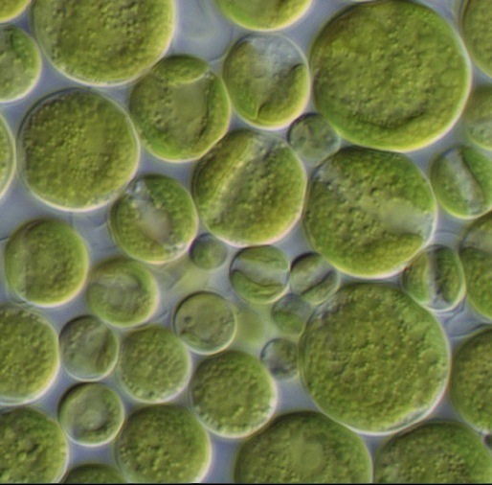
Unicellular microalgae
Aquatic
Photosynthetic
Eukaryote
High densities and growth rates
  24-hour doubling
  CO₂, water, sunlight, minerals
High oil content (up to 50%)
Chlorella (2 – 10 μm)
Wikipedia

Slide 30
Algal oil yields?
While most terrestrial oil crops max out at 5% oil yield, algae is consistently higher and can be induced to up to 80% oil as dry weight.
microalga | oil (% dry weight)
Botryococcus braunii | 25 - 75
Chlorella sp. | 28 - 32
Crypthecodinium cohnii | 20
Cylindrotheca sp. | 16 - 37
Nitzschia sp. | 45 - 47
Phaeodactylum tricornutum | 20 - 30
Schizochytrium sp. | 50 - 70
Tetraselmis suecia | 15 - 23
crop | oil yield (gallons/acre)
corn | 18
soybeans | 48
canola | 127
jatropha | 202
coconut | 287
oil palm | 636
microalgae | 6,283 – 14,641
15X ↑ LB
30X ↑ LB
https://farm-energy.extension.org/algae-for-biofuel-production/

Slide 31
Per acre oil yields?
Theoretically, algae could produce far more oil than existing, conventional crops.
source | biofuel yield (gallons/acre)
algae | 5,000 – 10,000
*cellulosic ethanol (poplars) | 2,700
palm | 650
jatropha | 175
rapeseed | 110 - 145
soy | 50
15X ↑ LB
30X ↑ LB
https://www.greentechmedia.com/articles/read/lessons-from-the-great-algae-biofuel-bubble (2017)

Slide 32
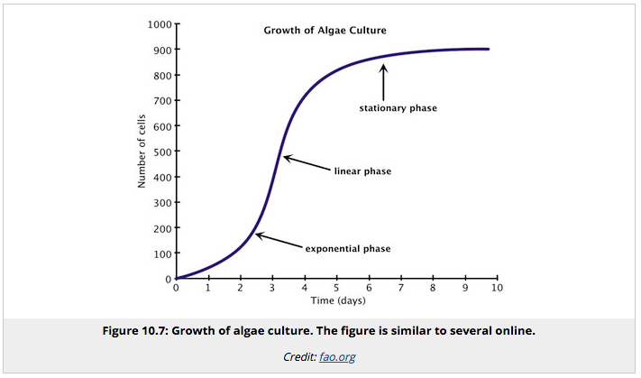
Phases of algal growth
Keeping cultures in the exponential and linear phases of growth will produce the most algae.
15X ↑ LB
30X ↑ LB
https://www.e-education.psu.edu/egee439/node/694

Slide 33
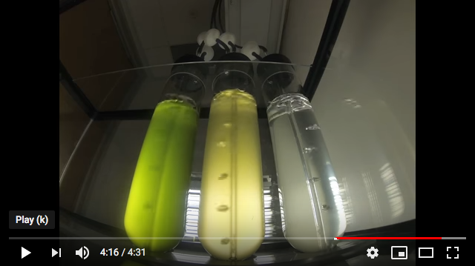
Growth conditions
Standard growth conditions:
  Light
  CO2
  water
  inorganic salts (N, P, Fe, Si)
  20 – 30ºC optimal
  neutral to alkaline pH
https://www.youtube.com/watch?v=QIyC7b0P-ng
Mixing is used to:
  keep the algae from settling;
  provide constant access to nutrients; and
  Provide constant access to light which only penetrates 7-10 cm.
15X ↑ LB
Nutrients are maximized during the day as algae mass grows during photosynthesis.
¼ of biomass gain can be lost at night during respiration.
30X ↑ LB
https://farm-energy.extension.org/algae-for-biofuel-production/
https://www.e-education.psu.edu/egee439/node/694

Slide 34
Strategy?
grow massive amounts of microalgae
CO₂
light
warmth
water with overly high nutrients, salt OK
stress the mature algae cultured
nitrogen starvation
osmotic stress
pH
temperature
harvest algae and remove water
break open the cells
food or anaerobic digestion
algal bodies:
protein, carbs
lipid bodies:
TAGs
convert to biodiesel

Slide 35
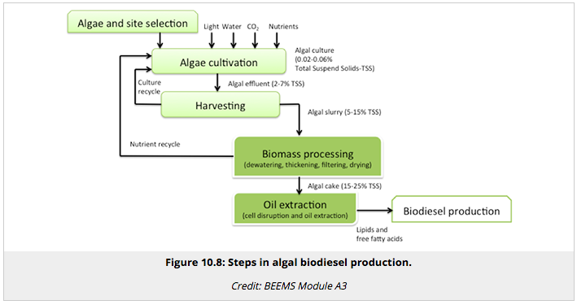
Strategy and process diagram

Slide 36
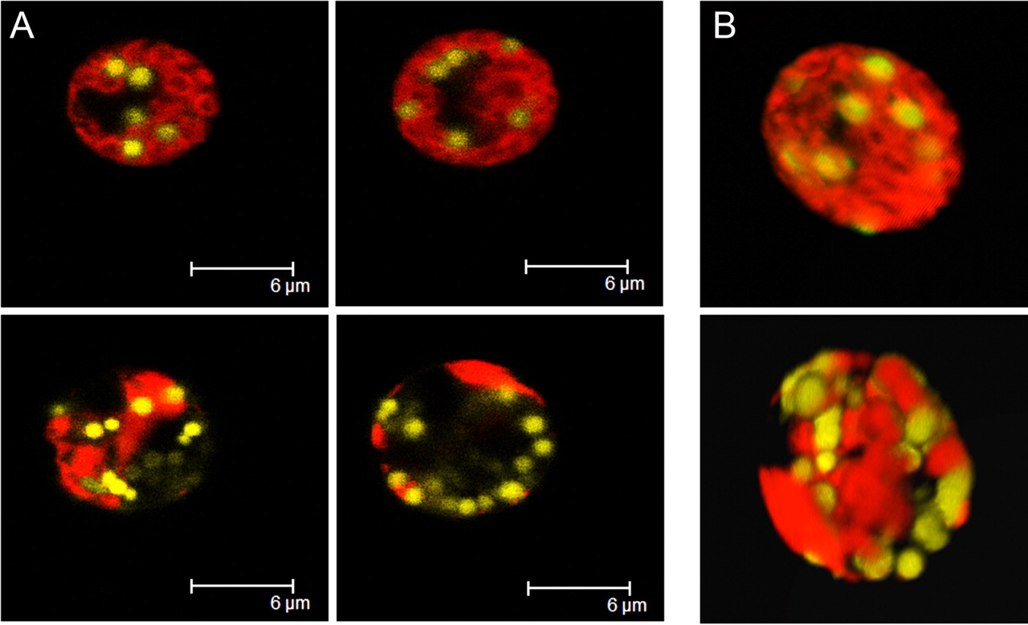
Microalgae storing fat?
When stressed, microalgae ‘panic’ and store energy in lipid bodies (oil droplets) that can help them survive (even through dehydration).
Chlamydomonas reinhardtii – a soil microalgae
cw15
15X ↑ LB
cw15
sta6
(starch
neg)
30X ↑ LB
Zi Teng Wang et al. Eukaryotic Cell 2009; doi:10.1128/EC.00272-09

Slide 37
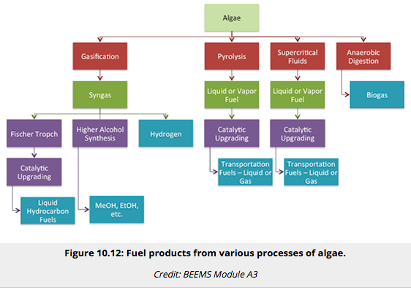
Other algal biofuels
Algal oil can be used to make biodiesel, but algae can also be used to produce other biofuels:
https://www.e-education.psu.edu/egee439/node/692

Slide 38
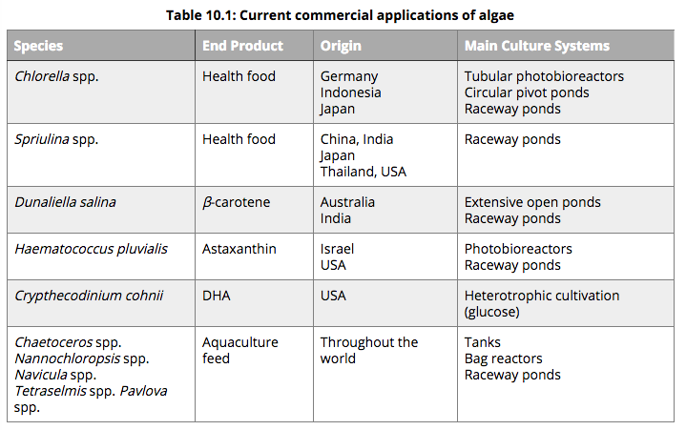
Algal co-products
Fertilizer, proteins, omega-3 and -6 fatty acids, food thickeners, agar growth media for microbiology, animal and human food, diatomaceous earth.
https://www.e-education.psu.edu/egee439/node/692

Slide 39
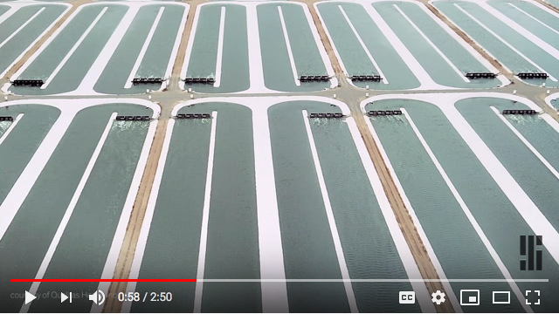
Large-scale growth: raceway
Raceways: open recirculation ponds
Shallow, ~1 foot deep, to allow sunlight to penetrate
Concrete or lined with plastic
Stirred with a paddle-wheel
Fed in front of the wheel
Harvested just before reaching the wheel
Agricultural waste water rich in manure can be used for nutrients.
15X ↑ LB
CO₂ uptake is limited.
Water evaporates.
Contamination happens.
https://www.youtube.com/watch?v=gA9LMjHoh_I
30X ↑ LB
https://farm-energy.extension.org/algae-for-biofuel-production/

Slide 40
Raceway climate and location
For efficient growth in open raceways, a year-round tropical to subtropical climate with optimal sunlight is required.
Best US locations:
  Hawaii
  California
  Arizona
  New Mexico
  Texas
  Florida
Other requirements?
  Open land
  Available water (or wastewater)
  CO₂, preferably concentrated
30X ↑ LB
https://www.e-education.psu.edu/egee439/node/695

Slide 41
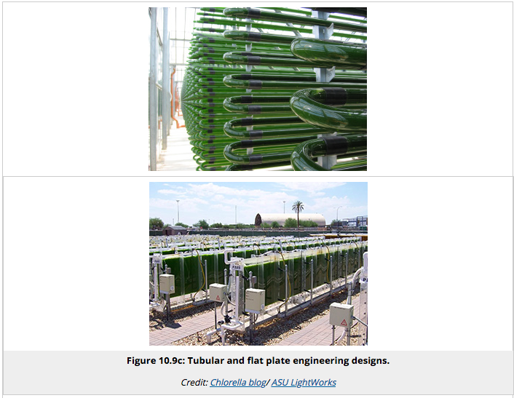
Large-scale growth: bioreactors
Photobioreactors: large laboratory facilities in which algae are grown with addition of nutrients and light
Maximize surface to volume ratio to maximize light
https://www.e-education.psu.edu/egee439/node/695

Slide 42
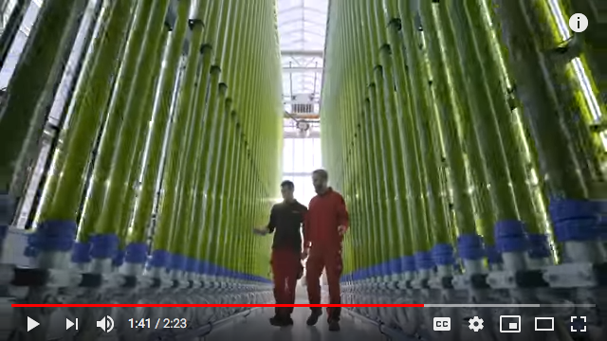
Large-scale growth: bioreactors
Photobioreactors: large laboratory facilities in which algae are grown with addition of nutrients and light
Maximize surface to volume ratio to maximize light
Outdoors or indoors
Recirculated to mix.
Feed at one end and
harvest at the other.
15X ↑ LB
CO₂ is bubbled in and
O₂ must be degassed out as it inhibits growth.
Less expensive
30X more concentrated.
Monocultures are possible.
https://www.youtube.com/watch?v=PQt1jkrHzoA
30X ↑ LB
https://farm-energy.extension.org/algae-for-biofuel-production/

Slide 43
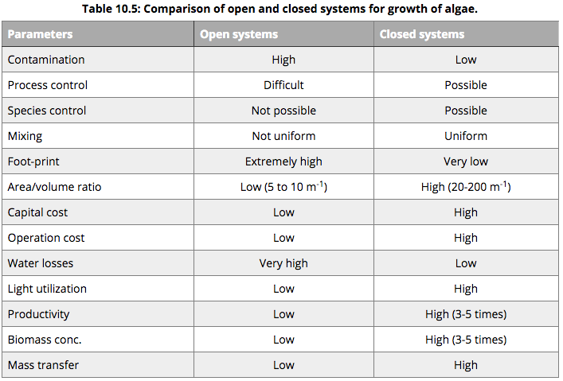
Comparison of growth systems
https://www.e-education.psu.edu/egee439/node/695

Slide 44
Yields from cultivation
Yields of algae vary with a number of factors:
  Cultivation method
  Growth conditions (and oil-inducing stress)
  Species and strain of algae
Cultivation method | Dry mass yield | Dry mass yield
Raceway / open pond | 5 – 10 g/m²/day (50) | 7.4 – 14.8 tons/acre/year (74)
Photobioreactor | 2– 3 g/L/day | 0.73 – 1.05 ton/m³/year
15X ↑ LB
30X ↑ LB
https://farm-energy.extension.org/algae-for-biofuel-production/

Slide 45
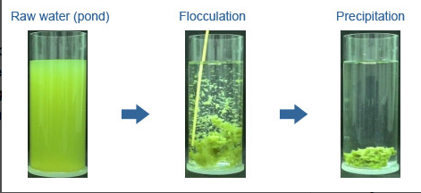
Harvesting algae
One major challenge of algae harvesting is to separate algae from water. This is generally done by:
  Settling or sedimentation
  Membrane separation with vacuum
  Flocculation
  – a flocculant (or CO₂) is added to cause clumping
  Froth flotation (DAF: dissolved air flotation)
  - air is bubbled up carrying algae with it; scum is pulled off
  Centrifugation
30X ↑ LB
https://www.e-education.psu.edu/egee439/node/696

Slide 46
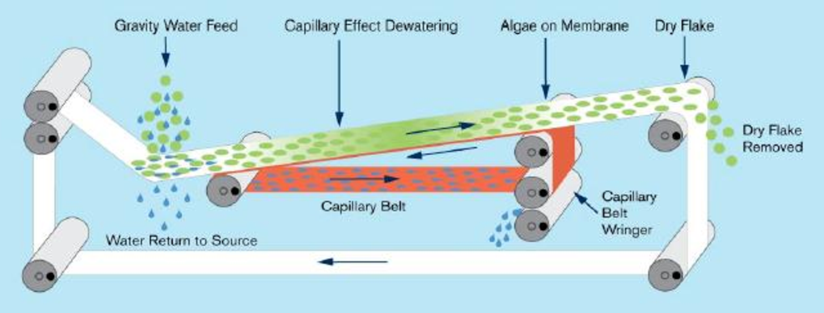
Drying algae
Another major challenge of algae harvesting is drying to reduce the water content of the harvested algae slurry.
Reducing water content from 98% down to 50% uses 60% of the energy contained in the algae itself.
Generally done using a filter belt process.
https://www.e-education.psu.edu/egee439/node/696
https://www.semanticscholar.org/paper/Modeling-and-Control-of-Algae-Harvesting%2C-and-
(HDD)-Li/1cdcd062d38fc2997edad2972cbf252253615d91
30X ↑ LB

Slide 47
Extracting algal lipids
Because algae have tough cells walls, bursting the cell and extracting the oil is a difficult and expensive process.
Physical extraction methods:
Mechanical disruption
Electric field
Sonication
Osmotic shock
Expeller press
Chemical and biological extraction methods:
Solvent extraction
Co-extraction and transesterification – solvents for bursting vs. lipids
Supercritical fluids – solvents with higher temperature, pressure
Enzymatic reaction
30X ↑ LB
https://www.e-education.psu.edu/egee439/node/696

Slide 48
Challenges for algal biofuels
The US DOE aggressively funded algal biofuels research from the 1980s to the 1990s via the Algae Production Systems (APS) program.
Conclusion?
Still too expensive to be commercially viable in the near future.
Major challenges?
Difficult to maintain desirable strain in large commercial grows.
Contamination of monocultures with ‘wild’ algae and bacteria.
Low oil yields
High cost of harvesting algae and their oil.
Land, water, CO₂
15X ↑ LB
30X ↑ LB
https://farm-energy.extension.org/algae-for-biofuel-production/

Slide 49
Revival and new goals
GCC and the need for low-carbon liquid fuels revived interest in algal biofuels in the early 2000s.
Goals of new work
Increase oil content or select high-oil strains.
Increase growth rates.
Create better and more robust cultivation systems.
Develop co-products and markets to bring the cost of fuel down.
Biorefinery approach
Use algae in bioremediation.
Develop efficient algae harvesting methods.
15X ↑ LB
Results?
Improvements but no breakthroughs or game-changers.
2007:
Diesel $2.00 – 3.00/gallon
Algal oil $10.50/gallon …. before conversion and distribution!
30X ↑ LB
https://farm-energy.extension.org/algae-for-biofuel-production/

Slide 50
The algae bubble
“Jim Lane of Biofuels Digest authored what was possibly history's least accurate market forecast, projecting that algal biofuel capacity would reach 1 billion gallons by 2014. In 2009, Solazyme promised competitively priced fuel from algae by 2012. Algenol planned to make 100 million gallons of ethanol annually in Mexico’s Sonoran Desert by the end of 2009 and 1 billion gallons by the end of 2012 at a production rate of 10,000 gallons per acre. PetroSun looked to develop an algae farm network of 1,100 acres of saltwater ponds that could produce 4.4 million gallons of algal oil and 110 million pounds of biomass per year.”
2005 – 2012:
Dozens of companies trying to make algae biodiesel work
Funding from ARRA following the recession of 2007-2008
https://www.greentechmedia.com/articles/read/lessons-from-the-great-algae-biofuel-bubble

Slide 51
Bubbles tend to burst
“During the advanced biofuel craze of the past decade, many companies made claims that weren't remotely credible. A long list of companies claimed they could economically convert biomass like straw or wood chips into fuel for around a dollar a gallon.”
“Investors and taxpayers funded many ventures that were destined to fail. Technologies that were abandoned decades ago because the economics weren't viable were revived and received government funding to once again prove that the economics aren't viable.”
Take homes messages:
(1) Entrepreneurs can have tunnel vision.
(2) VC herd mentality doesn’t produce results.
(3) Physics and thermodynamics are fairly important in energy
applications
https://www.forbes.com/sites/rrapier/2018/10/22/an-algal-biofuel-obituary/#64e930b76fb4
https://www.greentechmedia.com/articles/read/lessons-from-the-great-algae-biofuel-bubble

Slide 52
Who was involved?
Algae Floating Systems
Algenol
Algae Tec
Algix
AlgaeLink
Alga Technologies
Aquaflow
Aurora Biofuels
Cellana
Global Algae Innovations
GreenFuel Technologies
Heliae
LiveFuels
OriginOil
PetroAlgae
Phycal
Pond Technologies
Along with boatload of universities
One could argue that universities should be the home of R&D
Renewable Algal Energy
Sapphire Energy
Seambiotic
Solix
Synthetic Genomics
TerraVia (formerly Solazyme)
XL Renewables
https://www.greentechmedia.com/articles/read/lessons-from-the-great-algae-biofuel-bubble

Slide 53
The way forward?
The biorefinery model, using all co-products to lower costs, is the only potential way forward for algal biofuels and perhaps most forms of bioenergy.
“To make this model cost-effective and sustainable, we would need to use waste sources of heat, carbon dioxide and nutrients to grow the algae. These are widely available from power plants, factories and water treatment plants and so could reduce some of the costs of growing algae. After making algal fuel, you’re left with lots of proteins, carbohydrates and other molecules. These can be converted into the kinds of products mentioned above, or used to produce biogas (another fuel source). This biogas can be sold or used at the biorefinery to produce heat for the algae, closing the loop and making the whole process more efficient.”
https://www.weforum.org/agenda/2016/05/why-are-algal-biofuels-in-decline

Slide 54
7.5: Transesterifiction

Slide 55
Preparing the oil
Crude vegetable oil may contain phospholipids and crude oils and UFO often contain significant levels of free fatty acids.
Dewatering settles the oil and draws off any contaminating water.
Degumming is a process used to remove phospholipids.
Refining is a process used to remove free fatty acids.
High levels of FFA will create soaps when converted by base-catalyzed transesterification.
Caustic stripping adds a base to the feedstock, creates soaps & then removes them by centrifugation or water extraction.
Pahl (2005); Dahiya (2015)

Slide 56
Batch or continuous process?
Biodiesel transesterification can be done at a variety of scales, anything from kitchen blender to massive industrial plants.
Small-scale conversion is usually done using a batch process: a given volume of oil is converted to biodiesel.
A single container is used for the entire process.
To make more, start a new batch.
A continuous-flow process is often used at larger scales.
Different containers are used for each phase of the process.
The feedstock flows from one container to the next as the process continues.
Oil feedstock is continuously fed into one end of the process and finished biodiesel continuously flows out the other.
Pahl (2005)

Slide 57
Batch process
In a batch processor each batch of chemicals moves from one tank to the next.
Each tank is drained as the material is moved to the next tank….
... Allowing the next batch to be started.
MeOH
water
water
biodiesel
5
3
4
dryer
wash water
TAG
1
2
evaporator
wash tank
MeO-
MeOH
acid
batch processor
settling
tank
crude glycerol
3
4
salts
evaporator
Pahl (2005); Dahiya (2015)

Slide 58
Continuous process
In a continuous processor input chemicals move from one tank to the next as more input is pumped in behind them.
Inputs flow in continuously while…
... product flows out continuously.
A second reactor ensures complete conversion of feedstock to biodiesel.
MeOH
MeOH
MeO-
TAG
biodiesel
1
2
3
4
5
6
7
MeO-
crude glycerol
crude glycerol
heater
reactor
1
evaporator
separator
reactor
2
evaporator
separator
Pahl (2005); Dahiya (2015)

Slide 59
Production yields
Transesterification is the chemical process that transforms fats into biodiesel
100 lb oil
100 lb biodiesel
transesterification
10 lb alcohol/Na
10 lb glycerol
EROI ~ 5.54:1
Modern biodiesel plants can use a variety of feedstock oil or a mixed blend of oils and achieve a 100% yield, converting all TAG and FFA into biodiesel esters.
The market for glycerol affects the costs and profits of biodiesel production.
The market for glycerol is smaller; finding new markets will be critical.
Dahiya (2015); Pahl (2005)

Slide 60
Step 1
Determination of free fatty acid content of oil feedstock:
The presence of high levels of free fatty acids:
Is caused by excessive or repeated heating / storage of oil feedstock.
Can result in the formation of soap rather than biodiesel.
Requires the use of additional catalyst because the FFAs react with and neutralize hydroxide catalysts.
Titration is used to determine FFA concentrations in oil feedstock.
The feedstock oil is titrated with sodium hydroxide using a pH indicator like phenol red.
Neutral pH is indicated by change of color (yellow to pink).
Isopropal alcohol is added to co-solubilize the oil feedstock and the sodium hydroxide used for titration.
Pahl (2005)

Slide 61
Step 2
Creation of the powerful base, sodium methoxide
Carefully measured amounts of sodium hydroxide and anhydrous methanol are very carefully mixed to create the very powerful base.
Safety is critical and PPE should include glasses, masks or respirators, gloves and aprons.
Methoxide can create fumes that are very hazardous to human health, so this work must be done in a well ventilated space.
The chemical reaction produces heat. Mixing the chemicals on ice can help prevent boiling.
Methoxide, and even sodium hydroxide, can corrode scratched glass containers and should be kept in plastic.
Methoxide should be used as it is produced and not stored.
Several alcohols (1-4C) can be used but water should be <0.08%.
Water interferes with transesterification and can enhance soap formation.
Pahl (2005)

Slide 62
Step 3
Mixing of methoxide and oil feedstock
Methoxide and oil feedstock are mixed and stirred or agitated for a given length of time (generally a 1-2 hours).
The mixture is sometimes heated to 65°C (25-85°C).
Mixing should be thorough but if overly vigorous a fine emulsion may be produced that will not settle and separate.
  Slowing mixing near the end of the reaction will encourage early phase separation and completion of the reaction.
Transesterification occurs here! (aka ‘cracking’)
Neutralizers are sometimes added to deactivate any unreacted catalyst.
For basic catalysts the neutralizer is a small amount of acid.
Alternatively, the acid may be added in the water wash.
Pahl (2005)

Slide 63
Step 4
Settling / separation
Mixing is stopped and the mixture is allowed to settle and phase separate for eight hours or more.
The biodiesel (an oil) rises to the top of the container.
Glycerol (water-soluble) sinks to the bottom.
The interface contains partially reacted molecules and other contaminants and is usually discarded.
A centrifuge can be used to speed up separation.
Pahl (2005)

Slide 64
Step 5
Washing / polishing
The biodiesel layer may still contain contaminants like alcohol, base, glycerol or unreacted free fatty acids. These are all water-soluble to differing degrees.
Water is mixed into the biodiesel, sometimes by bubbling up through.
  Acidic water is sometimes used to neutralize free fatty acids & unreacted methoxide.
The mixture is left to settle again.
  Clean biodiesel rises to the top.
  The impurities settle with the water in the lower layer & can be removed.
Larger producers may use columns of resins to remove these water-soluble contaminants.
  The capital and O&M costs are greater.
  But the process is much faster.
Pahl (2005)

Slide 65
Step 6
QA / QC
Clear-and-bright test: A quick test for biodiesel fuel quality
Flush the system.
Collect a sample in a clear glass container and allow to settle for a bit.
Hold the sample up against a printed surface in good light.
Good biodiesel should show the printing clearly.
Look for sediments.
Swirl the container; no change in density patters should occur.
Pahl (2005); Dahiya (2015)

Slide 66
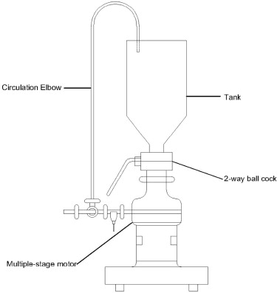
Shear force reactors
An ultra-shear reactor (USR) uses shear force to create very small droplets and high rates of mixing of oil and reactants.
Speeds the rate of conversion
Increases the efficiency of conversion
A continuous process
https://www.sciencedirect.com/science/article/pii/S096085241001792X

Slide 67
7.6: Small-scale (on-farm) production

Slide 68
On-farm biodiesel: challenges
Safety: two chemicals used in biodiesel production can be hazards
  Base (sodium or potassium hydroxide) is caustic & corrosive
  Methanol is toxic & extremely flammable
Precautions? Goggles, gloves, dust masks, protocols designed to minimize handling, transfer and exposure. Use of sensors for combustible fumes.
Consider conducting a hazard review and failure modes & effects analysis before constructing & operating a biodiesel production facility.
Dahiya (2015)

Slide 69
On-farm biodiesel: modeling
Chris Callahan of UVM extension modeled production of biodiesel from sunflowers at several on-farm scales.
Smaller scale: 4,000 - 13,000 gallons/year
Larger scale: 100,000 gallons/year
Small-scale | 4,000 gallons/year | 13,000 gallons/year
Acres of sunflowers | 66 | 214
Biodiesel production | $2.52/gallon | $2.29/gallon
Meal production | $389/ton | $353/ton
When biodiesel is produced and used on-farm, as opposed to on-road, both transportation costs and taxes can be avoided.
Dahiya (2015)
Dahiya (2015)

