Slide 1
Module 9:
Introduction to Anaerobic Digestion
9.1: What is anaerobic digestion?
9.2: How is AD applied?
9.3: Snapshot of AD in Vermont (2015)
9.4: Energy products & co-products of AD
9.5: Environmental impacts of AD: benefits & concerns
This curriculum is adapted from: eXtension Course 3: AD, University of Wisconsin

Slide 2
9.1: What is anaerobic digestion?

Slide 3
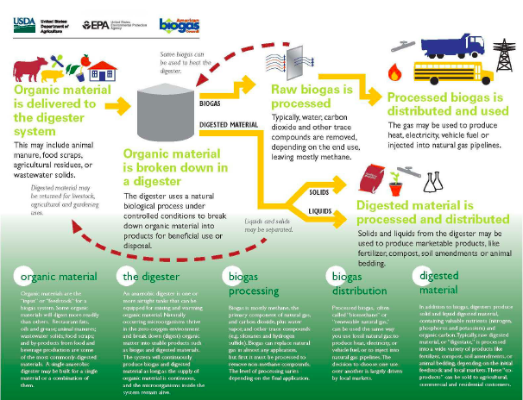
Overview cartoon

Slide 4
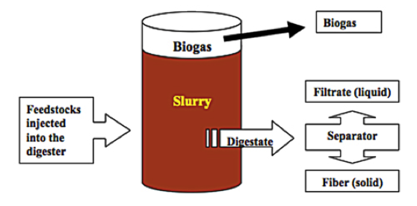
What is anaerobic digestion?
Anaerobic digestion: a natural bacterial process of ruminant animals, like cattle and sheep, and of anaerobic environments, like lake bottoms, marshes and swamps. In the absence of oxygen, the AD (anaerobic digestion) process degrades organic materials (often seen as waste) into methane-rich biogas and nutrient-rich digestate.

Slide 5
Basic AD terms
Aerobic: process that occurs in the presence of freely available oxygen
Anaerobic: process that occurs in the absence of freely available & chemically bound oxygen
Alkalinity: acid-neutralizing capacity; sum of all bases
BOD (biological oxygen demand): amount of oxygen required to biologically oxidize & degrade organic material
COD (chemical oxygen demand): amount of oxygen required the chemically oxidize & degrade organic material; faster than BOD; values typically higher
Feedstock: manure & organic material ‘fed’ to the AD to produce biogas
Slurry: (aka sludge) the mixture of feedstock & microbes filling the AD
Biogas: combustible gas produced by AD: 60% CH₄, 40% CO₂, H₂, H₂S
Digestate: (aka effluent or filtrate) slurry after digestion; nutrient-rich
Fiber: (aka separated solids) solid portion of digestate; used as fertilizer, bedding, compost
Volatile solids: the organic component of solid feedstock materials
(Mackay & Rowlands, 20__)

Slide 6
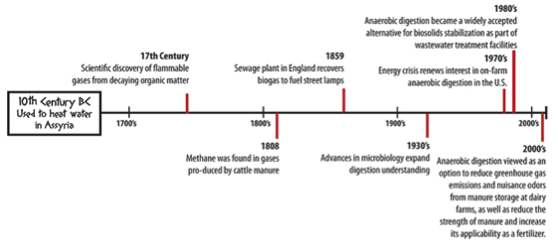
An ancient, but evolving, technology
Used by man long before the modern era, modern AD is a renewable energy technology that produces heat and electricity, recycles society’s organic wastes to produce nutrients for agriculture, and reduces odors and pathogens.

Slide 7
Global AD today
Today, simple, small- to medium-scale AD installations are used in the developing world to produce cooking and heating gas from organic wastes.
2005: 8 million small AD facilities in China
2011: 500 AD in Tanzania & 1000 AD in Lesotho
AD is widely applied in Europe as a combined heat & power technology.
Germany: 6800 AD systems
Austria: 511 AD systems
Manure is a secondary feedstock; crops & organic wastes dominate.
Why is AD more widespread in Europe than in the US?
Fossil fuel energy is not (or is less) subsidized in Europe
But European governments do support renewable energy technologies
European farm subsidies favor diversification and AD
Europe’s resources are more limited so they focus on reuse & efficiency
Europe is focused on mitigating climate change
Wellinger & Linberg (2000)

Slide 8
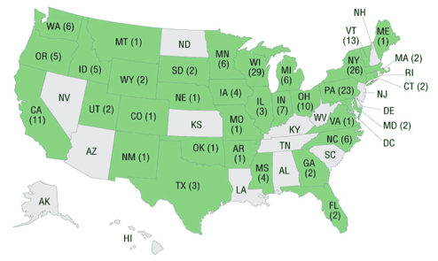
AD in the US today
In the US, AD is mainly employed at municipal wastewater treatment plants to reduce volumes of sludge and levels of pathogens. Biogas is sometimes used to heat the plant, but just over 100 use biogas to produce energy.
However, most wastewater plants rely mainly on aerobic processes.
2008: only 1,351 of 3,171 wastewater plants used AD
US farms began using AD to produce energy during the energy crisis of the 1970s. This early effort was largely unsuccessful. However, farm AD has boomed since 2000.
2014: 239 farm AD plants
205 produce electricity
586,000 MWh electricity
55,000 MWh heat (1 MWh ~1000 households)
Vermont: 17 AD plants in 2013
http://www.epa.gov/agstar/projects/

Slide 9
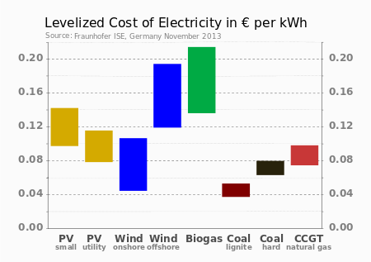
AD vs. other RE technologies
AD is more expensive to install than solar or on-shore wind. However, AD produces energy 24 hours per day, 7 days per week, 365 days per year.
And, unlike other renewable energy technologies, AD provides ecosystem services: benefits provided by ecosystems that contribute to making human life both possible & worth living.
Reduces the GHG potential of methane.
Recycles society’s wastes.
Recovers & manages nutrients for use in
agriculture.

Slide 10
9.2: How is AD applied?

Slide 11
AD for wastewater treatment
Wastewater treatment: AD treats ‘high-strength’ organic wastes
‘High-strength’ wastes (or feedstock materials) have high concentrations of decomposable organic material, or high biological oxygen demand (BOD).
[NB: chemical oxygen demand (COD) is easier to measure than BOD and often used to gauge feedstock ‘strength’.
High-strength example: fats, oils and grease (FOG)
Discharge of untreated high-strength organics into the environment causes high rates of microbial growth and release of excess nutrients, resulting in depletion of oxygen, and eutrophication of water.
Advantages of using AD for wastewater treatment:
AD uses less energy than aerobic treatment
AD decreases the volume of biosolids produced
AD produces biogas: renewable energy

Slide 12
On-farm AD: motivation
The main reasons for using on-farm AD in the US are not energy production!
Reduction of manure odors
Management of manure nutrients
Growing concerns about environmental quality, biosecurity, energy security, nutrient scarcity and climate change have also boosted on-farm AD.
Algae growth in Lake Champlain is fueled by nutrient runoff
Peak phosphorous is upon us: we’ve used up half of global P supplies
AD provides some separation of N & P nutrients
AD converts N to a form more readily used by plants
AD drastically reduces that pathogens present in manures
Methane from farms & landfills is a GHG 27-times as potent as CO_{2,} accounting for 9% of GHG emissions.
In 2009, the US Dairy Industry pledged to reduce methane emissions by 25% by 2020. In 2014 the USDA released its Biogas Opportunities Roadmap to guide us to this goal. It suggests installation of 11,000 additional AD plants, capable of powering 3 million homes.

Slide 13
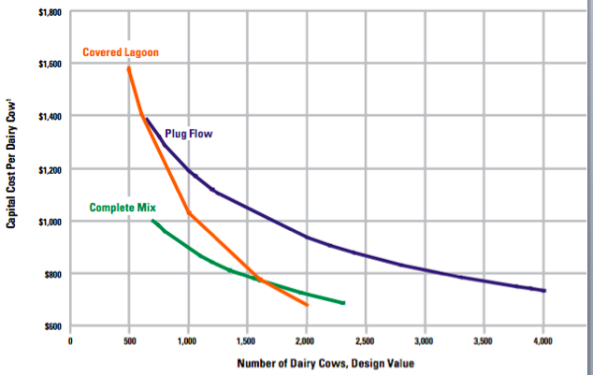
On-farm AD: challenges
Installing efficient farm AD requires capital & training investments.
Costs vary with AD technology
2009: average per AD installation cost was $1.5 million
Operator training is critical, though daily work hours may be less than full time.

Slide 14
Small-farm AD?
Generally, it’s thought that 1000 cows are needed to justify farm AD.
However, AD may soon pay for smaller 150 – 200 cow farms because:
Off-farm feedstock (organic wastes) effectively increase herd size
New small-scale AD technologies
USDA financing & feed-in tariffs for renewable energy
Genset size of the 205 on-farm AD projects that produce electricity in the US ranges from 15 – 6450 kW.
Average genset size is 750 kW
Only two Vermont projects have gensets > 500 kW
Herd size of the 239 on-farm AD projects in the US:
Average herd size is 2100 head of cattle
Only 67 are fed by less than 1000 head
7 of the small herds are in Vermont and range from 75 – 950 head
Only five Vermont AD projects are based on less than 500 head

Slide 15
9.3: A snapshot of AD in Vermont (2015)

Slide 16
Support for AD in Vermont
Vermont is very supportive of anaerobic digestion, particularly on-farm.
Vermont has more on-farm AD, per capita, than any other US state.
Funding:
USDA offers farmers grants through the REAP (Renewable Energy for America Program) program. http://www.rurdev.usda.gov/orreap_renew_grants.html
The Vermont Agency of Agriculture Food and Markets (VAAFM) has worked with farms to provide technical support & secure USDA funding.
Vermont’s Clean Energy Development Fund has provided support to AD projects. http://publicservice.vermont.gov/topics/renewable_energy/cedf
In 2005, Vermont’s first-in-the-nation feed-in tariff for renewable energy (the SPEED program) guaranteed a premium price for AD electricity for 20 years, allowing investors to recoup their investment in a reasonable time. http://vermontspeed.com/
In 2015, the Vermont Legislature replaced SPEED with RESET. [coming modules]

Slide 17
Cow Power
Green Mountain Power, Vermont’s largest electric utility, sells renewable electricity to its customers at a 4¢ premium through its Cow Power program:
http://www.greenmountainpower.com/innovative/cow/
http://video.pbs.org/video/2225827234/
On-farm anaerobic digestion provides most of that renewable electricity.
GMP purchases renewable energy credits (RECs) from partner farms and sells them to GMP customers, providing partner farms with a reliable market for their RECs.
GMP has also provided technical assistance to partner farms to keep their AD systems up and running.
In many ways, GMP’s Cow Power program has been a vocal & effective advocate for AD across the state.

Slide 18
AD technology in Vermont?
In Vermont, most on-farm AD plants have plug flow designs built by GHD, now DVO.
http://www.dvoinc.net/
There are at least four complete-mix on-farm AD facilities built by RCM or Bio-Methatech (using the technology of Lipp of Germany) and others.a
http://www.bio-methatech.com/
http://www.rcmdigesters.com/
Magic Hat brewerey uses a unique design from PurposeEnergy.
http://www.sevendaysvt.com/vermont/magic-hat-produces-its-own-energy-with-beer/Content?oid=2142409
And there are a few other design in Vermont as well. Modules 3 address AD technology and design in detail.

Slide 19
9.4: Energy products & co-products of AD

Slide 20
AD produces energy & ‘co-products’
Anaerobic digestion produces energy and co-products. Revenue and benefits from co-products often surpasses that from biogas.
Biogas: combusted to produce heat or co-generation of heat & electricity
Digestate: the biomass that remains after feedstock is processed by AD
Effluent (liquid filtrate) used as fertilizer; rich source of N, P, K
Offsetting use of synthetic fertilizer lowers costs & carbon footprint
Separated solids (fiber) used as dairy herd bedding, fertilizer, compost base
High bedding costs make this a valuable co-product
CO₂ (carbon dioxide): methane is converted to CO2 during combustion
Generally seen as a pollutant, CO2 can be used to augment the growth of plants and algae

Slide 21
Biogas
Biogas: a mixture of 50-60% CH₄, 40ish% CO₂ with some H₂O, H₂S, H₂, N₂, etc.
Methane content varies with feedstock from 50 – 70%
Typical yields: 7 – 12 ft³ / lb volatile solids in feedstock
Biogas energy content:
10 Btu / 1 ft³ or
2.52 kcal / 0.028 m³
So, biogas with 65% methane produces 650 Btu / ft³ or 5,857 kcal / m³
Biogas combustion is improved by conditioning or scrubbing: drying off water and reducing the levels of CO₂ and H₂S.
Most systems pipe biogas underground to the generator. The cooler earth temperatures condense the water vapor, providing somewhat drier biogas for combustion.

Slide 22
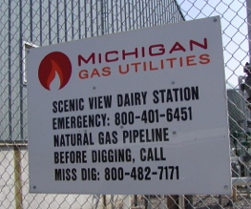
Scrubbing biogas to biomethane
Biomethane: methane produced by removing all other gases from biogas
Chemically equivalent to natural gas though biologically produced
Can be injected into natural gas pipelines
Can be used to vehicles equipped for natural gas
Increased energy density of 1000 Btu / ft³
Fiscally viable only when natural gas prices are high enough
Biomethane from Scenic View Dairy in MD is injected into the natural gas grid

Slide 23
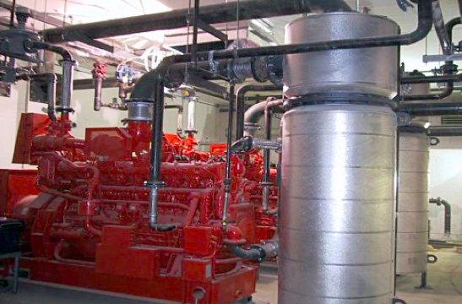
Biogas combustion & heat recovery
Biogas is burned in internal combustion engines that produce 30% electricity and 70% heat.
Heat can be recovered from:
From exhaust gases
Water jackets that surround the engine

Slide 24
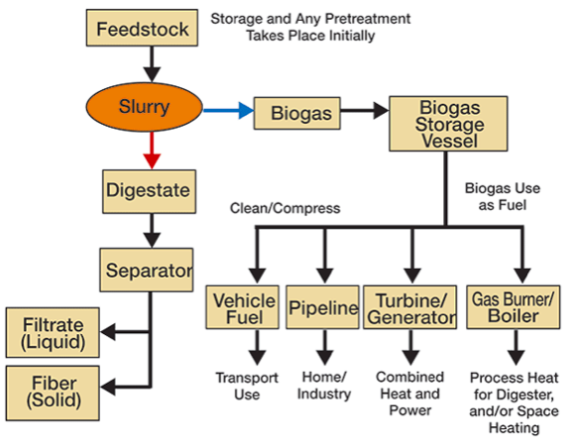
Digestate
Digestate: nutrient-rich slurry remaining after removal of biogas

Slide 25
Solids separation
Solids separation is accomplished using a screw-press or fan separator; an auger pushes digestate against a perforated screen, squeezing out liquid effluent.
Effluent: the liquid portion of digestate, enriched for ammonia nitrogen
Used as field fertilizer; should be injected rather than broadcast
Separated solids: the solid portion of digestate; roughly 35% moisture
Enriched for phosphorous
Animal bedding (often a source of both savings & profit)
Field fertilizer
Compost base
Component of composite materials

Slide 26
Solids as bedding
Animal bedding gives comfort to animals and absorbs moisture and urine.
Traditional bedding materials include straw, sawdust, grain hulls, and sand.
The increased energy demand for wood products has increased the cost of sawdust and shavings.
Sand bedding must be removed from manure before anaerobic digestion.
Separated solids reduce a farm’s operational costs and are often sold for profit.
Mastitis rates and somatic cell counts are not increased by solids bedding
http://cwmi.css.cornell.edu/beddingfinalreport.pdf
This topic is covered in depth in Module 6.

Slide 27
Solids as compost base
Composting: an aerobic process in which aerobic microbes decompose organic materials to CO₂, H₂O and soil-like and nutrient-rich compost.
Separated AD solids can be:
Used as a composting base (an input).
Combined with compost and nutrients to produce custom potting soils.
Used to produce nursery pots.
http://connecticut.cbslocal.com/2013/12/16/profile-a-connecticut-green -business-owner/

Slide 28
Solids to composite materials
Composite materials: materials created by blending a mixture of materials, often organics and inorganics
Michigan State University and the University of Wisconsin-Madison’s Forest Products Laboratory have used AD fiber to produce novel products:
Medium density fiberboard
Decking material

Slide 29
Nutrients & NMPs
The AD process ‘mineralizes’ nutrients, converting them to small molecules that are very bioavailable to plants. Digestate typically is a more effective fertilizer than the manure that it is created from.
Potassium (K) levels are unchanged
Nitrogen (N) is converted to ammonia (NH₃) and enriched in filtrate
Phosphorous (P) binds to solids and is concentrated in the solids
Vermont requires large (>700 cows) and medium (>200 cows) and farms with AD to use nutrient management plans to ensure that nutrients benefit crops and do not enter the water supply. The ability of AD to partially separate nutrients is helpful.
Nutrient management planning is addressed in detail in Module 8.

Slide 30
9.5: Environmental impacts of AD:
benefits & concerns

Slide 31
Environmental benefits of AD
AD’s environmental benefits:
Decreases GHG emissions as methane is contained and converted to CO₂
Odor control
Protection of water quality
Pathogen reduction & destruction

Slide 32
Greenhouse gas emissions
Greenhouse gases (GHGs): gases that reflect and contain heat in earth’s atmosphere and thus contribute to global climate change.
Methane is a greenhouse gas with 21 – 27 times the GHG potential of CO₂.
AD captures nearly all of the methane potential of manure.
Combustion of methane reduces its GHG potential 21 – 27 times.
Moving organic waste from landfills to AD captures methane now leaking from landfills.
Theoretically, the CO₂ emitted from the generating engine will be recycled to build the plants fed to cows or used for human food.
Practically, the carbon in CO₂ can be recycled by passing it through greenhouses to enhance plant growth.
Use of biogas to produce energy replaces fossil fuels, further reducing GHG emissions.
AD also reduces the emission of nitrous oxides (NOx), another GHG, from manure and organic wastes.

Slide 33
Odor reduction
Manure and livestock odors are produced by 75 malodorous molecules created by naturally ocuring anaerobic degradation of organics.
Most malodorous molecules contain N or S
Phenols & cresols
Indole & skatole
VFAs
The AD process redirects metabolism of volatile solids to produce methane, decreasing production of malodorous molecules.
Odors are reduced by AD for 10 days at 35°C.
Increasing retention (digestion) time increases odor reduction.
Odors don’t return even with digestate is stored for 3 months.
Odors are reduced by approximately 79%.

Slide 34
Water quality
The partial nutrient separation effected by AD makes it easier to apply nutrients where needed in a targeted manner.
The lower levels of P in liquid effluent allow farmers to slowly lower P levels in P-saturated fields.
The captured P in solids can be exported to P-poor land.
There is an environmental side-benefit from the regulatory requirement of NMPs for farms using AD technology.

Slide 35
Pathogen reduction or destruction
Studies show that AD reduces levels of many pathogens by 90% or more.
Coliform
Streptococcus
Of course, the degree of pathogen destruction is dependent on AD conditions:
AD temperature
AD retention time

Slide 36
Indirect environmental benefits
Reduction of transportation of high-strength organic wastes
Replaces land application of untreated high-strength organic wastes
Reduction of soil compaction because fertilizer is more effective

Slide 37
Environmental concerns about AD
AD does create some environmental concerns:
Air emissions
Biogas combustion
Aerated digestate
Human and animal health
Do digesters encourage the development of CAFOs?

Slide 38
Air emissions
There is little data to prove that AD plants don’t emit (or leak) any methane.
The EPA estimates 10% leakage when evaluating AD efficiency.
Combustion of biogas, as opposed to biomethane, releases small amounts of air pollutants in addition to CO₂.
NOx
CO
volatile organic compounds (VOCs)
Generation of these pollutants can be reduced by:
Scrubbing CO₂, H₂S, NH₃ from biogas
Reducing the amount of N & S in feedstock (reducing protein content)
AD plants use flares to burn of biogas that isn’t combusted, decreasing release of uncombusted biogas. Flares should have reliable igniters and be protected from wind.

Slide 39
Aerated digestate
When digestate is aerated during transfer or land-application, ammonia is released into the air and is an air pollutant.
Release of ammonia can be decreased by:
Incorporating digestate into soil: dragging or injecting
Lowering the pH of the digestate

Slide 40
Effects on human and animal health
Ammonia is toxic to animals and humans.
Ammonia is caustic or corrosive to the airways.
When ammonia combines with nitrous oxide it forms aerosol nitrate, a fine particulate pollutant.
Livestock are the greatest source of ammonia emissions.
Hydrogen sulfide (H₂S; hydrosulfuric acid) is acutely toxic to animals and humans and corrodes metals and machinery
Safety precautions are essential!

Slide 41
Does AD encourage CAFOs?
AD systems are most economical for very large farms with over 500 head of cattle or 2000 pigs or more chickens. These large operations confine rather than pasture the animals and are called Concentrated Animal Feeding Operations (CAFOs).
AD will reduce odors and make land application of effluent easier, but don’t reduce the threat of the huge volume and concentration of manure, nutrients and pathogens to water and land immediately surrounding the CAFO. Currently, most farm AD is on CAFOs.
If interconnection costs were covered by the cost paid for AD electricity, AD could be installed as easily on small farms as on CAFOs.

Slide 42
Opportunity costs?
Does the use of AD prevent investigation or use of other methods of managing manure and nutrients?
Development and implementation of NMPs and best management practices (BMPs) are much less expensive than AD and can be used on farms of any size.
Better manure containment and storage
Use of NMPs
Buffer strips
Rotational grazing
Composting

