Slide 1
SSC 2030: Energy Systems and Sustainability
Module 14: Transition modeling and challenges
14.1: Time to ante up: Who’s for carbon neutrality?
14.2: Could these models be implemented?
14.3: Seven challenges to making transition happen
14.4: Challenge 1 – Making emissions visible
14.5: Challenge 2 – Tripling energy productivity gains
14.6: Challenge 3 – Electrify with renewables
14.7: Challenge 4 – Reinvent cities
14.8: Challenge 5 – Boosting clean technologies
14.9: Challenge 6 – Redesigning industry
14.10: Challenge 7 – A swift and fair transition
Carbon Mitigation Initiative
Rocky Mountain Institute

Slide 2
Module 14. Transition modeling and challenges
14.1: Net-zero America transition models

Slide 3
Process: the starting point
Data used: US Department of Energy’s Annual Energy Outlook Reference Case projections across the economy to 2050
passenger vehicle road-miles
air-miles traveled
residential and commercial floor area provided with heating, cooling and lighting
outputs of industries
more
**Industrial energy service demands were adjusted to minimize “offshoring” of emissions beyond today’s level.
https://cmi.princeton.edu/annual-meetings/annual-reports/year-2019/the-net-zero-america-project-finding-pathways-to-a-carbon-neutral-future/

Slide 4
Process: analysis
The researchers rely on a linear-programming optimization model that incorporates projected energy service demands together with exogenously-specified market penetration rates of energy end-use technologies.
The model chooses the mix of primary energy sources and conversion technologies that meet the service demands and achieve NZE by 2050.
It makes supply-side choices that minimize the net present value of total energy supply system capital and operating costs from 2020 to 2050.
It assumes perfect 30-year foresight, seamless integration of electricity, buildings, industry and transportation sectors, and economically rational decision-making across society.
So the model is unrealistically optimistic: way-best possible scenario
https://cmi.princeton.edu/annual-meetings/annual-reports/year-2019/the-net-zero-america-project-finding-pathways-to-a-carbon-neutral-future/

Slide 5
Process: models
BAU = business as usual
E+ = high end-use electrification of buildings and transportation
E- = less high end-use electrification of buildings and transportation
E+RE- = high end-use electrification of buildings and transportation with constrained expansion of renewable energy (wind and solar)
E+RE+ = high end-use electrification of buildings and transportation with 100% renewable energy (wind and solar) by 2050
https://cmi.princeton.edu/annual-meetings/annual-reports/year-2019/the-net-zero-america-project-finding-pathways-to-a-carbon-neutral-future/

Slide 6
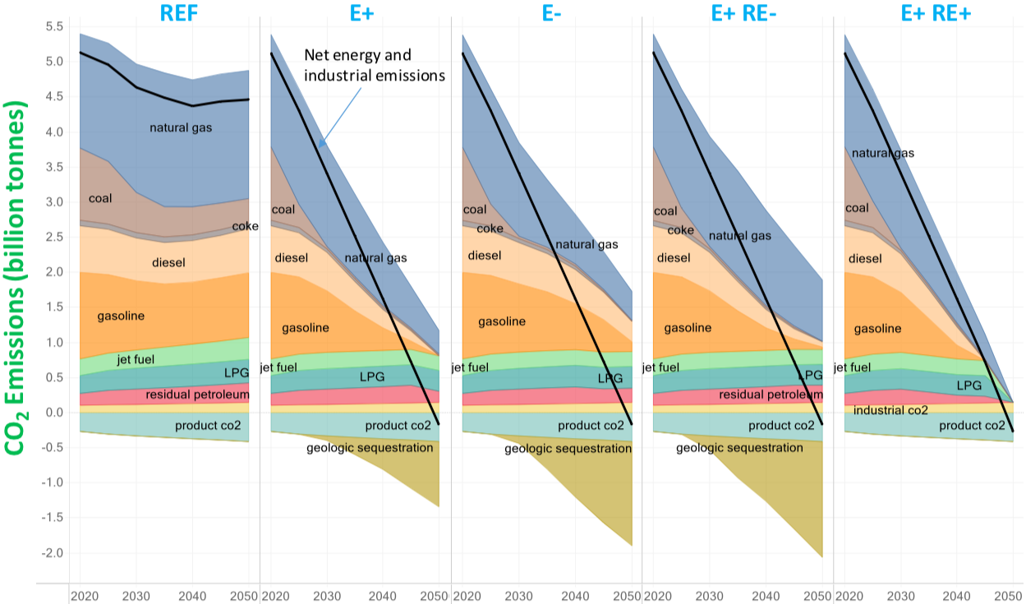
Modeled US carbon emissions
https://cmi.princeton.edu/annual-meetings/annual-reports/year-2019/the-net-zero-america-project-finding-pathways-to-a-carbon-neutral-future/

Slide 7
Modeled US carbon emissions
coal eliminated by 2030 → → →
oil down 75% 65% 50% 100%
oil down 75% 50% 65% 100%
NG sig. down sig. down less reduction sig. down
Not allowed in E+ RE+:
fossil fuel
nuclear
CCS
https://cmi.princeton.edu/annual-meetings/annual-reports/year-2019/the-net-zero-america-project-finding-pathways-to-a-carbon-neutral-future/

Slide 8
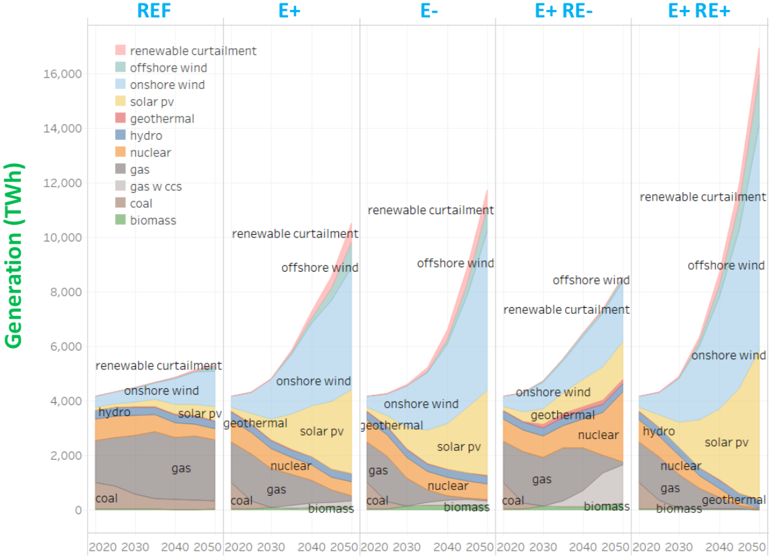
Modeled US electric generation
More electricity needed to make fuels needed in place of aggressive electrification.
https://cmi.princeton.edu/annual-meetings/annual-reports/year-2019/the-net-zero-america-project-finding-pathways-to-a-carbon-neutral-future/

Slide 9
Modeled US electric generation
More electricity needed to make fuels needed in place of aggressive electrification.
E+ RE-
RE is constrained to existing record rates of installation
NG/CCS and nuclear installation don’t exceed historical precedent
E+ RE+
Installation rates of wind and solar far exceed existing record rates
All except REF:
Where NG is used, CCS is applied to sequester carbon
https://cmi.princeton.edu/annual-meetings/annual-reports/year-2019/the-net-zero-america-project-finding-pathways-to-a-carbon-neutral-future/

Slide 10
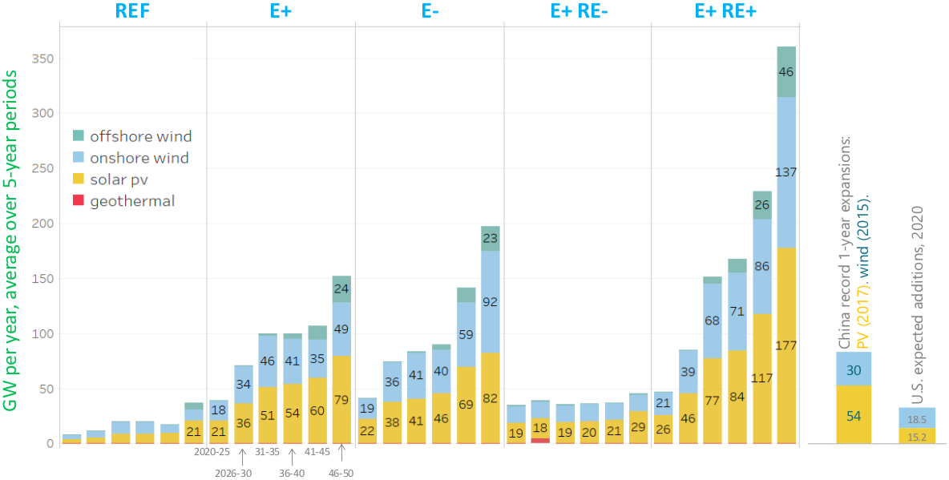
Average annual capacity addition of wind and solar

Slide 11
Average annual capacity addition of wind and solar
For all scenarios curtailment (loss of excess) RE is minimized by:
Coupling RE to large loads that can operate flexibly:
Electric boilers with fuel-fired backups
Electrolyzers that produce hydrogen fuel from water
(For direct use and to make fuel with CO₂)
Direct-air CCS

Slide 12
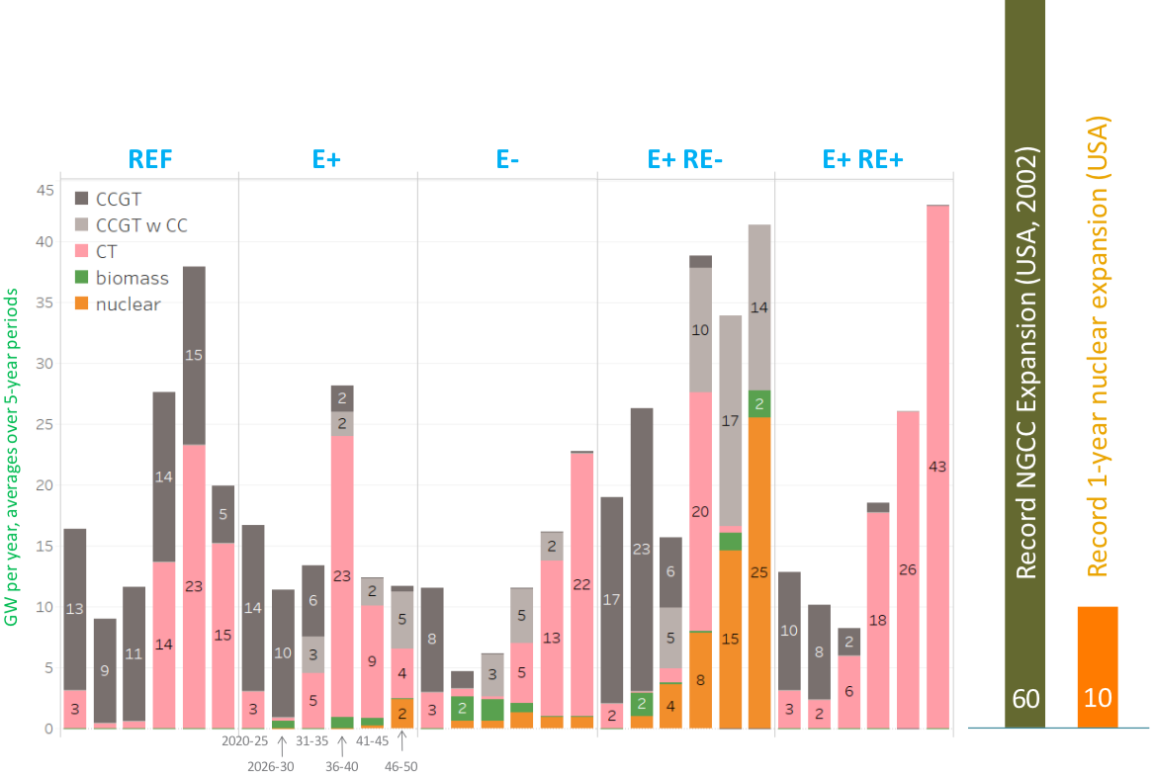
Average annual thermal generation capacity addition

Slide 13
Module 14. Transition modeling and challenges
14.2: Could these models be implemented?

Slide 14
What would it take to make this happen?
Shifting demand side investments and use patterns
Widespread industrial transformation
Coordinating public and private investment decision making to drive a capital-intensive transition
Decarbonizing remaining liquid and gaseous fuels – a high-cost proposition
Major market reform to lower risk and increase incentives of transition
Rapid expansion of new industries and supply chains
Coping with significant disruption to existing industries and employment
Minimizing environmental effects
Using transition to address social inequity and community opposition
https://cmi.princeton.edu/annual-meetings/annual-reports/year-2019/the-net-zero-america-project-finding-pathways-to-a-carbon-neutral-future/

Slide 15
Next steps?
The existing models are regional: 14 regions across the US. They are being downscaled to create state or sub-state models.
Quantification of the change needed from 2020 to 2050 in terms of:
magnitude
cost
spatial distribution
pace
https://cmi.princeton.edu/annual-meetings/annual-reports/year-2019/the-net-zero-america-project-finding-pathways-to-a-carbon-neutral-future/

Slide 16
The carbon challenge
https://cmi.princeton.edu/annual-meetings/annual-reports/year-2019/the-net-zero-america-project-finding-pathways-to-a-carbon-neutral-future/

Slide 17
Module 14. Transition modeling and challenges
14.3: Seven challenges to making transition happen

Slide 18
The problem
“Many nations are struggling to address issues of security, trade, and economic stability;…
…only a few have the focus and the will now necessary to make the major changes in energy policy that are required to put energy systems on a path to real change in the time frame needed.”
https://rmi.org/seven-challenges-report/

Slide 19
Rocky Mountain Institute’s solution?
“Our analysis and experience suggest that there is another way to get to the goal.
This is a path of emergence, sparked by bold and decisive actions on the part of citizens, corporations, philanthropic institutions,
subnational leaders, regulators, and policymakers.
Meaningful progress to address the climate crisis can emerge quickly from an upwelling of actions taken by leading institutions in the next two to three years—provided these institutions have the will and the capacity to work together in new ways..”
https://rmi.org/seven-challenges-report/

Slide 20
Systems thinking identifies seven challenges
Effective actions must be synergistic.
https://rmi.org/seven-challenges-report/

Slide 21
Seven challenges for energy transformation
https://rmi.org/seven-challenges-report/

Slide 22
Module 14. Transition modeling and challenges
14.4: Challenge 1 – Making emissions visible

Slide 23
1. Making emissions visible
To be effective, the world needs an ‘integrated, open-source systems capable of generating emissions maps of the world with continuously improved granularity, smaller uncertainty… and reduced time lags’.
Steps:
1. Convert today’s fragmented initiatives into a diverse information ecosystem.
2. Facilitate development of platforms that apply data and analytics to specific opportunities.
3. Integrate the result into an independent global system for climate and energy data tracking and communication.
https://rmi.org/seven-challenges-report/

Slide 24
Transformation data can drive more change
Consumers want to buy sustainable products.
Data on social media can influence behavior.
Investors look for opportunities that address energy transformation.
https://rmi.org/seven-challenges-report/

Slide 25
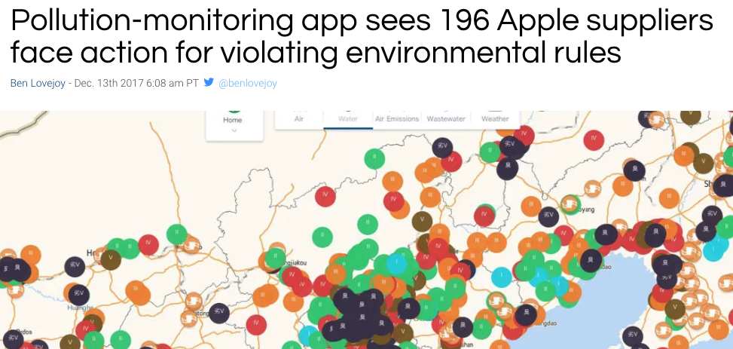
Better GHG data is essential for driving change
https://rmi.org/seven-challenges-report/
https://9to5mac.com/2017/12/13/china-pollution-apple-suppliers-blue-map-app/

Slide 26
Measuring C? Agreement = clear communication
If measuring carbon becomes a metric for successful transition, the data has to be not only transparent but also high quality and comprehensive.
https://rmi.org/seven-challenges-report/

Slide 27
Towards integrated climate and energy data system
And the data must be shaped into an integrated system that is used every day .….in addition to being transparent.
https://rmi.org/seven-challenges-report/

Slide 28
1. Opportunities?
How will dramatically increased C-transparency affect operation and construction of carbon-intensive assets?
How can the fractured landscape of carbon and environment reporting be unified and improved?
How can experts across technical, policy and economic fields work together to identify leverage points for data transparency?
What are the opportunities for coordination of systems for mutual benefit of a variety of data applications?
https://rmi.org/seven-challenges-report/

Slide 29
Module 14. Transition modeling and challenges
14.5: Challenge 2 – Tripling energy productivity gains

Slide 30
2. Tripling energy productivity gains
We need to triple the rate of growth of energy productivity in the next decade.
Steps:
1. Figure the right incentives through integrated planning and utility regulation.
2. Quickly scale energy efficiency programs and regulations working today.
3. Rapidly electrify energy use in buildings, transportation and much industry where electricity is the right answer.
4. Improve design practices to achieve leapfrogging efficiency gains
5. Accelerate asset transformation with retrofits and scrapping.
https://rmi.org/seven-challenges-report/

Slide 31
Tripling the amount we do with each unit of energy
The tripling of energy productivity goal is ambitious but worth starting now.
LED: low energy demand model
SSP1: shared socioeconomic pathway model
https://rmi.org/seven-challenges-report/

Slide 32
Save now or pay later?
The later we start to increase productivity the more expensive it becomes.
https://rmi.org/seven-challenges-report/

Slide 33
2. Opportunities?
How to keep the focus on energy efficiency though it’s invisible/
Increase the visibility of energy efficiency by assessing it with detail and rigor?
Correct the misperception that efficiency isn’t important?
How to accelerate retirement or deep retrofit of all existing energy stocks?
How can developing companies leapfrog over conventional inefficient design and infrastructure?
How does integrative design become the norm?
https://rmi.org/seven-challenges-report/

Slide 34
Module 14. Transition modeling and challenges
14.6: Challenge 3 – Electrify with renewables

Slide 35
3. Electrify with renewables
Electrifying energy through renewables is a critical leverage point. Renewables are at a tipping point but need a bit more push.
Need:
1. Electrify 40 – 50% of energy use by 2040.
2. Increase use of renewable electricity to 75 – 85%.
3. Increase economic efficiency and decrease materials use.
How?
1. Reform utility business models.
2. Expand competitive energy markets.
3. Retiring uneconomic (high-C) assets.
https://rmi.org/seven-challenges-report/

Slide 36
How much electrification do we need by 2040?
It depends on the temperature limit we want.
But aggressive aim may produce conservative results.
global RE 2020
https://rmi.org/seven-challenges-report/

Slide 37
New NG is a threat that brings decades of GHG
2019 LCOEs suggest that it makes economic sense to operate existing NG plants but not to build new NG plants.
$ / MWh (2019)
https://rmi.org/seven-challenges-report/

Slide 38
Electrification milestones for a 2C limit
Not only do we need to vastly increase electrification, we need to electrify across sectors.
transportation: EVs
buildings
industry
https://rmi.org/seven-challenges-report/

Slide 39
3. Opportunities?
Design competitive markets to support clean and efficient electrification in the developing world?
Redesign of utilities to do the same?
Rapidly evolve utility regulations to create clear policy + incentives to transform?
Create regulations that encourage utilities and providers to innovate?
Electrify existing buildings at scale and speed?
https://rmi.org/seven-challenges-report/

Slide 40
Module 14. Transition modeling and challenges
14.7: Challenge 4 – Reinvent cities

Slide 41
4. Reinvent cities
Cities are hubs of rapid learning, knowledge sharing, and experimentation, with the potential to reshape global energy.
Potential?
Investments of $2 trillion annually could yield:
$2.8 trillion in returns by 2030;
$7 trillion by 2050;
90% reduction in emissions
How?
Electrification of buildings and transportation;
Sharing city innovations and best practices globally;
Leapfrogging through better urban design.
https://rmi.org/seven-challenges-report/

Slide 42
Projected growth of cities through 2050
millions
https://rmi.org/seven-challenges-report/

Slide 43
Cities are critical leverage points for the GCC
Urban areas use 70% of energy and emit 70% of GHG.
https://rmi.org/seven-challenges-report/

Slide 44
Leapfrogging change in fastest growing cities
Switzerland: 24 years
large cities: 19 years
medium cities: 10 years
small cities: 3 years
Energy consumption(EJ)
https://rmi.org/seven-challenges-report/

Slide 45
4. Opportunities?
Coordination of human-centered solutions learned globally and applied locally
Funding to boost leadership that encourages urban experimentation and change
Bulk procurement of new tech by cities to scale and drive down costs
Rapidly test and scale new infrastructure and designs and align codes and standards
Apply best practices in clean transportation to rapidly growing cities
Design criteria for the next C40 cities?
City leaders need to influence all constituents?
https://rmi.org/seven-challenges-report/

Slide 46
Module 14. Transition modeling and challenges
14.8: Challenge 5 – Boosting clean technologies

Slide 47
5. Boosting clean technology
It’s clear that renewables and energy storage thrive in the global regions that have scaled manufacturing of these technologies.
Success? Prices have dropped and installation has boomed for:
Wind
Solar
Battery storage
The next needs for scale?
Industry
Transportation
How?
Coordination between industry and government
Targeted R&D and deployment
Hydrogen production
Long—term energy storage
Insulation materials
Industrial processes
Look to pharmaceuticals and biotech for fast processes
https://rmi.org/seven-challenges-report/

Slide 48
Tipping point: costs allow transformation deployment
Conventional integrated assessment models in wide use to study responses to climate change are flawed because they don’t consider complex system dynamics.
So, these IAMs are of limited use and can limit transformation.
Example: IAM modeling didn’t see how quickly RE prices would fall and drive increased deployment.
https://rmi.org/seven-challenges-report/

Slide 49
By 2030, RE will beat fossil fuels globally
% of coal facilities (existing and under construction) with higher operating costs than RE
https://rmi.org/seven-challenges-report/

Slide 50
Example: PV learning curve to GW installation
FiTs in Germany and China, RPS in US states, tax incentives in China and the US drove demand and thus scaled technology and lowered costs.
Modeling suggests that price drops will continue.
unit cost relative to 2017
https://rmi.org/seven-challenges-report/

Slide 51
5. Opportunities?
How do we boost supply and demand of high-cost but commercially ready technologies to drive down costs and increase deployment?
How can private sector, government and academia create integrated, systems solutions to commercialize new tech?
How can other countries (with different governing systems) emulate China’s successful scale-up and price-drop of RE and batteries?
How can private sectors coordinate to drive change where governments fail?
https://rmi.org/seven-challenges-report/

Slide 52
Module 14. Transition modeling and challenges
14.9: Challenge 6 – Redesigning industry

Slide 53
6. Redesigning industry
The need to massively accelerate decarbonization of these sectors is urgent:
heavy industry;
long-haul transportation; and
aviation.
Levers?
1. Climate-aligned financial sector commitments
2. Top-down and bottom-up policy incentives
3. Market evolution to greater transparency and rewards for low-carbon solutions
4. Catalytic multi-stakeholder collaboration focused on pragmatic solutions
https://rmi.org/seven-challenges-report/

Slide 54
A circular economy: reduce emissions 40% by 2050
Circular economy?
Eliminate waste
Reuse product
Material recycling
Better product and materials design for steel, aluminum, plastics, cement
https://rmi.org/seven-challenges-report/

Slide 55
Circular systems diagram
Today less than 10% of material is used to its design capacity.
We can do better.
https://rmi.org/seven-challenges-report/

Slide 56
Could decarbonization be radically accelerated?
Three case studies of opportunities to radically accelerate decarbonization.
1. Cost-competitive green hydrogen by 2030
2. Green steel
3. C-transparency for materials and methane creates new solutions
https://rmi.org/seven-challenges-report/

Slide 57
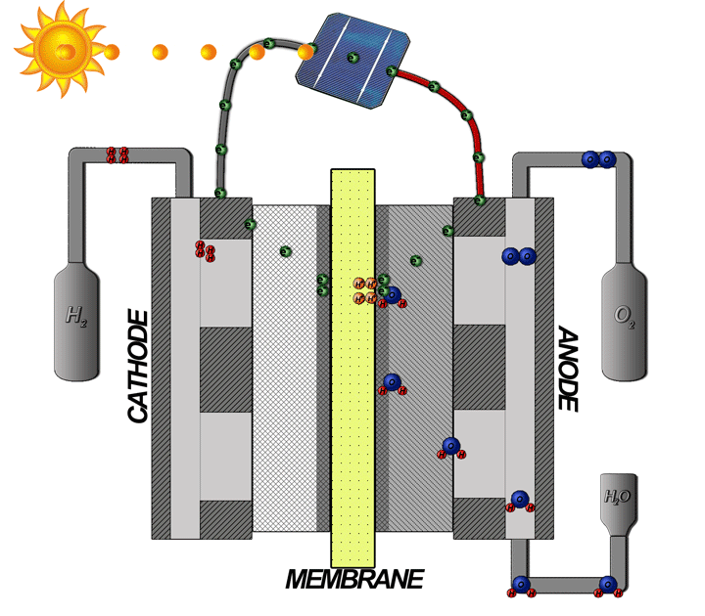
1. Cost-competitive green hydrogen by 2030
Green hydrogen = H₂ gas created by electrolysis of water by renewable energy
Leverage point?
Cost and efficiency of PEM (polymer electrolyte membranes) electrolyzers
Over the next decade the cost of PEM electrolyzers could drop below $300/kW.
Combined with low-cost RE to drop the price of green hydrogen to far below $1.50/kg in areas with strong wind and solar resources.
What needs to happen?
Big increases in RE
Coordination of businesses, policy, consumers
Focus on US, China, Australia
https://rmi.org/seven-challenges-report/; Wikipedia

Slide 58
2. Green steel – biggest evolution since WWII
Green hydrogen fuel can create the very high temperatures needed to create and work steel without fossil fuels and radically reduce the C footprint of many materials.
New processes, like molten oxide electrolysis (MOE), can create steel without fossil fuels and with tiny carbon footprints.
https://rmi.org/seven-challenges-report/; Wikipedia
https://www.downtoearth.org.in/news/scientists-discover-green-way-to-produce-steel-41179

Slide 59
Low-C MOE must use low-C electricity
In order to combat GCC, MOE would have to use low-C electricity.
And its cost will depend on the cost of that low-C electricity.
https://rmi.org/seven-challenges-report/; Wikipedia
https://www.downtoearth.org.in/news/scientists-discover-green-way-to-produce-steel-41179

Slide 60
3. Carbon transparency to spur new solutions
What’s carbon transparency?
Embedding the CO₂ footprint (or carbon cost) at all stages of a material’s or product’s supply chain in a visible way
Carbon transparency allows industries, consumers and investors to make choices and therefore apply pressure to decarbonize across the economy.
Low-carbon industries and low-carbon portfolios will capture larger investments and grow faster.
aka ‘climate-aligned’
https://rmi.org/seven-challenges-report/

Slide 61
6. Opportunities?
How do we connect developers, designers and funders to scale up and deploy next-generation materials in buildings?
What policies, models and customer demands can be used to change redesign and recirculation of materials?
What platforms and standards can be used to unleash consumer pull for low- and no-C products and services? And help move investors?
How can sectors work together to accelerate cost reduction of green hydrogen?
What lessons can be learned from accelerated capital transitions and applied to decarbonization?
https://rmi.org/seven-challenges-report/

Slide 62
Module 14. Transition modeling and challenges
14.10: Challenge 7 – A swift and fair transition?

Slide 63
7. Securing a swift and fair transition
“Progress toward supplanting carbon-intensive assets with zero-carbon alternatives entails disruption and dislocations that must be predicted and managed…. [to]…mitigate negative impacts on affected industries and communities in order to maximize net value creation from global clean energy transformation.”
Levers?
1. Building new low-carbon assets
2. Preventing build-out of high-carbon assets
3. Accelerate the retirement of existing carbon-intensive assets
4. Improving the productivity of existing and new capital stock
https://rmi.org/seven-challenges-report/

Slide 64
Reinvent climate financing: 4 levers
4 levers of an integrated approach to reinventing climate financing:
1. Build new low-carbon assets
2. Halt the build out of new high-carbon assets
3. Accelerate the retirement of existing carbon-intensive assets
4. Improve the productivity of existing and new capital
https://rmi.org/seven-challenges-report/

Slide 65
Reinvent climate financing: the numbers
2% of gross world economic product over one decade
https://rmi.org/seven-challenges-report/

Slide 66
Different approaches: industrialized vs. developing
https://rmi.org/seven-challenges-report/

Slide 67
Example: reduce cost of minigrids to beat diesel
Dropping the cost of RE-powered mini-grids, including battery storage, by 60% would allow them to leapfrog expansion of fossil fuel-powered electric generation in developing countries.
$ / kWh
https://rmi.org/seven-challenges-report/

Slide 68
7. Opportunities?
Lessons to be learned from ARRA disruptions in 2007 – 2008?
Voluntary investor initiatives to ‘climate-align’
How can banks learn the economics and timing needed to retire high-C assets and minimize stranded assets?
Planning to ensure that developing countries create clean, accessible energy?
Tools for planners to assess transition risks and solutions??
Methods to assist communities and nations hit hard by transition?
https://rmi.org/seven-challenges-report/

Slide 69
XXX
XXX
https://rmi.org/seven-challenges-report/

Slide 70
Harnessing positive feedback in tech and markets
Amplify use of electric buses: What if they adopt batteries requiring 50% less space and double energy storage with 25% less space?
Increases the range of trips.
Increases use to passengers, upping ridership.
Lowers cost of operation.
Increases return on investment
Encourages more bus manufacturing and deployment.
Using positive feedback to jump-starting next gen batteries
Encourages more R&D and use of batteries.
https://rmi.org/seven-challenges-report/

Slide 71
Models may limit the rate of change
Installed global solar generation capacity (GW)
Example: Solar generation exceeded IAM modeling
https://rmi.org/seven-challenges-report/

Slide 72
Better GHG data is essential for driving change
https://rmi.org/seven-challenges-report/

Slide 73
GHG data sources need to be comparable, coordinated
https://rmi.org/seven-challenges-report/

Slide 74
Platforms and coordinated data facilitate change
https://rmi.org/seven-challenges-report/

Slide 75
XXX
https://rmi.org/seven-challenges-report/

Slide 76
XXX
https://rmi.org/seven-challenges-report/

Slide 77
XXX
https://rmi.org/seven-challenges-report/

Slide 78
XXX
https://rmi.org/seven-challenges-report/

Slide 79
XXX
https://rmi.org/seven-challenges-report/

Slide 80
XXX
https://rmi.org/seven-challenges-report/

Slide 81
Leapfrog efficiency gains from integrative design
https://rmi.org/seven-challenges-report/

Slide 82
LCOE of RE is falling quickly, but not fast enough
2018 LCOE values: FF’s are subsidized while RE are not
https://rmi.org/seven-challenges-report/

Slide 83
Investment planning for a NZE future: push now
XXX
https://rmi.org/seven-challenges-report/

Slide 84
To accelerate from 5% to 7% annual RE growth
XXX
https://rmi.org/seven-challenges-report/

Slide 85
Electrification opportunities vs. obstacles? (1)
XXX
https://rmi.org/seven-challenges-report/

Slide 86
Electrification opportunities vs. obstacles? (2)
XXX
https://rmi.org/seven-challenges-report/

Slide 87
Leverage points to boost electrification
XXX
https://rmi.org/seven-challenges-report/

Slide 88
Sustainable transportation for cities
XXX
https://rmi.org/seven-challenges-report/

Slide 89
Accelerate urban change by sharing knowledge
XXX
https://rmi.org/seven-challenges-report/

Slide 90
How many Switzerlands does it take?
https://rmi.org/seven-challenges-report/

