Slide 1

SSC 2030: Energy Systems and Sustainability
3. Primary energy forms and uses
3.1: Primary energy consumption (conservation!)
3.2: Units of energy and energy data
3.3: Energy density (aka heat content)
3.4: Global and regional sources of energy
3.5: UK energy use today
3.6: Primary energy: UK vs. Denmark vs. US
3.7: Primary energy: France vs. India vs. China
3.8: Trends in US energy use
3.9: Vermont energy statistics
3.10: Effect of COVID-19 on global energy use

Slide 2
Module 3. Primary energy forms and uses
  3.1: Energy ‘consumption’
Remember that energy is conserved.
Humans transfer & transform energy.
Transformation from primary energy to used energy is inefficient
Human energy use has increased through time

Slide 3
Energy ‘consumption’
We say that, “The US consumes more energy per capita than any other nation on earth.”
But, that’s incorrect.
The 1st law of thermodynamics:
Energy is neither created nor destroyed but transformed or transferred.
So, the US transforms or converts more energy…
How? For example:
Combustion: fuel → heat energy electricity
chemical energy
Hydroelectric: potential energy → kinetic energy → electricity
Wind power: kinetic energy → electricity
Energy Systems and Sustainability, 2/e, Chapter 2

Slide 4
Energy ‘consumption’
We say that, “The US consumes more energy per capita than any other nation on earth.”
But, that’s incorrect.
The 1st law of thermodynamics:
Energy is neither created nor destroyed but transformed or transferred.
So, the US transforms or converts more energy…
Primary energy
How? For example:
Combustion: fuel → heat energy electricity
chemical energy
Hydroelectric: potential energy → kinetic energy → electricity
Wind power: kinetic energy → electricity
Energy Systems and Sustainability, 2/e, Chapter 2

Slide 5
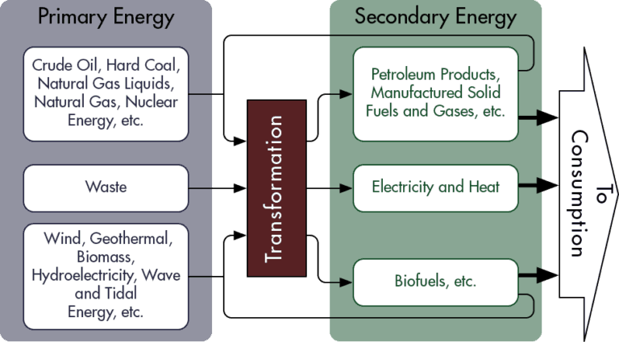
Primary energy (vs. secondary or tertiary energy)
Primary energy: the crude / naturally occurring form of a fuel
Total energy content of the energy source.
more convenient / storable
end use
Tertiary Energy
electricity and heat
https://stem.guide/topic/primary-resources-and-secondary-energy/
electricity and heat

Slide 6
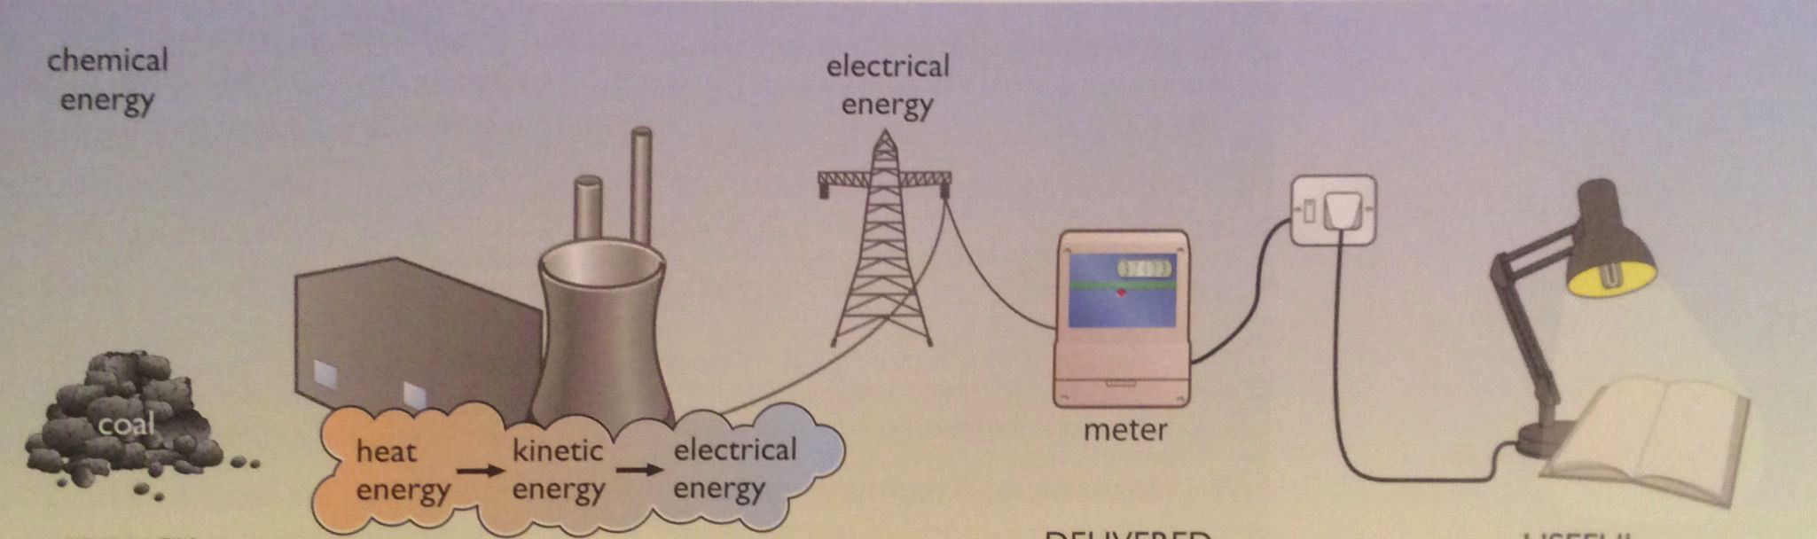
Conversion of primary to useful energy
Transformation of energy, from one form to another, and transfer of energy from generator to user, both result in losses.
Overall, this process is inefficient, particularly for electricity.
60-70%
waste heat
7% loss
transmission
10% used
90% wasted
2.5% used
in mining
1 GJ
32 MJ CFL light
948 MJ waste heat
secondary
tertiary
delivered
used
primary
wasted
Energy Systems and Sustainability, 2/e, Chapter 3

Slide 7
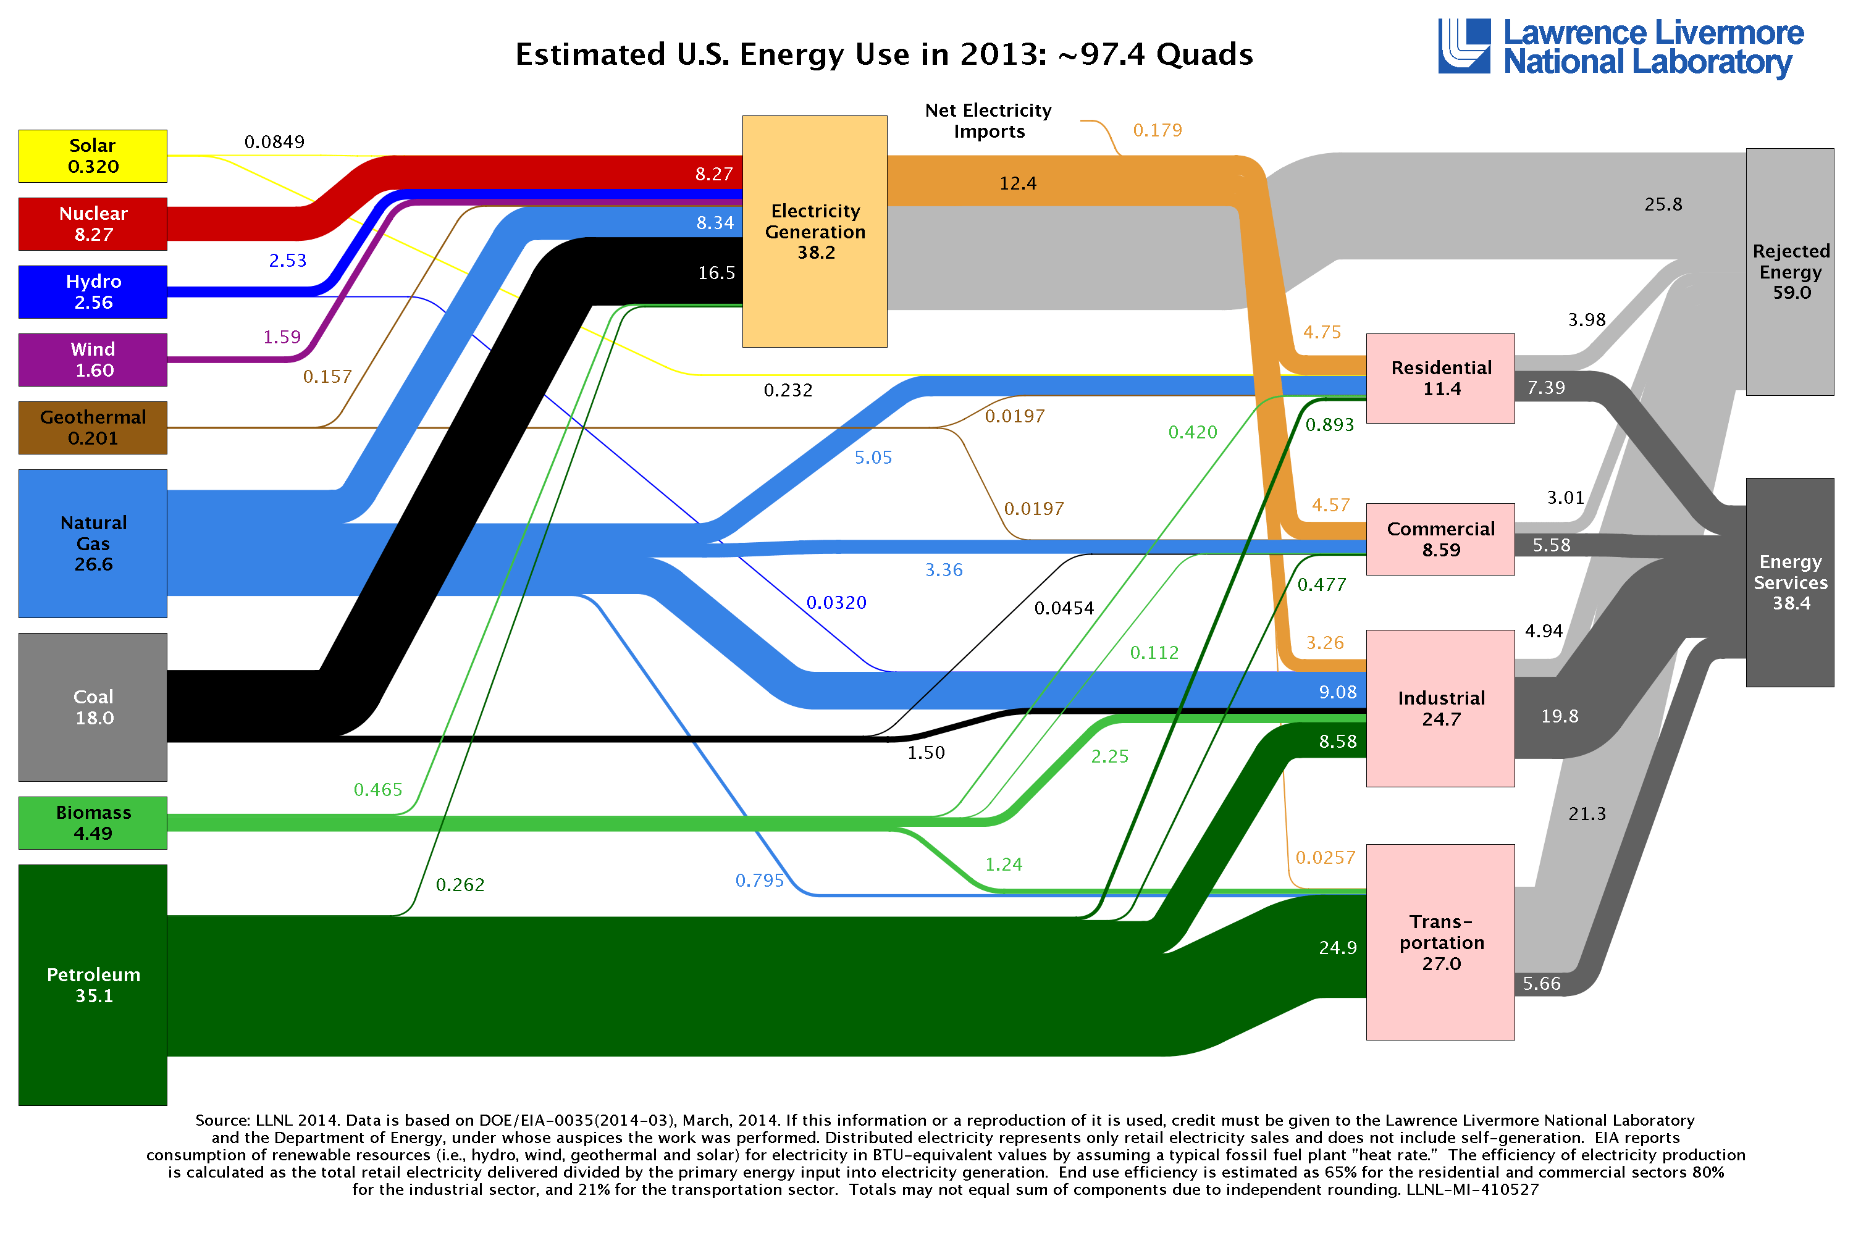
Energy flow maps sources to uses
waste heat
60.6% ‘rejected’
39.4% used
https://flowcharts.llnl.gov/content/energy/energy_archive/energy_flow_2013/2013USEnergy.png
EIA, 2011

Slide 8
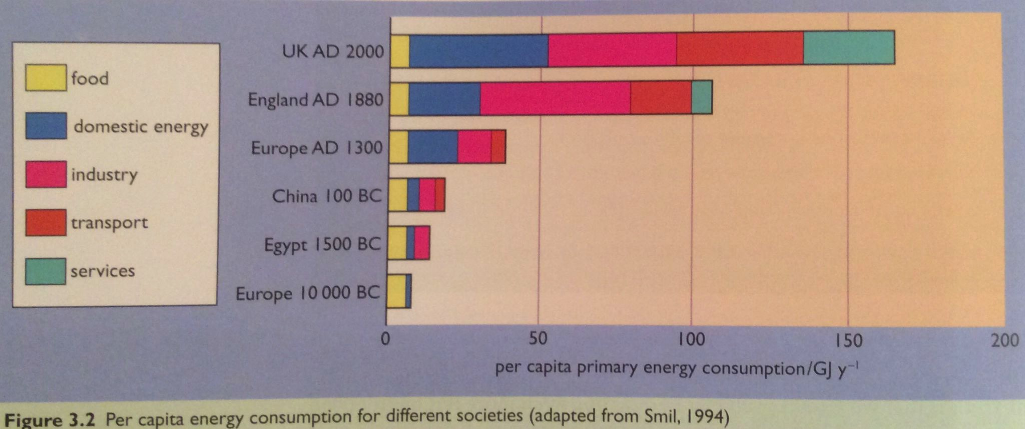
Energy use has increased over time
Why?
New technologies: fire → steam → electricity → etc.,.
New uses: ‘services’ include our computers & nifty new devices
Rapidly growing human population
Energy Systems & Sustainability, 2/e, Chapter 3

Slide 9
Module 3. Primary energy forms and uses
  3.2: Units of energy and energy data
  Energy is an amount while power is a rate
  Units… many different units
  Heat content: a measure of fuel’s energy

Slide 10
Let’s compare everyday fuels
Comparing everyday amounts of gasoline, oil and coal:
 | Joule | Btu | calorie (kcal) | kWh
full gas tank | 1,570,893,171 | 1,488,857 | 375,192,000 | 436
gallon of gas | 130,907,764 | 124,071 | 31,266,000 | 36
*barrel of gas | 5,498,126,100 | 5,211,000 | 1,313,172,000 | 1,527
*barrel of crude oil | 6,119,580,000 | 5,800,000 | 1,461,000,000 | 1,700
coal, 2000 lb | 21,896,490,300 | 20,753,000 | 5,299,756,000 | 6,082
* 1 barrel = 432 US gallons or 159 L
So, it’s clear that we’re going to have to have a basic understanding of units and simple conversion math (‘energy arithmetic’) even in this course.
Energy Systems and Sustainability, 2/e, Chapter 2 / wikipedia

Slide 11
Units of energy vs. power
See: APS physics link for more information
Energy:
J Joule
Btu British thermal unit
kW-hr kilowatt-hour
cal calorie
Cal (or kcal) kilocalorie
ft-lb foot-pound
TOE ton oil equivalent
TCE ton coal equivalent
Quad = quadrillion Btu = 1 E15 Btu = 1.056 EJ
Therm = 100,000 Btu
Power:
W watt
HP horsepower
Energy Systems & Sustainability, 2/e, Chapter 2

Slide 12
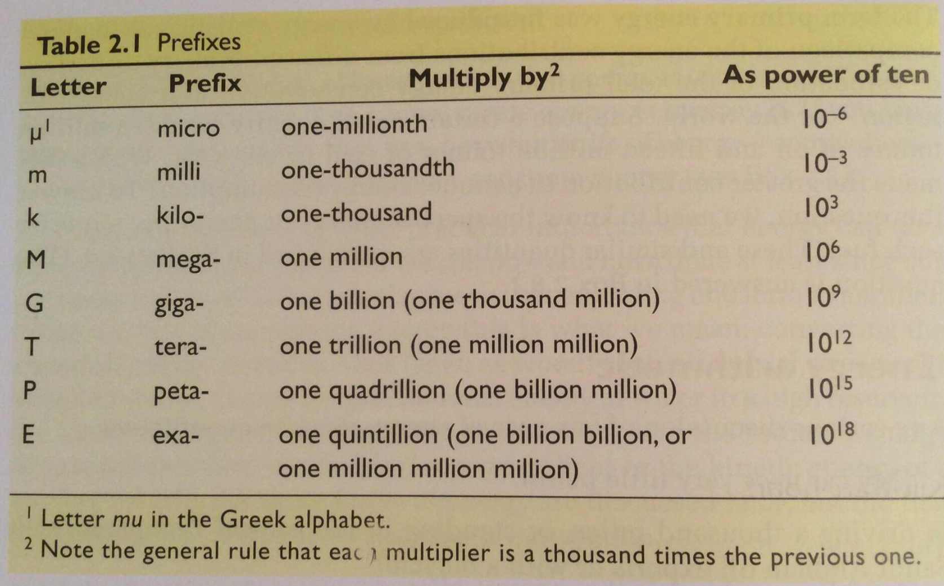
Scientific notation and metric prefixes
number | scientific notation
2 | 2 E0
300 | 3 E2
3,421.768 | 3.421768 E3
-53,000 | -5.3 E4
6,720,000,000 | 6.72 E9
0.2 | 2 E-1
0.00000000751 | 7.51 E-9
Energy Systems and Sustainability, 2/e, Chapter 2 / wikipedia

Slide 13
Often confused…
Units can be confusing. Here are two frequent issues:
When is a ton a tonne?
What’s the difference between m & M?
1 tonne | 1000 kg | 2200 lb
1 ton | 1016 kg | 2240 lb
1 short ton | 907 kg | 2000 lb
←metric or SI
←imperial
←standard US
m | milli- | 1 E-3
M | mega- | 1 E6
MM | Mega- | 1 E6
And writers are often sloppy:
Furnace output in Btu probably means Btu/hour;
Energy use in kW probably means kWh; and
MMBtu should be interpreted as million Btu.
Energy Systems and Sustainability, 2/e, Chapter 2 / wikipedia

Slide 14
watts (W) vs. kilowatt-hour (kWh)
Watt: the rate at which energy is being transformed or converted
    unit of power
    one joule per second
600 W heater?
Transforms energy to heat at a rates of 600 joules each second
Global consumption of 15.9 TW of energy?
We convert 15.9 million million joules of primary energy each second to electricity, heat, etc.,.
Kilowatt-hour: the amount of energy converted in one hour, at a rate of 1 kW (1 E3 W)
    unit of energy
    1 kWh = 3.6 MJ
3 kW clothes dryer used for 40 minutes?
Converts 2 kWh of electricity into heat energy
  [ =(2/3 hr)(3 kW) = 2 kWhr]
Energy Systems and Sustainability, 2/e, Chapter 2 / wikipedia

Slide 15
Module 3. Primary energy forms and uses
  3.3: Energy density (aka heat content)

Slide 16
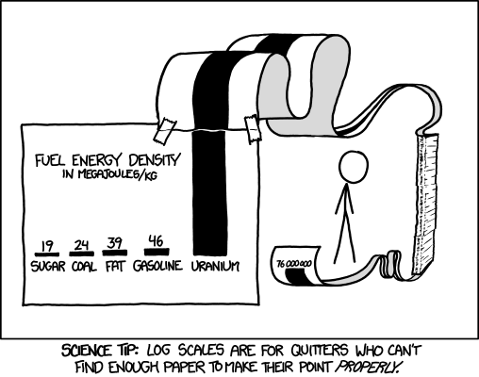
Relative energy densities
http://xkcd.com/1162

Slide 17
Chemical energy density
Storing energy is ‘expensive’ in terms of quantities of chemical or potential energy needed.
pounds to store 10 gas gallon equivalents
22
52
68
105
191
6,578
11,440
762,667
fuel (=chemical energy) | MJ/kg
hydrogen gas | 130
natural gas | 55
gasoline | 45
oil | 42
coal | 28
ethanol | 27
wood | 15
lead-acid batteries
water at 80c
pumped storage (h = 370 m)
Energy Systems and Sustainability, 2/e, Chapter 4

Slide 18
HHV vs. LHV heat values?
There are two ‘flavors’ of heat values (or energy densities) for combusted fuels.
HHV (high heat values) used when the steam is condensed after use; condensing steam to water releases additional energy.
Aka HCV or GCV
LHV (low heat values) used when the steam is not condensed after use.
Aka LCV or NCV
Fuel | HHV (MJ/kg) | LHV (MJ/kg)
hydrogen | 141.80 | 119.96
methane | 55.50 | 50.00
propane | 50.35 | 46.35
diesel | 44.80 | 43.40
wood | 21.20 | 17.0
Energy Systems and Sustainability, 2/e, Chapter 4; wikipedia

Slide 19
Comparing heat contents (energy density)
 | Btu/gallon (gross) | Btu/gallon (net)
auto gasoline | 125,000 | 115,400
hydrogen | 134,200 | 113,400
diesel fuel | 138,700 | 128,700
biodiesel | 126,206 | 117,093
methanol | 64,600 | 56,560
ethanol | 84,600 | 75,670
gasohol | 120,900 | 112,417
aviation gas | 120,200 | 112,000
propane | 91,300 | 83,500
butane | 103,000 | 93,000
jet fuel (naptha) | 127,500 | 118,700
jet fuel (kerosene) | 135,000 | 128,100
crude petroleum | 138,100 | 131,800
residual fuel oil | 149,700 | 138,400
distillate fuel oil | 138,700 | 131,800
gaseous and solid fuels | Btu/_____
natural gas, wet | 1,109 Btu/ft3
natural gas, dry | 1,027 Btu/ft3
natural gas, compressed | 20,551 Btu/lb
liquid natural gas | 90,800 Btu/gallon
anthracite coal | 21.7 E6 Btu/short ton
lignite/bit coal | 21.0 E6 Btu/short ton
Net = water’s heat of vaporization is subtracted from gross energy content
Energy Systems and Sustainability, 2/e, Chapter 2 / wikipedia

Slide 20
Module 3. Primary energy forms and uses
  3.4: Global and regional sources of energy
  Current global use and projections
  Energy inequity
  Use of renewable energy?

Slide 21
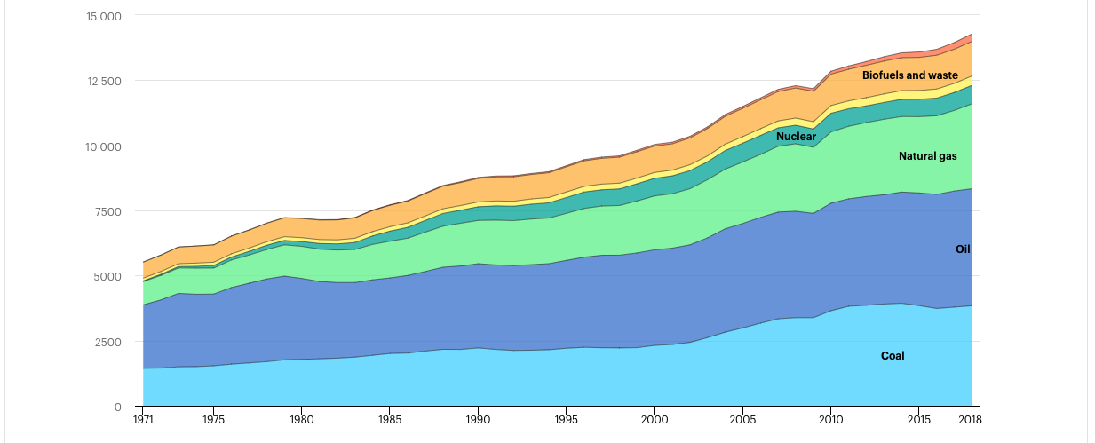
World energy supply by primary source: 1971 - 2018
fossil fuels | 81.2%
low-carbon | 18.8%
renewable | 13.8%
hydro
fossil fuels
86.4%
Mtoe
IEA
https://www.iea.org/reports/key-world-energy-statistics-202 0

Slide 22
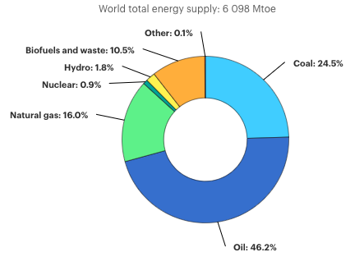
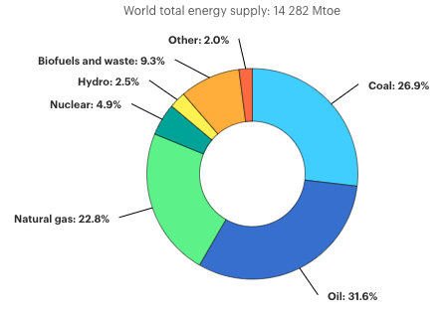
Change in world primary energy use: 1973 vs 2018
1973
2018
↑134%
86.7% FF
81.3% FF
IEA:
https://www.iea.org/reports/key-world-energy-statistics-2020

Slide 23
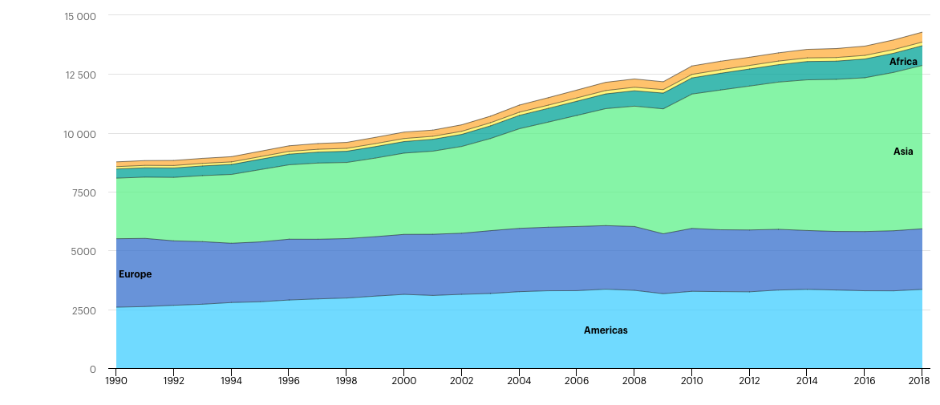
World energy supply by region: 1990 - 2018
Mtoe
6745.7
2576.0
2910.1
2574.9
3347.0
2589.4
IEA:
https://www.iea.org/reports/key-world-energy-statistics-2020

Slide 24
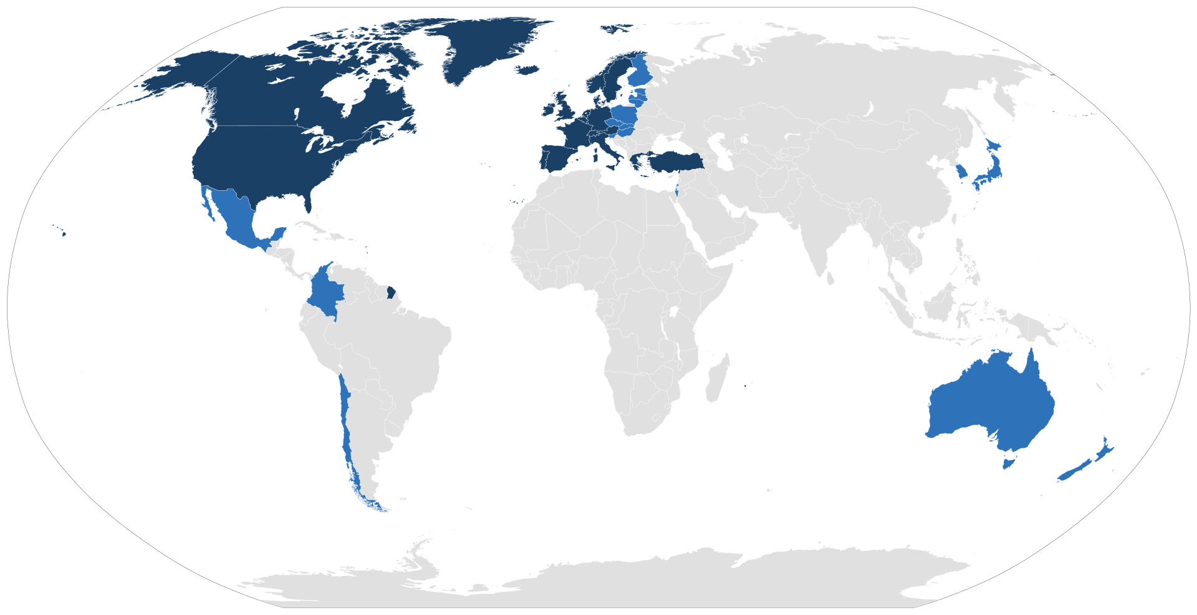
OECD nations
OECD is the Organization for Economic Co-operation and Development.
Founded in 1961 to stimulate economic progress and world trade.
Member states are committed to democracy and the market economy.
https://en.wikipedia.org/wiki/OECD

Slide 25
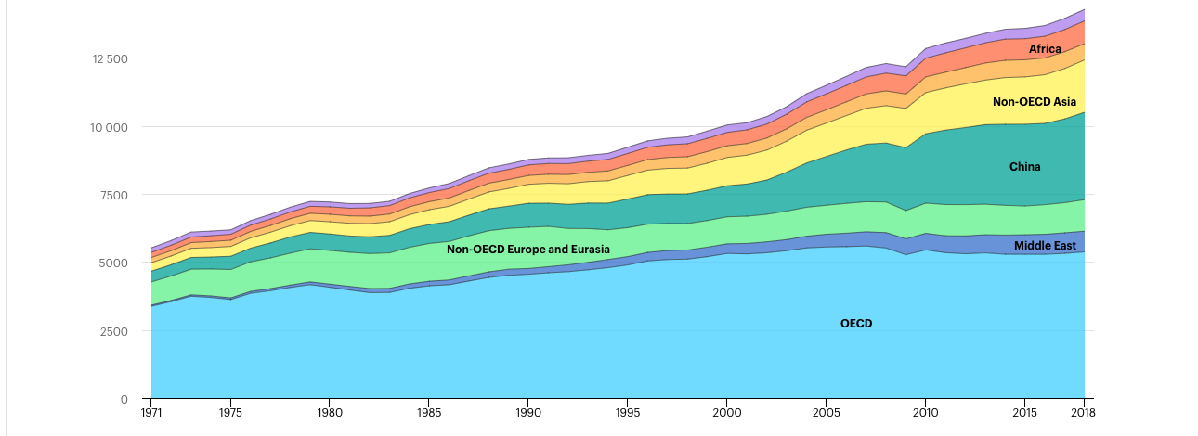
OECD nations: share of world energy use: 1971 - 2018
non-OECD Americas
Mtoe
https://www.iea.org/reports/key-world-energy-statistics-2020

Slide 26
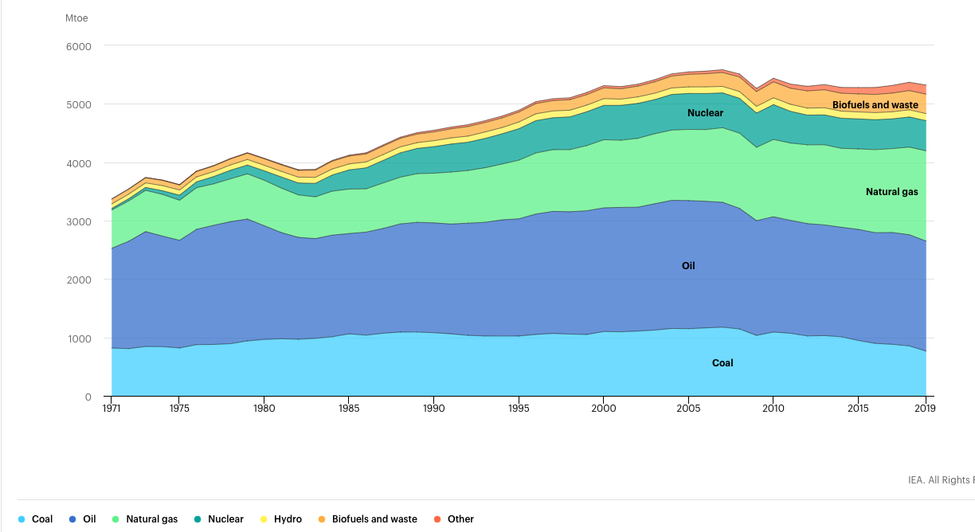
OECD primary energy by source: 1971 - 2019
Mtoe
IEA:
https://www.iea.org/reports/key-world-energy-statistics-2020

Slide 27
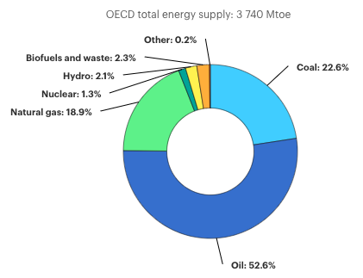
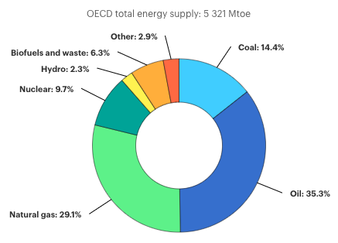
Change in OECD primary energy use: 1973 vs 2018
1973
2018
↑ 42.3%
IEA:
https://www.iea.org/reports/key-world-energy-statistics-2020
94.1% FF
78.8% FF

Slide 28
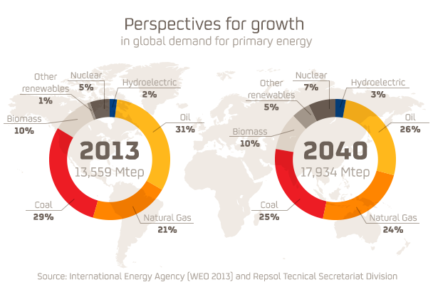
Predicted growth
1 quad
= 1 E15 Btu
= 1.06 E18 J
= 25.2 Mtep
Energy Systems and Sustainability, 2/e, Chapter 2 / repsol.com

Slide 29
Predicted growth
1 quad
= 1 E15 Btu
= 1.06 E18 J
= 25.2 Mtep
Questions:
How the heck do we decarbonize this?
Does decarbonization mean we have to use less energy?
Energy Systems and Sustainability, 2/e, Chapter 2 / repsol.com

Slide 30
The 14%
A small part of the world’s population uses most of its energy resources.
 | Population (global %) | Energy produced (%) | Energy consumed (%) | Primary energy consumption per capita** | GDP per capita**
Wealthiest* | 14% | 31% | 41% | 3.1 | 3.4
Others | 86% | 69% | 59% | 0.7 | 0.5
* USA, Canada, Western Europe, Australia, New Zealand, Japan
** As a multiple of the global average
Energy Systems and Sustainability, 2/e, Chapter 2 / Table 2.3

Slide 31
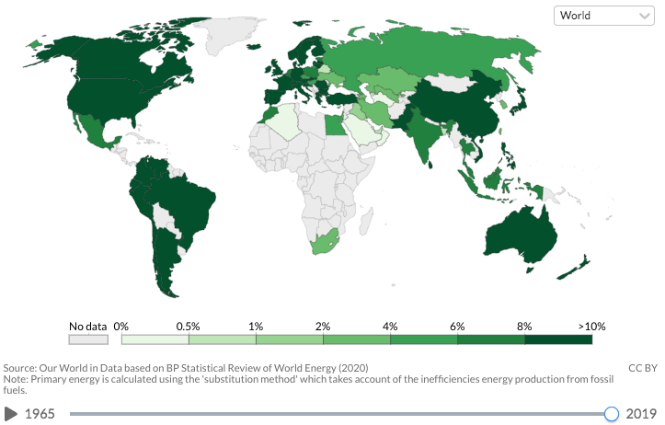
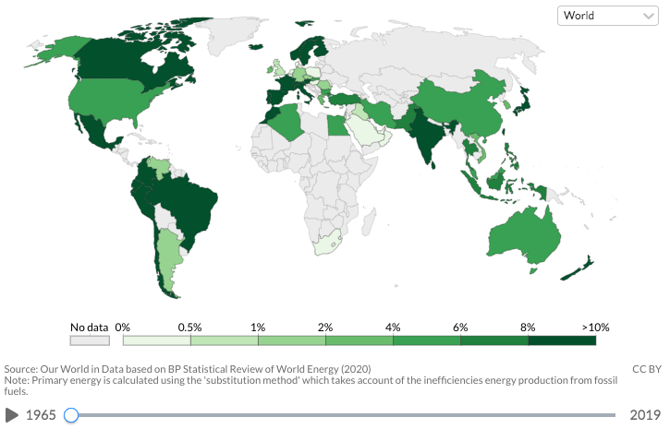
Share primary energy from renewables: 1965 - 2019
https://ourworldindata.org/grapher/per-capita-renewables?year=earliest

Slide 32
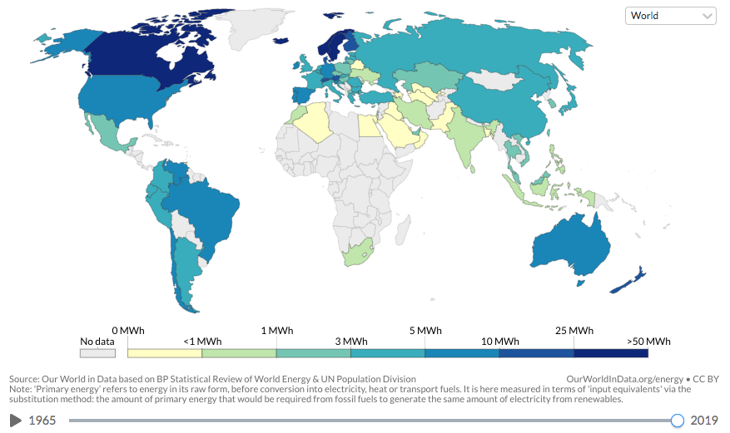
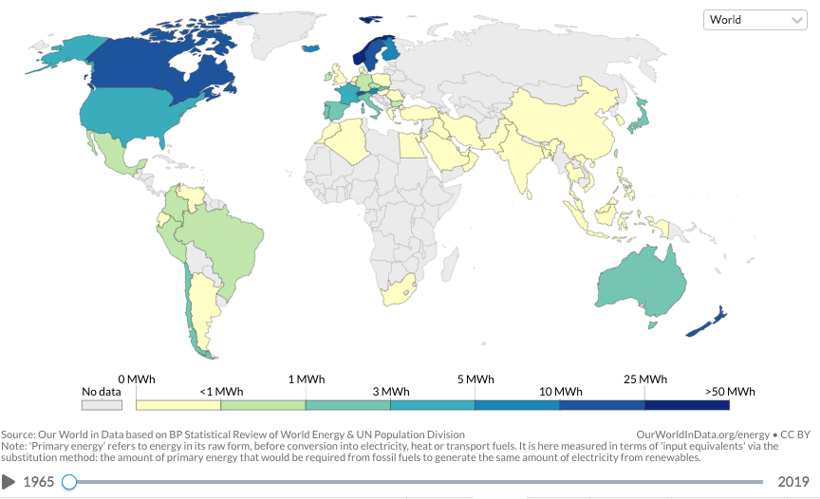
Global per capita renewable energy production
https://ourworldindata.org/grapher/per-capita-renewables?year=earliest

Slide 33
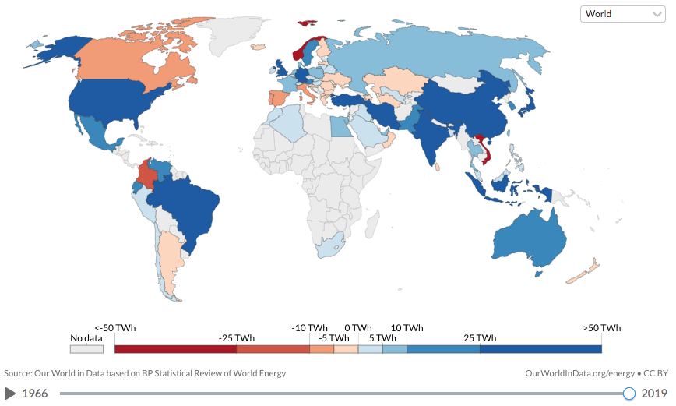
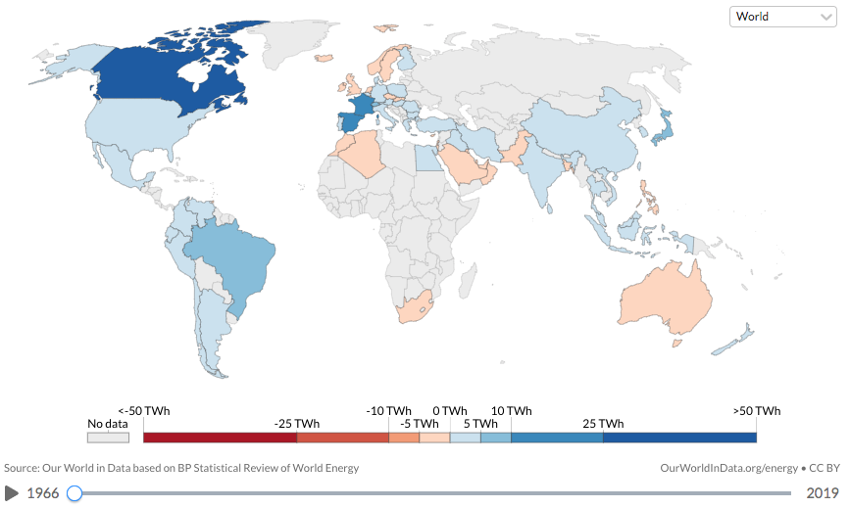
Global annual change in renewable energy production
https://ourworldindata.org/grapher/annual-change-renewables?year=earliest

Slide 34
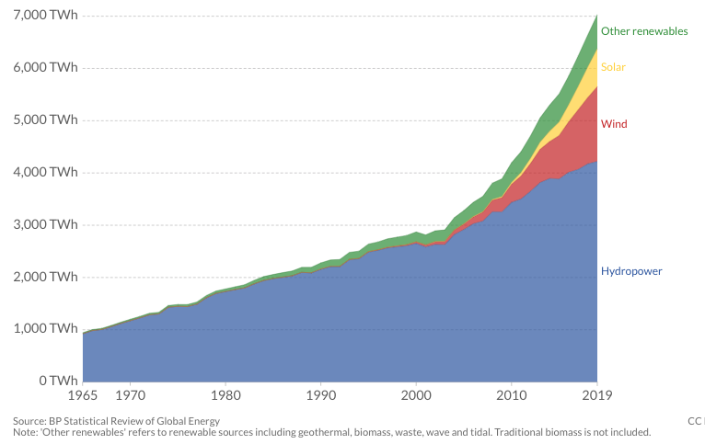
Renewable energy technologies: 1965 - 2019
total global production
https://ourworldindata.org/grapher/annual-change-renewables?year=earliest

Slide 35
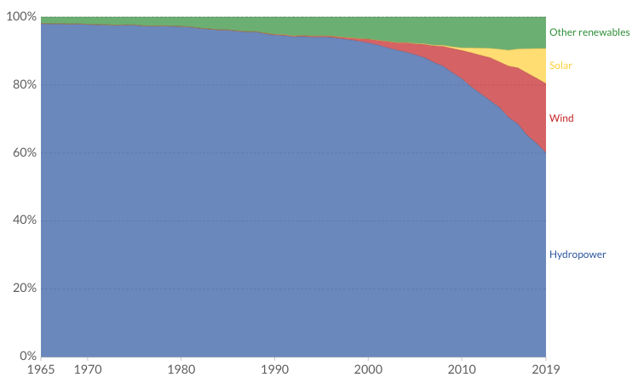
Renewable energy technologies: 1965 - 2019
https://ourworldindata.org/grapher/annual-change-renewables?year=earliest
relative percentages

Slide 36
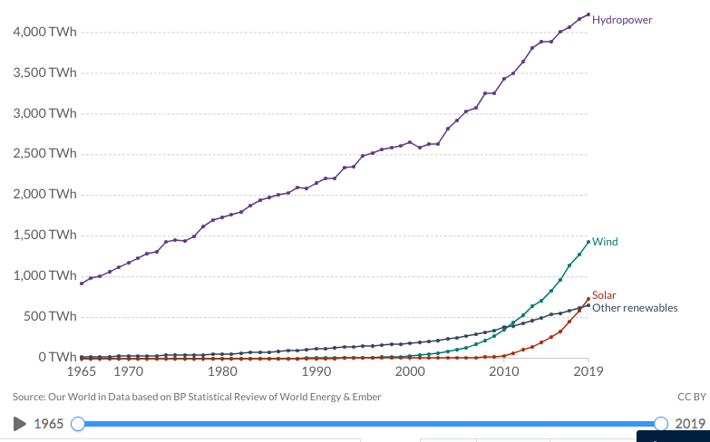
Renewable energy generation source: 1965 - 2019
https://ourworldindata.org/grapher/annual-change-renewables?year=earliest

Slide 37
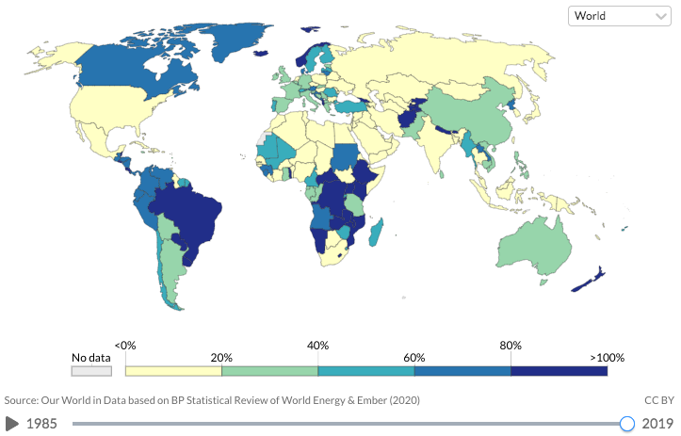
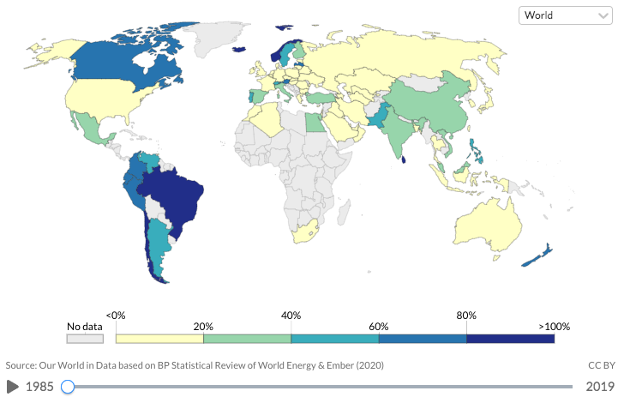
Share of electricity from renewables: 1985 - 2019
https://ourworldindata.org/grapher/annual-change-renewables?year=earliest

Slide 38
Module 3. Primary energy forms and uses
  3.5: UK energy use today

Slide 39
UK energy use 2009
UK total primary energy consumption in 2009: 9000 PJ (9000 E15 J)
UK population was 62 million in 2009
So, per capita energy use: 145 GJ per person
125.06 GJ/person (2013)
We’re about to dive into some data that demonstrates:
8840 PJ of energy is provided
6021 PJ of energy is delivered
There’s a discrepancy of 2819 PJ
  5% (141 PJ) is used for shipping
  95% is lost in conversion and delivery
  Electricity generation is only 35% efficient
Energy Systems and Sustainability, 2/e, Chapter 3

Slide 40
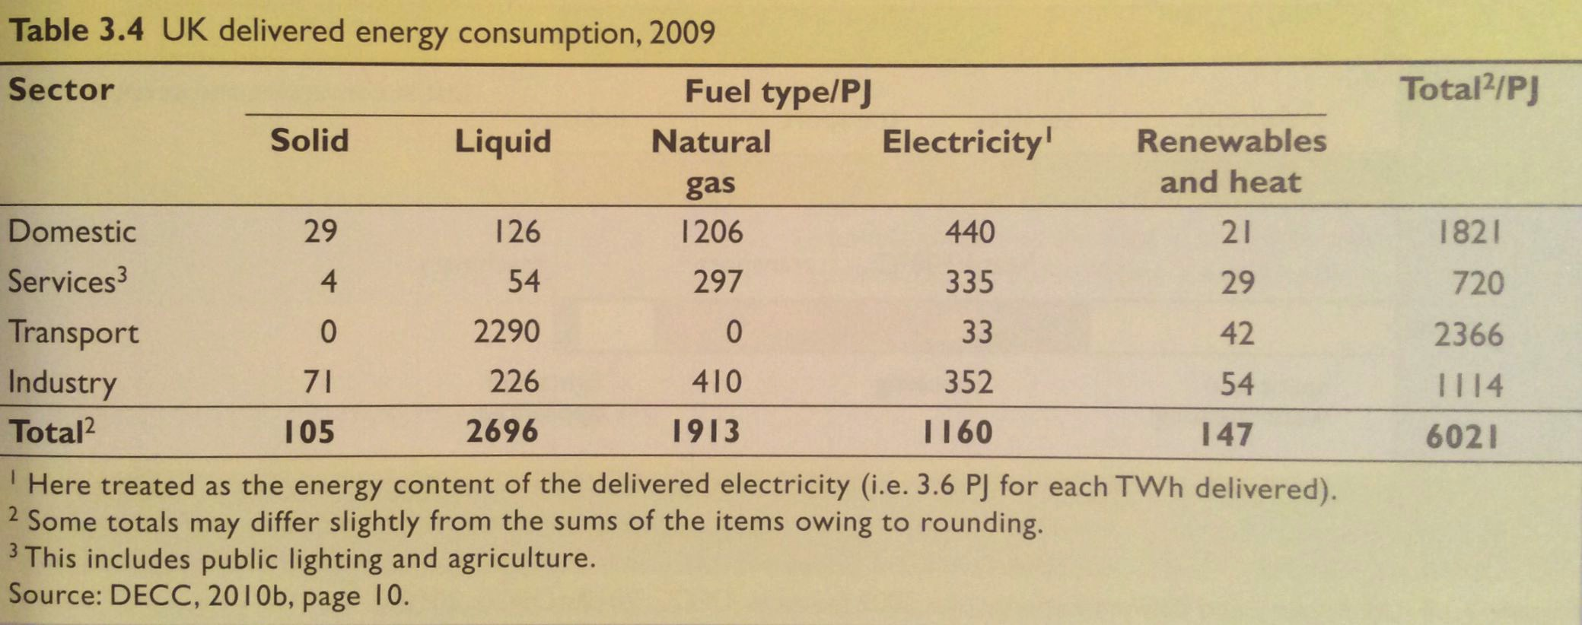
UK delivered energy consumption: 2009
Here we can look at the types and amounts of fuels used by each sector in the UK.
What stands out to you?
30.2%
11.9%
39.3%
18.5%
Energy Systems and Sustainability, 2/e, Chapter 3

Slide 41
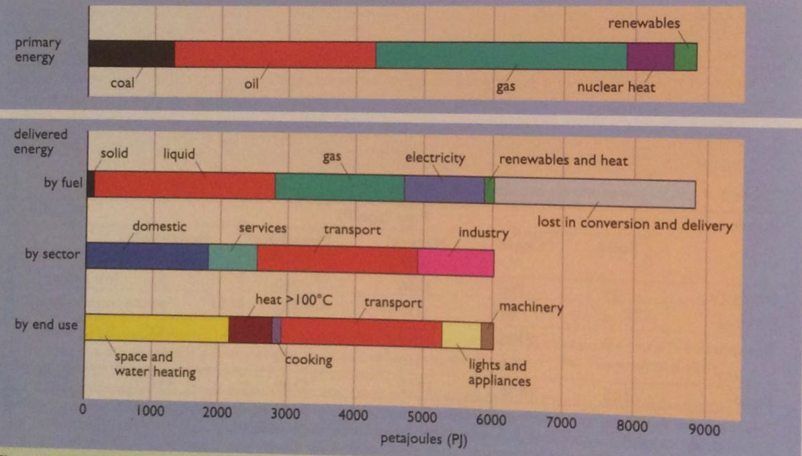
UK primary vs. delivered energy: 2009
~30% loss
Energy Systems and Sustainability, 2/e, Chapter 3

Slide 42
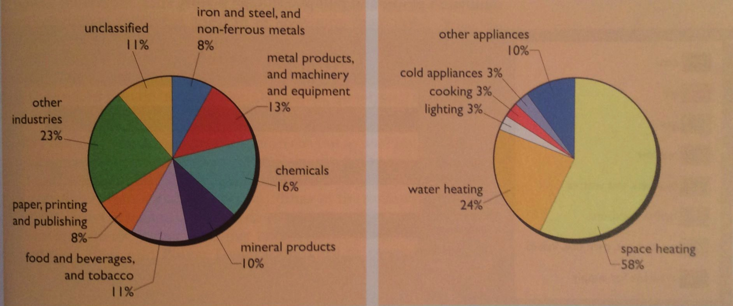
UK industrial vs. domestic use: 2009
UK industrial use
UK domestic use
Energy Systems and Sustainability, 2/e, Chapter 3

Slide 43
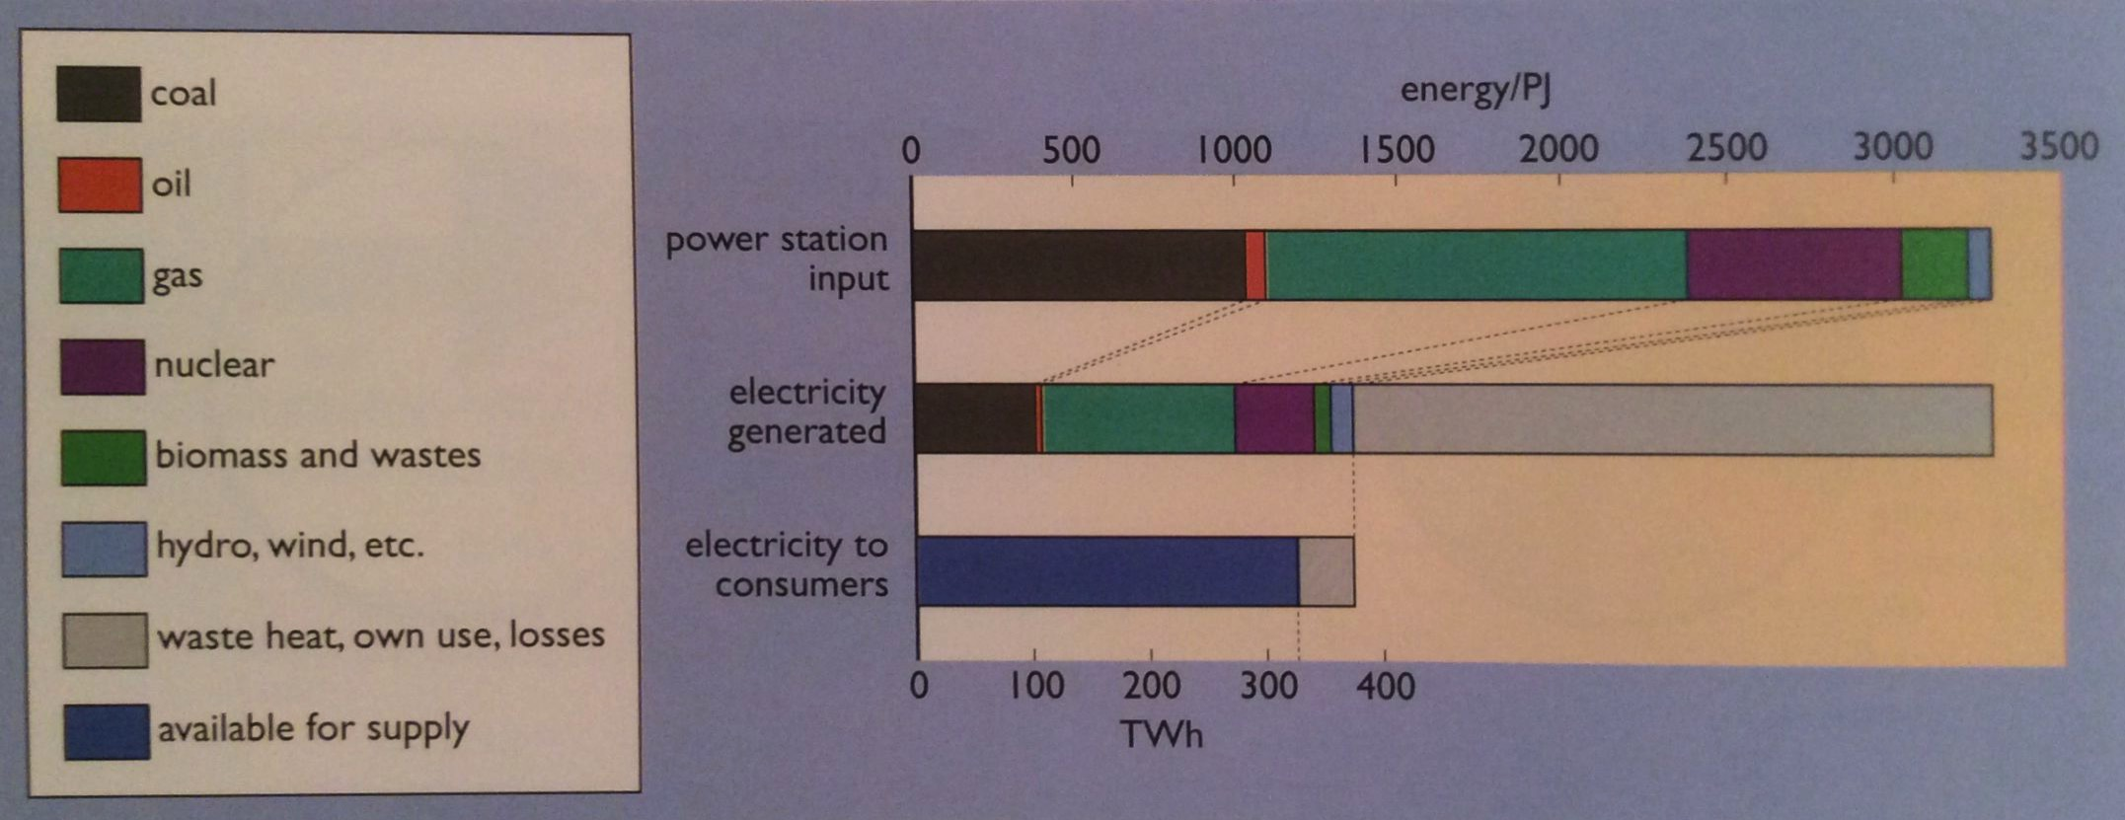
UK generation and distribution of electricity: 2009
~10% used; 90% wasted
Energy Systems and Sustainability, 2/e, Chapter 3

Slide 44
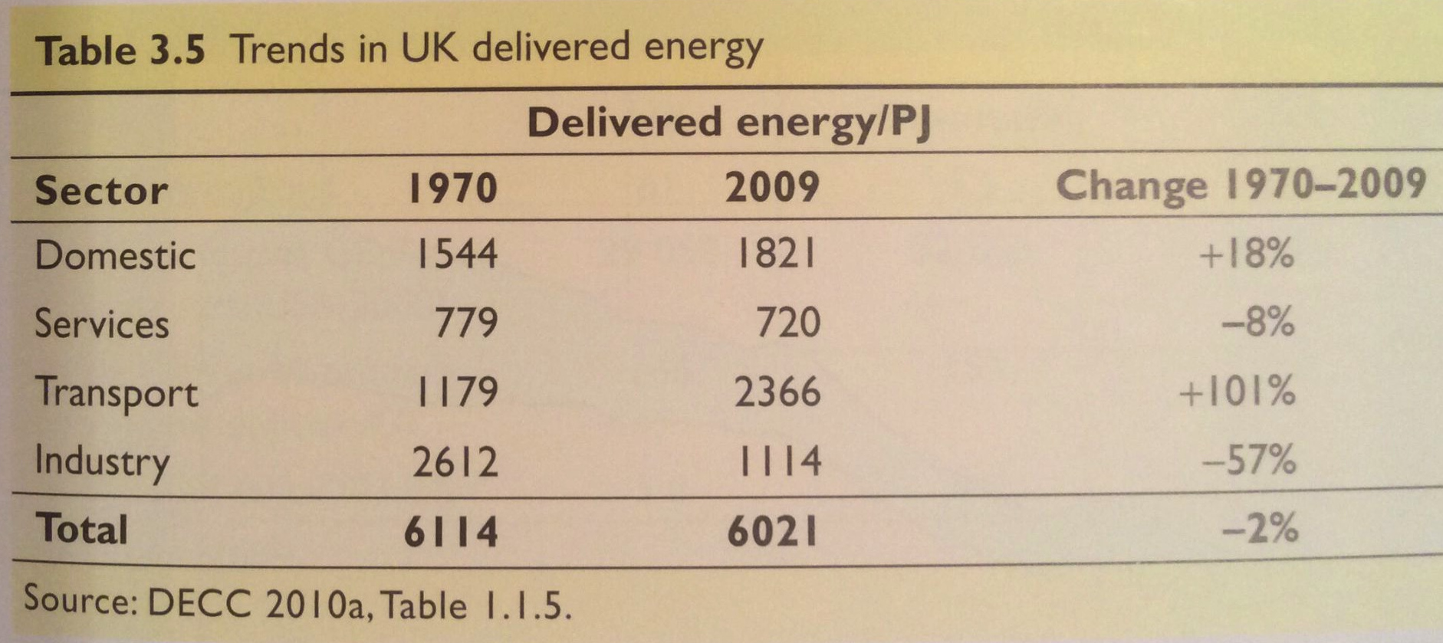
UK trends in energy use by sector: 2009
Energy use per capita has only increased by about 50% over the last 100 years.
  Industry has become more efficient.
  Transportation has doubled energy use; more autos.
Energy Systems and Sustainability, 2/e, Chapter 3

Slide 45
Module 3. Primary energy forms and uses
  3.6: Primary energy: UK vs. Denmark vs. US
  What’s self-sufficiency?
  UK
  Denmark
  US

Slide 46
Ideal primary energy profile? Self-sufficient, low-C
What should a country’s (or a region’s or planet’s) primary energy profile look like?
1. Self-sufficient: a good match between primary energy production and consumption.
Self-sufficiency (%) = primary energy production (100)
primary energy consumption
2. Low-carbon and low polluting
Does energy self-sufficiency guarantee energy security (trilemma)?
If not, what else needs to be considered?
3. Sustainable and local
Are there any negative effects of national energy security?
Energy Systems and Sustainability, 2/e, Chapter 2 / wikiwand.com / https://www.cfr.org/blog/does-net-energy-self-sufficiency-mean-anything

Slide 47
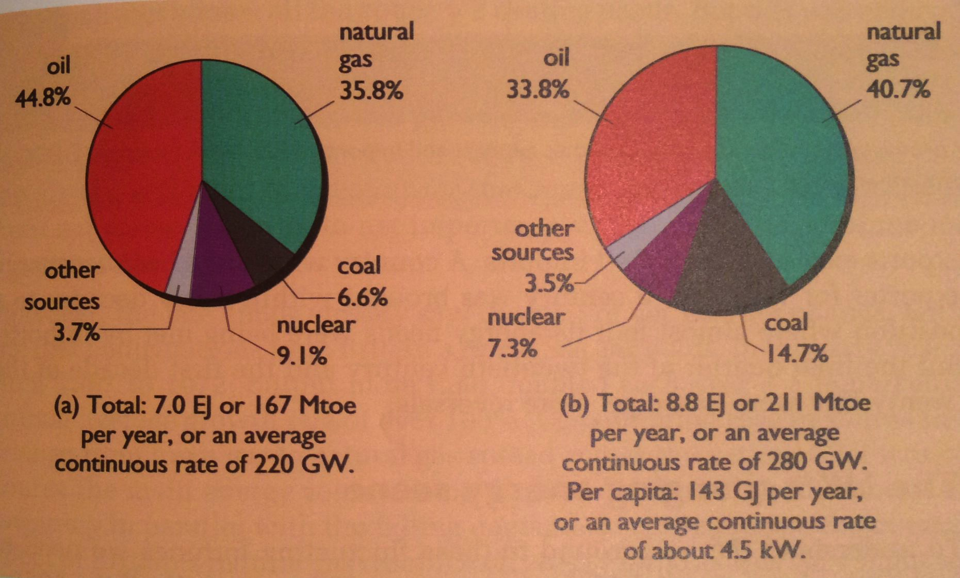
Primary energy in the UK: 2009
Production
Consumption
125 GJ/person
Compared to other industrialized countries: less biomass; little hydro.
When North Sea oil and gas was at its peak (1970-80s) UK was a net oil and NG exporter.
Now past peak and importing.
Still consuming residual coal reserves.
Energy Systems and Sustainability, 2/e, Chapter 2

Slide 48
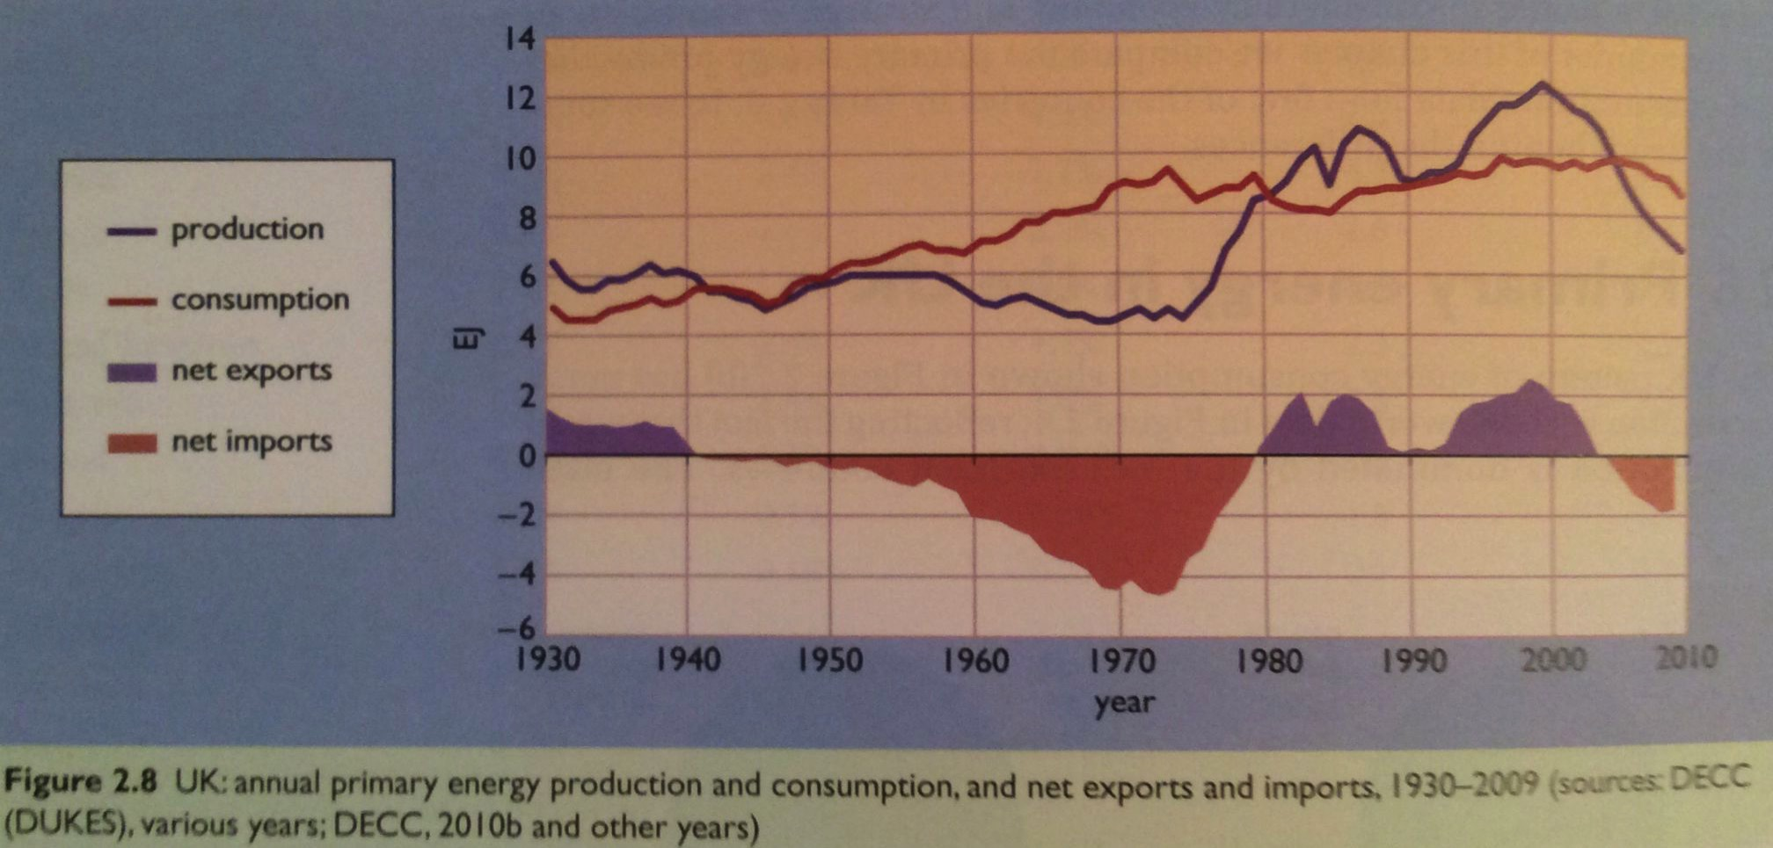
Changes in UK primary energy use: 1930 - 2010
This graph of UK primary energy production and use shows how UK production and consumption have determined whether the country is a net importer or exporter.
WWII
North Sea
oil and NG
depleted
Coal exports
Energy Systems and Sustainability, 2/e, Chapter 2

Slide 49
Influence of energy insecurity
The UK has been fuel-secure; first coal, then North Sea oil and gas.
However, prior to 1970, Denmark imported nearly all its fuel: 95% oil.
When oil prices soared in the 1970s and 1980s Demark was forced to act and make changes:
  Extreme energy conservation;
  Power stations switched from oil to coal;
  Expansion of use of CHP (combined use of heat & power);
  Favored district heat over individual heating systems;
  Requirements for insulation and building standards; and
  More renewable energy, particularly wind and biomass.
waste heat
Results? (2007)
Energy use in Denmark has been stable since 1980.
District heat was used in 60% of homes and made up 12% of delivered energy.
CHP kept waste down to 22% vs. 32% in the UK.
Renewable energy rose to 14%.
Still dependent on oil, particularly for transportation.
Energy Systems and Sustainability, 2/e, Chapter 3

Slide 50
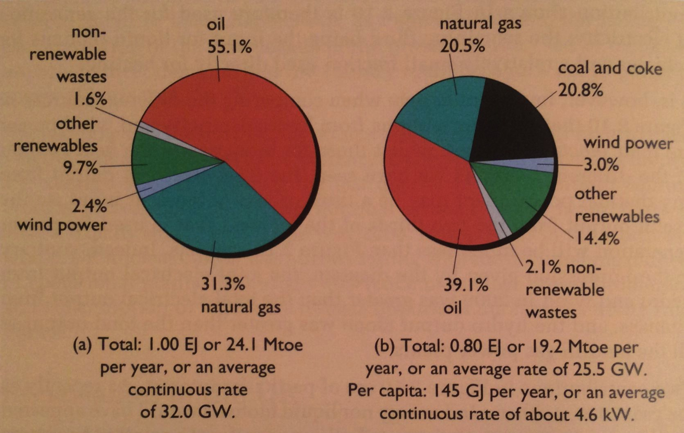
Primary energy in Denmark: 2009
Production
Consumption
Like UK, ff dominate use and production.
Per capita energy use is very similar the UK & Denmark.
Unlike the UK, Denmark was self-sufficient in 2009.
Denmark had very little native ff energy resources.
  Denmark has halved oil consumption since 1970.
130 GJ/person
Energy Systems and Sustainability, 2/e, Chapter 2

Slide 51
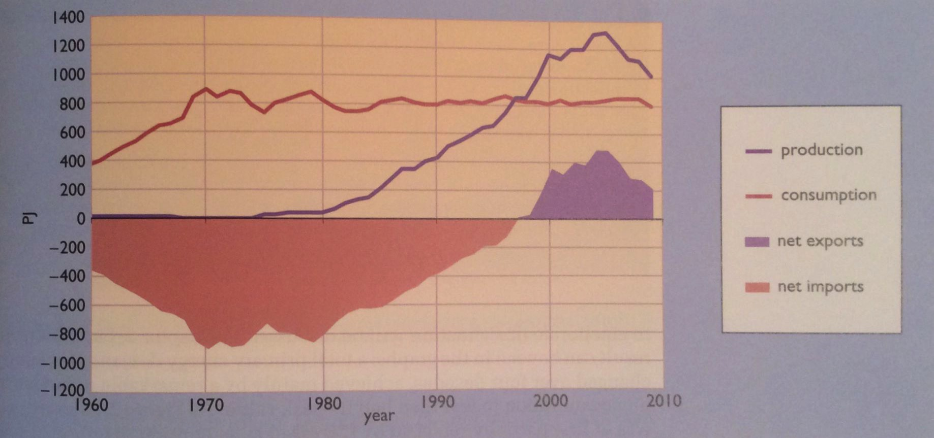
Changes in Denmark’s primary energy: 1960 - 2010
Denmark had little coal, and when they got North Sea oil and NG they made it last.
To Denmark, it’s obvious that the future is RE and conservation.
Notice that consumption has remained flat even while production has risen.
RE = 14% of production
= 20% of consumption
North Sea
oil and NG
Demark relied on imported
ff energy until ….
Energy Systems and Sustainability, 2/e, Chapter 2

Slide 52
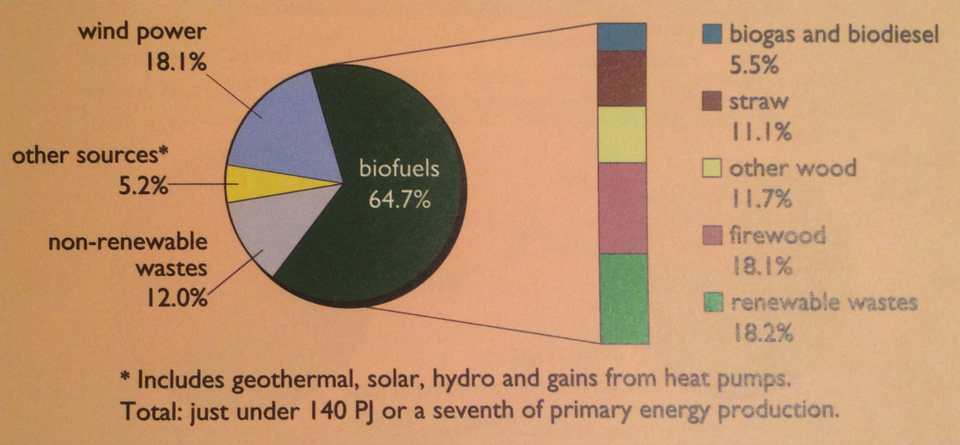
RE in Denmark
By 2008, Denmark had made much greater use of renewable energy than the UK.
Use of heat pumps for space heating has contributed to conservation of fossil fuels and electricity.
Energy Systems and Sustainability, 2/e, Chapter 2

Slide 53
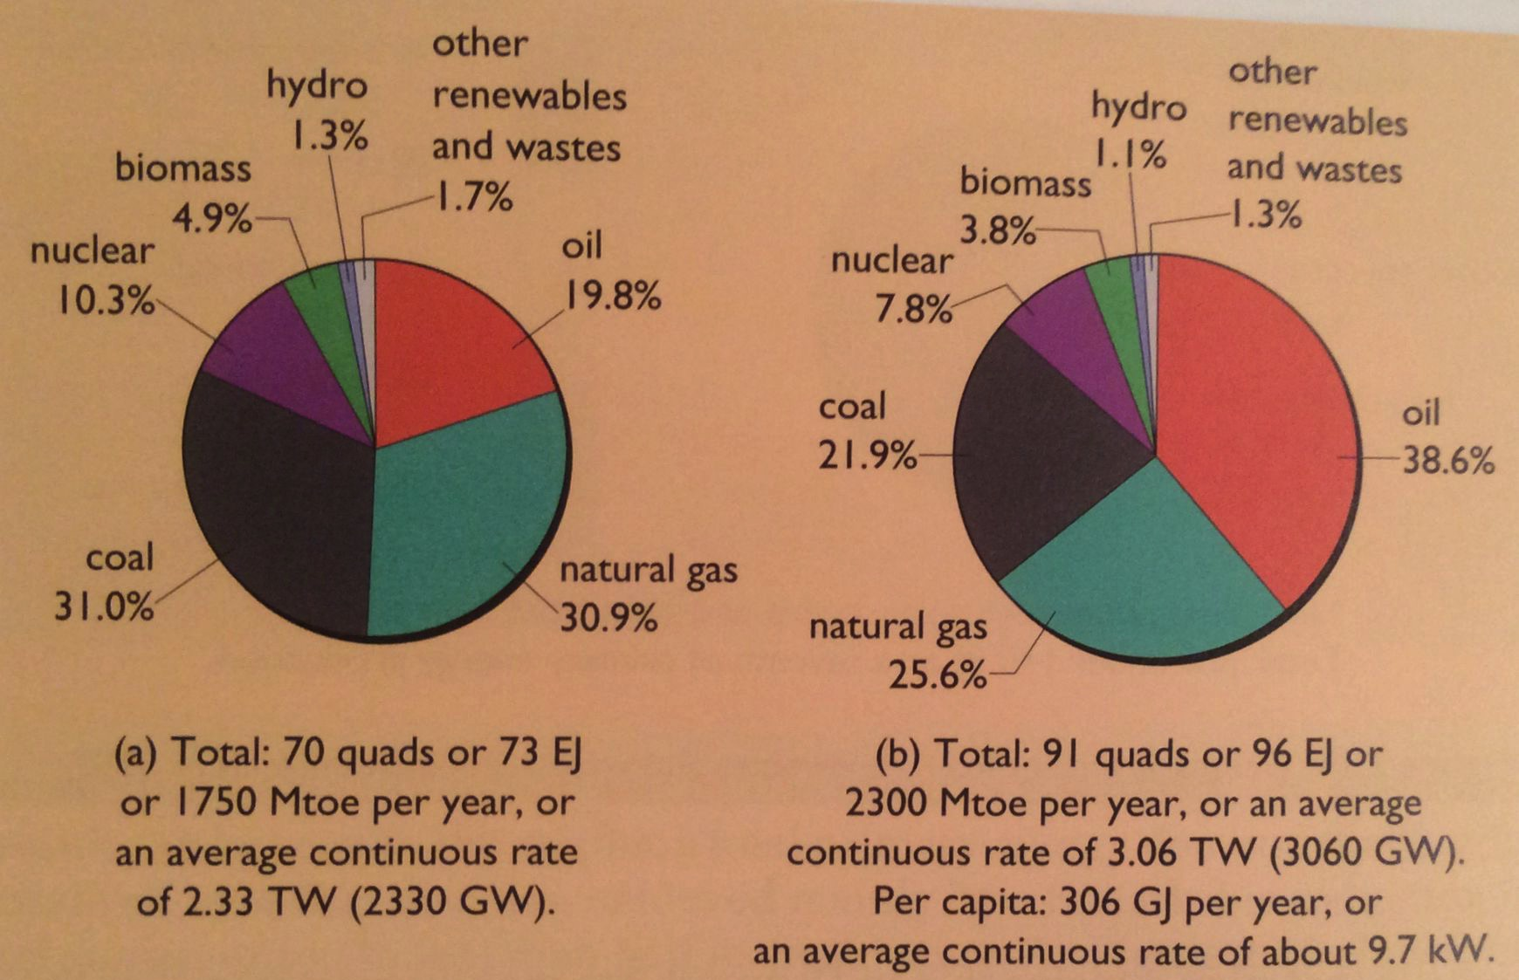
Primary energy in the US: 2009
Production
Consumption
Note that the US prefers oil to NG and coal.
The US is a net exporter of coal, mainly to Europe, though coal mining and exporting are falling.
The US is also a net exporter of NG (gas by pipeline, liquid by tanker) to Canada, Mexico, Argentina, Barbados, Brazil, Chile, China, India, Japan, Portugal, Taiwan & the UAE.
Self sufficiency was 61% in 2013; nearing self-sufficiency in 2020.
291 GJ/person
Energy Systems and Sustainability, 2/e, Chapter 2

Slide 54
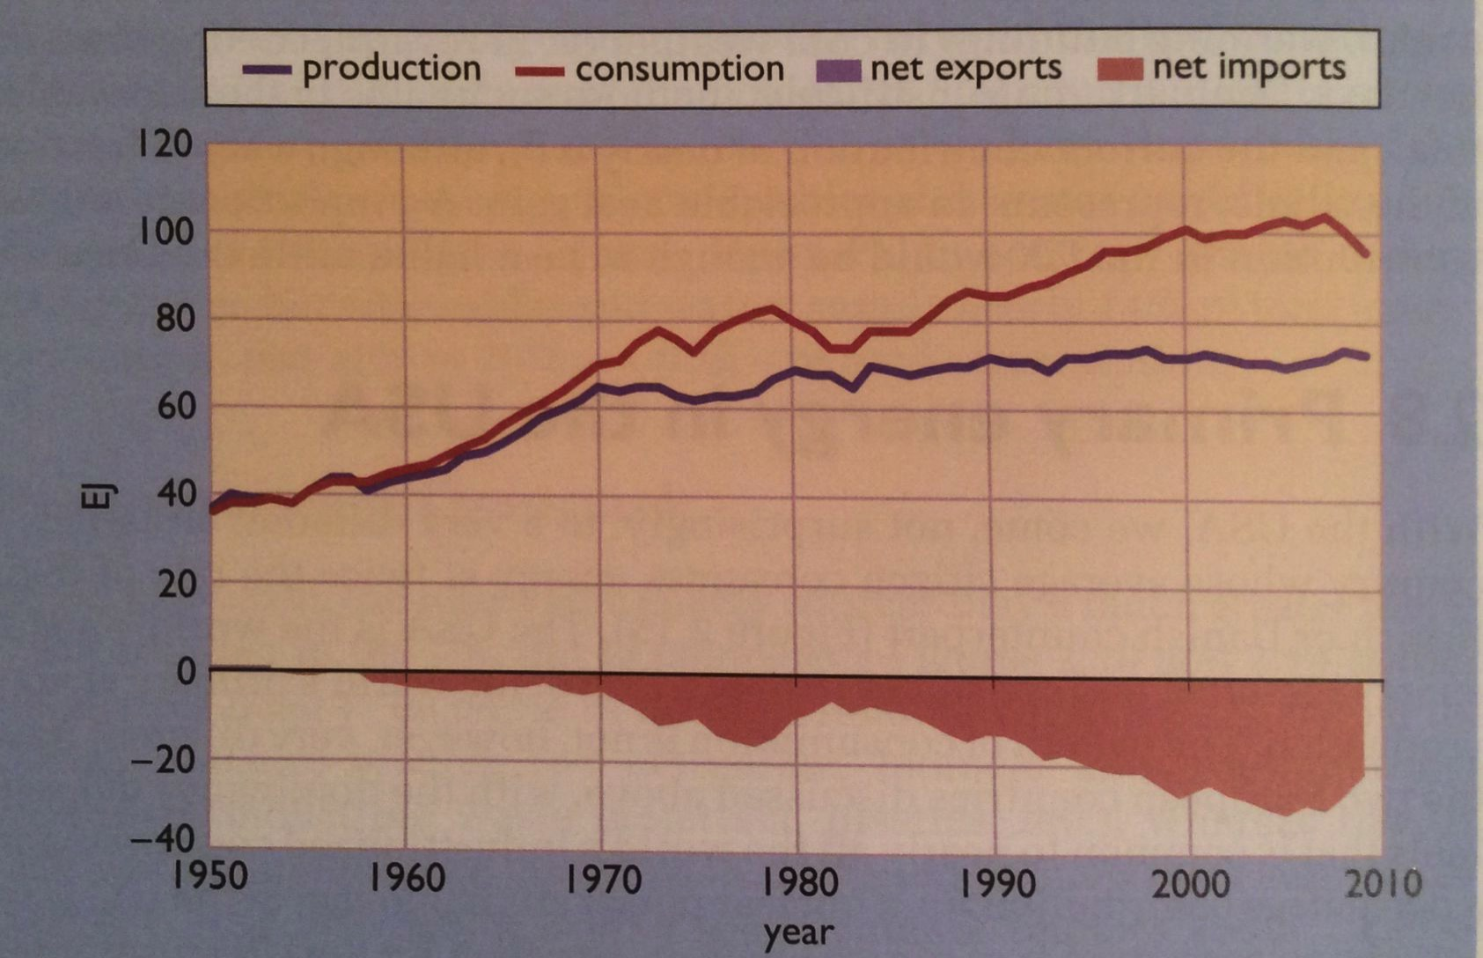
Changes in US primary energy use
US consumption has continued to rise.
Recently (not shown here) fracking has increased exports.
US has been a net energy importer since 1950.
Energy Systems and Sustainability, 2/e, Chapter 2

Slide 55
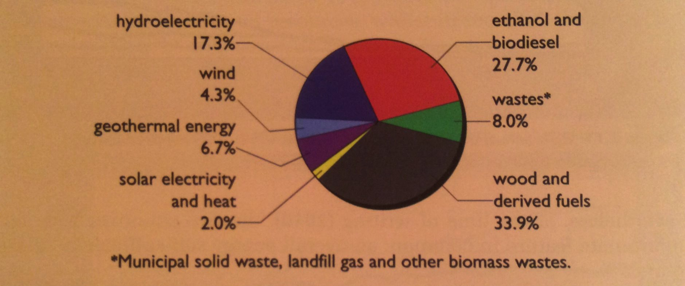
RE in the US: 2009
By 2009, the US produce about 8% of energy with renewable resources.
Ethanol use is a result of government subsidies and the farm lobby.
2019: RE up to 11% in the US
Energy Systems and Sustainability, 2/e, Chapter 2

Slide 56
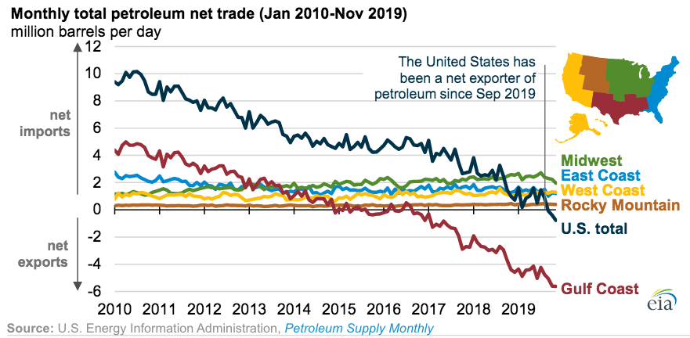
US is now a net petroleum exporter, but…

Slide 57
Recent energy use in the US
https://www.eia.gov/energyexplained/?page=us_energy_home
Energy Systems and Sustainability, 2/e, Chapter 1

Slide 58
Comparing the UK, Denmark and US
Fossil fuel use is similar across the board.
Consumption much higher in the US.
  Denmark produces and uses more renewable energy.
 | fossil fuels (% primary consumption) | per capita use (GJ/year) | self-sufficiency (%) | RE electricity (% produc.) | RE (% consump.)
UK | 89.2 | 125 | 70 | 33.0 | 3.5
Denmark | 80.4 | 130 | 81 | 60.5 | 19.5
US | 86.1 | 290 | 97 | 14.7 | 6.2
% = primary energy supply (100)
primary energy production
blue: 2013, 2018 updates
Energy Systems and Sustainability, 2/e, Chapter 2; http://energyatlas.iea.org/#!/tellmap/-297203538/ ; Wikipedia

Slide 59
Module 3. Primary energy forms and uses
  3.7: Primary energy: France vs. India vs. China
  France
  India
  China
  Global future forecast?

Slide 60
US and France (1970 – 2008)
US: Per capita energy use is high.
Energy use rose across all energy sectors, averaging 40% increase.
Service sector saw the largest increase.
50% 30% of electricity is generated with coal.
  Coal-fired plants increased three-fold.
  Electricity losses (27 EJ) are larger than total production in the UK.
waste heat
France: Per capita energy use is also high.
Energy use rose across all energy sectors:
  By 75% to 2005, then decreased slightly.
75% of electricity is generated with nuclear power.
France uses less NG than UK or US.
Energy Systems and Sustainability, 2/e, Chapter 3

Slide 61
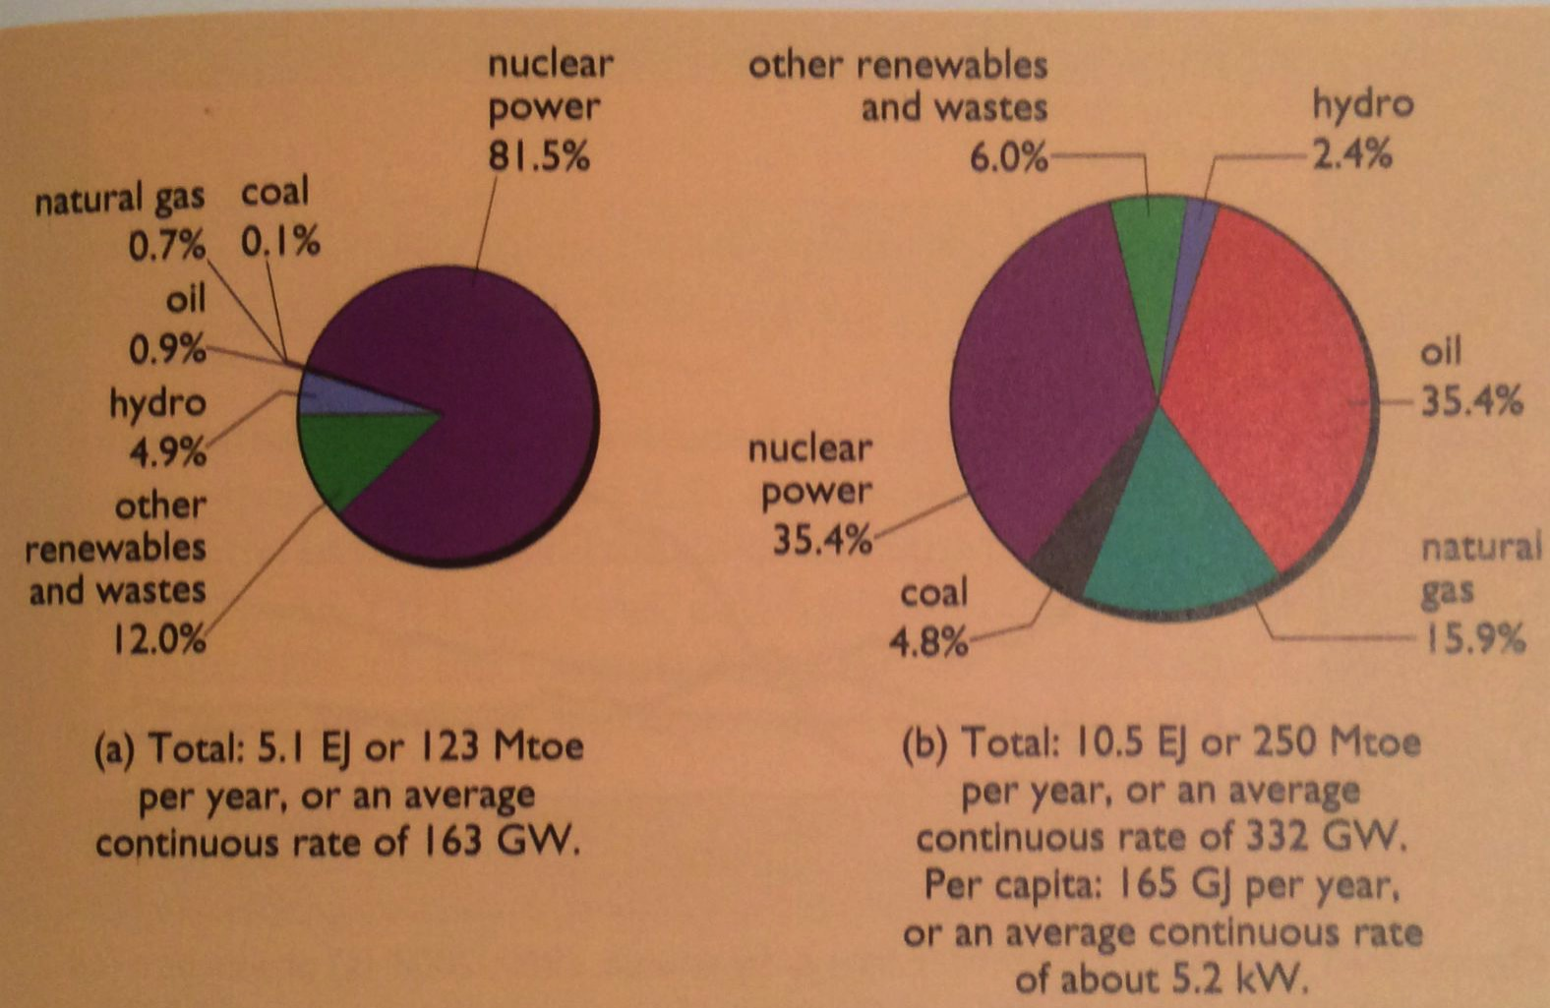
Primary energy in France
Production
Consumption
With few fossil fuel resources France has become the world leader in producing nuclear energy.
  In fact, a 2014 report suggested that France would deplete its fossil fuel resources within one year.
Since nuclear energy can’t be used for transportation and heating, causing France to import large amounts of oil and NG.
161 GJ/person
Energy Systems and Sustainability, 2/e, Chapter 2

Slide 62
India
India: Overall, per capital energy use is very low, but rising.
Population is massive.
25% live in cities where energy use is higher and growing quickly.
While 95% of the population has access to electricity, supply can be unreliable, particularly in rural areas.
Coal is used for electricity
  Efficiency is a low 28%
  25% of all electric production is lost.
Agriculture uses 25% of all electricity; mainly for irrigation; diesel pumps are also used.
  35% of electricity is produced renewably.
About 32% of primary energy is biofuel / biomass.
National programs push electrification and use of LNG vs. biomass.
waste heat
Energy Systems and Sustainability, 2/e, Chapter 3

Slide 63
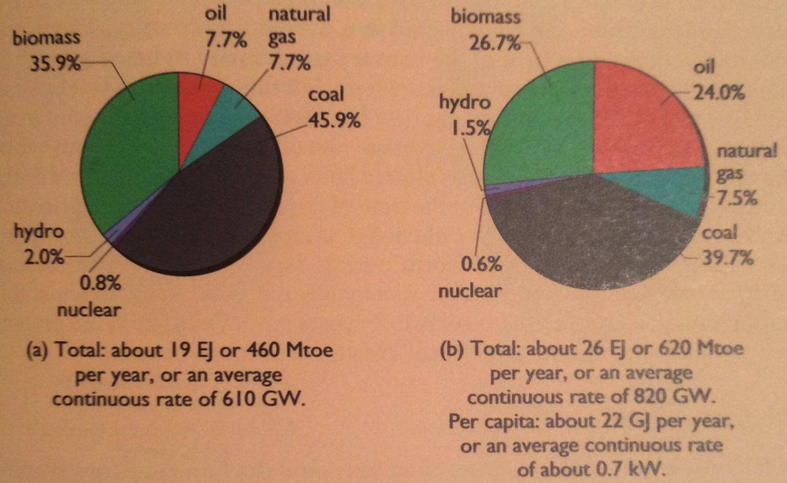
Primary energy in India
Production
Consumption
2nd largest population; 4th largest consumer of energy.
Dependent on native biomass and coal.
India has large reserves of coal, but quality is so low that they import better coal.
25.5 GJ/person
Energy Systems and Sustainability, 2/e, Chapter 2

Slide 64
China
China: Energy use low but rising.
Population is massive: rose to 1.3 billion by 2006, 80% live in cities.
In 2005, biomass still made up 20% of primary energy, and 50% of domestic fuel.
From 1980 – 2006, primary energy use increased three-fold, and GDP increased 10-fold.
From 1952 – 1978, energy / GDP ratio tripled, then fell with efficiency.
Industrial energy use is massive and rose 4-fold from 1980 – 2006. 80% of all new energy use is industrial. Industry consumes 70% of all electricity, most generated from coal. (100 years of coal are left.)
  In 2006, China produced many global goods: 50% of cement & glass; 35% of steel; 28% of aluminum.
Agriculture uses 3.5% of all electricity, mainly pumping deep wells.
Transportation is up from 0.8 to 5 EJ, nearly all petroleum.
Up to 35% of electricity is renewable, but electricity use is so huge and so growing that coal is still a dominant force.
waste heat
Energy Systems and Sustainability, 2/e, Chapter 3

Slide 65
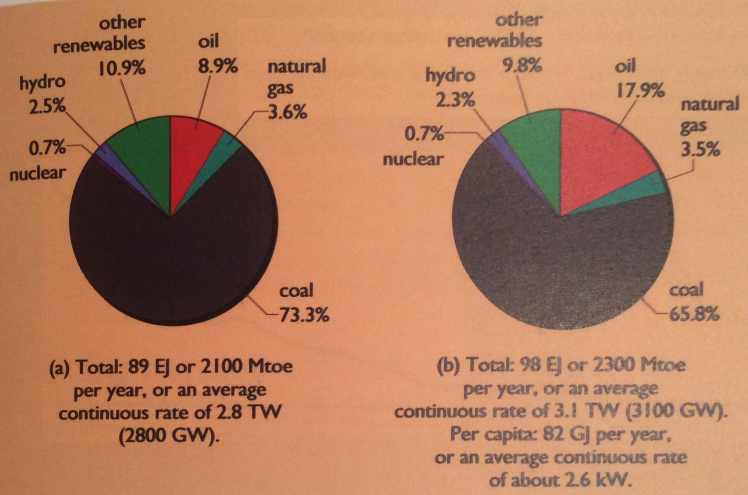
Primary energy in China
Production
Consumption
China’s rapid industrialization and development during the 20th century is driving increased coal production.
Coal is our largest remaining fossil fuel reserve.
And reserves are found in Asia.
Recently, China has massively deployed RE.
93.5 GJ/person
Energy Systems and Sustainability, 2/e, Chapter 2

Slide 66
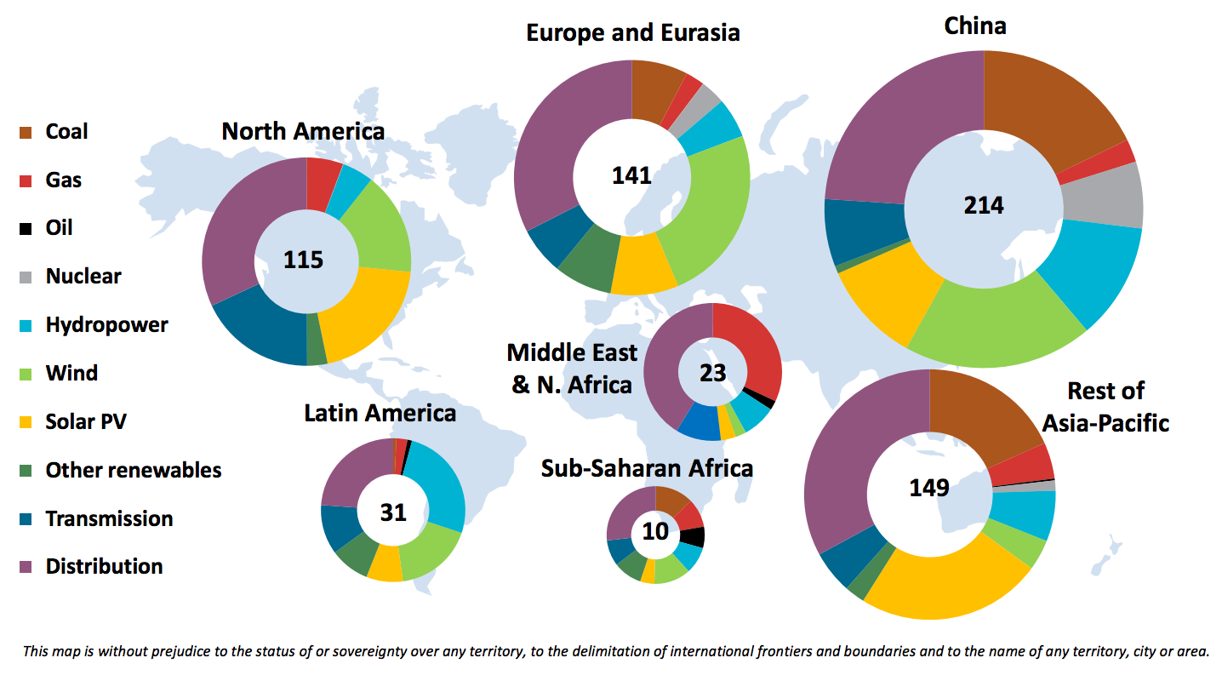
How is this changing?
Investment in electric generation and networks for 2015 (IEA data).
http://www.eco-business.com/news/seven-charts-show-new-renewables-outpacing-rising-demand-for-first-time/

Slide 67
Module 3. Primary energy forms and uses
  3.8: Trends in US energy use
  Some increases in use and in efficiency
  Gains in efficiency lost to increased use for electronics
  Heating may be returning to electricity
  Manufacturing has become more efficient
  Transportation is a huge FF user

Slide 68
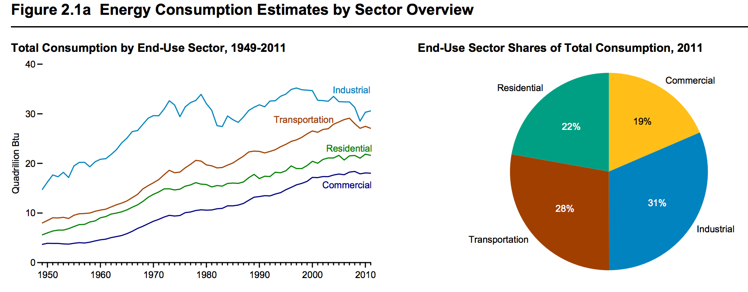
Growth of consumption by sector
Not surprisingly, energy use most sectors has increased since WWII.
Why does industrial use seem to be leveling off more than other uses?
What was going on with industrial use in the late 1970s, early 1980s?
waste heat
https://www.eia.gov/totalenergy/data/annual/pdf/sec2.pdf

Slide 69
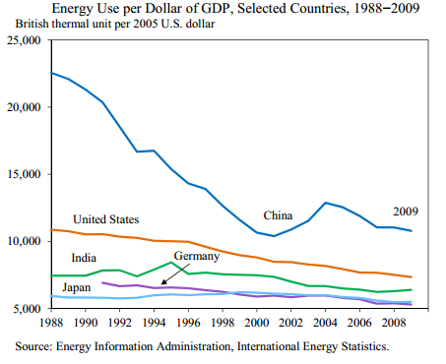
But efficiency evolves as well
Energy use / $GDP is a measure of a nation’s energy efficiency or of the nature of the nation’s economy.
By the 1990s, the US was manufacturing less than China, but increasing energy costs and scarcity were causing the Chinese economy to become more efficient.
EIA

Slide 70
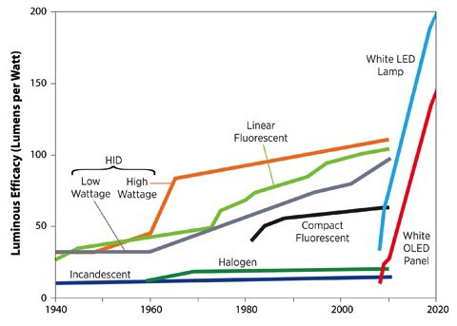
Evolution of lighting technologies
Lighting technology continues to become more energy efficient.
http://www.led-evolution.com/Technology/benefits-of-LED.html

Slide 71
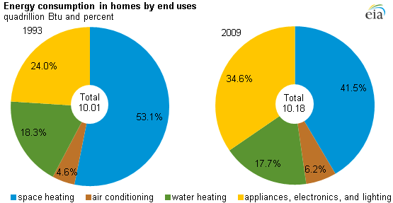
Domestic energy use
Energy use in homes hasn’t changed dramatically, but use has shifted.
Efficiency has increased, lowering energy use for heating and cooling.
But energy use for ‘electronics’ has increased.
11.9 in 2018
https://www.eia.gov/todayinenergy/detail.php?id=10271

Slide 72
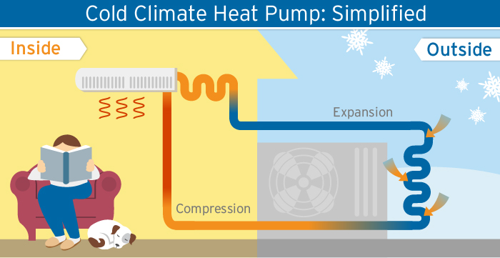
Heating fuels have also changed
Heating fuels have changed… and changed back!
wood → coal → oil → electricity → natural gas → (RE) electricity
antiquity
1900 -
1970s
1920 -
2000s
1700 - 1900
Efficiency Vermont

Slide 73

Manufacturing energy use down
https://www.eia.gov/consumption/manufacturing/

Slide 74

Manufacturing output, not so clearly
EIA: https://www.eia.gov/consumption/manufacturing/reports/2014/pre_estimates/

Slide 75

Transportation in the US
In the US, transportation is dominated by the private auto.
http://news.thomasnet.com/imt/2012/03/12/the-damage-done-gas-addiction-edition-how-detrimental-is-petrol

Slide 76

Commercial services
Note that heating and lighting account for 2/3 of all energy use.
Energy Systems and Sustainability, 2/e, Chapter 3; EIA

Slide 77
Summary: GJ/capital for 2003 vs 2013
2003
2013
Wikipedia data

Slide 78
Module 3. Primary energy forms and uses
  3.9: Vermont energy statistics
  RE accounts for ~25% of primary energy
  Most electricity supply is RE
  Transportation and heating are FF dependent
  Energy production and consumption are low
  Energy costs are high
  Vermont‘s Comprehensive Energy Plan is agressive

Slide 79
Vermont primary energy use (2015)
24.8% RE
71.4%
fossil fuels
EIA State Energy Profiles & Estimates

Slide 80
Vermont primary energy use (2015)
193,000 MWh
EIA State Energy Profiles and Estimates

Slide 81

Production
https://www.eia.gov/state/?sid=VT

Slide 82

VT energy quick facts from the EIA
https://www.eia.gov/state/?sid=VT

Slide 83

VT consumption by source - EIA
https://www.eia.gov/state/?sid=VT

Slide 84

VT consumption by sector - EIA
https://www.eia.gov/state/?sid=VT

Slide 85

VT energy production - EIA
https://www.eia.gov/state/?sid=VT

Slide 86

VT electricity production - EIA
https://www.eia.gov/state/?sid=VT

Slide 87

VT energy prices - EIA
https://www.eia.gov/state/?sid=VT

Slide 88
Vermont’s incentives for renewable energy
Vermont offered America’s first feed-in-tariff that awarded installers of renewable energy with a 20-year, fixed-price contract for production of renewable electricity.
The long contract with a guaranteed price allowed RE developers to know they would payback the cost of the system and then accrue profits.
  A ten-year payback would allow at least 10 years of profit.
  Certainty!
In the years 2011 through 2016, Vermont installed 59.2 megawatts of commercial-scale solar photovoltaic capacity, 26.8 megawatts in 2016 alone.
Developers were also allowed to sell RECs (renewable energy credits) to other states allowing those buyers to claim that they had also developed RE and were producing green energy.
  ‘Double dipping’ controversy; greenwashing
In response, Vermont has enacted the nation's first integrated renewable energy standard (RES), which makes utilities responsible both for supplying renewable electricity and for supporting reductions in customers' fossil fuel use.
EIA State Energy Profiles and Estimates

Slide 89
Vermont energy stats (2015)
 | value | US ranking
population | 600,000
labor force | 300,000
GDP | $31.1 billion | 51
average temperature | 44.7 F | 43
average rainfall | 39.1 inches | 24
per capita income | $50,321 | 20
total energy consumption |  | 50
energy consumption per capita | 211 million Btu/year | 44
energy cost per capita | $4,273 | 9
energy production |  | 47
electricity production |  | 50
RE production | 204,000 MWh
RE consumption | 24.9% of all energy consumption | 8
electricity costs |  | 8
energy intensity | 8,1000 Btu/$ GDP
total carbon emissions | 6 million metric tonnes CO₂ | 50
EIA State Energy Profiles and Estimates

Slide 90

Vermont Comprehensive Energy Planning
http://www.vtenergydashboard.org/90-by-2050/detail/2016-comprehensive-energy-plan

Slide 91
Module 3. Primary energy forms and uses
  3.10: Effect of COVID-19 on global energy; parallels
  Can we learn from our experience to multiple global crises? Or will we just deny and flail?
  Giving an edge to low-carbon resources?

Slide 92
Implications of the effects of COVID-19?
“The Covid‑19 crisis is also influencing the path for clean energy transitions. Global CO₂ emissions are set for the largest year-to-year reduction on record, but a sustainable energy pathway calls for continuous efforts and commitment. The unprecedented decline in emissions in 2020 may only be temporary without structural changes. Recoveries from past crises have caused immediate rebounds in CO₂ emissions, including the highest year-on-year increase on record in 2010.”
“Governments will play a major role in shaping the energy sector’s recovery from the Covid‑19 crisis, just as they have long been in the driving seat in orienting energy investment. In particular, the design of economic stimulus packages presents a major opportunity for governments to link economic recovery efforts with clean energy transitions – and steer the energy system onto a more sustainable path. While the clean energy transitions and stimulus discussions are gathering momentum, a co-ordinated policy effort will be needed to harvest its opportunities and lead to a more modern, cleaner and more resilient energy sector for all.”
https://www.iea.org/reports/global-energy-review-2020/implications#abstract

Slide 93

Effects of COVID on energy statistics through Q1 2020
https://www.iea.org/reports/global-energy-review-2020

