Slide 1

SSC 2030: Energy Systems and Sustainability
Module 8: Bioenergy
8.1: Introduction to bioenergy
8.2: Use of bioenergy
8.3: Comparing fossil fuels and bioenergy
8.4: Bioenergy feedstock materials (resources)
8.5: Biomass – solid fuel for combustion, cordwood
8.6: Biomass – solid fuel for combustion, wood chips
8.7: Biomass – solid fuel for combustion, pellets
8.8: Liquid biofuels, bioethanol
8.9: Liquid biofuels, biodiesel
8.10: Biogas from anaerobic digestion
8.11: Carbon neutrality?

Slide 2
Module 8: Biomass
8.1: Introduction to bioenergy

Slide 3
What is bioenergy?
Bioenergy:
Renewable* energy produced from living (or recently living) biological material called biomass ¹
Useful renewable energy produced from organic matter – the conversion of complex carbohydrates in organic matter to energy ²
Energy from biofuels ³
*Renewable if the amount of biomass used is less than the amount of biomass that can be regrown.
1: Dahiya (2015)
2: U.S. DOE’s Oak Ridge National Laboratory’s (ORNL) Bioenergy Feedstock Network
3: Food & Agriculture Organization of the United Nations (FAO)

Slide 4
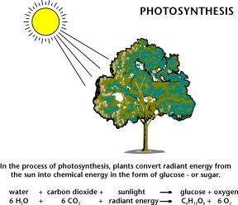
Sun power via photosynthesis
Bioenergy technologies are
sun-powered.
The energy of sunlight is used to build
carbon-based biomolecules from units of CO₂.
Carbon sequestration
Combustion / oxidation of fuels breaks those
biomolecules down into CO₂, releasing bond energy.
Carbon cycling
The National Energy Education Project (Public Domain)

Slide 5
Brief history of bioenergy
Bioenergy is an ancient technology.
Was fire man’s first tool?
For centuries man lived with his animals; the original central heating.
Man has burned just about anything as fuel: wood, fiber, dried manure.
10th century BC: the Assyrians harnessed biogas for heating water
1908: Henry Ford’s model T was supposed to be fueled with ethanol
Ethanol has been used throughout the 20th century. But use ramped up in 1970s.
Nov 1975: Brazil created it’ National Alcohol Program using sugarcane
Late 1970s: US moved towards creating 10/90 ethanol/gasoline blend
1992 Clean Energy Act
2007 Energy Independence and Security Act
The EU, China and India are also increasing production and use of biofuels
Rosillo-Calle & Johnson (2010)

Slide 6
Paths to bioenergy
Biomass:
An energy source derived from organic matter, excluding fossil fuels
Generally refers to solid bioenergy
Biodiesel:
Renewable liquid fuel derived from vegetable oils or animal fats by transesterification; fatty acid esters
Biofuels (and biogas):
Biomass converted to (solid), liquid or gaseous fuels like ethanol, methanol, methane and hydrogen
Mechanical means: using simple mechanical processing;
Sometimes densifying biomass
Chemistry: using simple organic chemistry to
transform biomass into biofuel
Biomimicry: using (microbial) biology to convert (digest)
biomass to biofuel
Dahiya (2015)

Slide 7
Bioenergy process overview
thermal
conversion
thermochemical conversion
chemical conversion
biochemical conversions
lignocellulose
lignocellulose
fats oils grease
lignocellulose
landfill waste
biowaste
sugars
starches
(crops)
densification
torrefaction
fermentation
gasification
combustion
trans-esterification
anaerobic
digestion
pyrolysis
charcoal
methanol
syngas
bio-oil
power
heat
steam
biogas or
biomethane
bio-coal
biodiesel
ethanol
BIOEN1

Slide 8
‘Generational’ categories
First generation biofuels:
Derived from oils, sugars and starches in food crops:
Corn ethanol, soy biodiesel, etc,.,
Second generation biofuels:
Derived from food crop waste and crop residues; leftovers:
Biodiesel from waste oil; and
Biogas from organic wastes.
Third generation biofuels:
Produced from algae, perennial grass and fast-growing trees:
  Energy crops; and
  Algae for oil-based fuels.
Dahiya (2015)

Slide 9
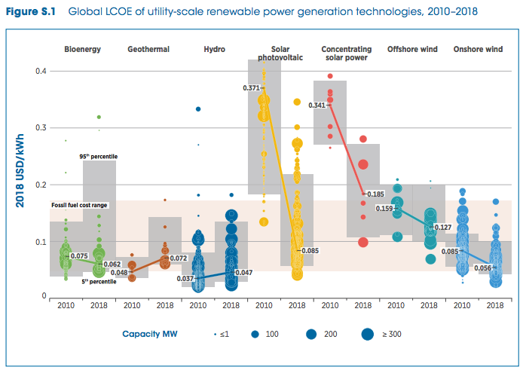
Bioenergy LCOE (2010 - 2018)
fossil fuel range
https://www.irena.org/-/media/Files/IRENA/Agency/Publication/2019/May/IRENA_Renewable-Power-Generations-Costs-in-2018.pdf

Slide 10
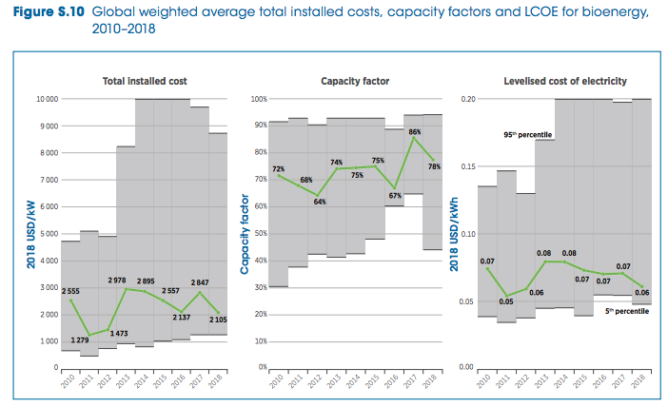
Bioenergy LCOE (2010 - 2018)
fossil fuel range
https://www.irena.org/-/media/Files/IRENA/Agency/Publication/2019/May/IRENA_Renewable-Power-Generations-Costs-in-2018.pdf

Slide 11
Biggest concerns about bioenergy?
Can we produce enough bioenergy to make a dent in fossil fuels?
Does bioenergy need a new infrastructure?
43 days
Is / can bioenergy carbon-neutral? Carbon-negative?
What is the environmental cost or impact of bioenergy?
Local vs. global: environmental justice
The food vs. fuels debate?
What is the cost of bioenergy?
What is the best uses of bioenergy?

Slide 12
Module 8: Biomass
8.2: Use of bioenergy

Slide 13
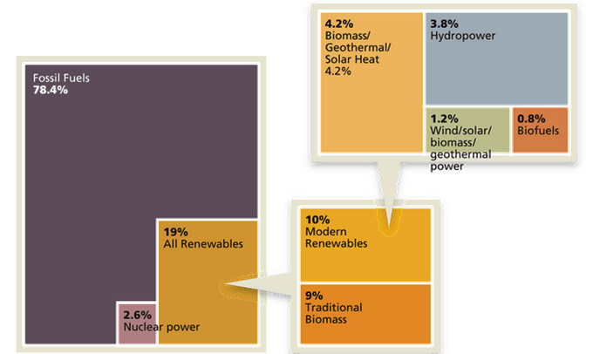
Current global energy use
Estimated RE Share of Global
Final Energy Consumption
http://www.renewableenergyworld.com/articles/2015/02/outlook-for-bioenergy-2015-whats-in-store-for-this-
versatile-renewable-energy-feedstock.html

Slide 14
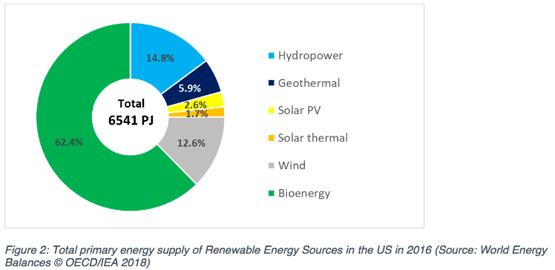
Most primary RE is bioenergy
Bioenergy overall only increased from 3.0 to 4.5% from 2005 to 2013 with little change since then.
https://www.ieabioenergy.com/wp-content/uploads/2018/10/CountryReport2018_UnitedStates_final.pdf

Slide 15
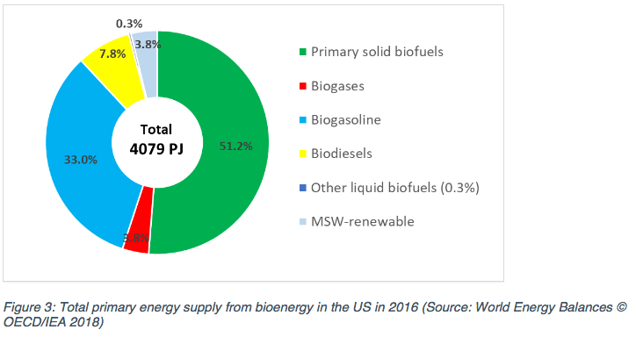
Primary bioenergy is ½ biomass
https://www.ieabioenergy.com/wp-content/uploads/2018/10/CountryReport2018_UnitedStates_final.pdf

Slide 16
Breakdown of biomass use in US
In 2010, US biomass use looked like this:
46% was wood or wood-derived
43% was biofuel, mainly ethanol
11% was derived from municipal waste
BIOEN1
EIA @www.eia.doe.gov and www.repp.org/bioenergy/link6.htm;
www.extension.org/pages/Biomass_Feedstocks_and_Energy_Independence

Slide 17
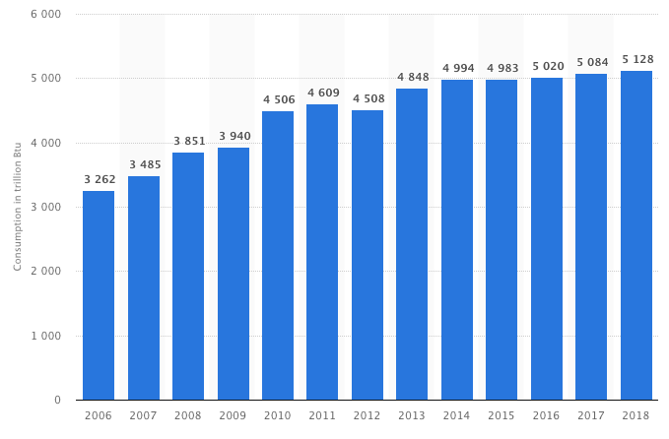
US biomass energy use static
From 2000 to 2018, electricity produced from biomass hasn’t increased.
https://www.statista.com/statistics/183429/biopower-generation-by-source-in-the-united-states-from-2000/

Slide 18
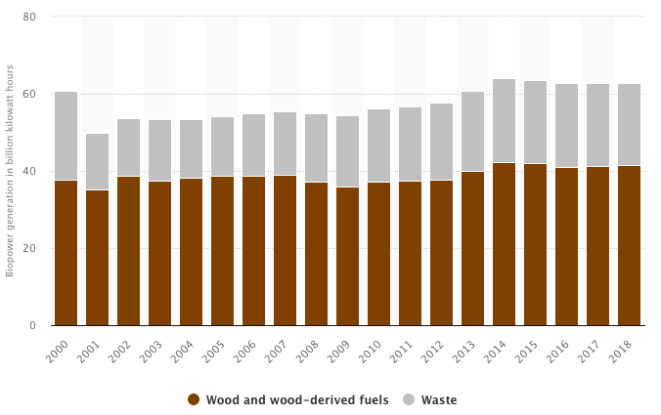
Biopower is static in the US
From 2000 to 2018, electricity produced from biomass hasn’t increased.
https://www.statista.com/statistics/183429/biopower-generation-by-source-in-the-united-states-from-2000/

Slide 19
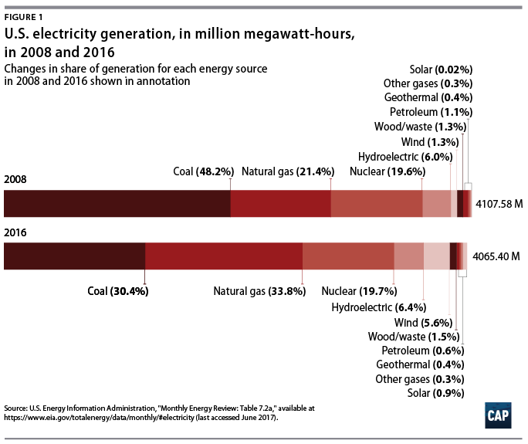
Obama administration?
Under the Obama administration, renewable energy and NG made great gains.
Biomass gains were modest:
Renewable Fuel Standard (RFS)
Biomass Crop Assistance program
Biofuels Working Group
https://www.americanprogress.org/issues/green/reports/2017/06/29/435281/americas-clean-energy-success-numbers/
https://en.wikipedia.org/wiki/Energy_policy_of_the_Barack_Obama_administration

Slide 20
Trump administration?
August 2019: exemptions from requirement to add bioethanol to 31/40 small refineries.
“Iowa’s Republican Senator Chuck Grassley said the EPA had “screwed” the U.S. ethanol industry and farmers by granting the waivers.” - Reuters
December 2018: reauthorization of the Farm Bill, including Rural Energy for American Program (REAP) and Biomass Crop Assistance Program
- Established Interagency Biogas Opportunities Task Force
- But didn’t fund several of these programs as suggested
“The Trump administration endorsed burning trees and other biomass to produce energy on Thursday, vowing to promote a practice some scientists have declared more environmentally devastating than coal-fired power. – Bloomberg News
April 2018: replaced Clean Power Plan, Affordable Clean Energy Rule
- Allows co-gen (addition of biomass to coal) to ‘reduce emissions’
http://biomassmagazine.com/articles/15838/trump-signs-2018-farm-bill

Slide 21
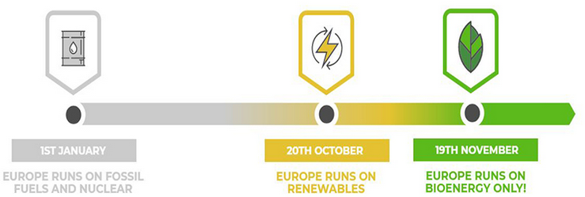
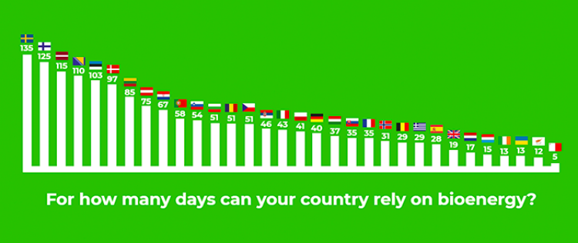
EU-28: annual days of bioenergy
43 days
https://bioenergyinternational.com/opinion-commentary/poland-celebrates-national-bioenergy-day-2018
https://bioenergyinternational.com/markets-finance/biomass-can-heat-cool-power-and-transport-eu-28-for-43-days
U.S.

Slide 22
Module 8: Biomass
8.3: Comparing fossil fuels and bioenergy

Slide 23
Bioenergy vs. fossil fuels
Generally, bioenergy is seen as less advanced or less efficient than fossil fuels.
 | bioenergy | fossil fuels
pro | renewable may be carbon neutral widely available (energy security) | energy dense supported by current energy infrastructure
con | lower energy density may compete with food production not supported by our current energy infrastructure (less universal) require a variety of processing methods can have substantial environmental impacts: loss of habitat. | finite supply increase atmospheric carbon the limited number of producers causes global inequity and leads to global tension and conflict accidental releases during extraction and transportation can have substantial environmental impacts fracking can degrade the quality of groundwater

Slide 24
Relative energy densities
Energy density is an expression of the energy content of a type of fuel per volume.
fuel | GJ/metric tonne
natural gas | 55
oil | 42
coal | 28
biogas | ~33
charcoal | 30
wood, dried | 15 - 18
paper | 17
bagasse | 17
MSW, commercial | 16
manure, dried | 16
straw | 15
MSW, residential | 9
wood, green | 6
grass, fresh | 4
fossil fuel
Fossil fuels convenience and widespread use can be attributed to their high energy densities and to the universal availability of fossil fuel-based energy infrastructure.
bioenergy
bio-wastes
Boyle (2004) RE

Slide 25
Energy balance (EREOI) values
EREOI values aren’t easy to come by, but here are a few examples.
fossil fuel | EREOI
coal | 80
nuclear | 10 - 75
oil | 20 - 35
natural gas | 10
tar sands | 3
renewable fuel | EREOI
hydropower | 100
geothermal | 10 - 32
solar, thermal conc. | 19
wind | 18
PV | 6.8
biogas | 2
biodiesel | 1.3 – 6
bioethanol | 1 – 1.3
3 - 9
Rosillo-Calle & Johnson (2010)

Slide 26
Infrastructure compatibility?
The US, and most countries, has a well-developed infrastructure for fossil fuels.
Developing new and unique infrastructures is expensive and inefficient if each new energy technology requires its own specialized infrastructure.
Can bioenergy use existing energy infrastructure?
Wood and burned biomass?
Liquid biofuels?
Gaseous biofuels?

Slide 27
Module 8: Biomass
8.4: Bioenergy feedstock materials

Slide 28
Feedstock and supply chain
Bioenergy feedstock: biomass-derived material that can be converted to energy using microbes, heat, chemicals or some combination thereof
Some amount of conversion (aka ‘refining’) is usually required to turn feedstock into use-ready biofuel.
Processing (refining) often involves densification (or aggregation) to make transport of feedstock easier and cheaper.
biomass
biofuel
energy for use
processing
refining
use
(often combustion)
supply chain / value chain
trees
cordwood, chips, pellets
heat, CHP, electricity
soybean
plants
oil, biodiesel
heat, transportation fuel
Dahiya (2015)

Slide 29
Types of feedstock materials
woody
non-woody
lignocellulose
sugar
starch
cellulose/
lignocellulose
fats
Dahiya (2015)

Slide 30
Feedstock sources
forests
agriculture
waste
whole-tree
chips
short-rotation woody crops
sawmill residues
perennial lignocellulosic crops
construction wastes
bole chips
municipal wastes
bark chips
lignocellulosic residues
oil / fat waste
sugars / starches
landfill gas
oils
municipal solid waste
Dahiya (2015)

Slide 31
Biomass supply chain
source
biomass
processing
use / market
forests
tops and branches
small-diameter pulpwood
small understory trees
bark
power
heat
steam
biofuels
chemicals
annual crop residues
perennial energy crops
hybrid willow / poplar
densification
agriculture
all crop starches / sugar
construction materials
sawmill residue
cardboard & paper
waste
manure
food processing waste
food waste
BIOEN1

Slide 32
Biomass feedstock availability
The 2005 report, ‘Biomass as Feedstock for a Bioenergy and Bioproducts Industry: the Technical Feasibility of a Billion-Ton Annual Supply’ prepared by DOE and USDA made these conclusions:
We have enough biomass to replace 30% of US petroleum use by 2030.
Biomass harvests could be increased from 2005’s 473 million to 1.1 billion dry tons annually with modest changes to land management practices.
2011 update decreased estimates of forest and crop residue resources but increased the potential of energy crops.
Because biomass feedstock materials are not energy dense, transportation to processing plants affects the cost of feedstock and profitability of growing bioenergy feedstock.
Willingness to grow bioenergy crops may be limited by distance from processing plants.
Bioenergy Primer 1; BIOEN1

Slide 33
Module 8: Biomass
8.5: Biomass – solid fuel for combustion
cordwood

Slide 34
Wood fuel comparisons
How do values for wood stack up?
Less processing allows greater EROEI values.
fuel | price | thermal efficiency | $/Mbtu* | EROEI
cord wood | $200-300/cord | 50 - 60% | $15.15 | 50:1
wood chips | $80/ton | 30% |  | 18:1
wood pellets | $260/ton | 80 - 85% | $15.15 | 15:1
co-op wood pellets | $120/ton | 80 - 85% | $9.09 | 15:1
* $/million Btu
Other studies find higher whole-tree wood chip EROEI values of ~27:1
Vermont sustainable heating initiative (2012)
Residential wood heat: a non-commercial service in support of responsible home heating with wood (2016)

Slide 35
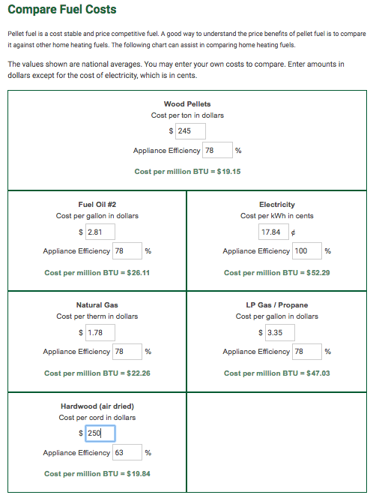
Cost calculators
A number of websites provide comparison tools.
This screenshot uses approximate Vermont costs in September of 2019.
https://www.pelletheat.org/compare-fuel-costs

Slide 36
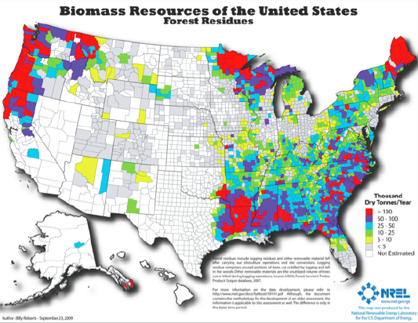
Forest-based feedstock sources
BIOEN1

Slide 37
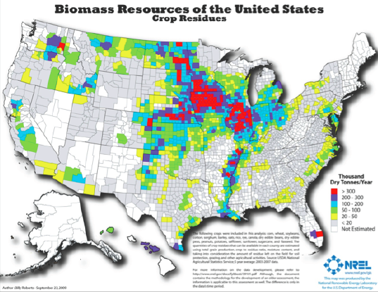
Agricultural residue sources
BIOEN1

Slide 38
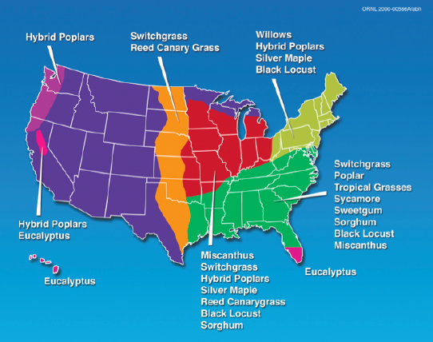
Agricultural perennial crops
BIOEN1

Slide 39
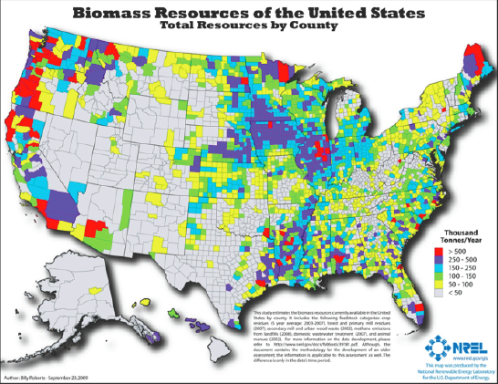
Total biomass sources
BIOEN1

Slide 40
Burned biomass technologies are similar
Wood (or other solid biomass) is combusted to produce heat and / or electricity.
Heat: combustion is used to produce:
  hot air
  hot water
  steam
80ish% efficient
Electricity: combustion is used to produce:
  steam which is used to turn turbines and produce electricity
30% efficient
Combined heat and power (CHP): combustion is used to produce:
  Steam which is used to turn turbines and produce electricity
  ‘Waste’ heat is captured and used to provide heat
60 – 80% efficient

Slide 41
Cord wood
Cord wood is cut into short lengths, split and dried and then combusted in fireplace, stove or furnace.
1 cord = 4 x 8 x 4-foot stack = 128 cubic feet
Because it is bulky and laborious to transport, cord wood is generally grown, harvested, processed and burned locally and used to produce heat but not electricity.

Slide 42
Vermont residential heating
Statistics from the US Energy Information Agency (EIA) don’t include wood as a residential heating fuel.
VT residential heating fuel | 2012 (%) | 2019 (%)
fuel oil | 59 | 60
propane | 14
natural gas | 12 | 20
electricity | 5
other | 10
wood |  | 14
total | 100 | 94
have wood stove? | 16
However, 16% of Vermont households have wood stoves (2012)
This is the highest per capital use of wood stoves in the US.
In Canada, 20% of households use some wood heat.
In 2008, the average Vermont household used 4.3 cords of wood.
Vermont sustainable heating initiative (2012)
https://www.eia.gov/state/print.php?sid=VT

Slide 43
Best use: residential cord wood gasifier
Tarm offers the Austrian Fröling FHG wood boiler that uses wood gasification combustion technology for residential heating.
91% overall efficiency when combined with a 500 – 1000-gallon water storage tank
  Down-draft gasification is used for hot and fast combustion.
  Water stores the heat provided by intermittent but hot combustion at maximum efficiency.
Clean double-burn with very little smoke and creosote
  Primary combustion → wood gases;
  Secondary burns gaeses and oxygen and combusts the gases at 1800 - 2000°F.
Operating features:
  Feed 1 – 2 times/day;
  Smokeless addition of wood;
  Periodic ash removal
www.revisionheat.com/home-cord-wood-boilers/

Slide 44
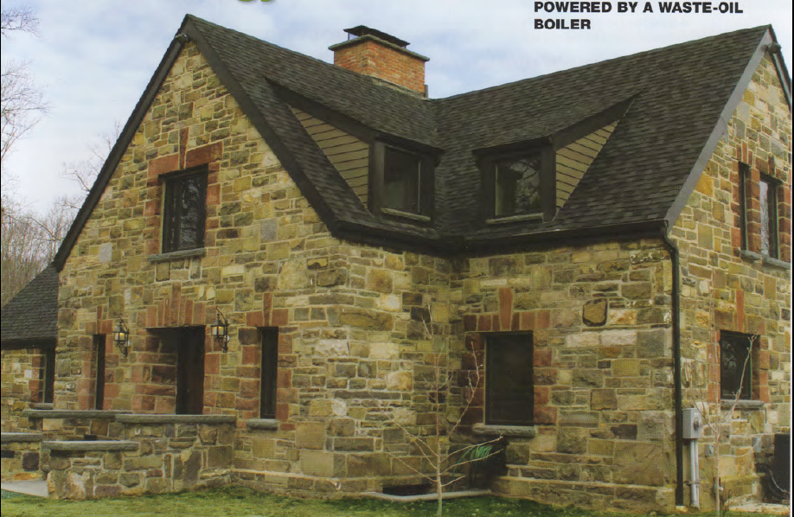
Gasification case study
NY stone home built in 1948.
3 levels
3,000 square feet
Original oil-fired hot air furnace inefficient ($1,400/month for 55°F)
Renovations weatherized the building and added radiant floor heating.
Backup heating system is an efficient propane-fired boiler.
Performance?
‘We only have to put in wood maybe twice a day on very cold days…then you put two pieces of paper in, and light it. It’s the easiest thing. We clean it out maybe once every two weeks.’
Old stone home uses modern heating technology, Radiant Living (2012)

Slide 45
Cord wood summary
Best EREOI for wood
Used for heat rather than power generation
  Heating use can be very efficient
Used locally, so local feedback loops are likely to regulate harvest

Slide 46
Module 8: Biomass
8.6: Biomass – solid fuel for combustion
Wood chips

Slide 47
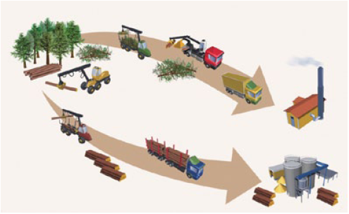
What type of wood is chipped?
Chips can be made from many tree species and tree components.
Bole chips made by chipping stems of low-quality trees now produces most wood chips used for heating. Often chipped in yards
Tops and limbs are often chipped in the woods.
Whole trees can be chipped in the woods.
A buyer’s guide to sourcing wood heating fuel in the northeastern US, BERC (2014)

Slide 48
Cost and reliability?
Chips cost less than fossil fuels, typically 30% less.
In 2014, chips for heating cost $45 - $65 per green ton.
Chip prices are less volatile than fossil fuel prices.
  In Vermont, prices have increased 2% since 2000.
Factors that impact cost:
Wood source & production costs.
Strength of the saw log market.
Regional balance of supply and demand for low-quality wood. Other uses:
  Pulp mills (paper mills);
  Power plants; and
  Pellet mills.
Trucking distances
Demand and demand seasonality
Woodchip quality
Lower demand frees up low-quality wood for energy
A buyer’s guide to sourcing wood heating fuel in the northeastern US, BERC (2014)

Slide 49
When to use chips?
Woodchip systems are cost-effective where:
Conventional (fossil) fuels are expensive;
In larger facilities;
Financed for 10 years or more; and / or
There are state funds to subsidize installation.
Generally, woodchip systems are most cost-effective when:
Space-heating electricity and oil prices are high;
Energy consumption is high;
The competing fuel is electricity rather than oil or gas;
A new system is being installed rather than an old system being replaced; and
A hydronic (hot water or steam) heat distribution system is already in place.
Wood-chip heating systems: a guide for institutional and commercial biomass installations, BERC (2004)

Slide 50
National Life case study
National Life (Montpelier) heats their HQ with wood chips.
Bids for long-term supply asked about price, quality, reputation and source.
Limlaw Pulpwood & Chipping (Topsham VT) has the contract.
Wood comes from a 50-mile radius.
Sourced from 50 small suppliers.
Most is cut by under the guidance of a forester;
But only a small fraction is 3rd-party certified by FSC, SFI or Tree Farm
National Life would like to buy more certified chips but they just isn’t available.
Other chip heating systems in Vermont:
District heating in Monteplier
46 schools; Norwich* and Middlebury and Goddard Colleges
  * Produces a bit of electricity
A buyer’s guide to sourcing wood heating fuel in the northeastern US, BERC (2014)

Slide 51
Example woodchip plant diagram
https://www.archdaily.com/340641/hotchkiss-biomass-power-plant-centerbrook-architects-and-planners/571d506ae58ece4ef3000089-hotchkiss-biomass-power-plant-centerbrook-architects-and-planners-plant-diagram

Slide 52
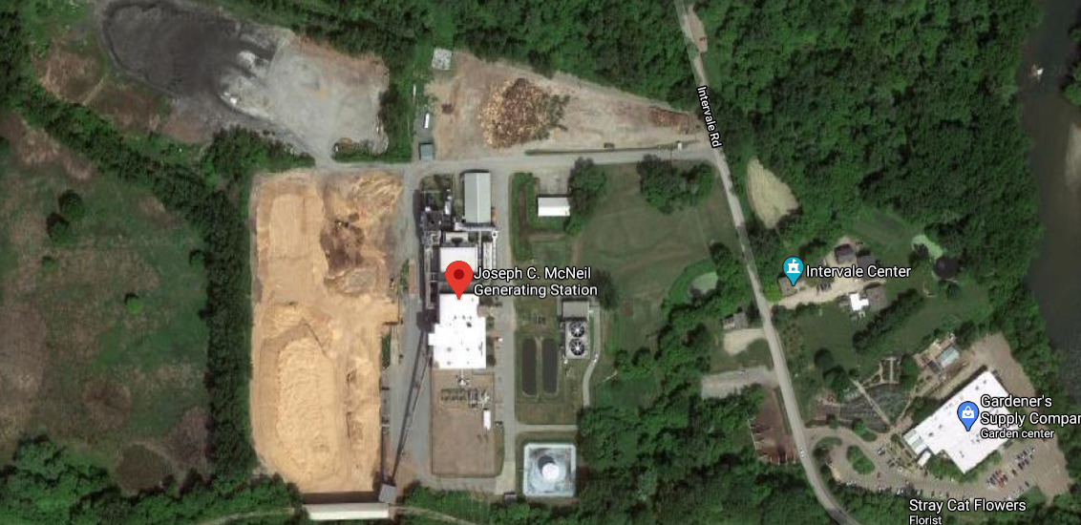
McNeil generating plant (Burlington Electric, VT)
The McNeil wood-chip electric generating plant was approved in 1970s, online 1984.
Located in Burlington’s Intervale
50 MW capacity supplies Burlington’s electric needs
Burns 76 tons of chips / hour at full operation
  Most chips sourced from within 60 miles; many delivered by rail
  Can also burn NG or oil
Heat isn’t used,
though it could heat
much of its
N. Burlington
neighborhood

Slide 53
Wood chip summary
Lower EREOI than cord wood
Used for heat, power or CHP
  Heating and CHP use can be very efficient
Used locally within 100-mile-ish distances
  Easier to transport than cord wood; tractor-trailers
Harvested as a ‘co-product’ of better timber harvesting
Use outside of the immediate area of harvest may blunt local feedback

Slide 54
Module 8: Biomass
8.7: Biomass – solid fuel for combustion
Wood pellets

Slide 55
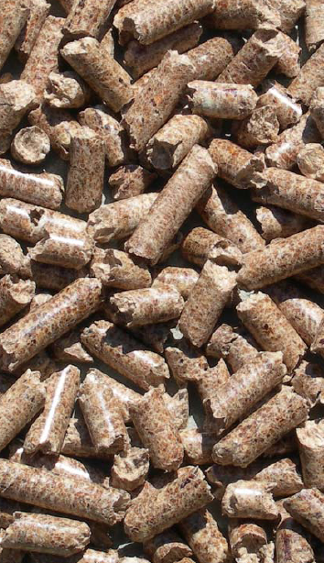
What are wood pellets?
Pellets are compressed wood:
  Sometimes by-products, sometimes de novo products
  Uniformly sized: ¼ - 5/16” in diameter and 1 – 1 ½ inches long;
  Easy to store; and
  Easy to use.
Because the moisture content of wood must be lowered before pellets can be made, the energy content of pellets is higher than other forms of wood biomass.
  6% moisture
  7,750 Btu per pound
Grades classified by amount of ash produced:
Premium: <1% ash
Standard: 1-2% ash
Industrial: > 3% ash
Wood pellet heating: a reference on wood pellet fuels & technology for small commercial & institutional systems

Slide 56
Candidates for wood pellet heating
Buildings:
between 10,000 – 50,000 square feet;
use electricity or fossil fuel for space heating and hot water;
or are new construction;
with heating loads of 0.25 – 1.5 million Btu per hour.
Buildings should have:
Centralized hot water heat distribution;
Space for bulk wood pellets near the boiler; &
Access for delivery to the silo.
Ideally, pellet users should be no more than 50 miles from the supplier to control delivery charges.
Today, NG is the only fossil fuel that can compete with wood pellet heat on price.
Wood pellet heating: a reference on wood pellet fuels & technology for small commercial & institutional systems

Slide 57
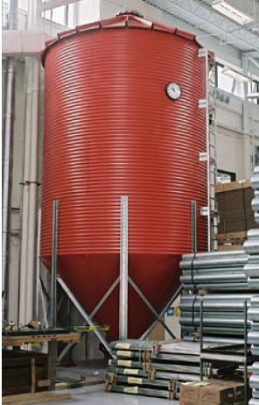
Case study: NRG Systems (VT)
NRG Systems makes wind-measurement equipment for the wind power industry.
Note that the building is so efficient that its heating load is smaller than expected for a building of this size.
46,000 SF heated space
30-ton silo (just 30-tons per year)
Fuels two residential scale 140,000 Btu/hour boilers
15 minutes per day
Offset 4,735 gallons of propane annually
Wood pellet heating: a reference on wood pellet fuels & technology for small commercial & institutional systems

Slide 58
Wood pellet summary
Lowest EREOI of wood biomass because of processing
Used for heat, power or CHP
  Heating and CHP use can be very efficient
Sometimes used very far from point of harvest
  Easier to transport than cord wood; tractor-trailers and huge cargo vessels
Harvested as a ‘co-product’ of better timber harvesting OR as wood energy harvesting
Use far from point of harvest:
  Lowers EROEI
  Increases carbon-footprint
  Hides environmental effects from end users of energy (‘greenwashing’)

Slide 59
Drax: importing wood pellets for ‘green’ co-firing
Drax (Yorkshire UK) is now the biggest ‘biomass’ electricity plant in the world
4 GW generation
Fuel has transitioned from coal to now 2/3 biomass (wood pellets)
Co-firing of coal and wood allows the energy to be classified as renewable.
  Drax burns more wood than the UK produces in one year
In 2018, Drax burned 7.5 million tons of wood pellets.
Most is imported from the US
Over 4.5 million tons of those wood pellets were imported from the US.
A second British plant imports 1.5 millions tons per year.
A third plant under construction will import >1 million tons from the US.
The London Times
https://energynews.us/2019/10/29/southeast/with-looming-loss-of-european-subsidy-wood-pellet-industry-faces-turning-point/

Slide 60
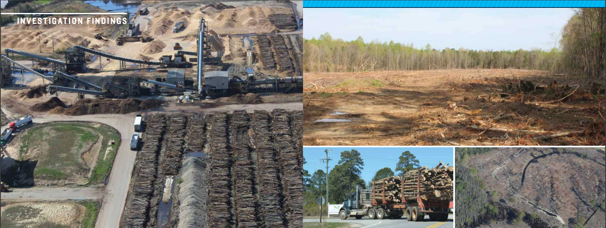
Wood pellet harvests are impacting US forests
“…mature, native hardwood forests in places like North Carolina, Virginia, and along the Gulf Coast are being clear-cut, with whole trees and other large-diameter wood then trucked to processing mills …. These pellets, the report said, are then being shipped to power plants such as Drax Power Station …Forests in the U.S. Southeast are being logged at four times the rate as those in the Amazon…
https://www.nrdc.org/sites/default/files/global-markets-biomass-energy-06172019.pdf

Slide 61
Module 8: Biomass
8.8: Liquid biofuels
bioethanol

Slide 62
Ethanol feedstock availability
The 2008 report, ’90-Billion Gallon Biofuel Deployment Study’ prepared by Sandia National Lab and General Motors R&D Center looked at availability of feedstock for ethanol production.
hitectransportation.org/news/2009/Exec_Summary02-2009.pdf
90 billion gallons of biomass ethanol could be produced annually.
  15 billion gallons from corn; and
  75 billion gallons from cellulosic biomass, mainly perennial energy crops
Requiring 48 m acres of land now characterized as ‘idle, pasture of non-grazed forest’.
In order for cellulosic ethanol to become commercially viable:
Biomass producers will need consistent & reliable markets;
Production contracts to help ensure supply;and
Supportive policy to encourage development.
Bioenergy Primer 1; BIOEN1

Slide 63
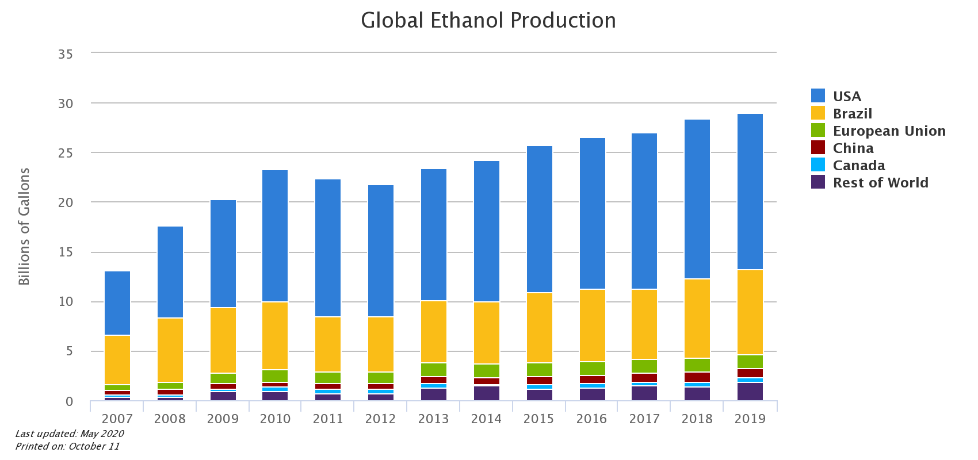
Global bioethanol production
corn ethanol
sugarcane ethanol
https://afdc.energy.gov/data/10331

Slide 64
Sugarcane ethanol production
Production of ethanol from corn is less energy efficient (and more expensive) because corn starch must be converted to sugar before fermentation.
http://www2.hawaii.edu/~khanal/fungal/sugarcaneethanol.html

Slide 65
Comparing corn and sugarcane ethanol
parameter | Brazil | US
feedstock | Sugar cane | corn
total production (2009) (million gallons) | 6,578 | 10,750
land used (million hectares) | 355 | 270
area used for ethanol crop (2006) (% arable land) | 1% | 3.7%
productivity (L ethanol / hectare) | 6.800 – 8,000 | 3,800 – 4,000
energy balance (EROEI) | 8.3 – 10.2 | 1.3 – 1.6
estimated GHG reduction | 86 – 90% | 10 - 30%
life-cycle carbon intensity (g CO2/MJ energy) | 73.40 | 105.10
ethanol’s share of the gasoline market | 50% | 10%
cost of production ($USD / gallon) | $0.71 – 0.90 | $1.55 - 1.74
Prior to 2011, the US had $0.54/gallon tariffs on imported sugarcane ethanol.
Since 1980, the US ethanol industry has received $45 b in subsidies.
https://en.wikipedia.org/wiki/Ethanol_fuel_by_country

Slide 66
The real costs of corn bioethanol ?
2011 study by the National Academy of Sciences found that biofuels can compete with fossil fuels only when the price of fossil fuels is high, about $5.00 / gallon for gas.
Lack of subsidies and taxes increase the price of gas in Europe, biofuels can be competitive.
In the US, DOE now projects gas prices of $2.00 – 4.00 for the foreseeable future.
Today, corn ethanol farming in the US uses 38 m acres (> Illonois).
That’s half the acreage used to produce all grains and vegetables eaten by US people.
Growing corn ethanol has increased the prices of common foods in the US.
Ground beef prices doubled.
Flour and rice prices increased by 50%.
Lower GHG could be worth the price!
But lifecycle analysis if corn ethanol shows that corn ethanol probably doesn’t decrease GHGs relative to gasoline and may even increase GHGs.
https://www.theatlantic.com/ideas/archive/2019/11/ethanol-has-forsaken-us/602191/

Slide 67
Bioethanol summary
EREOI varies with feedstock: good for sugarcane, poor for corn
Blended with gasoline for use in internal combustion engines; transportation
Uses existing gasoline infrastructure
Corn bioethanol increases food prices
Corn bioethanol likely doesn’t decrease our transportation GHG footprint
Now that the US is exporting oil, corn bioethanol doesn’t increase energy security
Corn bioethanol may take our focus of off more effective changes to transportation
Corn bioethanol is championed by several vested interests:
  Big Ag
  Big Oil
  Car companies

Slide 68
Module 8: Biomass
8.9: Liquid biofuels
biodiesel

Slide 69
Diesel engine fuels
The diesel engine was designed to run on a variety of fuels:
  whale oil
  hemp oil
  coal dust
  kerosene
  diesel … a dirty, petoleum-based fuel developed for the engine
Vegetable oil – proposed by Diesel who died in 1913 – was experimented with in agricultural settings from the 1920s through the 1940s.
Researched by European nations with African colonies.
In 1937, the University of Brussels was granted a patent for the use of ethyl esters of palm oil (aka biodiesel).
In WWII, vegetable oil was used as an emergency fuel.
The gigantic Japanese battleship, the Yamamoto, used refined soybean oil as bunker fuel.
Pahl (2005)

Slide 70
So why not use ‘straight’ vegetable oil?
Published studies suggest that long-term use of straight vegetable oil (SVO) in diesel engines will lead to reduced engine life caused by build up of carbon deposits inside the engine and of SVO in the engine lubricant.
Build up isn’t immediate but takes time.
Root cause is the higher viscosity of vegetable oils when compared to no. 2 diesel fuel.
Can buildup be prevented by:
Heating SVO prior to injection; or
Blending SVO with conventional fuel?
Nope!
Dahiya (2015)

Slide 71
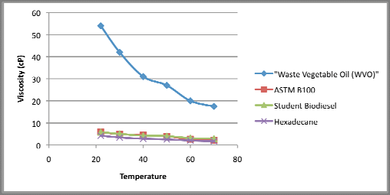
Viscosity and fuel oil
To fuel a diesel engine, oil should be:
  Flammable;
  Mainly C and H;
  Low viscosity; and yet
  Lubricating.
Viscosity: resistance to flow
TAG
16 C oil
https://www.researchgate.net/figure/Viscosity-of-Waste-Vegetable-Oil-WVO-compared-with-biodiesel-
Viscosity-applications_fig4_312085587

Slide 72
What is biodiesel?
Biodiesel is a nontoxic, biodegradable, combustible liquid fuel.
Domestic
Renewable
Made from vegetable & animal fats
The most diverse liquid fuel
EPA classifies biodiesel as an advanced biofuel
wastes
Made from oil feedstock:
soybean oil
canola oil
sunflower oil
mustard oil
rapeseed oil
cooking grease
fish oil
US biodiesel feedstock

Slide 73
Biodiesel use today
Though home to only 4.5% of the world’s population, the US uses 25% of global energy.
As of 2005, total global production of biodiesel approached 2 million metric tons, or 570 million gallons annually.
  2/3 in Western Europe
  1/3 in Eastern Europe, the US and the rest of the globe
How does that compare with current use of liquid petroleum fuels in the US?
58 billion gallons per year
  35 billion gallons (60%) for highway vehicles
  Remainder (40%) for all other uses
Biodiesel could replace about 14% of petro fuel use if made from:
½ of used cooking oil (2.5%)
½ of animal fats (1.25%)
All fallow cropland in the US were planted
to good yielding canola (10%)
So, with investment and work
biodiesel could make a dent in,
but not replace petrofuels.
Algae might produce another 14% of biodiesel.
Pahl (2005)

Slide 74
Oil feedstock for biodiesel
A wide variety of oils can be used as biodiesel feedstock.
Reuse increases the EROEI.
Go local.
Be flexible; feedstock is 70% of the cost of production of biodiesel.
rapeseed = canola
oil palm
coconut
jatropha
rapeseed / canola
peanut
sunflower
safflower
mustard
soybean
corn
used cooking oil
animal fat
algae
European biodiesel feedstock

Slide 75
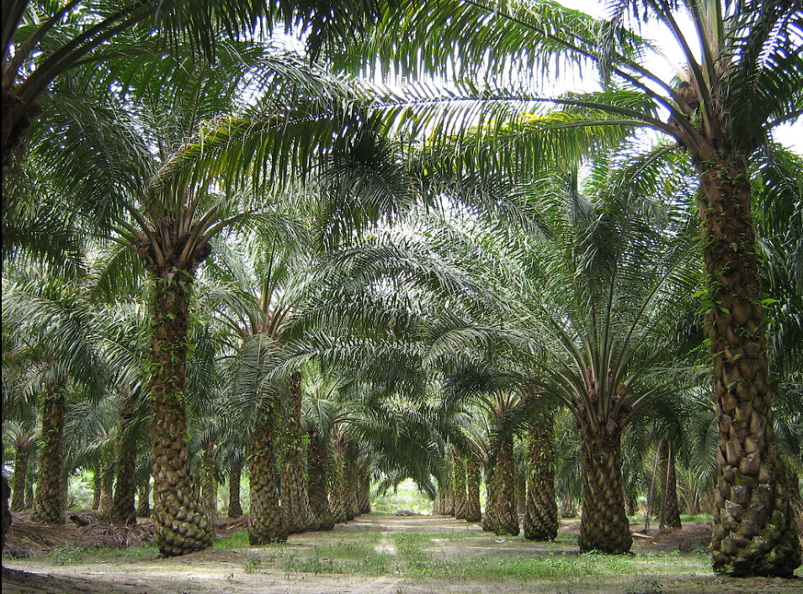
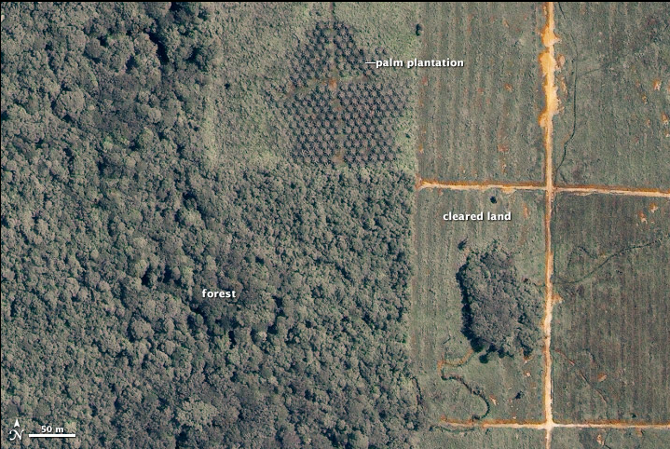
Oil palm
Oil palm:
Fruits are 45 – 55% oil.
High yields of 365 gallons per acre;
Cake is used as animal feed;
High cloud point.
Oil palm plantations are expanding rapidly.
Major threat to rainforest and tropical habitats that are cleared to plant palm plantations.
Drastically reduces biodiversity….
… and wildlife habitats.
Oil palm plantations are feeding Europe’s
biodiesel appetites, fueled by renewable
energy targets and policies.
Pahl (2005)

Slide 76
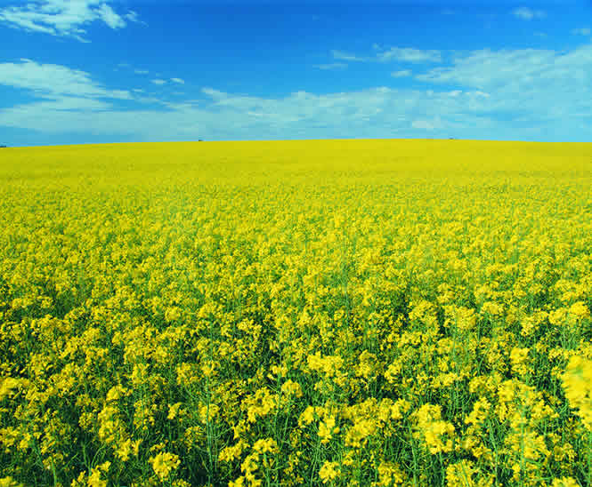
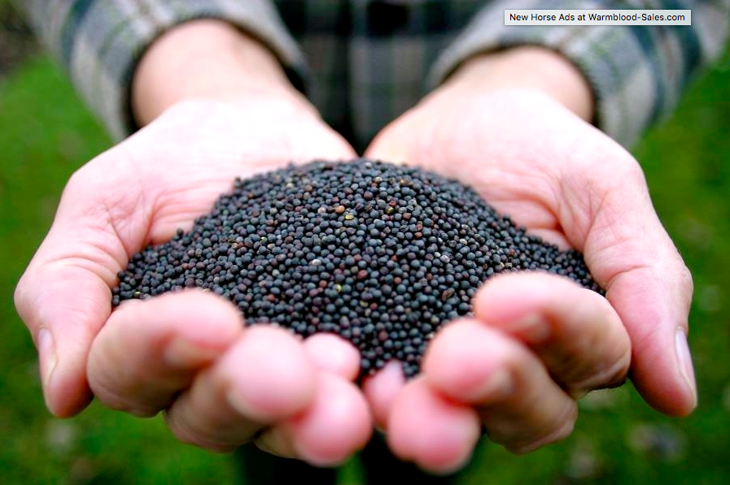
Canola / rapeseed
Canola is also known as rapeseed:
Already a major commercial crop in Europe and NA for oil and livestock feed.
Temperate zone crop.
Yields 127 gallons per acre.
  Highest for any conventional oilseed crop.
Currently the largest global source for biodiesel feedstock.
Pahl (2005)

Slide 77
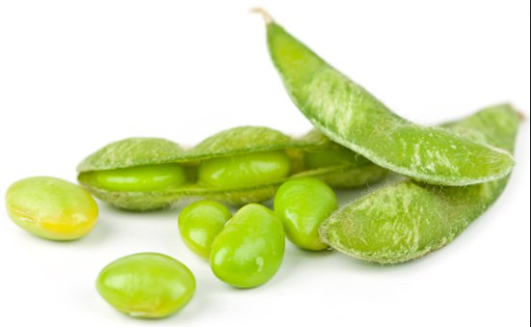
Soybean
Soy:
One of the world’s most critical sources of oil and proteins.
Soy is the most common crop in the US and grown around the world.
Yields 48 gallons per acre.
Oil is used in foods, paints, linoleum, inks, soaps, insecticides, etc.,.
Meal is a valuable feed for animals and people.
Though most US biodiesel is made from soy oil, it’s not the most economic way to make biodiesel.
Pahl (2005)

Slide 78
Used cooking oil
The US uses 3 billion gallons of fryer oil each year!
Used for animal feed, makeup, fertilizer.
But most commonly sent to landfills or sewage treatment plants.
1/5 of NYC’s waste oil could fuel its bus system!
Big advantages:
Abundant, particularly in cities;
Inexpensive; and
High EROI.
Disadvantages?
High free fatty acid content from high and repeated heating.
Contamination with water, crumbs, etc.,.
Requires extra processing steps to produce commercial biodiesel.
Pahl (2005)

Slide 79
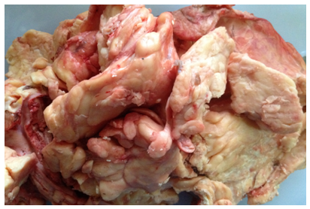
Animal fat
The US produces 11 billion gallons of animal fat each year.
  Enough to make 1.5 billion gallons of biodiesel.
Big advantages:
  Abundant – and may become more so with concerns about BSE;
  Inexpensive;
  High EROI; and
  Lower NOX levels than biodiesel
  from plant oils.
Disadvantages?
  High cloud point and poor cold-weather properties, but this isn’t a problem in warmer climates.
Pahl (2005)

Slide 80
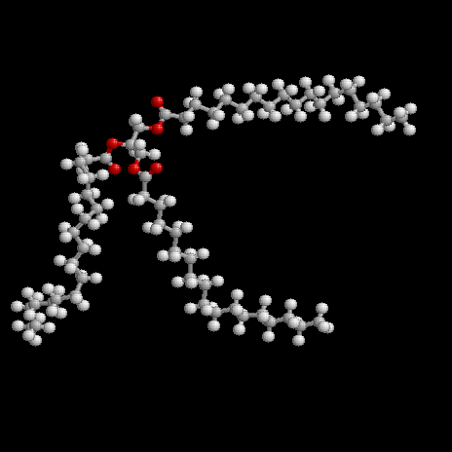
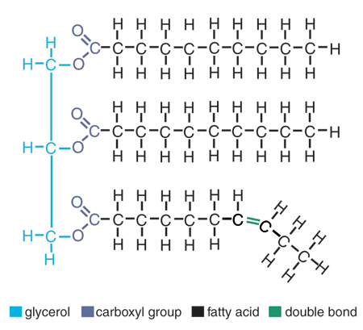
Feedstock oils are triacylglycerols (TAGs)
Vegetable oils are triacylglycerols: three fatty acids attached to a 3-carbon glycerol backbone by acyl bonds.
TAGs are not water soluble.
Long chains and linkages make TAGs viscous.
Pahl (2005)

Slide 81
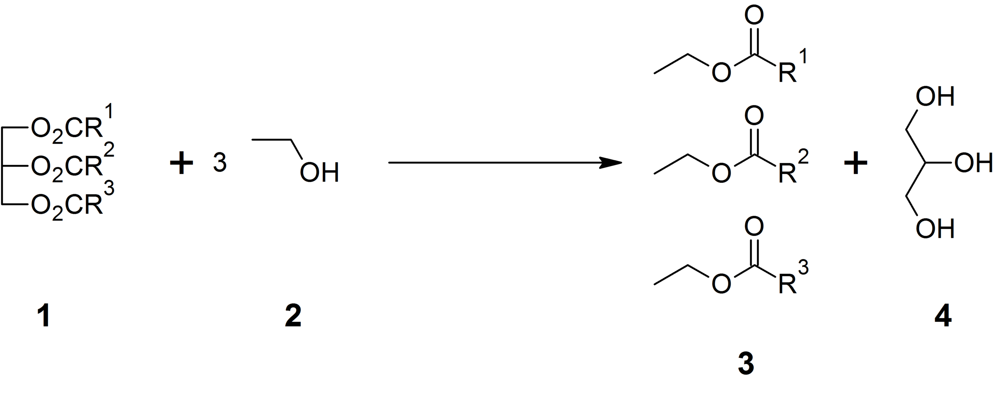
Transesterification cuts off and caps fatty acids
Transesterification is a simple chemical reaction that removes and caps the fatty acids from TAGs.
The reaction has a 3:1 stoichiometry, producing 3 biodiesels for every 1 TAG.
cap
(1) TAG
(3) methoxide
(1) glycerol
(3) methyl esters
(biodiesel)
Pahl (2005)

Slide 82
Biodiesel has a wide range of EREOI values
Reclaimed vegetable oil | EROI
Elsayed et al. (2003) | 4.85 – 5.88
Soybean oil | EROI
Pimental & Patzek (2005) | 0.78
Carraretto et al. (2004) | 2.090
Ahmet et al. (1994) | 2.5
Sheehan et al. (1998) | 3.215
Hill et al. (2006) | 3.67
Pradhan et al. (2009) | 4.56
Sunflower oil | EROI
Pimental & Patzek (2005) | 0.76
Edwards et al. (2006) | 0.85 – 1.08
Bona et al. (1999) | 1.3 – 8.7
ADEME & DIREM (2002) | 3.16
Kallivroussis et al. (2002) | 4.5
Rapeseed oil | EROI
Edwards et al. (2006) | 1.05 – 1.38
IEA (1999) | 1.09 – 2.48
Elsayed et al. (2003) | 2.17 – 2.42
ADEME & DIREM (2002) | 2.99
Richards (2000) | 3.71
Dahiya (2015)

Slide 83
Biodiesel’s cold weather issues
Diesel engines are notorious for being hard to start in cold weather. Why?
Petro-diesel ‘clouds’ at 20°F: crystals of paraffin wax begin to form.
The crystals clog fuel filters and stall the engine.
At colder temperatures petro-diesel fuels reach a pour-point at which it does not pour and won’t travel through fuel lines.
Finally, at 15°F petro-diesel gels to the consistency of petroleum jelly.
Biodiesel also clouds and gels, but at higher temperatures, making it even more difficult to use as an engine fuel.
The performance of biodiesel depends on the fuel source.
Winterizing agents are added to petro-diesel during the winter in colder regions.
These agents can also be used with biodiesel.
Blends?
Lower blends (B5 or B20) are better for use in the winter while higher blends (B50 – B100) can be used in warmer weather.
Pahl (2005)

Slide 84
4S’s: solvents, seals, sludge and slime
Biodiesel is more polar than petro-diesel so acts as a very effective solvent.
Rubber seals, hoses and gaskets in engines built before 1994 can be degraded (solubilized) by high concentrations of biodiesel, particularly B100.
  Rubber should be replaced by a less polar material like Viton.
  Newer diesel vehicles can run on B20 with no issues.
The sludge that typically coats old fuel tanks and lines is dissolved and cleaned off by biodiesel.
  That sounds good... but the moving sludge can clog fuel filters/
  Sludge problems are temporary.
Greenish black slime can form if bacteria grow in biodiesel in engines and lines during warm weather.
  Biocides can eliminate this problem.
Pahl (2005)

Slide 85
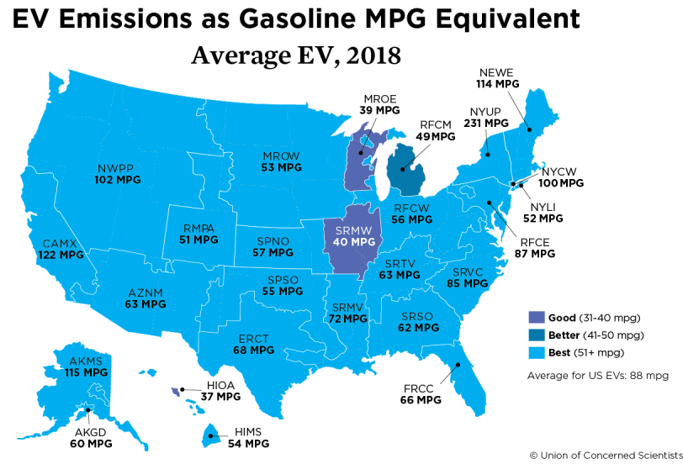
Biofuels vs. EVs and the future of transportation
A study using 2018 data found that equal amounts of carbon emissions would be produced by and average electric vehicle and a gas-powered car getting 88 mpg.
Driving an EV is less expensive than a gas- or diesel-fueled car.
Biofuels will play critical roles in transportation where electrification is more challenging: aviation, long-hauling.
https://blog.ucsusa.org/dave-reichmuth/are-electric-vehicles-really-better-for-the-climate-yes-heres-why

Slide 86
Heating with biodiesel
Use of heating oil in Vermont peaked at 80% in 1970 and declined to 58% by 2000.
Number 2 heating oil is petro-diesel and can therefore be blended with, or replaced by, biodiesel.
  ‘bioheat’ = B2 to B5
  ‘biofuel’
Conversion from number 2 to biodiesel doesn’t require any retrofitting.
Just add biodiesel to the fuel tank.
Keep extra fuel filters on hand and change the filters frequently until all the sludge in the fuel tank and lines has been dissolve and displaced.
Watch the seals on the fuel pump, or have seals replaced to use B100.
There are no winterization problems if the fuel is stored in the house.
Use of B100 in furnaces will require some retrofitting.
The oil heat industry plans to convert to B100 by 2040.
Pahl (2005); Dahiya (2015)

Slide 87
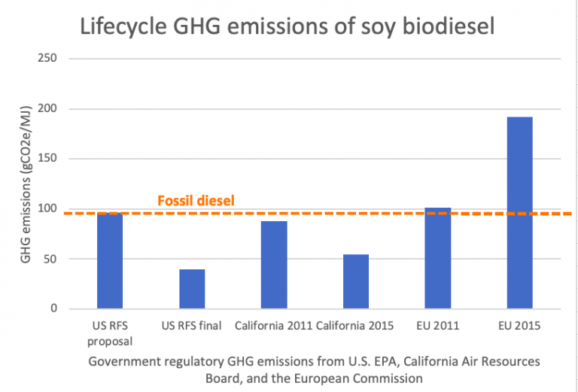
Biodiesel GHG footprint: virgin feedstock
Determined on a LCA basis, the carbon footprint of biodiesel made from virgin feedstock may not be significantly lower than that of petrodiesel.
https://www.mightyearth.org/rethinking-biodiesel-subsidies/

Slide 88
Biodiesel GHG footprint: used oil feedstock
However, the carbon footprint of biodiesel made from used cooking oil (UCO) feedstock is significantly lower than that of petrodiesel, first-generation bioidiesel and third-generation algae biodiesel.
https://www.sciencedirect.com/science/article/abs/pii/S0960148120302081#undfig1

Slide 89
Lessons from Europe: incentives and their effects
1992: EU’s Common Agricultural Policy instructed farmers to set aside 10% of
arable land. This land could not be used for food crops but could be planted with
oil-seed crops. This spurred the production of biodiesel feedstock.
The result? A boom in construction of biodiesel plants across Europe.
1999: EU’s CAP set aside reduced to 5%; oil-seed costs rose; price of petro-diesel fell.
Biodiesel producers turned to used fryer oil (UFO), a lower-cost feedstock
1999 - 2002: Oil-seed prices fell while petro-diesel prices stayed higher. This resulted in another round of biodiesel plant construction.
2004: Oil-seed prices rose again, causing a shortage of feedstock for biodiesel plants.
Pahl (2005)

Slide 90
European targets
EU regulations and the Kyoto Protocol (and subsequent versions) set goals for biodiesel market share:
  2% by 2005
  7.5% by 2010
Critically, legislation allowed producers to import feedstock if local supplies did not allow them to reach targets.
  This has resulted in creation of huge palm oil plantations outside of Europe with devastating environmental consequences. And this feedstock doesn’t support renewable energy generation in producing countries.
In 2003, the EU passed legislation that allows member states to detax (or exempt) biofuels from excise taxes. All fossil fuels were now subject to this tax.
Pahl (2005)

Slide 91
Germany planned for fuel transition
Germany is Europe’s leader in biodiesel production, with 25 plants.
  Until 2003, Germany used only pure B100 for every application.
In 1996, Germany banned the sale of leaded gasoline.
  This opened up about 1,000 fuel pumps.
  Biodiesel producers were ready!
  600 pumps were quickly switched to the abundant supply of B100.
In 1999, Germany placed an eco-tax on fossil fuels that would increase slowly over a period of four years.
The German Taxi Association tested biodiesel in 1991-2 and liked the results.
When they ordered large numbers of new taxis manufacturers took note and began making larger numbers of vehicles that could handle B100.
  Mercedes-Benz, Volkswagen, Audi, Volvo, BMW
Other fleets (buses, public transport, corporate) followed suit.
Pahl (2005)

Slide 92
'Renewable diesel’?
Like biodiesel, renewable diesel is made by chemical modification of bio-oils.
  But the oxygen atoms are replaced with hydrogen.
  And it’s then structurally identical to petro-diesel.
A related process can be used to make ‘renewable’ jet fuel or ‘bio-jet’.
Because these fuels are chemically identical to petro-fuels they are sometimes referred to as ‘drop-in fuels’.
  They can be used without any modification of vehicles.
  Thus, more easily marketed.
  Switching fuels isn’t a hardship.
https://www.ucsusa.org/resources/biodiesel-basics (2015)

Slide 93
'Renewable diesel’?
Using a catalyst and a nitrogen atmosphere to pervert oxidation, fats can be converted into bio-fuels in a one-step process.
https://www.sciencedirect.com/science/article/abs/pii/S1385894719305339#f0060

Slide 94
Biodiesel summary
EREOI varies with feedstock and is best for waste (used) oil vs. virgin oils
  Tropical oils (like palm oil) encourage deforestation
Can be used in diesel engines (transportation) or heating
  Biodiesel has cold-weather challenges that can be overcome
Uses existing diesel fuel infrastructure
Biodiesel from waste oil has significantly decreased GHG footprint
Renewable bio-jet can also be made from bio-oil feedstocks and is a ‘drop-in’ replacement for petro-diesel

Slide 95
Take-home? Waste feedstocks are a no-brainer
“Fuels made from true wastes can deliver strong GHG savings without negatively impacting other uses. Cellulosic biofuels produced from sustainably harvested crop residues and energy crops grown on unused, low-carbon land may also play a prominent role in long-term transport decarbonization.”
While the amounts of waste are limited, they should be our focus for biofuels.
https://theicct.org/blog/staff/epa-account-ghg-emissions-from-waste

Slide 96
Module 8: Biomass
8.10: Biogas from anaerobic digestion
https://www.virtualfarm.psu.edu/assets/uploads/content/Aguirre-Villegas_et_al_10.1002_bbb.1496.pdf
file:///Users/JRH_Air/Downloads/Herman,%20Tess%20Accepted%20Thesis%208-02-19%20Su%2019%20(2).pdf

Slide 97
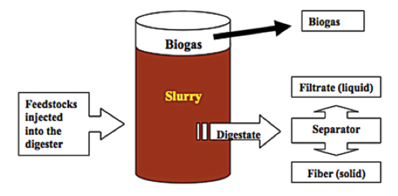
What is anaerobic digestion (AD)?
Anaerobic digestion: a natural bacterial process of ruminant animals, like cattle and sheep, and of anaerobic environments, like lake bottoms, marshes and swamps. In the absence of oxygen, the AD (anaerobic digestion) process degrades organic materials (often seen as waste) into methane-rich biogas and nutrient-rich digestate.

Slide 98
Global use of AD today
Today, simple, small- to medium-scale AD installations are used in the developing world to produce cooking and heating gas from organic wastes.
  2005: 8 million small AD facilities in China
  2011: 500 AD in Tanzania & 1000 AD in Lesotho
AD is widely applied in Europe as a combined heat and power technology.
  Germany: 6800 AD systems
  Austria: 511 AD systems
Manure is a secondary feedstock; crops & organic wastes dominate.
Why is AD more widespread in Europe than in the US?
Fossil fuel energy is not (or is less) subsidized in Europe
But European governments do support renewable energy technologies
European farm subsidies favor diversification and AD
Europe’s resources are more limited, so they focus on reuse and efficiency
Europe is focused on mitigating climate change

Slide 99
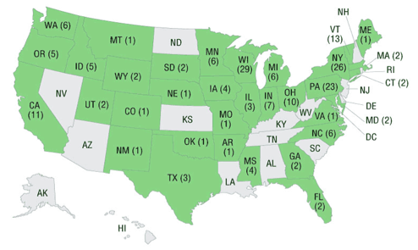
Global and local use of AD today
In the US, AD is mainly employed at municipal wastewater treatment plants to reduce volumes of sludge and levels of pathogens. Biogas is sometimes used to heat the plant, but just over 100 use biogas to produce energy.
However, most wastewater plants rely mainly on aerobic processes.
2008: only 1,351 of 3,171 wastewater plants used AD
US farms began using AD to produce energy during the energy crisis of the 1970s. This early effort was largely unsuccessful. However, farm AD has boomed since 2000.
2020: 255 farm AD plants
205 produce electricity
586,000 MWh electricity
55,000 MWh heat
(1 MWh ~1000 households)
Vermont:
  16 AD plants operational 2020
  7 AD plants shutdown
http://www.epa.gov/agstar/projects/

Slide 100
US farm AD motivations?
The main reasons for using on-farm AD in the US are not energy production!
Reduction of manure odors
Management of manure nutrients
Growing concerns about environmental quality, biosecurity, energy security, nutrient scarcity and climate change have also boosted on-farm AD.
Algae growth in Lake Champlain is fueled by nutrient runoff
Peak phosphorous is upon us: we’ve used up half of global P supplies
AD provides some separation of N & P nutrients
AD converts N to a form more readily used by plants
AD drastically reduces that pathogens present in manures
Methane from farms & landfills is a GHG 27-times as potent as CO_{2,}
accounting for 9% of GHG emissions.
In 2009, the US Dairy Industry pledged to reduce methane emissions by 25% by 2020. In 2014, USDA released its Biogas Opportunities Roadmap to guide us to this goal.
Suggests 11,000 additional AD plants, capable of powering 3 million homes.

Slide 101
AD is microbe farming
Populations of several specific types of bacteria must be established, grown and kept happy. And that requires a stable environment (homeostasis) and food supply.
Physical factors:
Temperature
Hydraulic retention time (HRT)
Solids retention time (SRT)
Organic loading rate (OLR)
Volatile solids loading rate
Mixing
Chemical factors:
pH
Alkalinity
Volatile fatty acids (VFAs)
Nutrients
Trace elements
Toxins

Slide 102
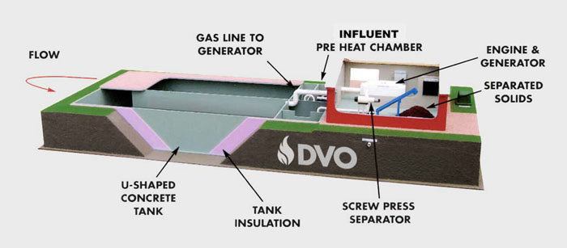
AD: a look at one design
Most on-farm digesters are a variation on a plug-flow design.
Plumbing, heating and gas-tight requirements make it far more complex than solid biomass and akin to a biofuel conversion plant.
https://www.dvoinc.com/howitworks.php
https://www.dvoinc.com/videos.php

Slide 103
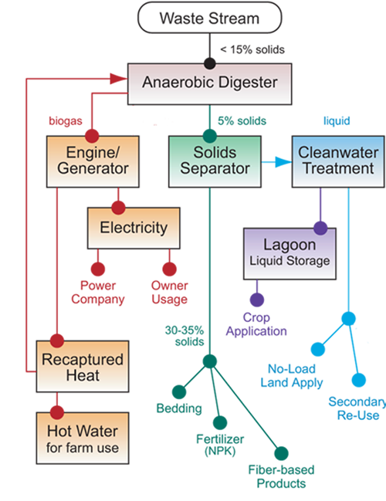
AD biorefinery: creating an integrated system
In a biorefinery approach and AD plant is integrated as part of a system that harvests, makes use of and profits from all products and co-products.
DVO has created ‘add-ons’ or components that can be used to create a biorefinery.
Nutrient separation and ‘clean’ water recovery and reuse are holy grails for the AD industry.
Separation of N and P allows maximal and optimal use of each.
Re-use of water is a big environmental benefit.
https://www.dvoinc.com/advantages.php

Slide 104
AD feedstock
Manure: has low energy since the feed has already been digested. But:
  Manure has a neutral pH and high buffering capacity (alkalinity);
  Has all the microbes needed for AD;
  Has all the macro- and micronutrients needed for AD; and
  Manure is abundant and pumpable.
Non-manure feedstock is often acidic with higher energy; increases biogas.
  Waste feed
  Food residuals
  Fats, oils and grease (FOG)
  Energy crops
  Waste from ethanol or biodiesel production
  Produce waste
  Cafeteria waste
  Farm animal mortalities

Slide 105
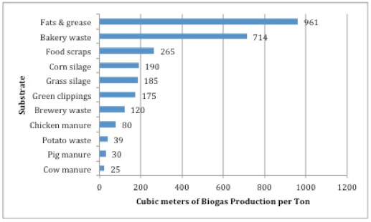
AD feedstock: go for high volatile solids
Volatile solids are organic compounds that can be made into methane.
The best feedstock materials have high levels of volatile solids.
Glycerol: the waste from converting UFU/UCO into biodiesel makes great AD feedstock

Slide 106

AD feedstock: waste
In Europe some AD facilities grow energy crops as AD feedstock.
However, nearly all AD feedstock is waste that might be landfilled rather than recycled.
Some materials are the waste-of-a-waste: glycerol, FOG

Slide 107
AD feeding is the key
Even the best and most abundant feedstock won’t keep an AD functioning properly and producing biogas unless it’s fed properly, taking these factors into account.
AD operators must monitor and control AD feeding rates, aka organic loading rates.
Critical factors include:
  Concentration of feedstock (solids/volume);
  Volatile solids content of feedstock;
  Inorganic (or inert) content of feedstock;
  Volatile solids / AD volume; and
  Hydraulic retention time.
Constant monitoring and frequent testing is required.
Hydraulic retention time (HRT): average days that feedstock stays in the AD
Allows the bacteria enough time to convert all VS to methane
Related to AD capacity
Equals AD volume (gallons) / feed volume (gallons/day)

Slide 108
AD products and co-products
Anaerobic digestion produces energy and co-products. Revenue and benefits from co-products often surpasses that from biogas, so a ‘bio-refinery’ approach is needed.
Biogas: methane combusted to produce heat or co-generation of heat and electricity
Digestate: the biomass that remains after feedstock is processed by AD
Effluent (liquid filtrate) used as fertilizer; rich source of N, P, K
  Offsetting use of synthetic fertilizer lowers costs and carbon footprint
Separated solids (fiber) used as dairy herd bedding, fertilizer, compost base
  High bedding costs make this a valuable co-product
Carbon dioxide: methane is combusted to CO₂
CO₂ could be used to augment the
growth of plants and algae

Slide 109
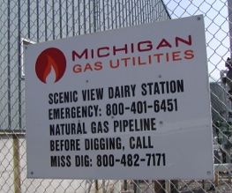
Biogas is combusted before or after scrubbing
Biomethane: methane produced by removing all other gases from biogas
  Chemically equivalent to natural gas though biologically produced
  Can be injected into natural gas pipelines
  Can be used to vehicles equipped for natural gas
  Increased energy density of 1000 Btu / ft³
  Fiscally viable only when natural gas prices are high enough
Biomethane from Scenic View Dairy (MD) is injected into the NG grid

Slide 110
AD ecosystem services
Unlike other forms of bioenergy, AD provides ecosystem services in addition to energy production.
Decreases GHG emissions as methane is contained and converted to carbon dioxide.
  Without AD, decomposition of waste would release methane to the atmosphere.
  Methane has 28 – 85X the GWP of carbon dioxide
Controls odors
Helps to capture and recycle nutrients in organic wastes that are usually landfilled
Protects of water quality by helping to manage nutrients
Pathogen reduction and destruction

Slide 111
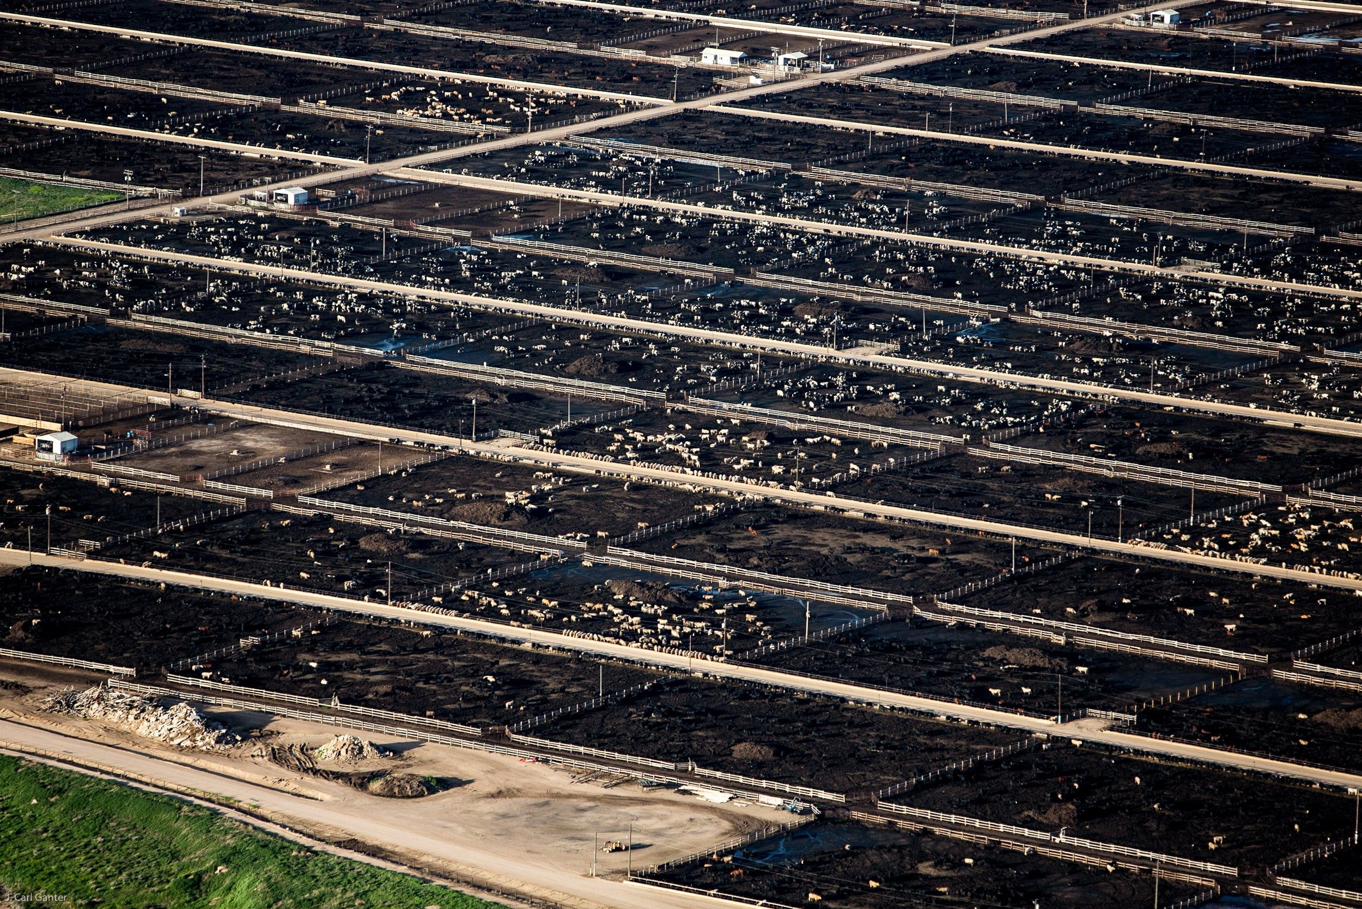
AD drawbacks? CAFOs and complexity
AD economy of scale: AD systems are most economical for very large farms with over 500 head of cattle or 2000 pigs or more chickens. These large operations (CAFOs) confine rather than pasture the animals.
AD will reduce odors and make land application of effluent easier but doesn’t reduce the threat of the huge volume and concentration of manure, nutrients and pathogens to water and land immediately surrounding the CAFO.
AD is complex:
AD requires more labor, maintenance, regulation and compliance than other forms of bioenergy.
So effort is required long after plants are built and commissioned.

Slide 112
Biogas (anaerobic digestion) summary
EREOI is low and difficult to estimate, ranging from ~ 2 - 8
  Rises when engine heat is used to heat the system, when methane loses are minimized and when biogas is used for heating or CHP rather than electricity alone
  Manure and feedstocks have low energy densities and high water contents
The ecosystem services add to the value of AD: waste-to-energy and capturing and using methane that could be released to the atmosphere
  Composting also recycles wastes and nutrients but…
    Doesn’t handle liquid wastes and doesn’t produce energy
AD has a real NIMBY challenge
The waste heat from AD is usually wasted in America. In Europe AD facilities are placed near heat loads to increase their efficiency.

Slide 113
Module 8: Bioenergy
8.11: Carbon neutral?

Slide 114
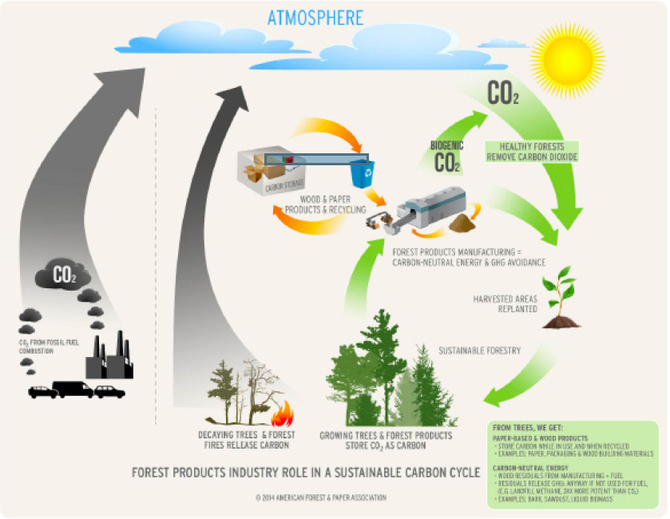
Biomass carbon cycling
Biomass carbon cycling
Remember that biomass has the potential to be carbon neutral or negative.
Growth rate
Harvest rate
Best practices
https://www.afandpa.org/issues/issues-group/carbon-neutrality-of-biomass

Slide 115
Lifecycle analysis
Lifecycle analysis must be used to truly evaluate the impact of any technology, biomass included, on carbon emissions.
Complication?
LCA models differ and come to different conclusions.
Let’s take a quick look at Sedjo’s comparison of three biomass LCAs.
  Manomet study
  Canadian Forest study
  TSM study
Sedjo (2013) Comparative Life Cycle Assessments: Carbon Neutrality and Wood Biomass Energy

Slide 116
Manomet study
Parameters:
One-time harvest for energy
100-year regrowth vs. 100-year carbon emissions?
Sedjo (2013) Comparative Life Cycle Assessments: Carbon Neutrality and Wood Biomass Energy
So, in the short term this will worsen GCC.
In the long term, GHG would be lower than use of fossil fuels. Reharvest?

Slide 117
Canadian forest study
Parameters:
Large 13 m-acre forest area studied
  Fixed area and fixed market
Harvested at a constant rate thought to be sustainable in the long-term
Takes 100 years to reach a steady state (harvest = growth)
Examines a number of scenarios for use of forest products.
Conclusions:
In most scenarios:
  Early C emissions are higher than fossil fuels.
  Longer-term C emissions are lower than fossil fuels.
    Often lower within the 100-year period before steady state.
  100-year forest holds less C, but emissions are still lower.
Use matters.
Unlike Manomet it looks at the effect of periodic harvest in a large forest system.
Sedjo (2013) Comparative Life Cycle Assessments: Carbon Neutrality and Wood Biomass Energy

Slide 118
TSM study
Parameters:
A dynamic optimization forest-management model
Considers that market conditions with change, influencing demand and supply.
  Allows the amount of forested land to grow or shrink with market demand.
Conclusions:
The demand for forest products, including wood energy, will rise and also increase:
  Harvest rates
  Investment in new forests
  Rates of C sequestration
If demand for forest products falls, so will C sequestration
Sedjo (2013) Comparative Life Cycle Assessments: Carbon Neutrality and Wood Biomass Energy

Slide 119
TSM study (1)
Increasing demand increases biomass price
Sedjo (2013) Comparative Life Cycle Assessments: Carbon Neutrality and Wood Biomass Energy

Slide 120
TSM study (2)
Increasing demand increases C sequestration
Sedjo (2013) Comparative Life Cycle Assessments: Carbon Neutrality and Wood Biomass Energy

Slide 121
TSM study (3)
Increasing demand increases forest area
Sedjo (2013) Comparative Life Cycle Assessments: Carbon Neutrality and Wood Biomass Energy

Slide 122
TSM study (4)
Increasing demand increases harvest
Sedjo (2013) Comparative Life Cycle Assessments: Carbon Neutrality and Wood Biomass Energy

Slide 123
Take away on carbon neutrality?
In the long-term, as we turn away from fossil fuels and increase the value of biomass energy and carbon sequestration its likely that we will use more biomass energy with some version of best practices.
Long-term biomass energy use will help sequester carbon and be neutral or better unless it is practiced in an atrocious manner.
In the near future, biomass energy could increase carbon emissions relative to fossil fuel use. So, we must:
Use best practices including accurate carbon accounting.
Learn far more about how forestry practices affect carbon sequestration.
Focus on biomass with short lag times and rapid regeneration.
  Grass?
  Short-term wood crops
Sedjo (2013) Comparative Life Cycle Assessments: Carbon Neutrality and Wood Biomass Energy

