Slide 1
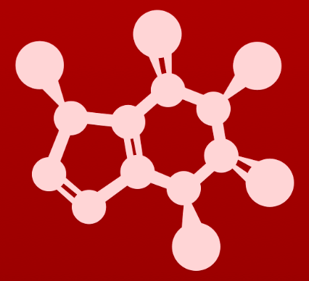
CHE 2060: Principles of Organic Chem
1. Introduction to organic structure & bonding
  1.1: Drawing organic structures
  A. Formal charge
  B. Common bonding patterns
  C. Using ‘line structure’ (aka line-bond) convention
  D. Constitutional (aka structural) isomers
  1.2: Functional groups & organic nomenclature
  A. Functional groups in organic compounds
  B. Naming organic compounds
  C. Abbreviating structural drawings
  1.3: Structures of some important biological molecules
  A. Lipids
  B. Biopolymer basics
  C. Carbohydrates
  D. Amino acids & proteins
  E. Nucleic acids (DNA & RNA)

Slide 2
1. Intro to organic structure & bonding
  Big ideas:
Functional groups are where the action is.
Drawing and understanding molecular structures is a critical skill.

Slide 3
1. Intro to organic structure & bonding
  1.1 Drawing organic structures
  A. Formal charge
  B. Common bonding patterns
  C. Using ‘line structure’ (aka line-bond) convention
  D. Constitutional (aka structural) isomers

Slide 4
1. Intro to organic structure & bonding
  1.1 Drawing organic structures
  Introduction

Slide 5
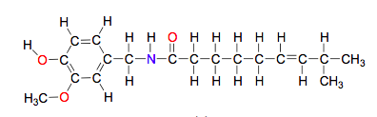
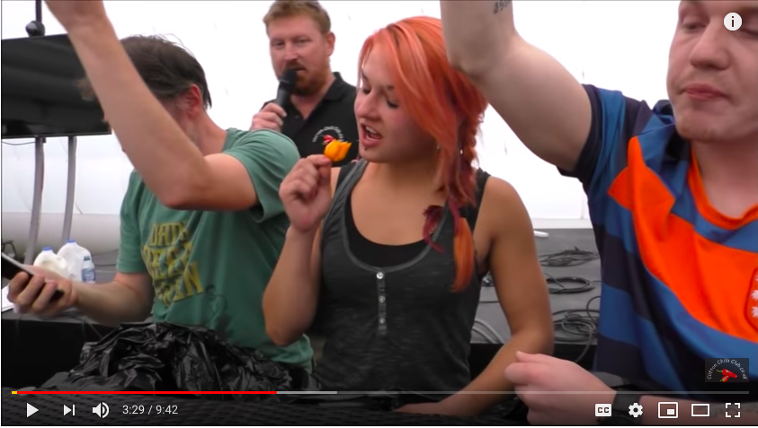
Organic molecules are hot…
The contestants in hot pepper eating contests are really competing against the biochemical properties of the capsaicin molecule, responsible for the heat.
Capsaicin binds to the mammalian TrpV1 receptor and tells us to ’stay away’.
Birds have a TrpV1 receptor, but aren’t sensitive to capsaicin.
They spread the seeds.

Slide 6

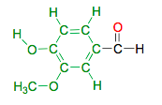
…and they add flavor to our lives
It’s not hot, but humans love the flavor found in vanilla beans.
A molecule called vanillin provides most of the flavor from the bean.
In this course, we’ll study organic molecules like these to learn more about what their structure can tell us about their origins, properties functions, and reactions.
What do the structures of capsaicin and vanillin have in common?

Slide 7
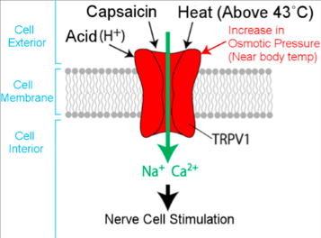
Binding → conf △ → signal → pain
When capsaicin binds to its receptor (TRPV1) it causes the receptor’s ion channel to change conformation and open.
An influx of ions then causes nerve stimulation, perceived as pain.
https://www.phytochemia.com/en/2017/07/11/caution-hot-subject/

Slide 8
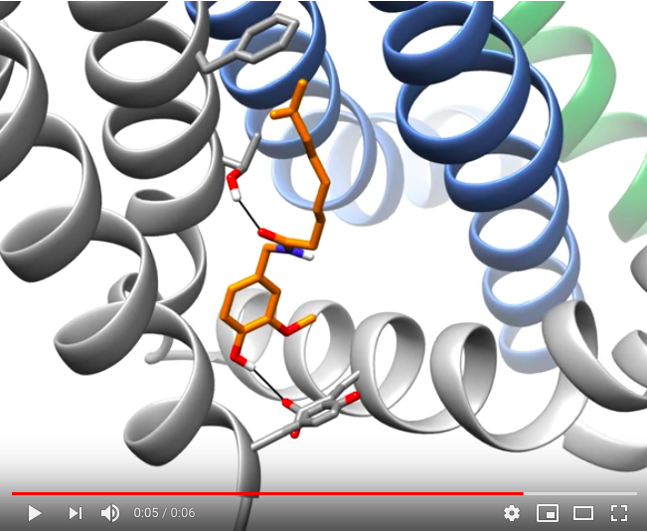
Binding → conf △ → signal → pain
When capsaicin binds to its receptor (TRPV1) it causes the receptor’s ion channel to change conformation and open.
An influx of ions then causes nerve stimulation, perceived as pain.
https://www.youtube.com/watch?v=8wHgcOWgnBg

Slide 9
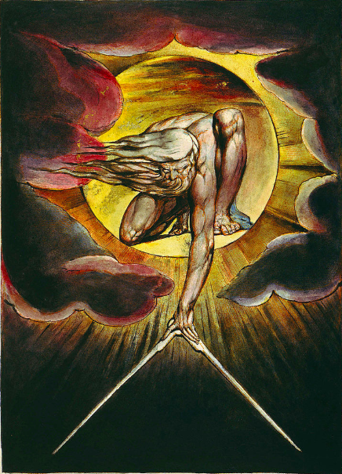
What’s ‘organic’ chemistry?
“The chemistry of living things; the chemistry of carbon-based molecules.”
There are at least 10 million different organic molecules!
By 1807, Jöns Jakob Berzelius had divided molecules into two camps:
Inorganic molecules
Organic molecules
It was generally believed that only God could create organic biomolecules,
that were imbued with a mysterious and vital life force: ‘vitalism’.
William Blake’s ’The Ancient of Days’

Slide 10
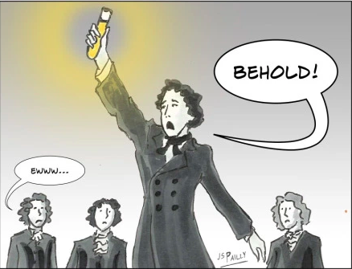
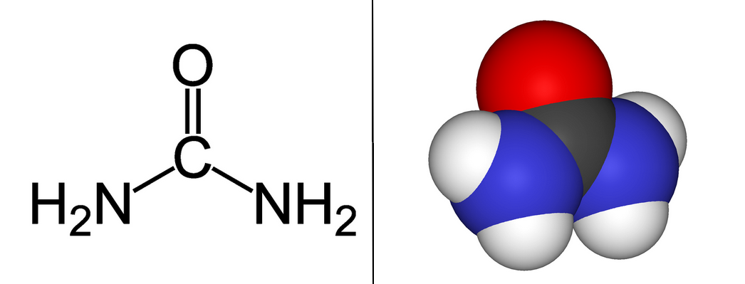
Wohler’s happy accident
The first man to “break” vitalism was Friedrich Wöhler.
In 1828, he was actually trying to make ammonium cyanate, an inorganic molecule for his research: NH4⁺¹ ⁻¹OCN, an inorganic molecule.
But every time, he made the small organic molecule urea instead.
:
:
:
:
https://planetpailly.com/2017/04/18/sciency-words-organic-an-a-to-z-challenge-post/
Many of the most famous discoveries have been made by accident.
“[The] research gave the unexpected result . . . that is the more noteworthy inasmuch
as it furnishes an example of the artificial production of an organic, indeed a so-called animal substance from inorganic materials.” - Wohler, 1828

Slide 11
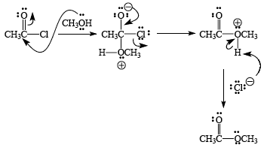
CHE 2060 goals
Understand that the function and behavior of organic molecules is
determined by their form or structure
..
..
..
..
H2N
..
H2N
NH2
N
NH2
triethylamine (gas/liquid)
fermented shark
rotten fish
putrecine (solid)
bad breath
death & decay
cadaverine (liquid)
bad breath
death & decay
2. Understand some basic type of reactions that organics undergo .
Bruice p.90
Atkins p.144
D&D p.276

Slide 12
What you need to recall from CHE 1031
There are some topics that you should recall from CHE 1031, General Chem I.
If you need to review these topics you should!
  Basic facts about atoms and elements
  Atomic structure
  Orbitals
  Covalent and ionic compounds
  Drawing Lewis structures
See the CHE2060 Module 1 webpage for links to Khan Academy video tutorials on these topics.

Slide 13
Can you?
(1) Define the term organic chemistry?
(2) Give examples of a few organic molecules?
(3) Explain the concept of vitalism?
(4) Remember what you should have mastered, as prior knowledge, from
CHE 1031, General Chemistry I?

Slide 14
1. Intro to organic structure & bonding
  1.1A: Formal charge
    calculation
    Zwitterions

Slide 15
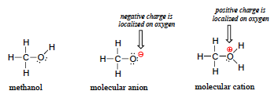
Formal charge
Formal charge is the atomic location of charge within a molecule’s structure.
Monoatomic ions were simple and predictable.
But polyatomic ions were …. less so. Until you draw their Lewis dot structures.
  Lewis structures reveal charges that result from bonding patterns.
Formal charge = (# ve-) – (dots + sticks)

Slide 16
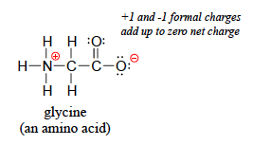
Zwitterions
Zwitterions are molecules that have ‘internal’ formal charges even though their net (or overall) charge is zero.
For uncharged molecules, all internal formal charges must sum to zero.
From the German zwitter, or between
H = 1 - (0 + 1) = 0
C = 4 - (0 + 4) = 0
N = 5 - (0 + 4) = +1
O= = 6 – (4 + 2) = 0
O- = 6 – (6 + 1) = -1

Slide 17
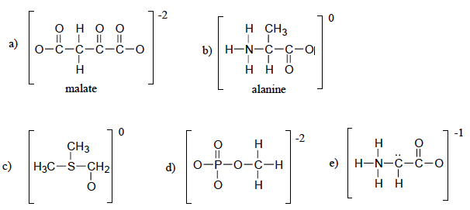
Try these:
1. Add any missing free electron pairs to each structure.
2. Calculate the formal charges on each atom of each structure.
3. And identify any zwitterions.
zwitterion
:
:
:
:
:
:
..
..
+1
..
:
:
..
:
..
..
-1
-1
:
:
-1
:
:
:
:
:
..
..
+1
-1
..
:
:
..
..
..
..
+1
:
:
-1
:
:
-1
..
-1
..
-1
zwitterion
..

Slide 18
Can you?
(1) Define the term ‘formal charge’?
(2) Calculate the formal charge of ions and molecules?
(3) Define the term ‘zwitterion’?

Slide 19
1. Intro to organic structure & bonding
  1.1B: Common bonding patterns
    Common (uncharged) vs charged patterns
    Using patterns to determine formal charge

Slide 20
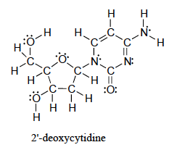
Dealing with larger structures?
Calculating formal charge isn’t difficult, but it gets tedious and time-consuming when molecules get larger and their structures become more complicated.
This is a nucleotide, a tiny building
block for RNA or DNA.
Better approach?
Learn the common (typical) bonding patterns (Lewis patterns) for the atoms found in organic molecules.
Create Lewis structures using these patterns.
Know that formal charge is zero if typical bonding patterns are used.

Slide 21
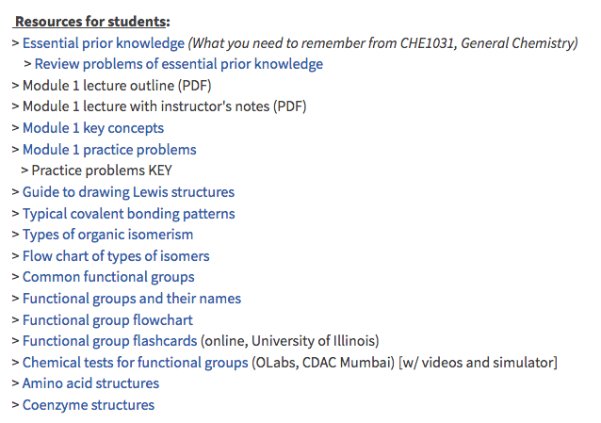
Typical bonding patterns
Let’s turn to two handouts for this information.

Slide 22
Try this:
Apply common bonding patterns to draw Lewis structures for these molecules.
Assume all atoms have full valence shells.
Show all lone electron pairs.
Show formal charges as determined by patterns; you can calculate to confirm.
NB: There is more than one solution to each!
C5H10O C5H8O
C6H8NO⁺¹ C4H3O2⁻¹
..
O
..
This is is a tough assignment, but will seem easier by the end of this module.
There are many possible structures for each formula.
..
O
..
+1
N
..
:O:
O
..
..
-1
O:
..

Slide 23
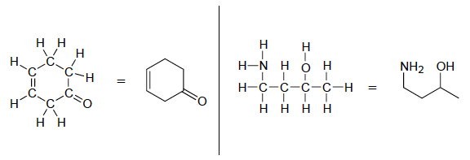
Line-bond drawings
Line-bond drawings are chemists’ favorite way to show the structure of organic molecules because this method:
Is simple;
Is fast;
Shows the shape of a molecule; and
Focuses attention on functional groups rather than the carbon skeleton.
..
..
..
..
..
..
..
..
..
Line-bond rules:
Carbon atoms are found at the end of each line segment.
Carbon chains ‘zig-zag’ to show the 109.5º angle of carbon-carbon bonds.
‘Heteroatoms’ and free electron pairs must be shown.
Hydrogen atoms are shown only when they are bound to heteroatoms.

Slide 24
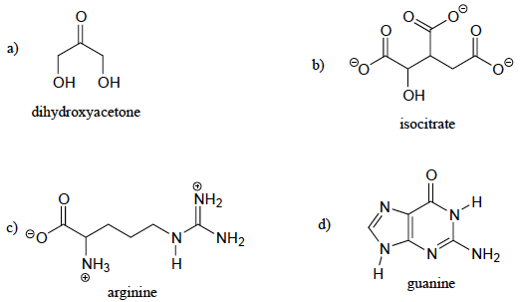
Try this:
Count the number of carbon and hydrogen atoms for each of these molecules.
:
:
:
:
:
:
:
:
:
:
:
3 C
6 H
:
:
6 C
5 H
:
:
:
:
:
:
:
:
:
:
:
:
:
:
:
:
:
:
:
:
:
:
:
:
6 C
15 H
5 C
5 H

Slide 25
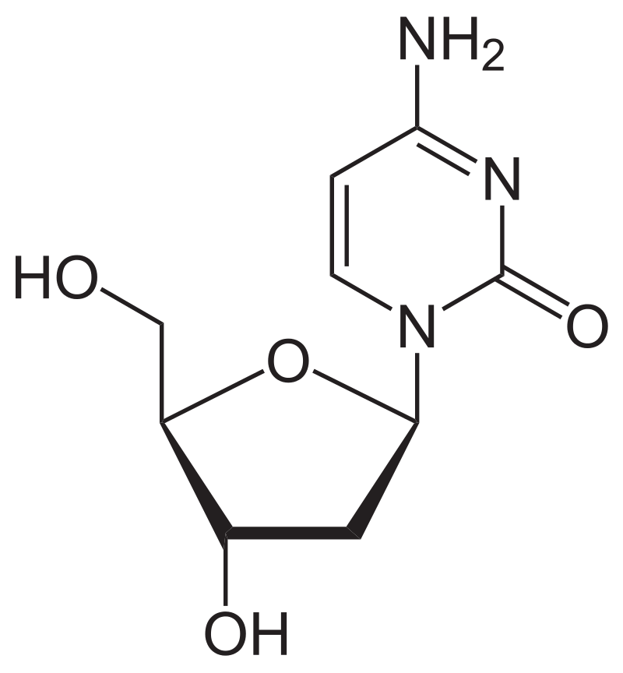
Try this:
Create a line-bond drawing for the DNA base 2-deoxycytidine.
:
:
:
:
:
:
:
:
:
:
:

Slide 26
Can you?
Describe the difference between a molecular formula, a complete structural formula and a condensed formula?
(2) Convert complete structural formulas to condensed formulas and vice versa?
(3) Convert complete Lewis dot structures to line-bond structures?

Slide 27
1. Intro to organic structure & bonding
  1.1D: Constitutional isomers

Slide 28
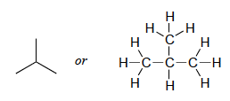

Constitutional isomers
Constitutional isomers: two structures that share a common molecular formula but have different bonding patterns, identities, and physical and chemical properties.
Draw a Lewis structure (or line-bond structure) for C4H10.
Many molecular formulas can represent more than one structure, or more than one molecule.

Slide 29
Flow chart of isomers
http://www.chem.ucalgary.ca/courses/351/Carey5th/Ch07/ch7-1.html

Slide 30
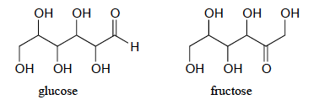
Sugar constitutional isomers
Glucose and fructose are constitutional isomers.
  Both are monosaccharide sugars.
  Both have 6 carbons and the formula C6H12O6.
:
:
:
:
:
:
:
:
:
:
:
:
:
:
:
:
:
:
:
:
:
:
:
:
Glucose is:
Sweet.
Found in disaccharides (sucrose).
Processed starches.
Absorbed directly into the bloodstream using insulin.
Stored as glycogen in the muscle and liver.
The only sugar that can fuel your brain.
Fructose is:
A little sweeter.
Found in honey, fruits, root vegetables.
Processed from sugar cane, sugar beets, corn.
Raises blood sugar more slowly; less impact on insulin.
Excess is converted to cholesterol and triacylglycerides.
https://www.healthline.com/nutrition/sucrose-glucose-fructose#absorption-and-use

Slide 31
Try this:
Draw ethanol, CH3CH2OH, and at least one constitutional isomer.
Hint: ethers have the oxygen in the center.
H H
| |
H - C - C - O - H
| |
H H
H H
| |
H - C - O - C - H
| |
H H
..
..
..
..
Ethanol
b.p. 78°C
Diethyl ether
b.p. -24°C

Slide 32
Try this:
Draw all possible constitutional isomers of C5H12.
n-pentane
pentane
2-methylbutane
2,2-dimethylpropane

Slide 33
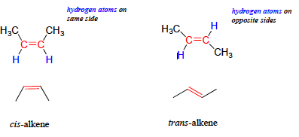
Cis vs trans isomers (brief look)
The next module will go into detail about molecular geometry and related isomers like the cis and trans isomers of the four-carbon alkene, butane, shown here.
At this point, the you should recognize that cis and trans are different structures.
A lack of free rotation around the double bonds of the alkene prevents these isomers from interconverting.

Slide 34
Can you?
Define the term ‘constitutional isomer’?
(2) Describe why or how one molecular formula can represent many different molecules?
(3) Draw constitutional isomers for a given formula?

