Slide 1
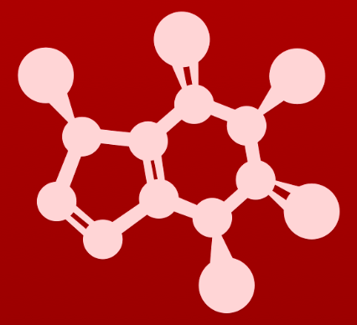
CHE 2060: Principles of Organic Chem
1. Introduction to organic structure & bonding
  1.1: Drawing organic structures
  A. Formal charge
  B. Common bonding patterns
  C. Using ‘line structure’ (aka line-bond) convention
  D. Constitutional (aka structural) isomers
  1.2: Functional groups & organic nomenclature
  A. Functional groups in organic compounds
  B. Naming organic compounds
  C. Abbreviating structural drawings
  1.3: Structures of some important biological molecules
  A. Lipids
  B. Biopolymer basics
  C. Carbohydrates
  D. Amino acids & proteins
  E. Nucleic acids (DNA & RNA)

Slide 2
1. Intro to organic structure & bonding
  Big ideas:
Functional groups are where the action is.
Drawing and understanding molecular structures is a critical skill.

Slide 3
1. Intro to organic structure & bonding
  1.2 Functional groups and organic nomenclature
  A. Functional groups in organic compounds
  B. Naming organic compounds
  C. Abbreviating structural drawings

Slide 4
1. Intro to organic structure & bonding
  1.2A: Functional groups in organic compounds
  See tables posted on Module 1 webpage.

Slide 5
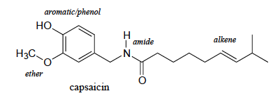
Functional groups
Functional groups: structural units defined by specific bonding arrangements between specific atoms
Where the chemistry happens; where the action is
Determine how the molecule will react with other molecules.
:
:
:
:
:
:
:

Slide 6
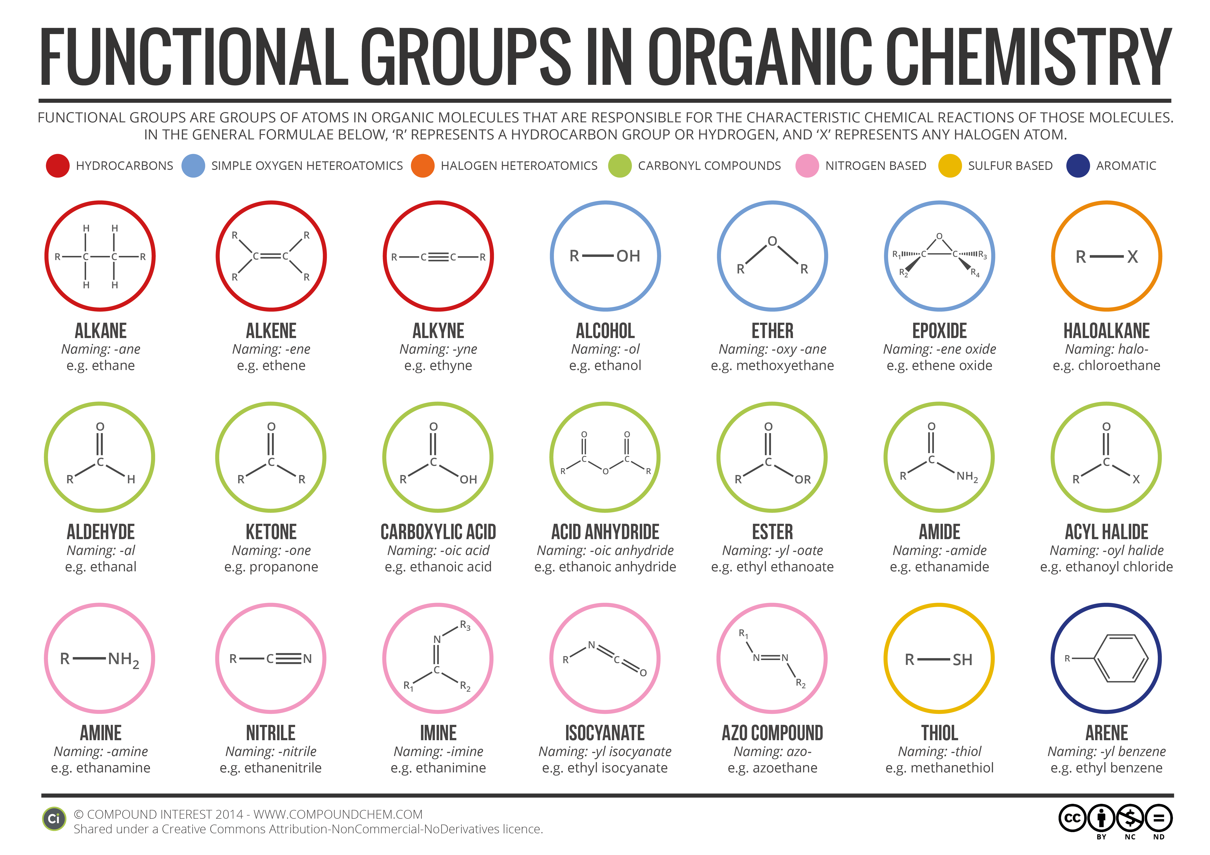
Common functional groups
compoundinterestchem.com

Slide 7
Alkanes, -enes, -ynes and arenes
The parts of a molecule that are not functional groups are the carbon backbone or carbon skeleton.
Structural scaffolding upon which functional groups are mounted and positioned.
Creates overall shape and stability.
Alkanes: hydrocarbons with single bonds; saturated with other atoms.
Alkenes and alkynes: hydrocarbons with double or triple bonds; unsaturated.
Arenes (aka aromatics): 6-carbon ring with alternating single & double bonds

Slide 8
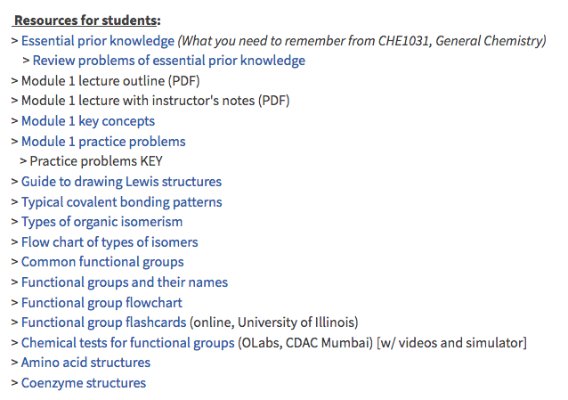
Common functional groups
Let’s turn to three handouts and a site (and games) for this information.

Slide 9
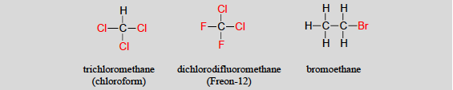
Alkyl halides (haloalkanes)
Alkyl halides: carbon structures with halogens attached
  Common in the lab but rare in nature
  Small molecules are easy to synthesize, useful and often harm human or environmental health
early anesthetic drug
used in organic synthesis
refrigerant that damages the ozone layer

Slide 10

Primary, secondary, tertiary groups
  Methyl: attached to a methyl group (1 carbon)
  Primary: bonded to a carbon with one carbon bond
  Secondary: bonded to a carbon with two carbon bonds
  Tertiary: bonded to a carbon with three carbon bonds
1º
2º
3º

Slide 11
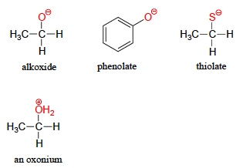
Deprotonated forms?
Deprotonation: when the hydroxyl group of an alcohol, phenol or thiol loses a proton (or hydrogen ion)
  Causes a negative charge
:
:
:
:
:
:
:
:
:
Protonation: when the hydroxyl group of an alcohol, phenol or thiol gains a proton (or hydrogen ion)
  Causes a positive charge
:

Slide 12
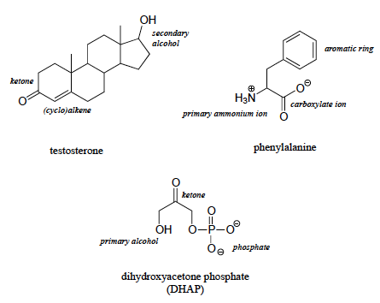
One molecule, many functional groups
:
:
:
:
:
:
:
:
:
:
:
:
:
:
:
:
:
:
:
:
:
:
:

Slide 13
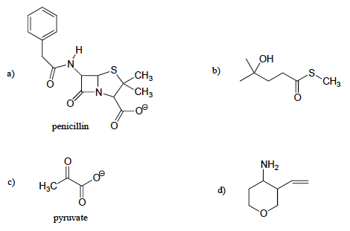
Try this:
Identify and label all functional groups (except alkanes).
Label alcohols and amines as primary, secondary or tertiary.
arene
amide
3º alcohol
thioether
:
:
:
:
:
:
:
:
:
:
:
:
ketone
:
:
:
thioester
:
:
:
carboxylic acid
1º amine
ketone
:
:
:
:
:
:
carboxylic acid
:
:
ether
:
:

Slide 14
Try this:
Draw line-bond structures, and show formal charges, for a compound with molecular formula C6H11NO that includes alkene, secondary amine, and primary alcohol functional groups.
H
N
..
..
O - H
..

Slide 15
Can you?
Define the term ’functional group’?
(2) Explain the importance of functional groups? Contrast the roles of
functional groups and carbon skeletons?
(3) Name all functional groups? (and protonated and deprotonated?)
(4) Name all functional groups containing _______ atoms? (O, N, S, P,
aromatic rings)
(5) Draw functional groups?
(6) Identify and name functional groups in larger molecules?

Slide 16
1. Intro to organic structure & bonding
  1.2B: Naming organic compounds
  Emphasis on drawing structures from IUPAC names

Slide 17
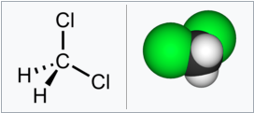
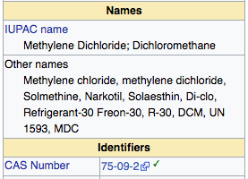
Naming systems
We’ll be focusing on the IUPAC (International Union of Pure and Applied Chemistry) naming system here.
Note that most chemical compounds have scores of aliases or common names. We’ll cover a few, but focus on IUPAC.
Dichloromethane is a tiny molecule.
It’s used as a solvent; once used to decaffeinate coffee
https://en.wikipedia.org/wiki/Dichloromethane
Yet, even tiny dichloromethane has multiple common names.
Names can be so numerous that a number, the CAS number, is used to officially identify each known chemical.

Slide 18
Alkanes start with the longest chain
Methane
Ethane
Propane
Butane
Pentane
Hexane
Heptane
Octane
Nonane
Decane
1 carbon
These molecules are simple, & so are their
names…. It will get more complicated.
All alkanes have an –ane suffix.
2 carbons
3 carbons
4 carbons
Each of these alkanes (> 3
carbons) has a cyclo- version, a ring, as well.
5 carbons
6 carbons
7 carbons
8 carbons
9 carbons
10 carbons
Alkanes are saturated because each carbon is bonded to four different atoms. Alkanes have no multiple bonds.

Slide 19

Ring structures are ‘cyclo’
When alkanes form rings rather than linear chains, add the prefix, ’cyclo’.
Since these rings have only single bonds, they are all alkanes and have an –ane suffix.
Cyclo ______ ane
Molecular formulas: Why do their formulas differ?
Linear or branched alkanes CnH2n+2
Cycloalkanes CnH2n
Terminal H are removed to join the carbons at either end and create the ring.

Slide 20

Alkenes?
Alkenes have an –ene suffix and the position of the double bond is numbered.
Number from the end closest to the multiple bond.
Multiple multiple bonds are quantified with prefixes just before the –ene or –yne suffix.
Molecular formulas: Why do their formulas differ?
Linear or branched alkanes CnH2n+2
Cycloalkanes CnH2n
Alkenes CnH2n
Terminal H are removed to join the carbons at either end and create the ring.
Each double bond eliminates two hydrogen atoms: one on each end of the double bond.

Slide 21
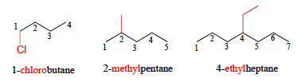
Substituents
Substituents: branches or groups that ‘decorate’ the main chain
Rules:
Find the longest carbon chain.
Number the chain from the end closes to the substituent.
The root name is based on the length of the longest carbon chain.
Each substituent is numbered for it’s position and named for it’s structure.
Number-dash-name_root

Slide 22
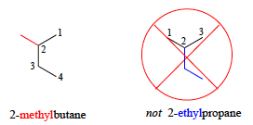
What is wrong here?
Why is the first name correct and the second incorrect?
The longest carbon chain in this molecule is 4-carbons, so the molecule’s root name is butane.

Slide 23
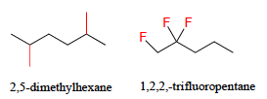
Multiple, identical substituents?
In the case of multiple and identical substituents, use prefixes to quantify the
number of substituents.
di 2
tri 3
tetra 4
penta 5
hexa 6
hepta 7
octa 8
nona 9
deca 10

Slide 24

Try this:
Name this branched alkane.
Steps:
Find the longest carbon chain.
Number the chain from the end closes to the substituent.
The root name is based on the length of the longest carbon chain.
Each substituent is numbered for it’s position and named for it’s structure.
Number-dash-name_root
methyl
7
Notice that branches (substituents) are listed (named) in alphabetical order: ethyl > methy
4
5
methyl
3
Dimethyl tells the reader that the molecule has two methyl groups.
1
ethyl
3-ethyl
-4,5-dimethyl
heptane

Slide 25
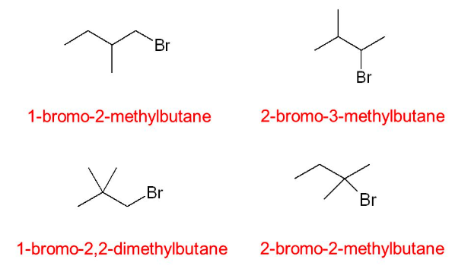




Multiple, different substituents?
In the case of multiple, different substituents:
Identify the longest carbon chain.
Number from the end closest to any substituent.
Name substituents in alphabetical order.
1-bromo-2-methylbutane
2-bromo-3-methylbutane
1-bromo-2,2-dimethylpropane
2-bromo-2-methylbutane

Slide 26

Functional groups add suffixes
Suffixes identify the molecule’s chief functional groups.
Both molecule’s have a 5-carbon backbone: ‘pent’.
:
:
:
:
Alcohol’s hydroxyl group is located and identified with the suffix, ‘-ol’.
Ketone’s carbonyl group is located and identified with the suffix, ‘-one’.

Slide 27

Terminal functional group suffixes
Some functional groups are terminal, found only on the ends of chains.
These groups don’t need to be located with numbers, as their ‘end’ is always numbered as ‘1’.
The ‘1-’ is assumed and therefore optional.
:
:
:
:
:
:
:
:
:
:
:
1-
1-
1-
aldehyde = ‘-al’
carboxylic acid = ‘-ic acid’
deprotonated carboxylic acid = ‘-ate’

Slide 28

Ethers and thioethers (sulfides)
Esters and sulfides are named for the groups found on either side of the ‘central’ oxygen or sulfur atoms.
1-
:
:
:
:
:
:
(dimethylthioether)

Slide 29
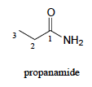
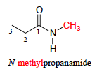
Amides
Terminal amides are named for the amide functional group.
1-
:
:
:
The names of substituted amides begin with the amide group’s substituent.
:
:
:
The ’N’ tells you where the next group is joined to the molecule.

Slide 30

Esters
Esters are named with the suffix ‘-oate’.
  The substituent attached to the single-bonded oxygen is named first.
:
:
:
:
:
:
:
:

Slide 31
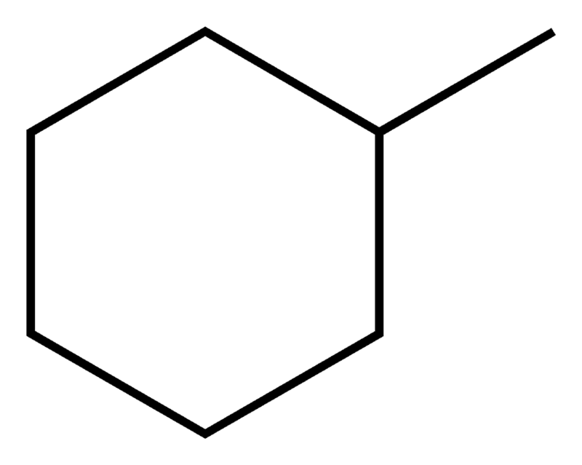

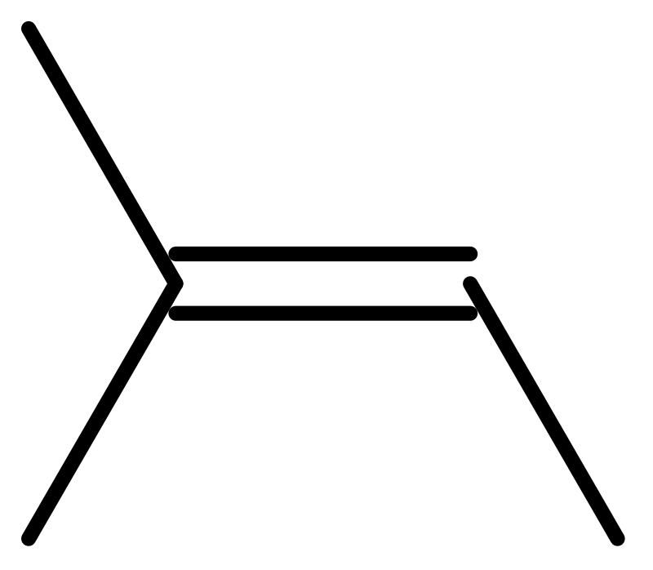
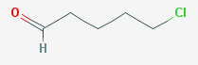
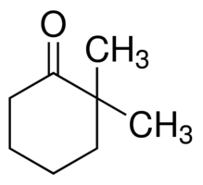
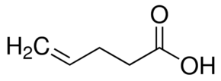
Try these:
Draw line-bond structures for these organic molecules:
(a) methylcyclohexane
(b) 5-methyl-1-hexanol
(c) 2-methyl-2-butene
(d) 5-chloropentanal
(e) 2,2-dimethylcyclohexanone
(f) 4-pentenoic acid
(g) N-ethyl-N-cyclopentylbutanamide

Slide 32
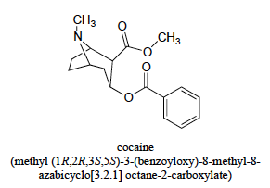
IUPAC becomes complicated…
… as molecules get larger.
1-
:
:
:
:
:
:
:
:
:
And it’s easy to see why common names take over in biochemistry and biology.

Slide 33
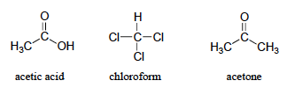
Simple common names
Here are the common names of a few, commonly used, small molecules.
1-
:
:
:
:
:
:
:
:
:
:
:
:
:
:
:
1,1,1-trichloromethane
ethanoic acid
dimethylketone
or propan-2-one
What are their IUPAC names?

Slide 34
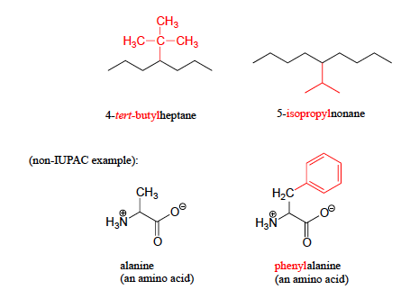
Examples of common names
:
:
:
:
:
:
:
:
:
:

Slide 35
Can you?
Explain the basic rules for naming alkanes, cycloalkanes, alkenes and alkynes?
(2) Explain which has priority in naming: longest chain, substituents, numbers,
letters?
(3) Associate functional groups with their suffices?
**(4) Draw line-bond structures from IUPAC names?
(5) Understand that common names also exist?

Slide 36
1. Intro to organic structure & bonding
  1.2C: Abbreviated organic structures
      R
      breaks

Slide 37

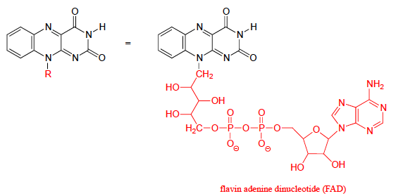
Abbreviating structure with ‘R’
In order to focus attention on one part of a large molecule, and to save time, the letter R is used as a stand in for part of the molecule’s structure.
Here R allows us to focus on the nature of the functional group.
:
:
:
:
:
:
:
:
:
:
:
:
:
:
:
:
:
:
:
:
:
:
:
:
:
:
:
:
:
:
:
:
:
:
:
:
Why R?
There is no R in the periodic table.
:
:
:
:
:
:
:
:
:
:
:
:
:
:
:
:
:
:
:
:

Slide 38
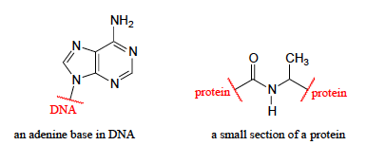
Abbreviating structure with ‘breaks’
In order to focus attention on one part of a large molecule, and to save time, ‘breaks’ and words can be used to describe parts of molecules.
Breaks are commonly used for polymers or structures with internal repeats.
:
:
:
:
:
:
:
:

Slide 39
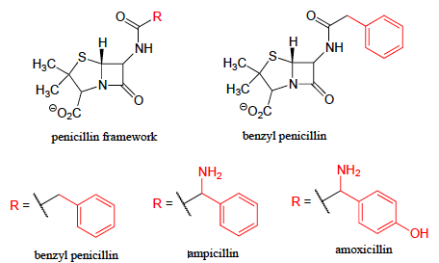
Example: related molecules
:
:
:
:
:
:
:
:
:
:
:
:
:
:
:
:
:
:
:
:
:
:
:
:
:

Slide 40
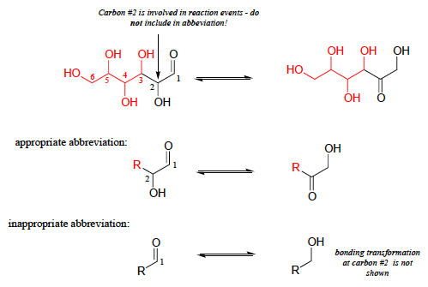
Example: reaction mechanisms
:
:
:
:
:
:
:
:
:
:
:
:
:
:
:
:
:
:
:
:
:
:
:
:
:
:
:
:
:
:
:
:
:
:
:
:

Slide 41
Try this:
If you intend to draw out the chemical details of a reaction in which the methyl ester functional group of cocaine was converted to a carboxylate plus methanol, what would be an appropriate abbreviation to use for the cocaine structure (assuming that you only wanted to discuss the chemistry specifically occurring at the ester group)?
:
:
:
:
:
:
:
:
:
:
:
R
:
:

Slide 42
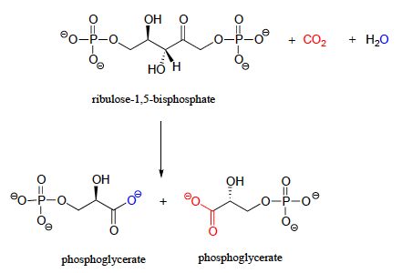
Try this:
Below is the (somewhat complicated) reaction catalyzed by an enzyme known as 'Rubisco', by which plants 'fix' carbon dioxide. Carbon dioxide and the oxygen of water are colored red and blue respectively to help you see where those atoms are incorporated into the products.
Propose an appropriate abbreviation for the starting compound (ribulose 1,5-bisphosphate), using two different 'R' groups, R1 and R2.
:
:
:
:
:
:
:
:
:
:
:
:
:
:
:
:
:
:
:
:
:
:
:
:
:
:
:
:
:
:
:
:
:
:
:
:
:
:
:
:
:
:
:
:
:
:
:
:
:
:
:
:
R1
R2
:
:
:
:
:
:
:
:
:
:
:
:
:
:
:
:
:
:
:
:
:
:
:
:
:
:
:
:
:
:
:
:
:
:
:
:
:
:
:
:

Slide 43
Can you?
Explain why ‘R’ or breaks are used to abbreviate large, complicated structures?
(2) Explain when breaks are more appropriate than R?
(3) Abbreviate large molecules while showing the critical structures involved in
reactions?

