Slide 1
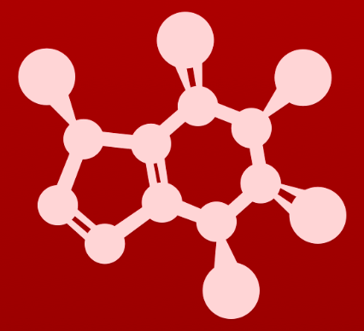
CHE 2060: Principles of Organic Chem
1. Introduction to organic structure & bonding
1.1: Drawing organic structures
A. Formal charge
B. Common bonding patterns
C. Using ‘line structure’ (aka line-bond) convention
D. Constitutional (aka structural) isomers
1.2: Functional groups & organic nomenclature
A. Functional groups in organic compounds
B. Naming organic compounds
C. Abbreviating structural drawings
1.3: Structures of some important biological molecules
A. Lipids
B. Biopolymer basics
C. Carbohydrates
D. Amino acids & proteins
E. Nucleic acids (DNA & RNA)

Slide 2
1. Intro to organic structure & bonding
Big ideas:
Functional groups are where the action is.
Drawing and understanding molecular structures is a critical skill.

Slide 3
1. Intro to organic structure & bonding
1.3 Structures of important classes of biomolecules
A. Lipids
B. Biopolymer basics
C. Carbohydrates
D. Amino acids & proteins
E. Nucleic acids (DNA & RNA)
……..sidebar…………….…...

Slide 4
1. Intro to organic structure & bonding
1.3A Lipids
Fatty acids
Triacylglycerols
Membrane lipids (phospholipids)
Waxes
Isoprenoids
……..sidebar…………….…...

Slide 5
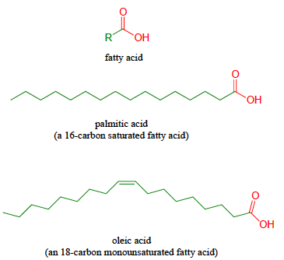
Fatty acids
Fatty acids: hydrocarbon chains ending in carboxylic acid groups (or carboxylate groups)
Saturated: single bonds only; carbons saturated with other atoms
Monounsaturated: one double bond
Polyunsaturated: multiple double bonds (mainly cis)
:
:
:
:
:
:
……..sidebar…………….…...
:
:
:
:
:
:
:

Slide 6
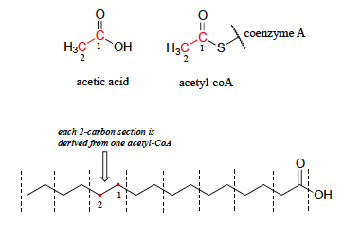
Metabolized 2-by-2
Fatty acids are made (elongated) and degraded (shortened) by 2-carbon units.
2-carbon units are derived from acetic acid…
… and carried by co-enzyme A via a thioester linkage.
When the body uses fat, these 2-carbon units produce energy (ATP) via the citric acid cycle (TCA, aka Krebs cycle).
:
:
:
:
:
:
:
:
……..sidebar…………….…...
:
:
:
:

Slide 7
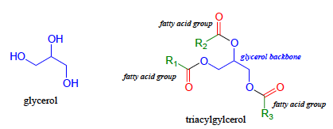
Triacylglycerols
Many common fats and oils are triacylglycerols (TAGs), lipids that store three fatty acid chains by linking them to a glycerol backbone with ester (or acyl) linkages.
Plant oils are TAGs.
Animal fats (the white stuff in meat) are TAGs.
:
:
:
:
:
:
:
:
:
……..sidebar…………….…...
:
:
:
:
:
:
:
:
:
Can you find the ester (or acyl) bonds?

Slide 8
Many lipids are amphipathic
Many lipids, particularly those that form biological membranes, are amphipathic: have dual natures, or hydrophilic and hydrophobic regions.
Hydrophilic: water loving, or polar
Structures that associate with water
Hydrophobic: water fearing, or nonpolar
Structures that associate with lipids
:
:
……..sidebar…………….…...
:
:
:
:
:
:
:
:
:
:
:
This is a phospholipid or diacylglycerol:
Polar, hydrophilic head group
Two nonpolar, hydrophobic fatty acid tails
:
:
:
:

Slide 9
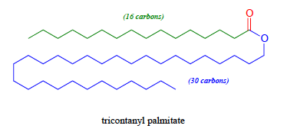
Waxes
Waxes: fatty acids linked to long-chain alcohols via an ester linkage
Hydrophobic
Used by insects to store extra energy:
Beeswax is tricontanyl palmitate.
Wax is what’s left on your windshield after bugs go splat.
:
:
:
:
……..sidebar…………….…...

Slide 10
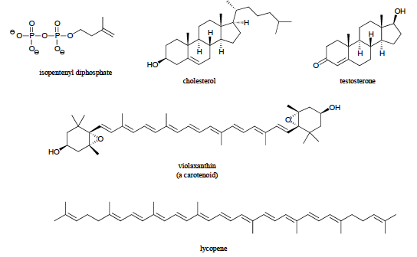
Isoprenoids
Isoprenoids: lipids based on a 5-carbon, branched isoprene unit
Largely hydrophobic
Animals: cholesterol, related hormones like testosterone, estradiol
Plants: lycopene (red of tomatoes), carotenoids (leaf colors)
……..sidebar…………….…...

Slide 11
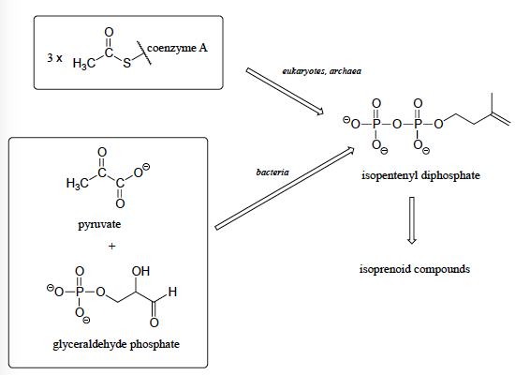
Isoprenoid synthesis
While isoprenoid molecules are pretty ubiquitous, species make them differently
……..sidebar…………….…...

Slide 12
Can you?
List different types of lipids?
(2) Explain how fatty acids are built from 2-carbon units?
(3) Define the terms ‘amphipathic’, ‘hydrophilic’ and ‘hydrophobic’?
……..sidebar…………….…...
(4) List the important parts of triacylglycerols, membrane lipids, waxes and isoprenoids?

Slide 13
1. Intro to organic structure & bonding
1.3B Biopolymer basics
……..sidebar…………….…...

Slide 14
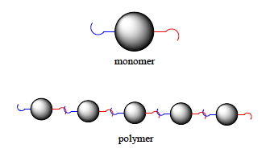
Biopolymers
Many biomolecules, like carbohydrates, proteins and nucleic acids, are polymers: long chains made by connecting identical, or similar, units with chemical bonds.
Monomers: the smaller units that polymers are built from
Links: the chemical bonds that connect monomers
……..sidebar…………….…...
Can you give my examples of common biopolymers?

Slide 15
Can you?
Define the terms ‘polymer’, ‘monomer’ and ‘linkage’?
(2) Give examples of common biopolymers?
……..sidebar…………….…...

Slide 16
1. Intro to organic structure & bonding
1.3C Carbohydrates
Monosaccharides
Disaccharides
Polysaccharides
……..sidebar…………….…...

Slide 17
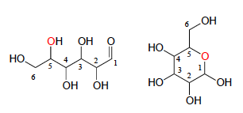
Carbohydrates, monosaccharides
Carbohydrates: ‘hydrated carbons’; commonly called sugars and starches
Monosaccharides: (sugars) 4-6-carbon molecules with multiple alcohols and one aldehyde or ketone
Hydrophilic
Often equilibrium exits between open and cyclic forms
:
:
:
:
:
:
:
:
:
……..sidebar…………….…...
:
:
:
:
:
:
:
:
:
:
:
:
:
:
:
open chain form cyclic form

Slide 18
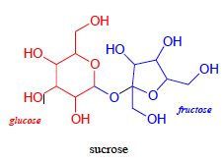
Disaccharides
Disaccharides: two monosaccharides linked together
:
:
:
:
:
:
:
:
:
:
:
:
:
:
:
:
:
:
:
:
……..sidebar…………….…...
:
:
What type of bond links the monosaccharides?
This is a variation of an ether bond called an acetal bond or a glycosidic linkage.

Slide 19
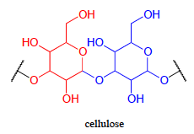
Polysaccharides
Polysaccharides: many monosaccharides linked together
Cellulose: many glucose monomers linked together
The most common organic molecule
:
:
:
:
:
:
:
:
:
:
:
:
repeat
repeat
……..sidebar…………….…...
:
:
:
:
:
:
:
:
:
:
:

Slide 20
Can you?
Describe how one could recognize a monosaccharide?
(2) Define the terms ‘monosaccharide’, ’disaccharide’ and ‘polysaccharide’?
(3) Name the world’s most common biomolecule?
……..sidebar…………….…...

Slide 21
1. Intro to organic structure & bonding
1.3D Amino acids and proteins
……..sidebar…………….…...

Slide 22
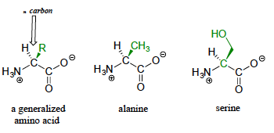
Amino acids
Amino acids: the building blocks of proteins
Four parts:
Amino group
Central ⍺-carbon
Carboxy group
Unique side chains (R)
20 natural amino acids
R is often a functional group
⍺-carbon
……..sidebar…………….…...
:
:
:
:
:
:
:
:
:
:
:
:
:
:
:
:
:

Slide 23
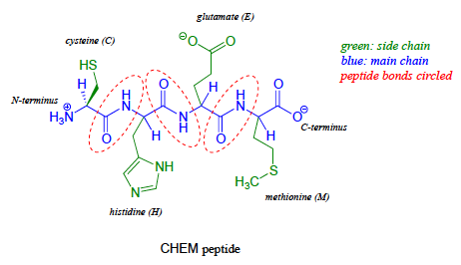
Proteins
Proteins: polymers of amino acids linked by amide (aka peptide) bonds
Peptides: short protein chains
:
:
:
:
:
:
:
:
:
:
:
:
:
……..sidebar…………….…...
:
:
:
:
:
:
:
:
:
:
:
:

Slide 24
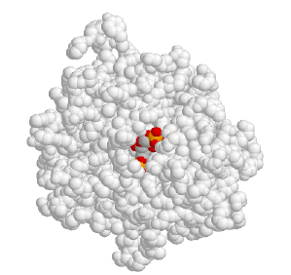
Enzymes: examples of folded proteins
Enzymes: proteins that catalyze biochemical reactions
Like all proteins, enzymes must be properly folded into the correct 3D shape to have function.
Function often involves changes in shape.
1,6-bisphosphate aldolase enzyme with its substrate bound in the active site ‘pocket’
……..sidebar…………….…...

Slide 25
Can you?
List the four parts of an amino acid molecule?
(2) Define the terms ‘peptide’ and ‘protein’?
(3) Remember what has to happen before proteins can function?
……..sidebar…………….…...

Slide 26
1. Intro to organic structure & bonding
1.3E Nucleic acids
DNA
RNA
……..sidebar…………….…...

Slide 27
Nucleic acids
Nucleic acids: polymers of nucleotide monomers
DNA (deoxyribonucleic acid): polymers of A,T, G, C monomers
RNA (ribonucleic acid): polymers of A, U, G, C monomers
:
:
:
:
:
:
:
:
:
:
:
:
:
:
……..sidebar…………….…...
:
:
:
:
:
:
:
These five bases encode all of the molecules needed for the structures of all organisms.
:
:
:
:
:

Slide 28
Nucleotides = base + sugar + phosphate
Nucleotides: add a ribose sugar and a phosphate to a base
Polymerizing nucleotides produces strands of nucleic acids
:
:
:
:
:
:
:
:
:
:
:
:
:
:
:
:
:
:
:
:
:
:
:
:
:
:
:
:
:
:
:
:
……..sidebar…………….…...
:
:
:
:
:
:
:
:
:
:
The difference between DNA and RNA is the presence (RNA) or absence (DNA) of the hydroxyl group at carbon 2 of the ribose.

Slide 29
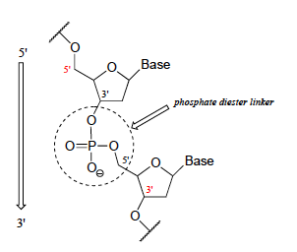
Nucleic acid polymers
Nucleic acids polymerize when a phosphodiester bond forms between the 5’ phosphate of one ribose and the 3’ hydroxyl group of another.
:
:
:
:
:
:
……..sidebar…………….…...
:
:
:
:
:
:
:
:
:
:
:
So the two ends of a nucleic acid polymer are different and are referred to as ‘5 prime’ and ‘3 prime’ ends.

Slide 30
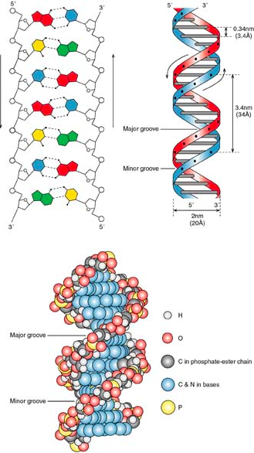
DNA double helix
DNA forms a double helix when two nucleic acids running in opposite directions join at the bases.
The joined bases, called base pairs, form the rungs of the double helical ladder.
……..sidebar…………….…...
http://pratclif.com/biologie-moleculaire/dna/helix.html

Slide 31
Can you?
Define the terms ‘nucleic acid’ and ‘nucleotide’?
(2) Describe the essential chemical difference between RNA and DNA?
(3) List the four bases of RNA and the four bases of DNA?
……..sidebar…………….…...
(4) Describe the linkage between adjacent nucleotides in a strand of nucleic acid polymer?
(5) Describe a DNA double helix, specifically describing the parts of the two strands that join together?

