Slide 1
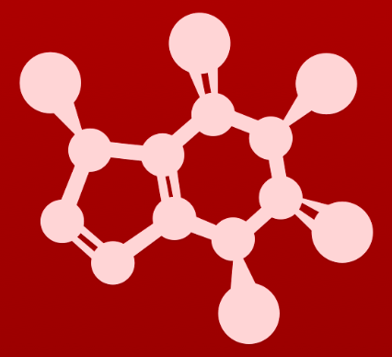
CHE 2060: Principles of Organic Chem
2. Introduction to organic structure & bonding, II
2.1: Covalent bonding in organic molecules
A. The σ bond in the H2 molecule
B. sp³ hybrid orbitals and tetrahedral bonding
C. sp² and sp hybrid orbitals and π bonds
2.2: Molecular orbital theory
A. Another look at the H2 molecule using MO theory
B. MO theory and conjugated π bonds
C. Aromaticity
2.3: Resonance
A. What is resonance?
B. Resonance contributors for the carboxylate group
C. Rules for drawing resonance structures
D. Major vs minor resonance contributors
2.4: Non-covalent interactions
A. Dipoles
B. Ion-ion, dipole-dipole, ion-dipole interactions
C. Van der Waals forces
D. Hydrogen bonds
E. Noncovalent interactions and protein structure
2.5: Physical properties of organic compounds
A. Solubility
B. Boiling and melting points
C. Physical properties of lipids and proteins
VSEPR

Slide 2
2. Intro to organic structure & bonding II
Big ideas?
Orbitals hybridize to allow atoms to form varied structures and geometries.
Resonance extends the idea of the probable location of electrons from atoms to molecules, and provides unexpected stability.

Slide 3
2. Intro to organic structure & bonding II
2.1: Covalent bonding in organic molecules
A. The σ bond in the H2 molecule
B. sp3 hybrid orbitals and tetrahedral bonding
C. sp2 and sp hybrid orbitals and π bonds

Slide 4
2. Intro to organic structure & bonding II
2.1A: The σ bond in the H2 molecule
Process
Energetics
Length & strength
Orbitals, not sticks

Slide 5
Valence bond theory
In valence bond theory, bonds form when two atomic orbitals overlap.
This brings two atoms together.
And the covalent bond forms when each shares one electron.
This concept is most easily understood using unhybridized s and p orbitals.
Here we can see that the hydrogen gas molecule (H2) forms when two hydrogen atoms approach, make contact and overlap.
Once they overlap, the two atoms share their single electrons (↑↓) form a shared electron pair, or covalent bond.

Slide 6
Energetics for bond formation
As two atoms approach, they begin to exert forces upon each other.
3. If the atoms get too close, strong repulsion occurs: nucleus to nucleus.
Bond lengths are unique to each type of bond.
2. After initial repulsion is overcome, the + nucleus of one atom is attracted to the – electrons of the other.
This happens at the optimal bonding distance.
1. Their valence shells repel each other, causing higher than optimal energy levels.

Slide 7
Examples of bond length & strength
Here are a few examples of covalent bond lengths and energies (strengths).
Notice these trends:
the number of bonds decreases bond length; but
Increases bond energies
But, bond lengths and strengths depend on the nature of the bonded atoms.
Bond | Length (pm)
H – H | 74
C – H | 109
C – C | 154
C = C | 134
C = C | 120
C - O | 143
C = O | 120
C = O | 113
energy (kJ/mol)
432
411
346
602
835
358
799
1072
=
=

Slide 8
Bonds: orbitals rather than sticks
Rather than thinking of covalent bonds as sticks between atoms, we should think of bonds as the shapes (probabilities) formed by overlapping atomic orbitals.
These are molecular orbitals: mathematical functions describing the wave-like behavior of an electron in a molecule.
H - H
Sigma (σ) bonds are single covalent bonds formed by the overlap of orbitals.
Shared pair of electrons
Cylindrical shape
Free rotation
H - F
F - F

Slide 9
Can you?
(1) Define the term ‘covalent bond’?
(2) Describe the process, and forces, occurring as two atoms approach and bond?
(3) Describe the energetics of covalent bond formation?
(4) Describe the range of covalent bond lengths and strengths?
(5) Draw overlapping s or p orbitals to create a more realistic image of
covalent bonding?

Slide 10
2. Intro to organic structure & bonding II
2.1B sp³ hybrid orbitals & tetrahedral bonding
Hybridization allows methane
Slot-arrow diagrams
VSEPR
Dash-wedge ‘3D’ drawings
Free rotation around σ bonds

Slide 11
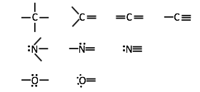
How: one configuration many patterns?
How can carbon (and oxygen, nitrogen, sulfur, etc.,.) have just a single ground state electron configuration but many bonding patterns that allow no formal charge?

Slide 12
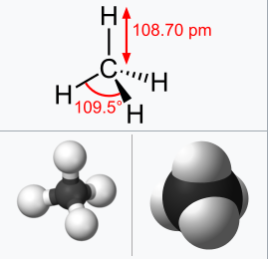
Methane: a contradiction?
Remember the valence electron configuration of carbon?
Is²2s²2p²
Now think about methane, CH4.
Draw it’s Lewis dot structure.
Build a molecular model.
Experimental work shows that:
Methane has a tetrahedral geometry.
Its four C-H bonds have equal lengths and strengths.
So, how can electrons in different orbitals form equivalent bonds?
https://en.wikipedia.org/wiki/Methane

Slide 13
Hybrid orbitals explain methane
If the orbitals of carbon are hybridized we can explain the structure of methane and all other carbon-based molecules.
Once hybridized, all four of carbon’s electrons occupy identical (sp³) orbitals with identical energy levels.
Thus, they can form equal bonds with hydrogen.
Tetrahedral:
All angles are 109.5º.
http://www.chemtube3d.com/orbitalshybrid.htm

Slide 14
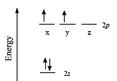
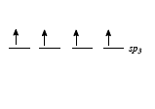
A closer look at sp³ hybridization
Using slot-arrow diagrams can help explain how hybridization works.
σ σ σ σ
unhybridized carbon
sp³ hybridized carbon
Unhybridized carbon cannot form – or explain – methane’s four equal bonds.
Instead, all four of carbon’s electrons must be in identical orbitals.
All four orbitals (1s and 3p) are ‘blended’ to create four equal orbitals with identical energy levels.
sp³ = 1s + 3p
sp³ energy level is much closer to p than to s.

Slide 15
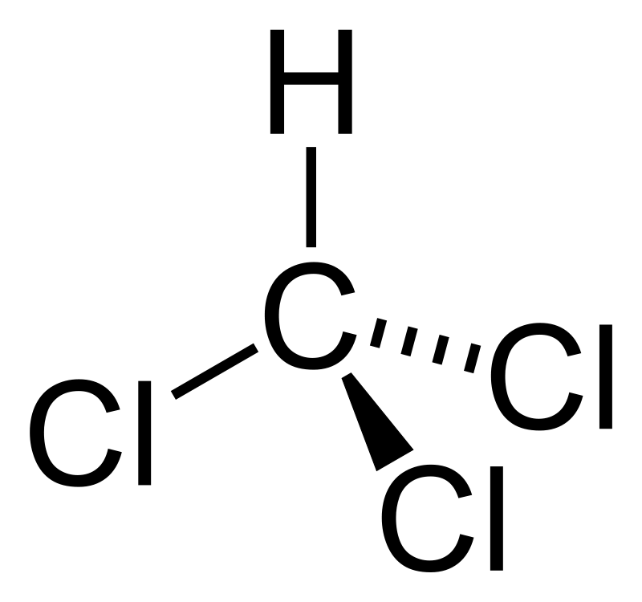
Try this:
What types of orbitals overlap to form chloroform, trichlormethane (CHCl3)?
C: 2s²2p² → hybridizes to four 2sp³ orbitals
H: 1s¹
Cl: 3s²2p⁵
Bonds:
C – H = sp³ – s
C – Cl = sp³ - p
:
:
:
:
:
:
:
:
:

Slide 16
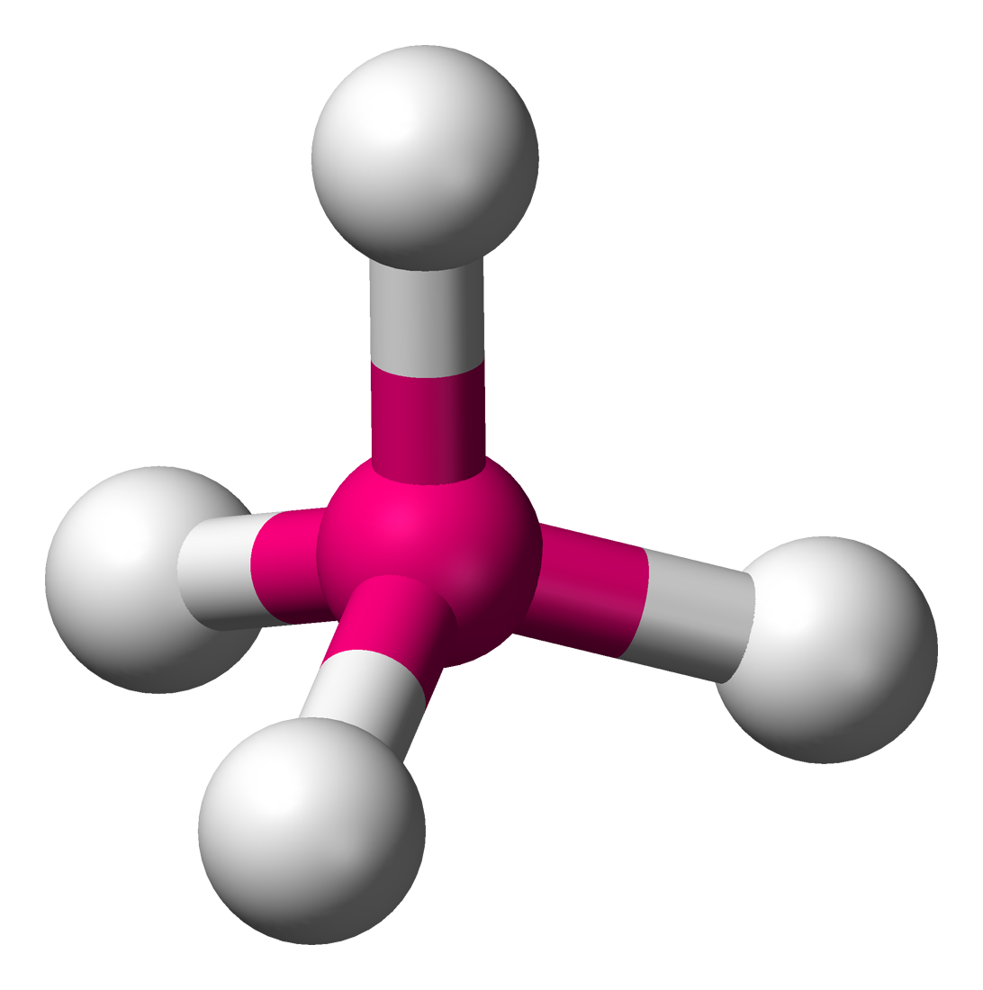
VSEPR explains geometry
Hybrid orbital geometry is dictated by VSEPR (valence shell e- pair repulsion)
“Since e- pairs occupying orbitals are all negatively charged they repel each other & therefore occupy spaces as far from other pairs as possible.”
https://en.wikipedia.org/wiki/VSEPR_theory

Slide 17
Using VSEPR
# lone e- pr | # atoms bonded | e- pair geometry |  | Molecular geometry | Bond Angle (°)
0 | 2 | linear |  | linear | 180
0 | 3 | trigonal planar |  | trigonal planar | 120
1 | 2 | trigonal planar |  | bent | < 120
0 | 4 | tetrahedral |  | tetrahedral | 109.5
1 | 3 | tetrahedral |  | trigonal pyramidal | < 109.5
2 | 2 | tetrahedral |  | bent | <109.5
0 | 5 | trigonal bipyramidal |  | trigonal bipyramidal | 90, 120, 180
1 | 4 | trigonal bipyramidal |  | seesaw | 90, 120, 180
2 | 3 | trigonal bipyramidal |  | T-shaped | 90, 180
3 | 2 | trigonal bipyramidal |  | linear | 180
0 | 6 | octahedral |  | octahedral | 90, 180
1 | 5 | octahedral |  | square pyramidal | 90, 180
2 | 4 | octahedral |  | square planar | 90, 180
sp
sp²
sp³
sp³d
sp³d²
http://intro.chem.okstate.edu

Slide 18
Dash-wedge drawings are ‘3D’
So, how do we show 3D structure using 2D paper and pens, chalkboards or whiteboards?
Dash-wedge structures provide some 3D information.
Going back into the page
In the plane of the page
Coming up out of the page

Slide 19
Try this:
In a-c, the methane molecule shown at the right is rotated and flipped.
Draw the missing hydrogen atom labels. (Make a model!)

Slide 20
Try this:
Ethane is C2H6.
Draw the line-bond structure.
Use VSEPR to determine the orbital hybridization of the carbon atoms.
What is the molecular geometry?
Use dash-wedge to represent the molecule’s 3D structure.
VSEPR: Each carbon is bonded to four atoms and as no lone pairs.
So, both carbons are sp³ hybridized.
Both sides (or halves) of the molecule are tetrahedral.

Slide 21
Free rotation around sigma bonds
There is free rotation around all single (aka sigma, σ) bonds.
eclipsed staggered
So the hydrogens bonded to the two carbon atoms of ethane can either be lined up with one another (eclipsed) or staggered.
The speed and frequency of rotation increase as energy is added to a solution of molecules: heat, mixing, vibration, light, etc.,.
Build a model and rotate methyl groups to convert eclipsed to staggered.
Watch rotation of a space-filling model of ethane.
https://www.youtube.com/watch?v=V2pr7e9g3E4

Slide 22
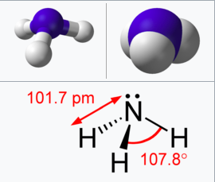
Other sp³ hybridizations
Amines, like ammonia, have sp3-hybridized nitrogen atoms.
Create a line-bond drawing of ammonia, NH3.
Use the VSEPR to determine the orbital hybridization of its nitrogen, its electron pair geometry and molecular geometry.
Use a dash-wedge drawing to show ammonia’s 3D structure.
Create a slot-arrow diagram to show how nitrogen’s valence electrons are sp³-hybridized.
VSEPR: 3 bonds, 1 lone pair
N is sp³ hybridized.
E pair geometry is tetrahedral.
Molecular geometry is trigonal pyramidal.
The lone pair closes the H’s angle.
https://en.wikipedia.org/wiki/Ammonia
http://www.chemtube3d.com/gallery/structurepages/nh3.html
↑
↑
↑
↑
↑
↑
↑
↑
..
σ
σ
σ
↑
↑
unhybridized
sp³ hybridized

Slide 23
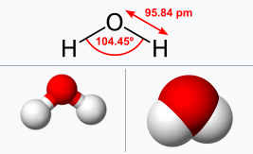
Other sp³ hybridizations
Water has an sp³-hybridized oxygen atom.
Create a line-bond drawing of water, H2O.
Use the VSEPR to determine the orbital hybridization of its oxygen, its electron pair geometry and molecular geometry.
Use a dash-wedge drawing to show water’s 3D structure.
Create a slot-arrow diagram to show how oxygen’s valence electrons are sp³-hybridized.
VSEPR: 2 bonds, 2 lone pairs
O is sp³ hybridized.
E pair geometry is tetrahedral.
Molecular geometry is bent.
The lone pairs closes the H’s angle.
https://en.wikipedia.org/wiki/Properties-of-water
↑
↑
↑
↑
↑
↑
↑
↑
↑
↑
Since all three atoms are in the same plane, there is no need for dashes or wedges.
..
..
σ
σ
↑
↑
unhybridized
sp³ hybridized

Slide 24
Can you?
(1) Explain why unhybridized carbon could not form four equivalent bonds?
(2) Describe how carbons orbitals are hybridized to form four equivalent sp³
orbitals?
(3) Define the term ‘VSPER’ and explain how it this concept determines
geometry?
(4) Differentiate between electron pair geometry and molecular geometry?
(5) Describe the effect of free electron pairs on molecular geometry?

Slide 25
2. Intro to organic structure & bonding II
2.1C: sp² and sp hybrid orbitals & π bonds
sp2 hybridization for double bonds
The π bond
Trigonal planar
Carbonyls and carbocations
sp hybridization for triple bonds
Two perpendicular π bonds
Linear
More acidic!

Slide 26
Ethene: we need a different model
Experimental data shows that the 2-carbon alkene, ethene:
Is flat, or planar;
Has bond angles of 120º rather than 109.5º;
Has C-C bond lengths of 134 pm rather than the 154 pm seen in ethane; and
Doesn’t have free rotation around the C=C double bond.
So sp³ hybridized carbons don’t explain this.
What does? sp² hybridized carbons!
VSEPR?
3 atoms bonded, no free pairs = sp² with trigonal planar geometry
The hybridized carbon needs to form three identical σ bonds (to C, H, H) and one double (aka π) bond.
So hybridize 3 orbitals
Leave an unhybridized p
↑
↑
↑
↑
↑
↑
↑
π
σ
σ
σ
↑
unhybridized
sp² hybridized

Slide 27
Formation of ethene from sp² carbons
sp² hybridized carbons form double bonds to make molecules like CH2CH2, ethene.
p+
p+
sp2
sp2
sp2
sp2
sp2
sp2
p-
p-
Each carbon has 3 trigonal planar hybridized sp² orbitals and an unhybridized p orbital that is perpendicular to the plane of the sp² orbitals.
Two of the sp² orbitals approach to overlap and bond.

Slide 28
Formation of ethene from sp² carbons
sp² hybridized carbons form double bonds to make molecules like CH2CH2, ethene.
p+
p+
sp2
sp2
sp2
sp2
sp2
sp2
p-
p-
sigma bond (σ)
The overlapping sp² orbitals form a sigma (single) bond between the carbons.

Slide 29
Formation of ethene from sp² carbons
sp² hybridized carbons form double bonds to make molecules like CH2CH2, ethene.
p+
p+
sp2
sp2
sp2
sp2
sp2
sp2
p-
p-
sigma bond (σ)
The overlapping sp² orbitals form a sigma (single) bond between the carbons.
The 2 unhybridized p orbitals bend in towards one another to share e-.

Slide 30
Formation of ethene from sp² carbons
sp² hybridized carbons form double bonds to make molecules like CH2CH2, ethene.
p+
sp2
sp2
sp2
sp2
sp2
sp2
http://www.chemtube3d.com/orbitalsethene.htm
p-
pi bond (π)
sigma bond (σ)
The parallel p orbitals “fuse” to form a π bond.
The π bond has both + and – lobe that sit further from the nucleus, above & below the sigma bond.
The π bond is the “second” bond of the double bond.
There is no rotational freedom around a π bond.

Slide 31
Extent of trigonal planar geometry
The trigonal planar geometry of alkenes extends only as far as the atoms directly bonded to the double-bonded carbons.
All red atoms are in the same plane.
Redraw the structures below, indicating the six atoms that lie in the same
plane due to the carbon-carbon double bond.
What is wrong with the way the structure of L-dopa is drawn?
The carbons of the aromatic ring, and all atoms directly connected to them, are planar and can’t come forward.

Slide 32
Carbonyl groups are also sp² hybridized
Formaldehyde is dominated by its carbonyl group.
σ
π
σ
σ
VSEPR shows that both the carbon and oxygen atoms are sp2 hybridized:
C: 3 bonded to, 0 lone pairs
O: 1 bonded to, 2 lone pairs
Geometry is trigonal planar.
The lone pairs are also c0-planar.
http://www.chemtube3d.com/orbitalsformaldehyde.htm

Slide 33
Try this:
Draw the bonding structure for the imine shown here. Include:
Dash-wedge;
Hybridization of carbon and nitrogen;
Electron pair geometry; and
Molecular geometry.
Dash-wedge isn’t necessary as all atoms are trigonal planar (coplanar).
VSEPR shows that both C and N are sp² hybridized.
C’s electron pair geometry and molecular geometry are trigonal planar.
N’s electron pair geometry is trigonal planar, but its molecular geometry is bent.

Slide 34
Try this:
Determine the hybridization of all carbons and label them so.
sp³ hybridized carbon
sp² hybridized carbon

Slide 35
Carbocations are sp² hybridized
This methyl carbocation’s carbon atom is sp² hybridized.
Bonded to three atoms; no lone pairs.
All atoms are trigonal planar.
There is an empty, unhybridized p orbital perpendicular to the atomic plane or the plane of the σ bonds.

Slide 36
Alkyne carbons are sp hybridized
Alkyne carbons, and nitrile carbons and nitrogens, are triple bonded.
VSEPR: 2 atoms bonded to; no lone pairs
Carbon is sp hybridized.
Electron pair and molecular geometries are linear.
The hybridized carbon needs to form two identical σ bonds (to C, H) and two π bonds.
So hybridize 2 orbitals
Leave 2 unhybridized ps
↑
↑
↑
↑
↑
↑
↑
π
π
σ
σ
↑
unhybridized
sp hybridized

Slide 37
Alkyne formation
p+
p+
π1
sp
sp
sp
sp
p+
sp
sp
p+
sp
sp
π2
p-
p-
π1
Two sp orbitals overlap to form a single or σ bond.
Two sets of parallel p orbitals bend toward one another & then “fuse” to form 2 perpendicular π bonds.
Each π bond has both + and – lobe that sit further from the nucleus, above & below the sigma bond.
The π bonds are the “second” & “third” bonds of the triple bond.
There is no rotational freedom around the bonded carbons.
http://www.chemtube3d.com/orbitalsacetylene.htm

Slide 38
Hybrid orbitals and bond length
Experimental observation shows that single bonds adjacent to multiple bonds are shorter and stronger than single bonds that sit next to other single bonds.
..
..
..
sp³
sp²
sp
Why?
S orbitals’ spherical shape places electrons closer to their nucleus, while the elongated shape of p orbitals keeps electrons further from the nucleus.
So, the more ‘s’ character hybridized orbitals have, the more tightly their electrons are held and the shorter and stronger the bonds they form.

Slide 39
Try this:
What kinds of orbitals are overlapping in bonds b-i indicated below?
Be sure to distinguish between σ and π bonds.
An example is provided for bond 'a'.
b: σ = overlap of N’s sp², C’s sp³
c: σ = overlap of sp² orbitals of
both Cs
π = overlap of unhybridized p
orbitals of both Cs
d: σ = overlap of sp² orbital of
the lower C with an sp³
orbital of the upper C
e: σ = overlap of sp³ orbitals of
both the C and the N

Slide 40
Can you?
(1) Understand that some, but not all, orbitals can be hybridized?
(2) Describe the relative geometry of various forms of hybridized s-p orbitals
with unhybridized p orbital?
(3) Describe how and why two neighboring unhybridized p orbitals form a π
orbital?
(4) Draw and describe the shape of a π orbital and the location of its electrons?
(5) Describe and draw the relative geometries of the σ and π bonds of double
and triple bonds?
(6) Explain why hybrid orbitals with more ‘s character’ hold their electrons
more tightly than those with more ‘p character’?

