Slide 1
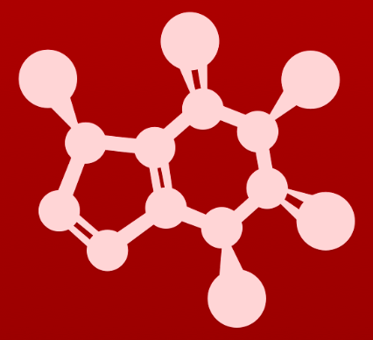
CHE 2060: Principles of Organic Chem
2. Introduction to organic structure & bonding, II
2.1: Covalent bonding in organic molecules
A. The σ bond in the H2 molecule
B. sp³ hybrid orbitals and tetrahedral bonding
C. sp² and sp hybrid orbitals and π bonds
2.2: Molecular orbital theory
A. Another look at the H2 molecule using MO theory
B. MO theory and conjugated π bonds
C. Aromaticity
2.3: Resonance
A. What is resonance?
B. Resonance contributors for the carboxylate group
C. Rules for drawing resonance structures
D. Major vs minor resonance contributors
2.4: Non-covalent interactions
A. Dipoles
B. Ion-ion, dipole-dipole, ion-dipole interactions
C. Van der Waals forces
D. Hydrogen bonds
E. Noncovalent interactions and protein structure
2.5: Physical properties of organic compounds
A. Solubility
B. Boiling and melting points
C. Physical properties of lipids and proteins
VSEPR

Slide 2
2. Intro to organic structure & bonding II
Big ideas?
Orbitals hybridize to allow atoms to form varied structures and geometries.
Resonance extends the idea of the probable location of electrons from atoms to molecules, and provides unexpected stability.

Slide 3
2. Intro to organic structure & bonding II
2.2: Molecular orbital theory
A. MOT: molecular orbital theory
B. Conjugated π bonds
C. Aromaticity

Slide 4
2. Intro to organic structure & bonding II
2.2A: Another look at H2 using molecular orbital theory
# atomic orbtials = # molecular orbitals
Bonding orbital fill, anti-bonding orbitals don’t
MO: constructive & destructive wave functions

Slide 5
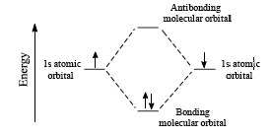
Bonding and antibonding… huh?
When two atomic orbitals overlap, two molecular orbitals are formed.
The bonding MO has a lower energy level than the antibonding MO. The lower energy orbital (bonding) is occupied.
H atom
H atom
H2
Notice that when the two H atoms bond, the overall energy state drops. The molecule, H2, forms because it allows the atoms to be in a lower energy state.
Lower energy states rule!
Dailey & Dailey

Slide 6
Molecular orbital theory
Molecular orbital theory (MOT): molecular orbitals describes the space around two or more bonded atoms in which their valence electrons are likely to be found.
This view of bonding explains the special properties of resonance, critical in many organic compounds and reactions.
1. # molecular orbitals = # atomic orbitals
2. e- pairs fill the lower energy MO, the bonding orbital
atomic orbitals
H & H
molecular orbitals
H2

Slide 7
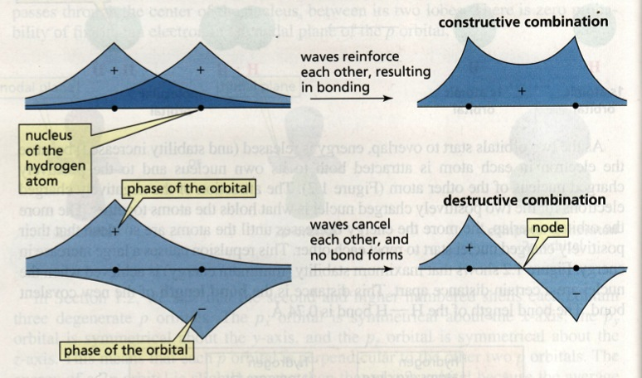
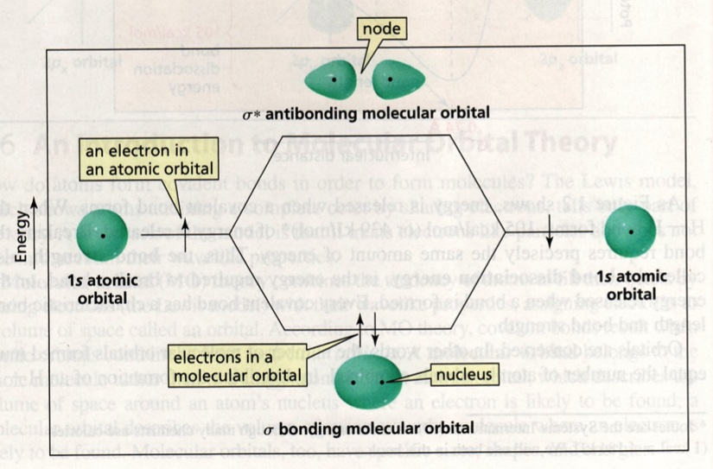
Think about wavicles
When electron waveicles combine constructively they produce a bonding orbitals: areas of high electron probability.
But destructive interaction cancels out, probability: antibonding orbital or node.
Notice that a node separates the nuclei of the two atoms in the anti-bonding orbital, while the bonding orbital allows the two nuclei to share electrons.
Bruice (2007)

Slide 8
Can you?
(1) Define the term ‘molecular orbital’?
(2) Predict the number of a compound’s molecular orbitals from the
number of its atomic orbitals?
(3) Draw diagrams of the shapes of bonding molecular orbitals vs.
anti-boding molecular orbitals?
(4) Draw energy diagrams of the bonding molecular orbitals vs.
anti-bonding molecular orbitals that explain why bonding orbitals fill
while anti-bonding orbitals don’t?
(5) Describe how constructive and destructive wave interference
contribute to the formation of bonding vs. anti-bonding molecular
orbitals?

Slide 9
2. Intro to organic structure & bonding II
2.2B: Conjugated π bonds
Conjugation affects singles in between
Conjugation increases stability
‘resonance-ish’
π are parallel p MOs [sidebar]

Slide 10
Conjugated double bonds?
Conjugated double bonds: double bonds alternate with single bonds
Conjugation increases the stability of double bonds.
Remember that energy decreases as stability increases.
Isolated double bonds are less stable.

Slide 11
Conjugated examples
Note that the systems of conjugated bonds can involve atoms other than carbon.

Slide 12
Try this:
For each of these molecules:
Identify all the conjugated bonds.
Count the number of overlapping p orbitals.
Count the number of electrons involved in π bonds.
No conjugated bonds
Conjugated bonds:
3 conjugated bonds on the left
6 overlapping p orbitals
6 electrons, one per p
2 conjugated bonds on the right
4 overlapping p orbitals
4 electrons, one per p

Slide 13
Try this:
This is lycopene, the molecule that gives tomatoes their red color.
It’s also thought to have health benefits, perhaps as an antioxidant.
Identify all the conjugated bonds.
Identify all isolated double bonds.
Count the number of π electrons involved in conjugated bonds.
isolated
conjugated
22 π e-
isolated
isolated

Slide 14
How do conjugated bonds behave?
Conjugated double bonds: double bonds alternate with single bonds
Expected?
Free rotation around the single, not double bonds.
Single bond = 154 pm
Double bond = 134 pm
Experimental observations:
The single bond doesn’t want to rotate
Single bond = 148 pm
1,3-butadiene
So what’s happening with these conjugated bonds?
The electrons in the π bond delocalize, or spread out, over the neighboring single bonds, giving them some ‘double bond character’.
http://pslc.ws/modelhtms/bdpdb.htm

Slide 15
π MO: p orbitals must align for bonding
So, lets start with a simple case of one, isolated double bond, ethene.
And let’s focus on p orbitals and π bonds only, ignoring σ bonds.
antibonding
destructive
no probability
no π bond forms
……..sidebar…………….…...
bonding
constructive
↑ probability
π bond forms
Here ‘black’ lobes represent the positive part of the wavefunction, while ‘empty’ lobes represent the negative portion.

Slide 16
MOT for conjugated bonds
Each of the 4 Cs has one unhybridized p
There are four possible MOs
Both antibonding MOs have higher energy than both bonding MOs.
So, the two antiboding MOs fill.
Strong π form C1-C2 and C3-C4, and some π character is seen C2-C3 as well.
……..sidebar…………….…...
C1 C2 C3 C4
The σ bond has less rotation than expected and is shorter than a typical σ.
Due to some filling of bonding + antibonding.

Slide 17
Can you?
(1) Identify isolated, conjugated and adjacent (cumulated) double bonds?
(2) Understand how conjugated double (π) bonds influence the single (σ)
bonds between the π bonds because of extended π electron
delocalization?
(3) Describe how and why two neighboring unhybridized p orbitals form a π
orbital? [sidebar]

Slide 18
2. Intro to organic structure & bonding II
2.2C: Aromaticity
Common and important
Definition and Hückel’s rule
N in aromatic rings: p not sp²

Slide 19
Aromatics: common and important

Slide 20
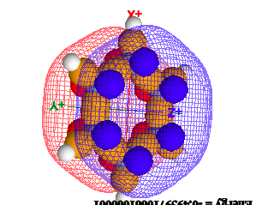
What is aromaticity?
Benzene is the quintessential aromatic molecule.
It is a cyclic molecule with conjugated bonds.
Because it’s bonds are conjugated, their lengths (138 pm) are intermediate, between single bonds (154 pm) and double bonds (134 pm).
And benzene’s bonds are less reactive than typical single or double bonds.
Benzene’s geometry is planar, allowing perfect sharing of adjacent π bonds.
isolated
So, put this all together an create a definition for aromaticity!
http://www.chemtube3d.com/orbitalsbenzene.htm

Slide 21
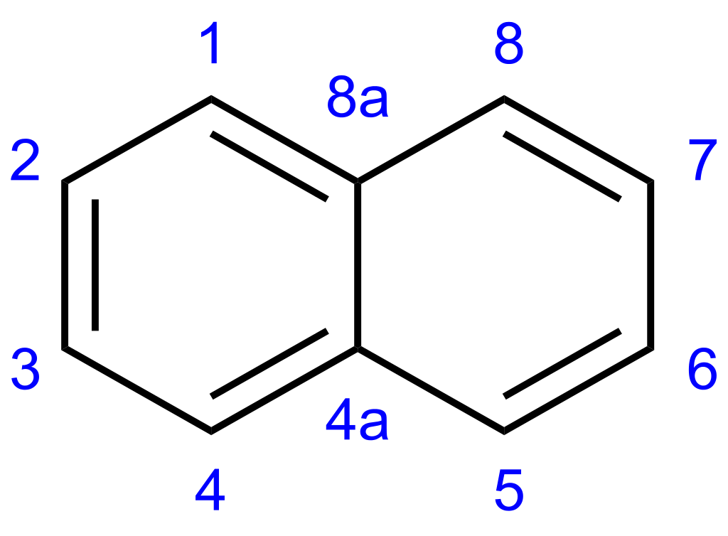
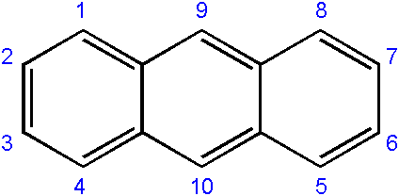
Hückel’s rule
Criteria for aromaticity:
Cyclic
Planar
Ring atoms must be sp²-hybridized.
Number of resonant ring (π) electrons must be 4n+2, where n is any positive integer, including zero.
Hückel’s rule: 2, 6, 10, 14, 18
Six is the most common Hückel number, often called the ‘aromatic sextet’.
benzene
Hückel’s 6
napthalene
Hückel’s 10
anthracene
Hückel’s 14

Slide 22
Anti-aromatic
Anti-aromatic: cyclic molecules that are 4n rather than 4n+2
Conjugated ring systems.
These molecules look aromatic but don’t obey Hückel’s rule.
They’re clever aromatic mimics!
Highly unstable and very reactive
8 π
4n
12 π
4n
4 π
4n

Slide 23
Heterocyclic rings: N w/ sp² lone pairs
Heterocyclic rings: have non-carbon atoms in their rings
Not necessarily aromatic, but may be.
In all of these cases, the N’s : don’t participate in the resonance (aromaticity) of their rings.
And all N : are sp².
Pyridine and pyridoxine are aromatic heterocyclics.
Nicotine has both aromatic and nonaromatic heterocyclic rings.
..
..

Slide 24
Heterocyclic rings: N w/ p lone pairs
We just saw that when a six-membered ring has three π bonds, the N’s : is held in an sp2 and doesn’t participate in aromaticity.
Here, the N’s : is needed to create aromaticity!
N’s sp2 orbitals form σ bonds.
N’s : is held in an unhybridized p and participate in resonance with the ring’s π bonds.
So N’s p: are part of the aromatic sextet.
..

Slide 25
Imidazole has both types of N
Imidazole’s ring is aromatic and needs one N’s lone pair.
If N : are needed, they are taken!
N : in sp²
Not participating
N : in p
In aromatic sextet

Slide 26
N : in fused rings; in or out of sextet?
Both indole and purine are aromatic, planar and have fused ring systems.
Both have the same number of π electrons delocalized around both rings.
sp²
:
:
sp²
10 shared ring electrons for each of these fused ring systems
All π + : indicated by arrows
If a : is needed it’s used.
If a : isn’t needed, it’s not used.
:
:
:
p
p
sp²
The ring R of tryptophan
Similar to A, G bases of DNA, RNA
Try this:
Add the missing lone pairs.
How many ‘aromatic’ or shared ring electrons does each molecule have? Which N lone pairs contribute to aromaticity?
What orbitals are the lone pairs in?

Slide 27
10 π e- = all π in the ring and the Ns’ lone pairs
DNA / RNA bases are aromatic
The five bases of nucleic acids are aromatic and therefore flat.
They must be flat to form the ladders of the double helix.
10 shared ring e-
all π in the ring
N : shown in red
How many π electrons does each of these bases have? Circle them.
6 shared ring e-
all π in the ring
N : shown in red
http://www.chem.purdue.edu/jmol/molecules/aden.html

Slide 28
Can you?
(1) Describe four characteristics of aromatic compounds?
(2) Explain Hückel’s rule and give examples of carbon rings that have the
aromatic sextet?
(3) Describe how sp² hybridized N atoms are incorporated into aromatic rings?
(4) Describe how unhybridized p orbitals of N atoms become part of the
‘aromatic sextet’?
(5) Distinguish from those ring N atoms that contribute to (and are needed
for) aromaticity and those N atoms that do not?

