Slide 1
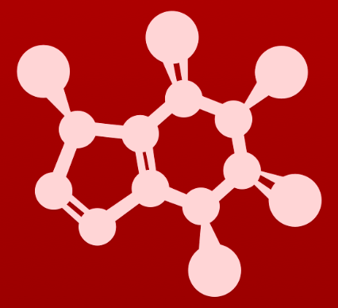
CHE 2060: Principles of Organic Chem
2. Introduction to organic structure & bonding, II
2.1: Covalent bonding in organic molecules
A. The σ bond in the H2 molecule
B. sp³ hybrid orbitals and tetrahedral bonding
C. sp² and sp hybrid orbitals and π bonds
2.2: Molecular orbital theory
A. Another look at the H2 molecule using MO theory
B. MO theory and conjugated π bonds
C. Aromaticity
2.3: Resonance
A. What is resonance?
B. Resonance contributors for the carboxylate group
C. Rules for drawing resonance structures
D. Major vs minor resonance contributors
2.4: Non-covalent interactions
A. Dipoles
B. Ion-ion, dipole-dipole, ion-dipole interactions
C. Van der Waals forces
D. Hydrogen bonds
E. Noncovalent interactions and protein structure
2.5: Physical properties of organic compounds
A. Solubility
B. Boiling and melting points
C. Physical properties of lipids and proteins
VSEPR

Slide 2
2. Intro to organic structure & bonding II
Big ideas?
Orbitals hybridize to allow atoms to form varied structures and geometries.
Resonance extends the idea of the probable location of electrons from atoms to molecules, and provides unexpected stability.

Slide 3
2. Intro to organic structure & bonding II
2.3: Resonance
A. What is resonance?
B. Resonance contributors for the carboxylate group
C. Rules for drawing resonance structures
D. Major vs minor resonance contributors

Slide 4
2. Intro to organic structure & bonding II
2.3A: Resonance
Big challenge of o-chem
Resonance structures (contributors)
Resonance hybrid

Slide 5
Listen to Soderberg!
Becoming adept at drawing resonance contributors, using the curved arrow notation to show how one contributor can be converted to another, and understanding the concepts of conjugation and resonance delocalization are some of the most challenging but also most important jobs that you will have as a beginning student of organic chemistry. If you work hard now to gain a firm grasp of these ideas, you will have come a long way toward understanding much of what follows in your organic chemistry course.
Conversely, if you fail to come to grips with these concepts now, a lot of what you see later in the course will seem like a bunch of mysterious and incomprehensible lines, dots, and arrows, and you will be in for a rough ride, to say the least. More so than many other topics in organic chemistry, understanding bonding, conjugation, and resonance is something that most students really need to work on 'in person' with an instructor or tutor, preferably using a molecular modeling kit. Keep working problems, keep asking questions, and keep at it until it all makes sense!

Slide 6
10 π e- = all π in the ring and the Ns’ lone pairs
Resonance
Resonance: a property that exits when more than one structures can be drawn for a molecule; the structures must be identical, except for the bonding pattern or arrangement of electrons.
1,2-dimethylbeneze has resonance:
These two resonance structures or contributors are equivalent. Note that we can use double headed arrows to change ‘one’ into the ‘other’ by moving π electrons.
Add arrows to B to change it back into A.

Slide 7
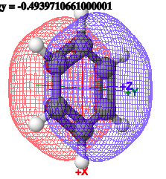
10 π e- = all π in the ring and the Ns’ lone pairs
Resonance hybrids
Resonance hybrids: a more realistic representation of the concept of resonance that uses dashed lines to show the spread of π electrons over the atoms involved in the conjugated bonds
shortcut
Remember that there is only one benzene molecule, and it’s π electrons spread around the ring.

Slide 8
Can you?
(1) See that resonance is something you must conquer?
(2) Define the term ‘resonance’?
(3) Define the term ‘resonance structures’ or ‘resonance contributors’?
(4) Determine the number of resonance structures from the compound’s
Lewis structure?
(5) Define the term ‘resonance hybrid’ and why it is the more realistic
representation of resonance?
(6) Understand that there is only one true structure of a molecule with
resonance?

Slide 9
2. Intro to organic structure & bonding II
2.3B: Resonance contributors for the carboxylate group
Both oxygens are sp²!
Major vs. minor contributors
Carbocations

Slide 10
Carboxylates have resonance
Carboxylates: organic anions formed by deprotonation of carboxylic acids
Can you see how formate has resonance?
Draw all resonance contributors.
Use double headed arrows to interconvert them.
Draw the resonance hybrid.

Slide 11
Resonance orbital hybridization: tricky
Nope!
Since formate is really much more like the hybrid, the hybridization of both oxygen atoms must be the same.
And they must be capable of π bond formation.
This suggests all three atoms are sp².
Observations?
Trigonal planar geometry
VSEPR: carbon is sp²
Double bonded O is sp²
Isn’t the negative O sp³?
In the hybrid, all three unhybridized p orbitals are parallel and partially overlap to form a delocalized π bond. The negative charge is also delocalized.

Slide 12
Try this:
There is a third, though very minor resonance contributor for formate.
Can you draw it?
Why is it so very minor?
This is a very minor resonance structure because it’s a carbocation and because of immediately proximal opposite charges.
It’s so unstable it won’t exist for more than an instant.

Slide 13
Carbocation resonance
This carbocation has a pair of double-bonded carbons that are clearly sp² hybridized.
Notice that the positively charged carbon is also bonded to three atoms.
Remember that the positive charge of carbocations is ‘carried’ by an empty p orbital.
So the charged carbon is also sp² hybridized.
All 3 carbons are sp².

Slide 14
Try this:
Follow the curved, double-headed arrows to move electron pairs and thus draw the missing resonance contributors.

Slide 15
Try this:
Add the curved, double-headed arrows needed to move electron pairs and convert the left-hand resonance contributor to that seen on the right side of each pair.

Slide 16
Can you?
Understand that both equivalent atoms of a molecule with resonance have the same sp² hybridization?
(2) Describe why both of these atoms have the same hybridization?

Slide 17
2. Intro to organic structure & bonding II
2.3C: Rules for drawing resonance structures
π and :
Legal and illegal moves of lone pairs, π

Slide 18
Rules for drawing resonance structures
1. Remember that resonance contributors are different ways of depicting one molecule or ion.
2. When comparing different resonance contributors:
The positions and connectivity of atoms cannot change.
Sigma bonds cannot be changed or broken.
π bonds and lone pairs adjacent to π bonds can be moved.
3. All resonance contributors must have the same net charge.
4. All resonance contributors must be drawn as proper Lewis (or line-bond) structures. The octet rule must be followed for atoms like carbon, oxygen and nitrogen.

Slide 19
Legal arrow moves
Curved arrows can move:
π to ..
.. to π
move π over one atom
And these moves can be combined.

Slide 20
Legal examples
For each, which ‘side’ do you think is more stable or lower energy, and why?
FC on O not C
FC on O not C
No FC

Slide 21
Try this:
Explain why each of these moves is illegal.
Adds a H atom
FC are incorrect →
C has 6 e-; O FC incorrect
Bottom C has too many bonds;
branch C should be +
O charges & # e- incorrect
Ring bond would be broken.

Slide 22
Can you?
(1) List the rules for drawing resonance structures?
(2) Apply those rules?
(3) Use curved arrows to move π or lone pair electrons to convert one
resonance structure (or contributor) to another?
(4) Describe the three types of ‘legal’ moves?
(5) Understand that some resonance structures are more stable than others?

Slide 23
2. Intro to organic structure & bonding II
2.3D: Minor vs major resonance contributors
Definitions
Rules

Slide 24
Not all resonance contributors are equal
Often, some resonance contributors are closer to the hybrid reality than others.
Major resonance contributors: make a larger contribution to the hybrid
Minor resonance contributors: make smaller contributions to the hybrid
For formate, A and B are major contributors, while C is a minor contributor.

Slide 25
Rules for determining major vs minor
1. When carbon is charged (not an octet) the contribution is likely minor.
2. Greater separation of charge? More likely to be minor.
3. Fewer bonds? More likely to be minor.
4. In major contributors, negative charges should be on more electronegative atoms.

Slide 26
Which rule here?
Which rule is at play in each of these examples of minor and major contributors?
Charged C
Charged C
FC; separation of charge

Slide 27
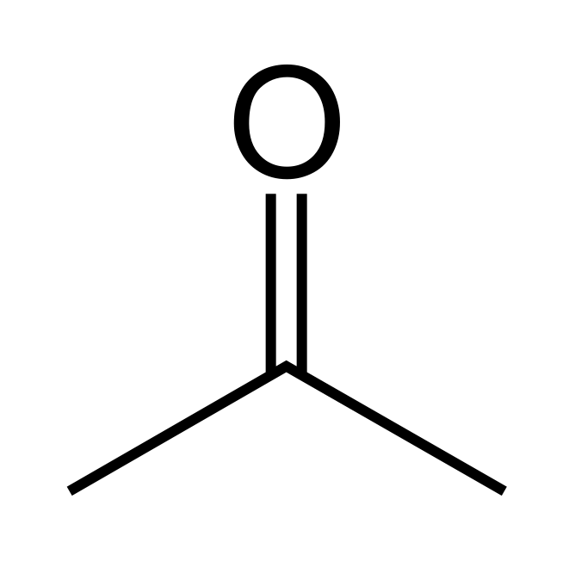
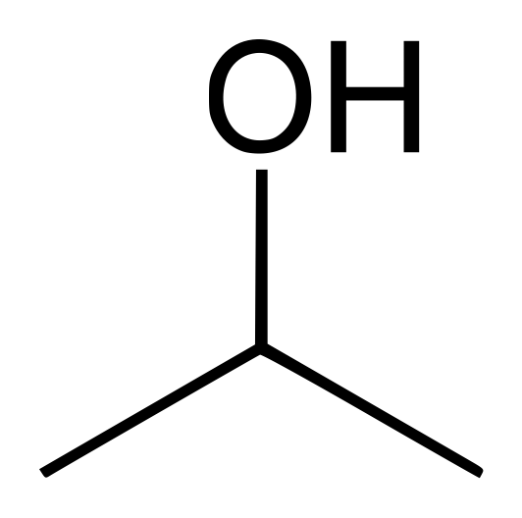
Try this:
Draw a minor resonance contributor for 2-propanone.
Why is it a minor contributor?
Charged C & separation of charges
Are 2-propanone and 2-propanol resonance contributors of each other?
Explain?
X
No, 2-propanol has an atom (H) that 2-propanone doesn’t have.

Slide 28
Can you?
Define the terms ‘minor resonance contributor’ and ‘major resonance contributor’?
(2) List the rules used to determine major and minor resonance contributors?
(3) Apply those rules?
(4) Draw both minor and major resonance contributors?

Slide 29
2. Intro to organic structure & bonding II
2.3E: Resonance and peptide bonds
Less rotation than expected
More resonance examples

Slide 30
Hybridization of the amide bond?
At first glance, the N of an amide bond would appear to be sp³ hybridized.
But the other resonance contributor makes it clear that sp³ won’t work, and the C, N and O of the amide bond must be sp² hybridized.
And the amide bond is trigonal planar….
… and resonance stabilized.
And, resonance prevents free rotation around amide (aka peptide) bonds in long protein chains or polymers. This ‘rigidity’ helps proteins fold into specific shapes.
Notice that the amide N is planar while the side chain N is trigonal pyramidal.
http://www.biotopics.co.uk/jsmol/leuala.html

Slide 31
Let’s try an exercise:
Draw the major resonance contributor of the structure below.
Include in your figure the appropriate curved arrows showing how you got from the given structure to your structure.
Explain why your contributor is the major one.
In what kind of orbitals are the two lone pairs on the oxygen?
:
:
The more en atom carries the charge
The O’s lone pairs are in:
(left) an sp² and an unhybridized p orbital
(right) an sp² orbital

Slide 32
Try this:
Below is a minor resonance contributor of a species known as an 'enamine', which we will study more in chapter 12.
Draw the major resonance contributor for the enamine and explain why your contributor is the major one (refer to resonance rules for major and minor contributors from this section).
Major because no FC

Slide 33
Another:
(a) Draw three additional resonance contributors for the carbocation below. Include in your figure the appropriate curved arrows showing how one contributor is converted to the next.
(b) Fill in the blanks: the conjugated π system in this carbocation is composed of ______ p orbitals sharing ________ delocalized π electrons.
7
6

Slide 34
Another:
Draw the major resonance contributor for each of the anions below.

Slide 35
Another:
The figure below shows how the negative formal charge on the oxygen
can be delocalized to the carbon indicated by an arrow. More resonance contributors can be drawn in which negative charge is delocalized to three other atoms on the molecule.
(a) Circle these atoms.
(b) Draw the two most important resonance contributors for the molecule.

Slide 36
Can you?
(1) Describe the orbital hybridization of the atoms involved in the amide bond?
(2) Describe the effects of resonance on stabilization and rotation of peptide
bonds?
(3) Cope with resonance problems!?

