Slide 1
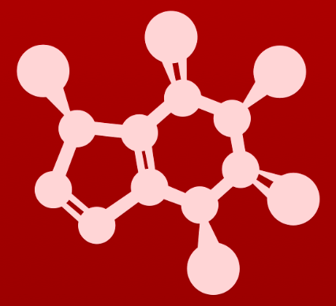
CHE 2060: Principles of Organic Chem
2. Introduction to organic structure & bonding, II
2.1: Covalent bonding in organic molecules
A. The σ bond in the H2 molecule
B. sp³ hybrid orbitals and tetrahedral bonding
C. sp² and sp hybrid orbitals and π bonds
2.2: Molecular orbital theory
A. Another look at the H2 molecule using MO theory
B. MO theory and conjugated π bonds
C. Aromaticity
2.3: Resonance
A. What is resonance?
B. Resonance contributors for the carboxylate group
C. Rules for drawing resonance structures
D. Major vs minor resonance contributors
2.4: Non-covalent interactions
A. Dipoles
B. Ion-ion, dipole-dipole, ion-dipole interactions
C. Van der Waals forces
D. Hydrogen bonds
E. Noncovalent interactions and protein structure
2.5: Physical properties of organic compounds
A. Solubility
B. Boiling and melting points
C. Physical properties of lipids and proteins
VSEPR

Slide 2
2. Intro to organic structure & bonding II
Big ideas?
Orbitals hybridize to allow atoms to form varied structures and geometries.
Resonance extends the idea of the probable location of electrons from atoms to molecules, and provides unexpected stability.

Slide 3
2. Intro to organic structure & bonding II
2.4: Non-covalent interactions
A. Dipoles
B. Ion-ion, dipole-dipole, ion-dipole interactions
C. Van der Waals forces
D. Hydrogen bonds
E. Noncovalent interactions and protein structure

Slide 4
2. Intro to organic structure & bonding II
2.4A: Dipoles
Electronegativity
Polarity
Dipole moment

Slide 5
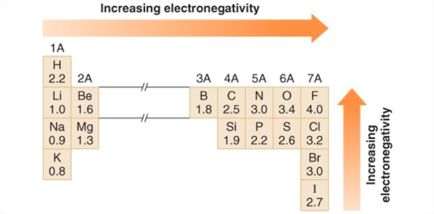
Let’s start with en and polarity
Electronegativity (en): the ability of an atom to hang on to its own electrons and attract electrons from other atoms
2.2
∂+
The electrons of covalent bonds are pulled toward the more en atom as shown by bond dipole arrows.
This creates a negative dipolar (partial) charge (∂-) on the more en atom and a positive dipolar charge (∂+)on the less en atom.
3.4
∂-
2.5
∂+

Slide 6
Do you remember?
Why does electronegativity increase across and up the periodic table?
Increasing left to right across rows:
Within each row, the number of protons in atoms increases across the row.
This increased positive charge holds electrons more tightly to the nucleus.
Increasing bottom to top up columns:
Within a column, the number or shells (principle energy levels, n) increase from top to bottom.
Atoms with more shells have ve- further from the nucleus, so ve- are less tightly held.

Slide 7
Molecular dipole moments
Molecular dipole moment: a molecule’s overall, or net, polarity
Not all molecules have a dipole moment.
Dipole arrow sum like vectors.
Which of these molecules have a dipole moment? In what direction?
In the last two, forces are equal, opposite and cancel.
none
none

Slide 8
Try this:
Which of these molecules have a dipole moment? In what direction?
none
Forces are equal, opposite and cancel.

Slide 9
2. Intro to organic structure & bonding II
2.4B: Ion-ion, dipole-dipole and ion-dipole interactions
Ionic
Dipole-dipole
Ion-dipole

Slide 10
Ion-ion (aka charge-charge) interactions
Ion-ion (charge-charge) interactions: non-covalent bonding caused by equal and opposite attractive forces
The strongest of the non-covalent interactions.
Similar to the forces that hold ions together in salts.
The Kreb’s cycle metabolic molecule 2-phosphoglycerate is held in the active site of the glycolytic enzyme enolase by interacting with the two magnesium ions in the active site.
Mg⁺²

Slide 11
Dipole-dipole interactions
Dipole-dipole interactions: non-covalent bonding caused by attractive forces between dipolar, or partial, charges
Effects polar molecules since they have dipolar charges.
Here acetone molecules line up so that positive and negative dipolar charges hold them together like magnets.
This reminds me of the n0se-to-tail way that dogs greet each other.

Slide 12
Ion-dipole interactions
Ion-dipole interactions: non-covalent bonding caused by attractive forces between a (fully charged) ion and a molecule with the opposite dipolar charge.
The presence of the ion causes a more extreme polarization of an already polar bond in the molecule.
∂-
Because the metal cation is very electropositive, its interaction increases the polarization of the carbonyl group, making the carbonyl group more reactive.
∂+

Slide 13
2. Intro to organic structure & bonding II
2.4C: Van der Waals forces
Universal
Induced and temporary

Slide 14
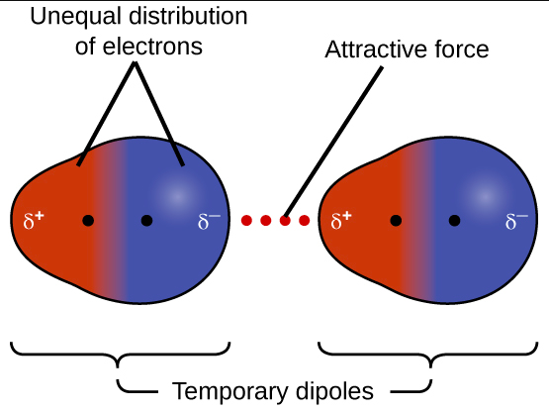
Van der Waals forces
Van der Waals forces (aka London dispersion forces): weak non-polar interactions between nonpolar molecules like hydrocarbons
The environment causes an temporary induction of polarity in nonpolar molecules by causing a shift in their internal electron density.
A in induced polarity (or dipole) can propagate from a few molecules throughout a solution.
As if a few ‘lead fish’ can turn a whole school of fish to follow them.
https://www.youtube.com/watch?v=HGc9RFD7iSE
https://s3-us-west-2.amazonaws.com/courses-images-archive-read-only/wp-content/uploads/sites/887/2015/06/23214344/CNX_Chem_10_01_DispForces.jpg
While weak, VdW forces act additively in a solution and have significant effects.

Slide 15
2. Intro to organic structure & bonding II
2.4D: Hydrogen bonds
Acceptors and donors
Relative strengths
Role in DNA and enzymes

Slide 16
Hydrogen bond
Hydrogen bond: a very specific type of dipolar bond between hydrogen bond donors and hydrogen bond acceptors
H-bond donors: a H bonded to an N, O or F and therefore very polar
H-bond acceptor: a lone pair on an N, O or F
H-b0nds are usually shown as dashed lines, indicating that they are weak, transient noncovalent bonds.
Water and alcohols form hydrogen bonds readily and often.

Slide 17
Try this:
Label each of these molecules as:
An H-bond donor
An H-bond acceptor
Neither
..
..
..
..
..
..
..
..
..
..
..
..

Slide 18
Try this:
Draw the hydrogen bonding that happens between:
Methanol (H-bond donor) and water (H-bond acceptor)
Methanol (H-bond acceptor) and water (H-bond donor)
Methyl acetate and methyl amine

Slide 19
Relative strengths of noncovalent bonds
strongest: covalent
hydrogen bonding
ion-ion
dipole-dipole
Van der Waals
weakest:

Slide 20
H-bonds: critical roles in biomolecules
H-bonds are responsible or the ‘pairing’ power of the DNA base pairs that hold the DNA double helix together and store the genetic information needed to create entire organisms.
A – T base pair
http://www.chemtube3d.com/solidstate/DNAbases.htm
G – C base pair

Slide 21
Can you see them?
Can you see where hydrogen bonds will form between the amino acid side chains and the peptide backbone of an enzyme and its substrate?
|||
|||
|||
|||
||||||
|||
|||
|||
|||
|||||||
|||
|||
|||
|||||
|||
||||
||
||||

Slide 22
Can you?
Define the term electronegativity and explain how and why electronegativity values vary though the periodic table?
(2) Define the term ‘molecular dipole’ or ‘dipole moment’ and identify
molecules that possess molecular dipoles?
(3) Describe ion-ion and dipole-dipole interactions and identify them?
(4) Describe ‘van der Waals’ force and understand that it is universal?
(5) Describe the term ‘hydrogen bond’ and understand that hydrogen bonds
are limited to three specific donors and three specific acceptors?
(6) Rank intermolecular bonds in order of strength?

