Slide 1
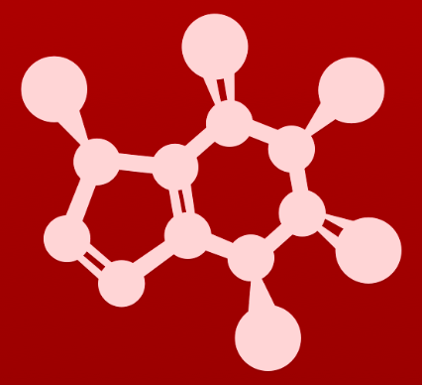
CHE 2060: Principles of Organic Chem
2. Introduction to organic structure & bonding, II
2.1: Covalent bonding in organic molecules
A. The σ bond in the H2 molecule
B. sp³ hybrid orbitals and tetrahedral bonding
C. sp² and sp hybrid orbitals and π bonds
2.2: Molecular orbital theory
A. Another look at the H2 molecule using MO theory
B. MO theory and conjugated π bonds
C. Aromaticity
2.3: Resonance
A. What is resonance?
B. Resonance contributors for the carboxylate group
C. Rules for drawing resonance structures
D. Major vs minor resonance contributors
2.4: Non-covalent interactions
A. Dipoles
B. Ion-ion, dipole-dipole, ion-dipole interactions
C. Van der Waals forces
D. Hydrogen bonds
E. Noncovalent interactions and protein structure
2.5: Physical properties of organic compounds
A. Solubility
B. Boiling and melting points
C. Physical properties of lipids and proteins
VSEPR

Slide 2
2. Intro to organic structure & bonding II
Big ideas?
Orbitals hybridize to allow atoms to form varied structures and geometries.
Resonance extends the idea of the probable location of electrons from atoms to molecules, and provides unexpected stability.

Slide 3
2. Intro to organic structure & bonding II
2.5: Physical properties of organic compounds
A. Solubility
B. Boiling and melting points
C. Physical properties of lipids and proteins

Slide 4
2. Intro to organic structure & bonding II
2.5A: Solubility
Definition
Like dissolves like
Water and shells of hydration
Effects of pH
Biomolecules and membranes [sidebar]

Slide 5
Solubility: nonpolar interactions
Most reactions between organic molecules happen in solutions.
In biochemistry, the universal solvent the very polar molecule, water.
However, many cellular and molecular microenvironments things are much less polar. These microenvironments are dominated by the molecules that create them.
Solubility: the extent to which a solute forms noncovalent bonds with a solvent ensuring that both molecules remain in the same phase
Solubility increases with the number of bonds between solutes and solvents.
Like dissolves like.
Shells of hydration
Here both water and salt are very polar and ‘bond’ via ion-dipole interactions.

Slide 6
Degrees of polarity
What about nonpolar molecules like biphenyl?
Hydrophobic
Doesn’t interact with water or polar solvents.
Van der Waals with itself.
Alcohols have differing levels of amphipathicity, or mixed nature.
The balance determines their solubilities.
The hydroxyl group H-bonds with water and can ‘carry’ a carbon or two with it.
As the number of carbons increases, the alcohol becomes too nonpolar for a single hydroxyl group to solubilize the whole molecule in water; not enough bonds!

Slide 7
So what about these?
Do you think glucose is soluble in water?
How many H-bonds could it form?
All possible donors and acceptors (unlikely):
17 H-bonds
Most
How soluble is ethanol in water?
How many H-bonds could it form?
All possible donors and acceptors (unlikely):
3 H-bonds
Middling
How soluble is dimethyl ether in water?
How many H-bonds could it form?
All possible acceptors (unlikely):
2 H-bonds
Least

Slide 8
Try this:
Compare these two organic acids.
Which is more soluble in water and why?
Acetic acid is more water-soluble.
Both carboxylic acids can form the same number of H-bonds with water. Those H-bonds can overcome the small nonpolar methane group of acetic acid, but not the large aromatic ring of benzoic acid.
How do things change if NaOH is added to the water and organic acids?
As NaOH is added the solution becomes more basic and the carboxylic acids are deprotonated. Both carboxylates are charged and therefore more water soluble then the carboxylic acids. The charge increases polarity and makes both molecules water soluble.
sodium benzoate

Slide 9
Water solubility?
How many carbons? Water solubility decreases as the number of carbons increases.
How many, and what type, of hydrophilic groups? Water solubility increases as the number of hydrophilic groups increases.
Hydrophilic groups (starting with the most powerful)
Charged groups Best without large nonpolar groups attached.
H-bond donor: polar H
H-bond acceptor: O, N, F
Other polar groups: use electronegativities

Slide 10
Try these:
Rank the compounds in each set in order of most to least soluble in water.

Slide 11
Try this:
Label each of these vitamins as water-soluble or fat-soluble.
water soluble (many OH)
water soluble (polar & charged)
fat soluble (nearly all nonpolar)

Slide 12
Try this:
Both of these compounds are nearly insoluble in pure water. Which is more soluble in a 10% aqueous hydrochloric acid solution? Why?
Aniline is basic and would be protonated (and thus cationic) in aqueous HCl.
Charged species are generally water soluble.
On the other hand, phenol is not basic and thus would remain as a neutral, water-insoluble molecule.

Slide 13
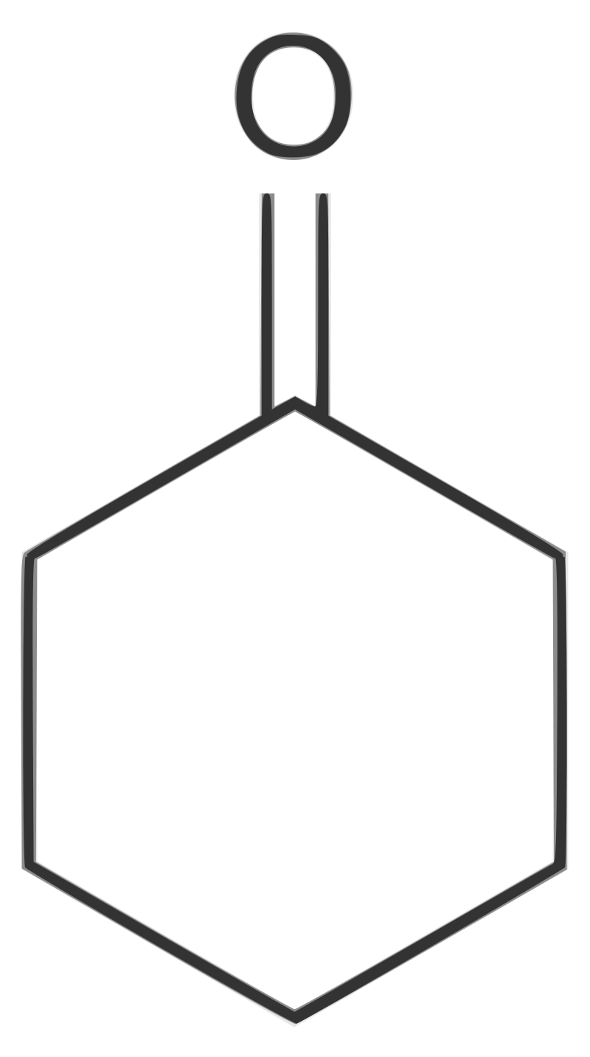
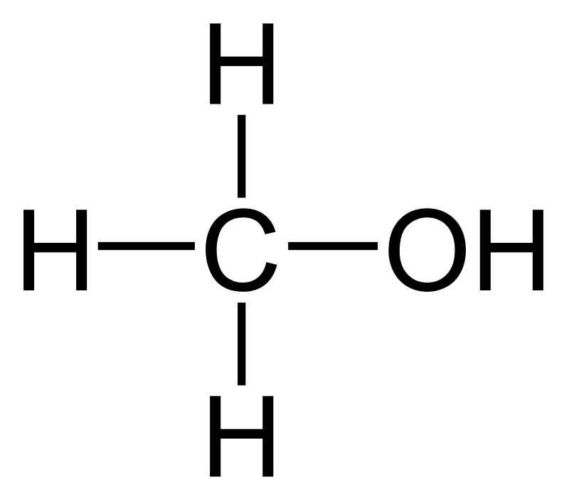
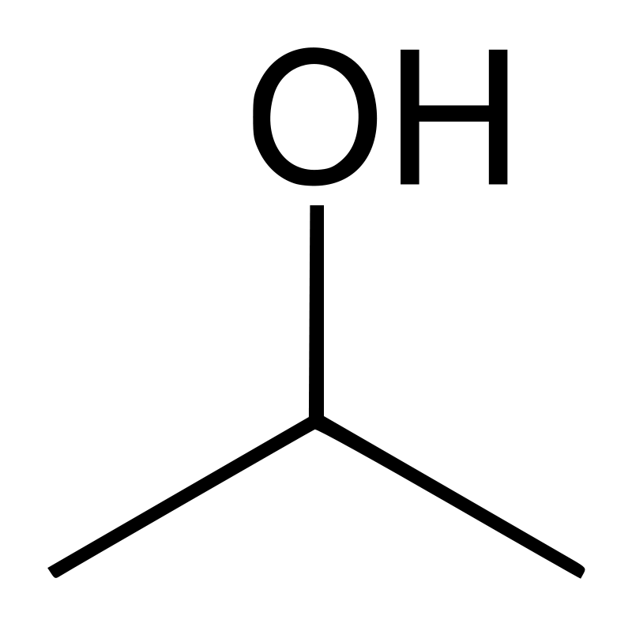
Try this:
Would you predict that methanol or 2-propanol would be a better solvent for cyclohexanone? Why?
Both alcohol solvents could form H-bonds with cyclohexanone, but isopropanol is less polar (it has three carbons), and thus would be the better solvent for the relatively nonpolar cyclohexanone.

Slide 14
What about biomolecules?
Because biomolecules exist in aqueous environments, most have charged functional groups like these.
phosphate
ammonium
carboxylate
……..sidebar…………….…...
Note that the charge is dependent on the molecule’s state of protonation.
The states you see here occur at a physiological pH, about 7.3

Slide 15
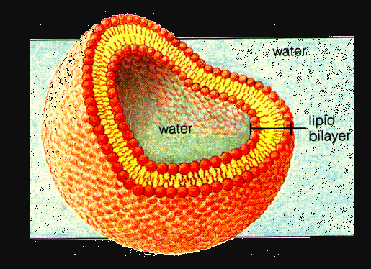
Amphipathic biomolecules?
Amphipathic membrane lipids self-assemble into bilayers in order to shield their hydrophobic tails from the aqueous environment. The lipid’s hydrophilic head groups form noncovalent interactions with water.
……..sidebar…………….…...
http://academic.brooklyn.cuny.edu/biology/bio4fv/page/lipos.gif

Slide 16
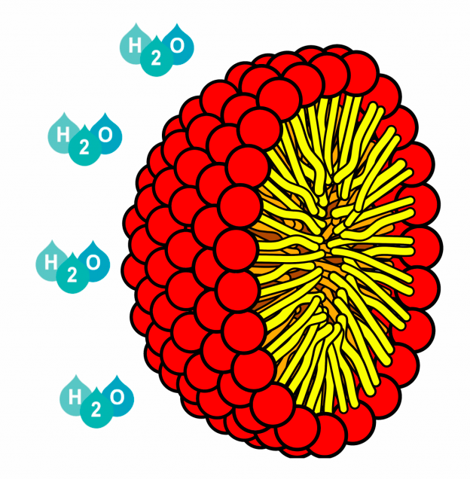
Detergents are amphipathic
Soaps or detergents are amphipathic fatty acids, usually released from triacylglycerol molecules by hydrolysis with a base like lye (potassium hydroxide)
Stearate (18:0)
Micelles form when detergents are placed in water.
The charged carboxylate groups interact with water.
The hydrophobic tail groups cluster inside the sphere to avoid contact with water.
……..sidebar…………….…...
http://www.beautybythegeeks.com/wp-content/uploads/micelle-1024x644.png

Slide 17
Other detergents
What do these synthetic detergents have in common with stearate?
……..sidebar…………….…...
All three molecules are amphipathic, and their hydrophilic groups are charged.

Slide 18
Can you?
(1) Define the term ‘solubility’?
(2) Describe, and apply, the concept of ‘like dissolves like’?
(3) Explain how solubility is related to intermolecular bonding?
(4) Define the term ‘amphipathic’?
(5) Assess degree of polarity and bonding to determine relative solubilities?
(6) Describe how amphipathicity determines the behavior of membrane lipids
(phospholipids) and detergents? [sidebar]

Slide 19
2. Intro to organic structure & bonding II
2.5B: Boiling and melting points
Similarities and differences
Factors

Slide 20
Melting and boiling points
Traditionally, the melting and boiling points of compounds have been used to determine purity and sometimes identity.
Melting point: the temperature at which a solid becomes a liquid
Boiling point: the temperature at which a liquid becomes a gas
What determines a molecule’s melting and boiling points?
The ability of the molecule to bind to itself
The strength of its noncovalent intermolecular interactions
The stronger the noncovalent intermolecular interactions, the higher the melting and boiling points.
https://www.youtube.com/watch?v=pILGRZ0nT4o

Slide 21
Larger molecules have higher bp
Larger size increases the surface area available for Van der Waals contact and extent of intermolecular interactions, increasing bp.
size (MW)
boiling point

Slide 22
H- and dipole bonds increase mp, bp
The more H-bonding and dipole bonding exists between molecules, the higher their mp and bp.
All molecules experience VdW bonding.
But not all molecules are polar or have H-bond donors and acceptors.
86.18 g/mol
100.16 g/mol
102.17 g/mol
vdW only vdW + dipole vdW + dipole + H-bond
boiling point

Slide 23
Water punches above its weight
Why is the bp of water higher than other molecules with similar MW?
Molecule | MW (g/mol) | Boiling point (°C)
CH4 | 16 | -161
NH3 | 17 | -33
H2O | 18 | 100
HF | 20 | 19
Possible H-bonds | donor acceptor
0 | NA
4 | 3/1
4 | 2/2
4 | 1/3
Water makes a huge number of H-bonds per MW and has a perfect ratio of H-bond donors to acceptors, so it networks perfectly.

Slide 24
Try this:
Based on their structures, rank phenol, benzene, benzaldehyde, and
benzoic acid in terms of lowest to highest boiling point. Explain your reasoning.
Sizes are roughly similar
vdW
dipolar
H-bond
vdW
vdW
dipolar
vdW
more dipolar
H-bond

Slide 25
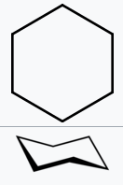
Melting points are a bit more complex
We’ve seen that solubility and boiling points both increase as solutes make more bonds to their solvents. This is true of melting points (mps) too.
But with mp, molecular shape also matters.
The energy required to melt solids depends on how well units stack together.
Better stacking increases VdW bonding and mps.
Aromatic rings are flat and stack very well, giving aromatics higher-than-expected mps.
planar
not planar
cyclohexane
mp = 6.5ºC
bp = 80.5ºC
Explain these different trends in mps and bps.
Bp all similar because similar MW.
Toluene’s mp is lower because the methyl group interrupts packing and stacking.

Slide 26
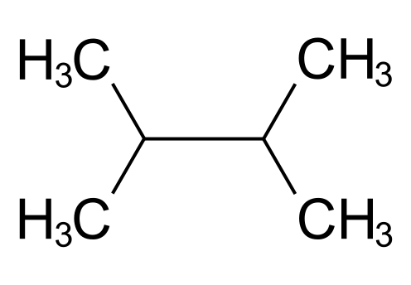
Try this:
Which would you expect to have the higher melting point, 2,3-dimethylbutane or hexane? Explain.
-94 to -96ºC
-136 to -124ºC
Hexane has the higher melting point. Both compounds have an equal number of carbons and hydrogens and are nonpolar, so it comes down to shape. 2-3-dimethylbutane is more sphere-like and is capable of less efficient molecule-to-molecule packing, so it has weaker intermolecular interactions and thus a lower melting point.

Slide 27
Can you?
(1) Define the terms ‘boiling point’ and ‘melting point’?
(2) Understand what factors increase boiling points and melting points?
(3) Understand that shape has a significant effects on melting points but not
boiling points?
(4) Rank the relative boiling points and melting points of organic molecules?

Slide 28
2. Intro to organic structure & bonding II
2.5C: Physical properties of lipids and proteins
Packing and kinks
Folding
Adaptation and evolution
……..sidebar…………….…...

Slide 29
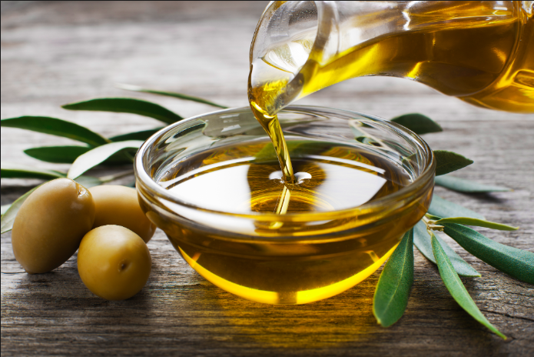
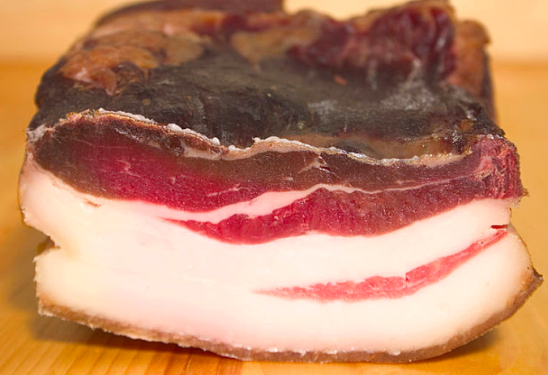
Lipids
We’ve all seen fats (lipids) in both liquid and solid physical states. You may have noticed that – at room temperature - plant fats tend to be liquid, while animal fats tend to be solid.
The more tightly molecules pack, the more VdW interaction they have.
Unsaturated plant lipids are ‘kinked’ and don’t pack well, so melt easily.
……..sidebar…………….…...
Saturated animal lipids are ‘straight’ and pack tightly, so require more energy to melt.

Slide 30
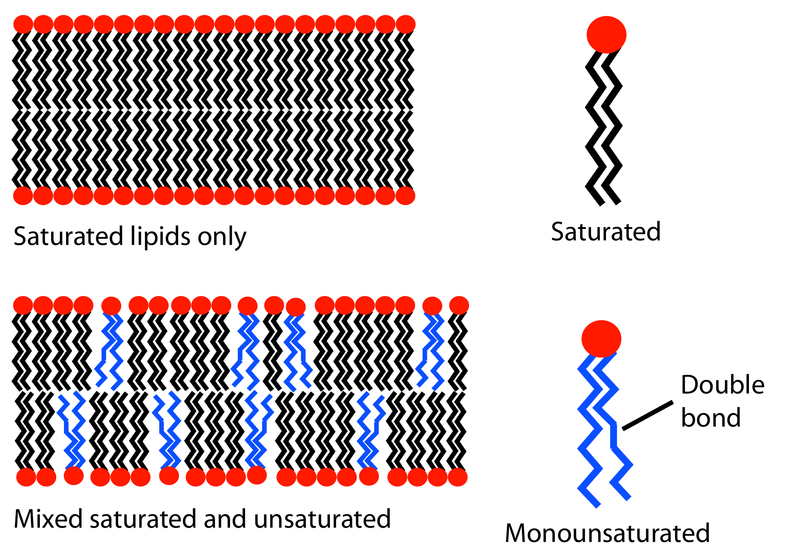
Packing determines mp
Have a look at these visuals to see how saturated lipids pack more tightly than unsaturated lipids.
……..sidebar…………….…...
https://www.youtube.com/watch?v=ESPNqKUluRs

Slide 31
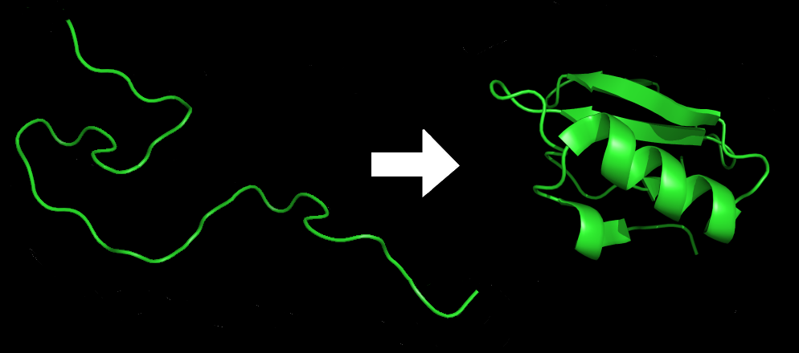
Protein
Proteins must fold in order to function properly.
Non-covalent bonds facilitate folding and then hold it in place (hairspray).
folded and functional
……..sidebar…………….…...
unfolded protein chain
exterior = hydrophilic
interior = hydrophobic

Slide 32
Adaptation via non-covalent interactions
While we are most aware of organisms that live at the temperatures we like (mesophiles), some organisms live at much higher temperatures (thermophiles), in hot springs or thermal vents, or at much colder temperatures (psychrophiles), in polar ice.
Enzymes from these organisms are remarkably similar, but have adaptations that allow them to maintain their folding and function at different temperatures.
Thermophiles have added more non-covalent bonds.
Psychrophiles don’t need as many.
……..sidebar…………….…...
thermophile
mesophile

Slide 33
Can you?
(1) Understand how the physical structure of lipids affects their physical
state?
(2) That proteins must fold in order to have function?
(3) Understand that increasing intermolecular interactions allow proteins to remain folded and functional at higher temperatures?
……..sidebar…………….…...

