Slide 1
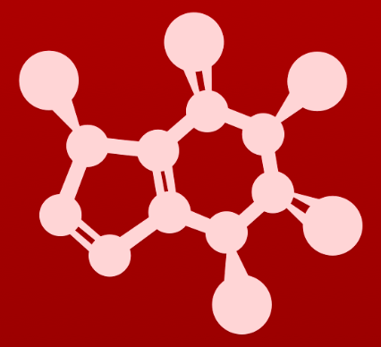
CHE 2060: Principles of Organic Chem
3. Conformation and stereochemistry
Introduction: Louis Pasteur and the discovery of molecular chirality
3.1: Conformations of open-chain organic molecules
3.2: Conformations of cyclic organic molecules
3.3: Chirality and stereoisomers
3.4: Labeling chiral centers
3.5: Optical activity
3.6: Compounds with multiple chiral centers
3.7: Meso compounds
3.8: Fischer and Haworth projections
3.9: Stereochemistry of alkenes
3.10: Stereochemistry in biology and medicine
3.11: Prochirality
3.11A: pro-R and pro-S groups on prochiral carbons
3.11B: The re and si faces of carbonyl and imine groups

Slide 2
3. Conformation and stereochemistry
Molecular models are your friend!
Because this chapter deals extensively with concepts that are inherently three-dimensional in nature, it will be very important for you to use a molecular modeling kit that is specifically intended for organic chemistry.
Many of the ideas we will be exploring can be extremely confusing if you are limited to the two dimensions of this page.
Be prepared to follow along with these discussions in three dimensions, with a molecular model in your hands!
https://www.amazon.com/Molymod-MMS-008-Organic-Chemistry-Molecular/dp/B007FAZOVS

Slide 3
3. Conformation and stereochemistry
Introduction:
Louis Pasteur and the discovery of molecular chirality

Slide 4
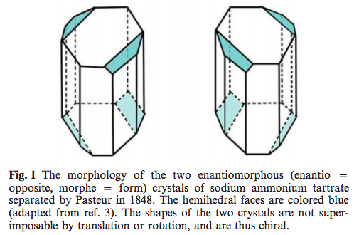
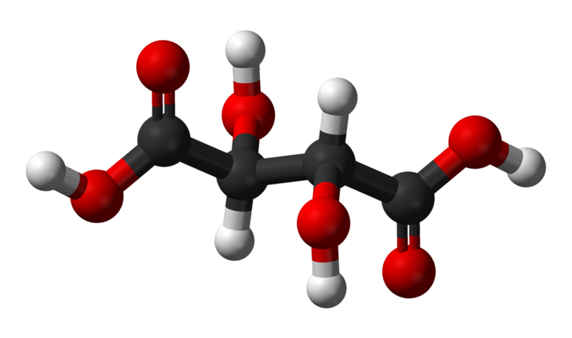
Introduction
Can you see that these two crystals are mirror images?
Can you perfectly superimpose them? Imagine rotating them around as much as you like.
Each is about the size of a crystal of table salt. Imagine separating them with a microscope and tweezers. Pasteur was a grind!
CrystEngComm, 2003, 5(26), 140–146 DOI: 10.1039/b304061e
tartaric acid

Slide 5
3. Conformation and stereochemistry
3.1: Conformations of open-chain organic molecules
(aka linear molecules)

Slide 6
Rotation around single bonds
Conformational isomerism results from free and rapid rotation around single σ bonds.
Notice the 3D difference.
Rotation around the C – C σ bond of ethane produces 3 different conformers (conformational isomer): different 3D arrangement of molecular groups in space.
Notice that this 3D difference can’t be seen on 2D paper without dash-wedge drawings.

Slide 7
Newman projections: ethane
Newman projections are a means of drawing molecules to highlight the difference between staggered and eclipsed conformers.
Looking down the axis (bond) between two carbon atoms.
Shows the 3D arrangement of all atoms bonded to those two carbons.
Staggered
Maximizes space for atoms
60º dihedral angles
Most stable conformer
º
Eclipsed
Atomic crowding
0º dihedral angles
Least stable conformer
Interactive model; video tutorial

Slide 8
Newman projections: butane
Note that butane’s Newman projection is a bit more complex.
Looking down from C2 – C3
C1 and C4 are shown as methyl groups (CH3)
All carbons must be shown!
Is eclipsed butane more or less stable than eclipsed ethane? And why?
Eclipsed butane is less stable than eclipsed ethane because the overlapping methyl groups are larger, causing more steric hindrance.
How many eclipsed butane conformers are there?
Three: methyl 1 can ’eclipse’ any of the three atoms attached to carbon 3; the red atoms.
Which of the eclipsed conformers are more and less stable?
The methyl-methyl eclipsed conformer is less stable than the methyl-hydrogen eclipsed conformers.

Slide 9
Gauche vs anti?
Just as there are several eclipsed conformations of butane, there are several staggered conformations as well.
Gauche is staggered when the two largest groups are not directly opposite on another.
Anti is staggered when the two largest groups are directly opposite on another.
Which staggered butane more or less stable? And why?
Anti is more stable than gauche since the two large methyl groups are furthest apart.

Slide 10
Steric strain (aka steric hinderance)
Steric strain (aka steric hinderance) is the loss of stability, or increase in energy, caused by spatial crowding of molecular groups in specific conformations.
This is the force responsible for the higher energy and lower stability of:
Eclipsed vs. staggered; and
Gauche vs. anti.
Note that the energy diagram of butane has two different peaks and two different valleys.
Can you explain why?
Butane interactive

Slide 11
Newman projections of larger molecules
Newman projections and dash-wedge drawings can be used to focus on one C – C bond of octane (C2 – C3).
Note the use of ’R’ to abbreviate large sections of the molecule, outside of the area of focus.

Slide 12
Try this:
Draw Newman projections of the lowest and highest energy conformations
of propane.

Slide 13
Can you?
(1) Visualize free rotation around σ bonds?
(2) Define the term ‘conformer’?
(3) Use dash-wedges to clearly show the different 3D structure of conformers?
(4) Use Newman projections to show staggered and eclipsed conformations?
(5) Describe ‘steric hindrance’ and how it determines the energy levels – and
therefore stability – of different conformers?

