Slide 1
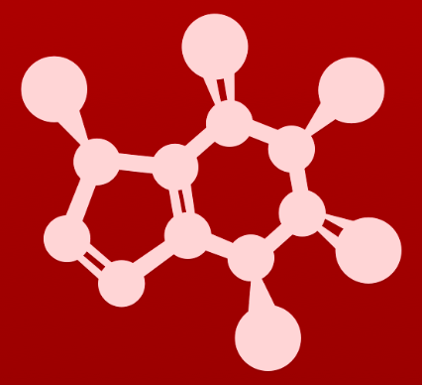
3. Conformation and stereochemistry
3.11: Prochirality
Prochiral carbons
Prochiral nitrogens

Slide 2
Prochirality
Prochirality: the potential of a tetrahedral (sp³) carbon to be converted from achiral to chiral by changing one substituent
Enzymes are able to differentiate the ‘blue’ and ‘red’ hydrogens because the ethanol molecule fits into the enzyme’s binding site in a particular orientation.
For example, the methyl group binds in the left-hand end of the pocket and the hydroxyl group binds in the right-hand end.
3
2
1
prochiral
chiral
Replacement of the ‘red’ hydrogen atom with deuterium creates the R enantiomer.
So the ‘red’ hydrogen is pro-R.
It follows that the ‘blue’ hydrogen is pro-S.
Z

Slide 3
Prochirality: not just for hydrogen atoms
Here methyl groups and carboxylic acid groups have prochirality.
Z

Slide 4
Prochiral carbonyl groups
Carbonyl groups (like ketones) are flat, trigonal planar, and therefore have two sides or two faces.
The re face has clockwise prioritization.
The si face has counterclockwise prioritization.
Here we are looking down on the re face of pyruvate.
Enzymatic reactions generally ‘attack’ from one side of the molecule, and thus create one enantiomer.
Z

Slide 5
Try this:
The concept of re and si faces can also be applied to planar alkenes.
Assign a designation of re, si, or N (not prochiral) to indicate which face
we are looking down on for each of the sp²-hybridized carbons in the structure below.
:
:
:
:
Z

Slide 6
Can you?
(1) Define the terms ‘prochirality’, ‘re’ and ‘si’?
(2) Describe how molecular geometry determines prochirality?
(3) Describe how prochirality affects the chiral outcome of reactions?
(4) Determine the configuration of prochiral centers?

