Slide 1
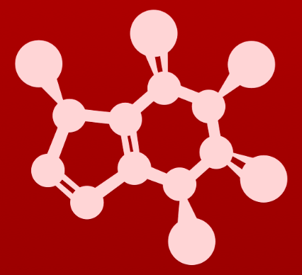
3. Conformation and stereochemistry
3.2: Conformations of cyclic organic molecules

Slide 2
Cyclic molecules: cis, trans isomerism
This section focuses on cyclic, but not aromatic, structures.
Many molecules, like glucose, have both open-chain and cyclic structures.
For both, dash-wedge allows us to see 3D structure.
trans
cis
Groups on the same side of the ring (both pointing up/towards) are cis.
Groups on the opposite side of the ring (one towards/one away) are trans.

Slide 3
Ring number, strain and reactivity
Most cyclic biomolecules have 5 or 6 atoms in their rings and are stable.
Angle strain makes rings with fewer atoms are less stable, more reactive.
These angles are far less then the ‘comfortable’ 109.5º.
The small rings, and resulting angle strain, make these two antibiotics effective as they react quickly once they find their bacterial targets.
Fosfomycin disrupts cell wall synthesis by inhibiting phosphoenolpyruvate synthetase and thus interferes with the production of peptidoglycan
Penicillin G burst bacterial cell walls by preventing peptidoglycans from cross-linking.
Wikipedia

Slide 4
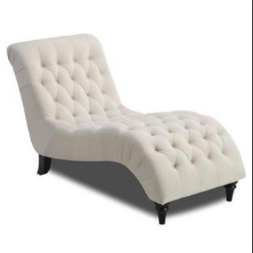
6-atom rings: puckered, thus stable
Rings with six atoms are very stable because of their favored 109.5º angles.
The ring ‘puckers’ to achieve that perfect angle.
A flat six-membered ring would have very high energy levels.
Chair conformation is the most stable conformer for a six-atom ring.
The ’bowtie’ is the line-bond abbreviation for the chair.

Slide 5
Chairs can flex, invert and bow
Because the C – C bonds of cyclohexane are single (σ) they can flex or invert.
Energy increases the rate at which σ bonds rotate, so rate of flexion.
At room temperature, inversion happens constantly.
The head of the chair can become the feet.
Both ends can bow up to form bow and stern of a boat conformer.
The boat conformer has higher energy, and less stability, than the chair conformer.
Can you explain why the boat conformer is less stable than the chair conformer?
1. In the boat hydrogen atoms are eclipsed. They are staggered in chair.
2. ‘Flagpole’ (bow and stern axial hydrogen atoms) are sterically hindered.

Slide 6
Axial and equatorial positions
Every carbon of a 6-carbon ring is bonded to two hydrogen atoms. Each occupies positions described as:
Axial: perpendicular to the mean plane of the ring; pointing up or down
Equatorial: in the mean plane of the ring; slightly up or down
Notice that as you travel around the ring axial hydrogen atoms alternate up and down.
Likewise, equatorial hydrogen atoms alternate angled up and angled down.
And, at one carbon, when axial is up, equatorial is down and vv.
When the ring is inverted or ‘flipped’ all axial positions become equatorial, and vv.
Which position do you think has higher energy, equatorial or axial? And why?
Axial is more crowded than equatorial, so axial is less stable than equatorial.

Slide 7
Axial / equatorial ≠ cis / trans
Both phenomenon happen in rings but mean different things.
1
2
3
4
What is the relationship between B on C2 and H on C1?
Both are equatorial and they are trans: B is above the mean plane; H is below it.
What is the relationship between A on C1 and H on C2?
Both are axial and they are trans: A is above the mean plane; H is below it.
What is the relationship between H on C3 and H on C4?
Both are equatorial and they are cis: both H atoms are below the mean plane.
What is the relationship between B on C3 and H on C4?
B is axial and H is equatorial.
They are trans: B is above the mean plane of the ring and H is below it.

Slide 8
Where do the big groups want to be?
Many rings have substituents larger than hydrogen atoms.
Which position do these larger groups want?
Does the methyl group want to be axial or equatorial? Why?
The methyl group wants to be equatorial because it has more space; it’s less sterically hindered or crowded.
Build a model to demonstrate the effects of ‘1-3 diaxial repulsion’?
Invert the models to compare methyl groups in the axial vs equatorial positions.

Slide 9
Bigger groups? Stronger preference
Here the ring has both a methyl group and a bulky ‘tertbutyl’ group.
IUPAC name for tertbutyl is 1,1-dimethylethyl.
The bigger, or ‘bulkier’ group takes the equatorial position.

Slide 10
Try this:
Draw the lower energy chair conformations of:
trans-1,2-dimethylcyclohexane
trans-1-isopropyl-3-methylcyclohexane
Be sure that axial and equatorial orientation is clear!

Slide 11
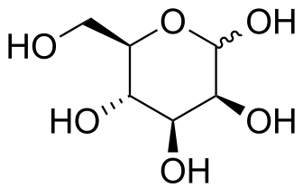
Try this:
One conformer of the ring form of glucose is more stable.
Draw the two chair conformations of the six-carbon sugar mannose, being
sure to clearly show each non-hydrogen substituent as axial or equatorial. Predict which conformation is likely to be more stable, and explain why.

Slide 12
Cyclopentane ‘envelope’
The lowest energy conformer of cyclopentane is called an ‘envelope’ because the one carbon that is proud of the rectangle formed by the other four looks like the flap of an envelope.
No axial and equatorial.
At room temperature, inversion causes carbons to take a turn at being endo.

Slide 13
Can you?
(1) Describe the cis-trans isomerism of rings and show it with dash-wedge
diagrams?
(2) Describe ‘angle strain’ and ‘pucker’ and why 5- and 6-membered rings are
most stable?
(3) Draw chair and boat forms of cyclohexane so that ‘axial’ and ‘equatorial’
positions are clearly shown?
(4) Flex and invert chairs, changing axial to equatorial and vice versa?
(5) Describe why chairs are more stable than boats?

